Slide 1
Laboratory 10
PWM Breathing Light

Slide 2
Purpose
熟悉 PYNQ-Z2 Board
了解 PWM (Pulse Width Modulation)

Slide 3
Outline
Introduction to PYNQ-Z2
Introduction to PWM
Lab Problem
  Part 1 - Behavioral Simulation
  Part 2 - PYNQ Board Implementation

Slide 4
Outline
Introduction to PYNQ-Z2
Introduction to PWM
Lab Problem
  Part 1 - Behavioral Simulation
  Part 2 - PYNQ Board Implementation

Slide 5
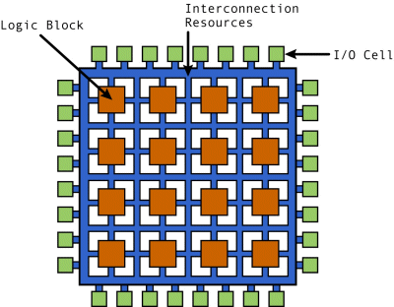
FPGA (Field Programmable Gate Array)
前幾次Lab中我們所完成的Verilog電路，若要被製作成真的電路，還必須經過幾個步驟。
  邏輯合成(Logic Synthesis)，是將電路轉換為製造商可支援的標準元件(standard cell)型式。
  布局和布線(Place & Route)，將轉換完的元件擺放和排線。
現場可程式化邏輯閘陣列 (Field Programmable Gate Array, FPGA)，是由許多的Logic block和接點組成的電路，透過燒錄的方式改變接點的開關，將其轉變為我們設計的電路。
過去幾周Lab所使用的Vivado，除了可以模擬電路，
最主要的功能其實是將電路合成和PR後，
燒錄至FPGA。

Slide 6
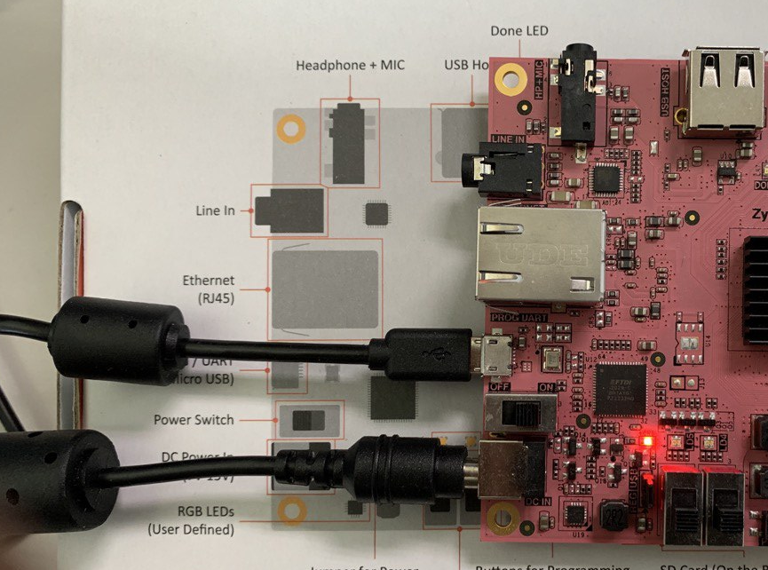
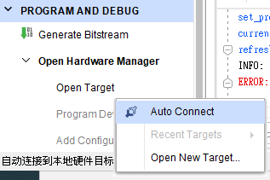
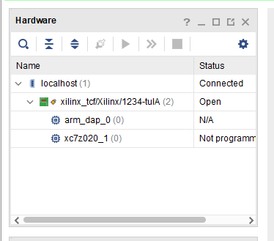
PYNQ-Z2 Board Connection Check
1. plug micro USB (Use USB port as power supply)
2. Turn on power switch
3. Connect to device
4. Check hardware panel
Plug-in USB
power switch
Set power mode to USB
Connect to device(Left down manual )
Hardware panel

Slide 7
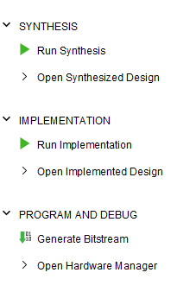
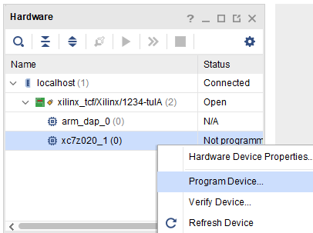
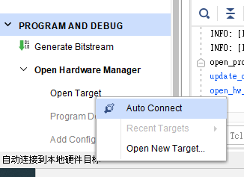
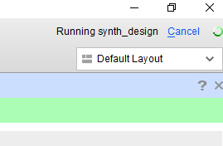
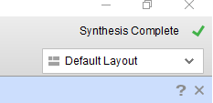
PYNQ Synthesis Procedure
1
2
7
8
3
4
Busy
Done
5
6

Slide 8
Outline
Introduction to PYNQ-Z2
Introduction to PWM
Lab Problem
  Part 1 - Behavioral Simulation
  Part 2 - PYNQ Board Implementation

Slide 9

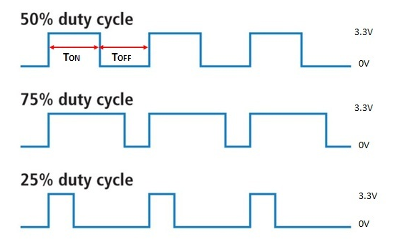
Duty Cycle
Duty cycle : Ratio of cycle period is ON compared to the time is OFF
Period T

Slide 10
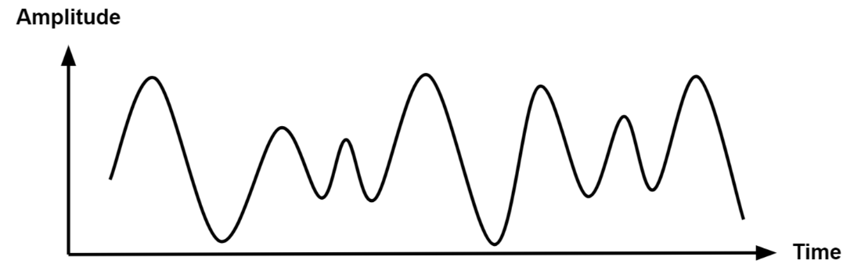
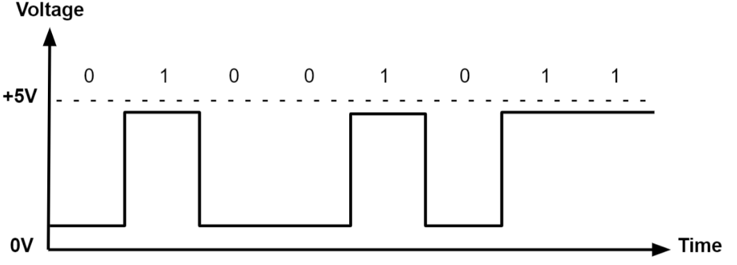
Pulse Width Modulation
PWM is the mechanism of representing analog signals with digital signals by controlling the duty cycle of the periods.
Analog Signal : Continuous
Digital Signal : Discrete
Figure source : https://www.monolithicpower.com/en/analog-vs-digital-signal
Analog signal
Digital signal

Slide 11
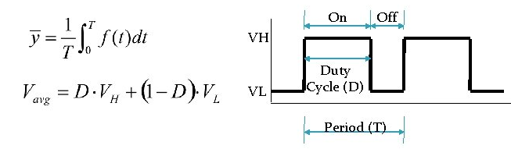
Pulse Width Modulation - Cont.
Digital signal ACTIVATE/OFF represents switch ON/OFF of the circuit, controlling the average current of each period
In general VL is zero; D is the duty; V_{avg} = D x V_{H}
The average value of the signal is directly dependent on the duty cycle D

Slide 12
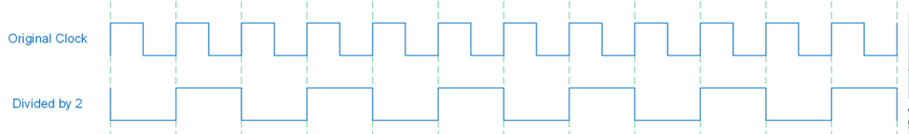
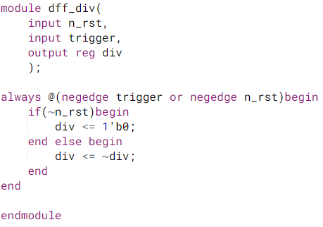
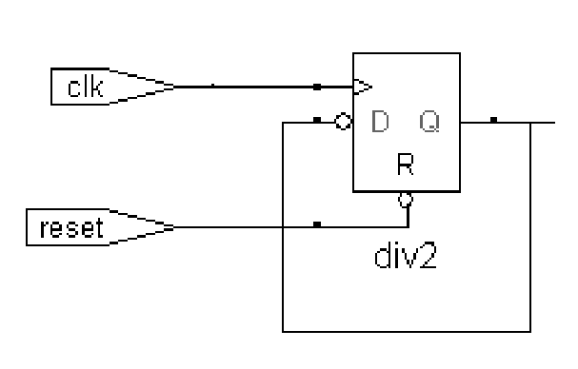
Clock Divider - 1
Divide clock frequency by 2
trigger
div
n_rst

Slide 13

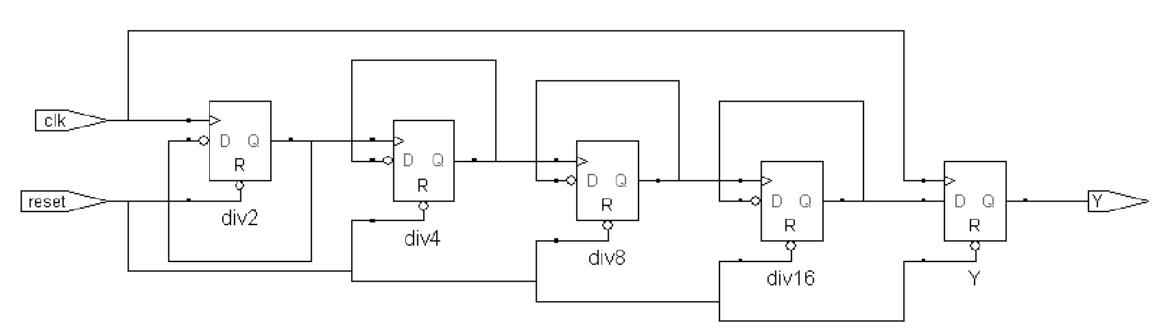
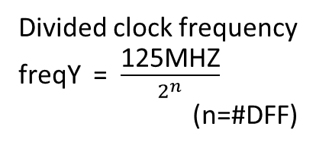
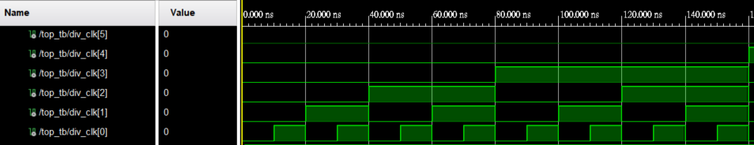
Clock Divider - 2

Slide 14
Ripple Counter
多個Clock Divider 串接，可以利用dff之間有著propagate的效果，將多個串接的dff視為一個counter；第一個的divider的output為LSB，而最後一個dff的output為MSB。
Cycle | dff5 | dff4 | dff3 | dff2 | dff1 | Value
1 | 0 | 0 | 0 | 0 | 0 | 0
2 | 0 | 0 | 0 | 0 | 1 | 1
3 | 0 | 0 | 0 | 1 | 0 | 2
4 | 0 | 0 | 0 | 1 | 1 | 3
5 | 0 | 0 | 1 | 0 | 0 | 4
6 | 0 | 0 | 1 | 0 | 1 | 5
dff 1
dff 2
dff 3
dff 4
dff 5
LSB
MSB

Slide 15
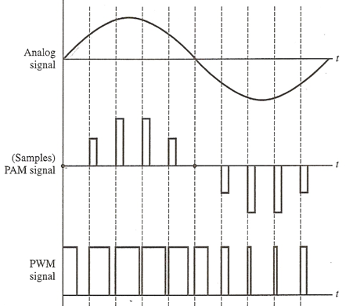
PWM Implementation
Modulation Wave
Analog
Signal
phase0
phase1
phase2
phase3
phase4
Wave
phase
phase5
phase6
phase7
phase8
phase9
Discrete
Sample
PWM
Signal
Duty = 50%
Duty = 25%
phase_trig n
duty_trig
duty_trig
phase_trig n+2
phase_trig n+1

Slide 16
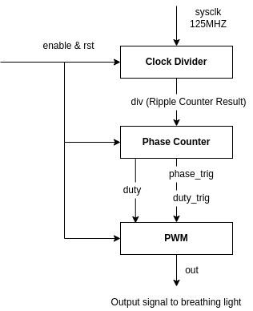
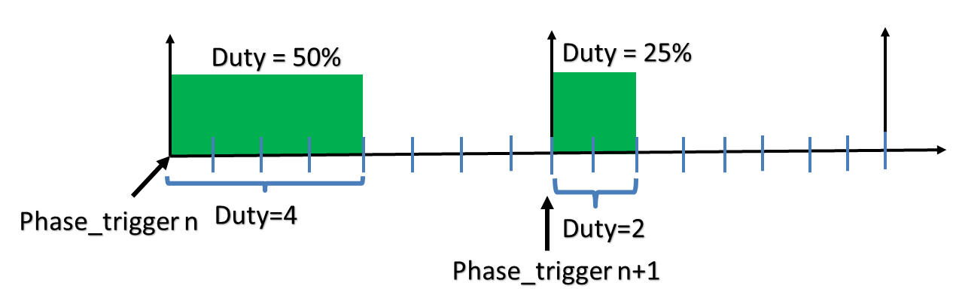
Simple PWM
由於sysclk的頻率為125MHZ，請先嘗試以clock divider將頻率降至適合操作的頻率
當phase的週期小於人眼圖像滯留的時間(約為40ms)，可以減少燈光閃爍的現象
Duty 為每次phase trigger之後set high的cycles，下圖的一個phase有八個cycle，duty分別為4和2，因此兩個phase的duty ratio分別為50%和25%

Slide 17
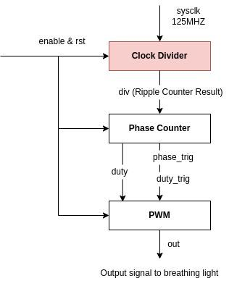
Simple PWM - Clock Divider
module ripple_div(
input rst,
input sysclk,
output wire [31:0] div
);
//Implement your code
endmodule

Slide 18
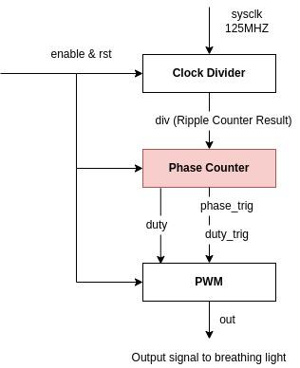
Simple PWM - Phase Counter
module phase_counter(
input enable,
input [7:0] phase_shift,
input[31:0] div,
output wire duty_trig,
output wire phase_trig,
output wire [7:0] duty
);
//Implement your code
endmodule

Slide 19
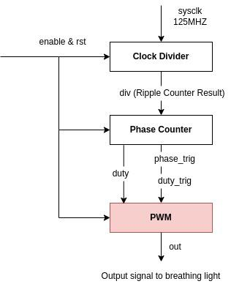
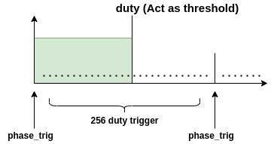
Simple PWM - 8 bit phase PWM
module pwm(
input rst,
input enable,
input duty_trig,
input phase_trig,
input [7:0] duty,
output wire out
);
reg[7:0] count;
assign out = ((count < duty) | phase_trig) & enable;
always@(posedge duty_trig or posedge rst)begin
if(rst)begin
count <= 8'b0;
end else if(phase_trig)begin
count <= 8'b0;
end else if(duty_trig)begin
count <= count + 1;
end else begin
count <= count;
end
end
endmodule

Slide 20
Outline
Introduction to PYNQ-Z2
Introduction to PWM
Lab Problem
  Part 1 - Behavioral Simulation
  Part 2 - PYNQ Board Implementation

Slide 21
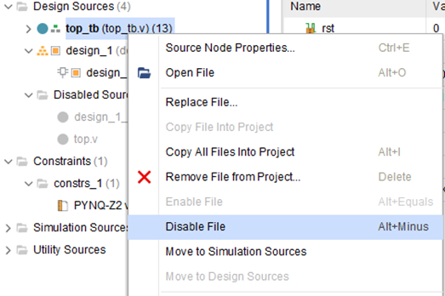
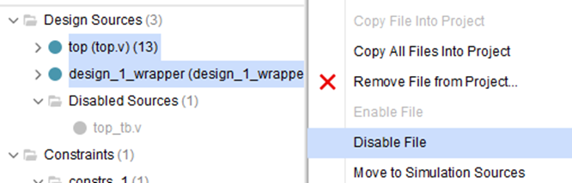
Configurations
Behavioral Simulation
1. Disable top.v
2. Disable design_1_wrapper.v
3. Enable top_tb.v
4. Set top_tb.v as top
PYNQ Board Implementation
1. Disable top_tb.v
2. Enable top.v
3. Enable design_1_wrapper.v
4. Set design_1_wrapper.v as top

Slide 22
I/O port of module
I/O port of module dff_div
I/O port of module ripple_div
Name | I/O | Width | Description
n_rst | Input | 1 | Active-low asynchronous reset signal
trigger | Input | 1 | Input clock
div | Output | 1 | Divided result
Name | I/O | Width | Description
n_rst | Input | 1 | Active-low asynchronous reset signal
sysclk | Input | 1 | System clock ( 125 MHZ )
div | Output | 32 | Divided result

Slide 23
I/O port of module
I/O port of module phase counter
I/O port of module LUT_sin
Name | I/O | Width | Description
enable | Input | 1 | SW[0] | SW[1] on FPGA board
phase_shift | Input | 8 | Offset of duty
div_clk | Input | 32 | Ripple Counter Result
duty_trig | Output | 1 | Trigger on every 256 cycles of sysclk
phase_trig | Output | 1 | Triggered when the startup of phase ( every 256 duty trig cycles )
duty | Output | 8 | Threshold of phase (Duty ratio)
Name | I/O | Width | Description
phase_idx | Input | 8 | Output of signal duty in phase counter
data | Output | 8 | Transform the threshold from linear to sine wave

Slide 24
I/O port of module
I/O port of module pwm
Name | I/O | Width | Description
rst | Input | 1 | Active-high asynchronous reset signal
enable | Input | 1 | SW[0] | SW[1] on FPGA board
duty_trig | Input | 1 | High every 256 cycles of sysclk
phase_trig | Input | 1 | High when the startup of phase ( every 256 duty trig cycles )
duty | Input | 8 | Threshold of phase
out | Output | 1 | Switch ON/OFF of led on FPGA board

Slide 25
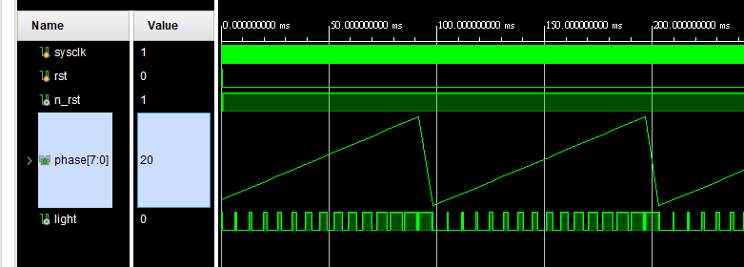
Behavioral Simulation - Problem 1
產生一組週期性的三角波，結報需解釋波型的產生方法與波型圖截圖(如下圖)。
右鍵 > Waveform Style > Analog

Slide 26
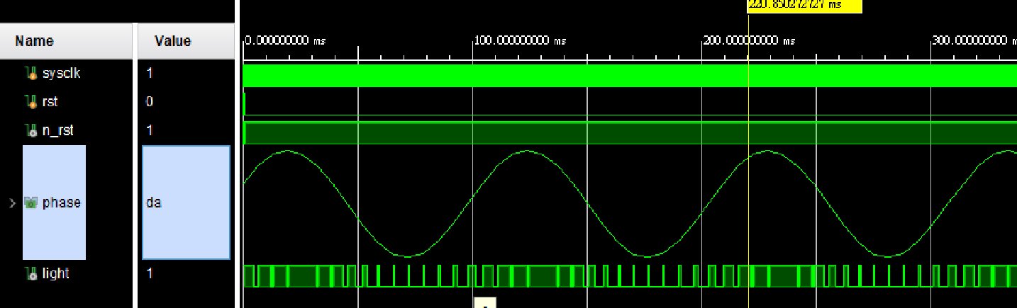
Behavioral Simulation - Problem 2
請利用 LUT_sin module 產生一組正弦
結報需解釋波型的產生方法與波型圖截圖(如下圖)。

Slide 27
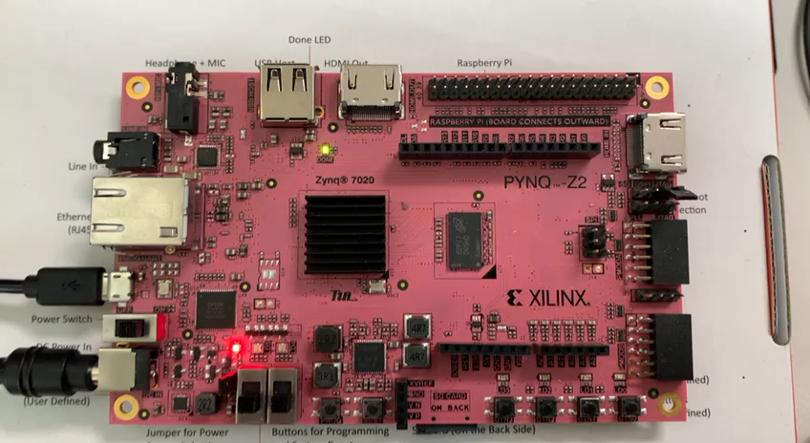
PYNQ Implementation - Breathing Light
白光呼吸燈
混色光呼吸燈

Slide 28
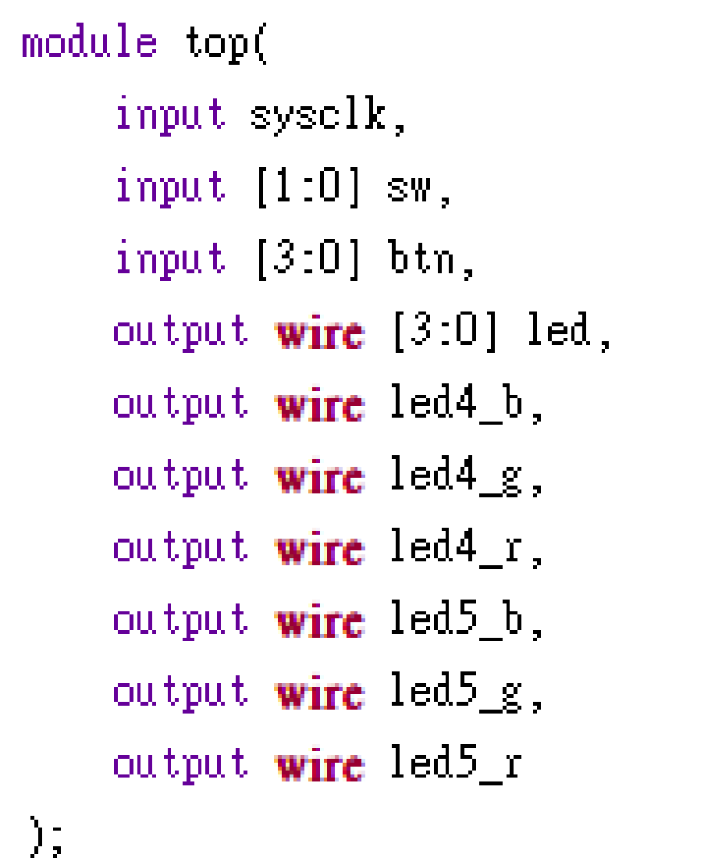
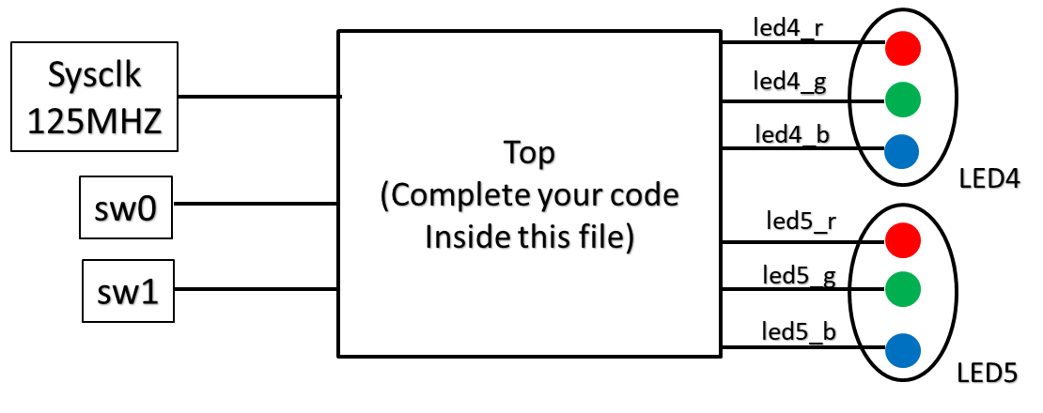
PYNQ Implementation - Breathing Light
實作top.v檔實作呼吸燈電路。可依需求修改 top檔案內非port name的部分(切記不可修改top.v 的port name，不然會合成失敗)。接著合成Bitstream檔並燒入到FPGA內。
Note : FPGA內LED4、LED5內有三種獨立RGB LED燈。可自行挑選。沒有使用的output線路記得要在top module內接地。(Assign to 0)。

Slide 29
本次結報需要附上的內容
Behavioral Simulation
  波形產生解釋和截圖波形
  實驗心得
PYNQ Board Implementation
  實驗心得(實作遇到什麼困難等等...)

Slide 30
本次結報注意事項
以 Lab10_Groupx 作為結報名稱
5/17 23:59 前於 moodle 上繳交結報
5/24 23:59 前於 moodle 接受補交，分數以 7 折計算

