Slide 1
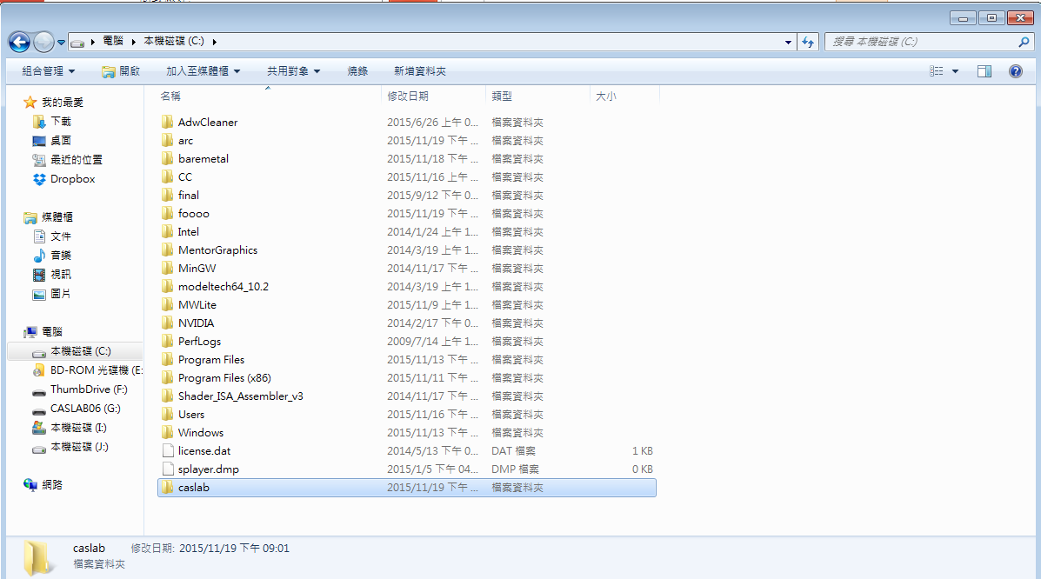
1.創造caslab資料夾

Slide 2
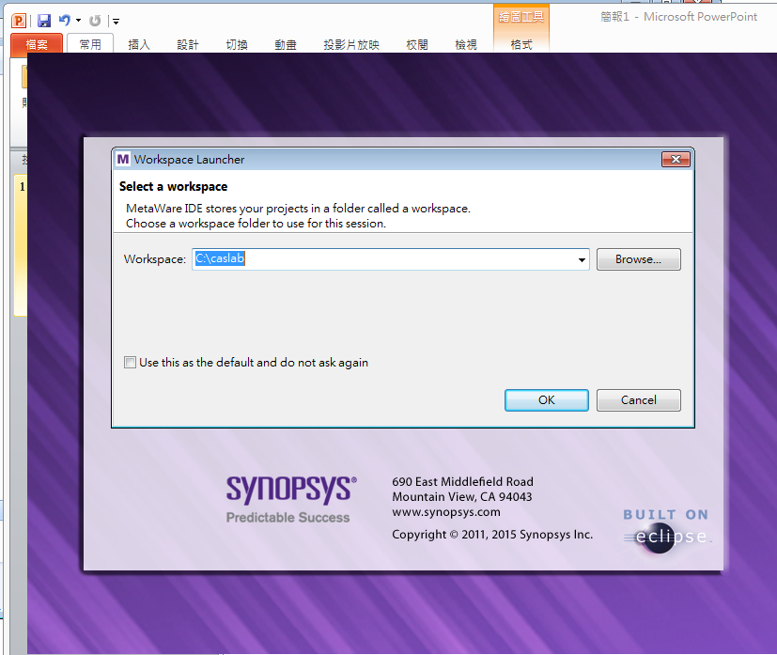
2. Change workspace to caslab

Slide 3
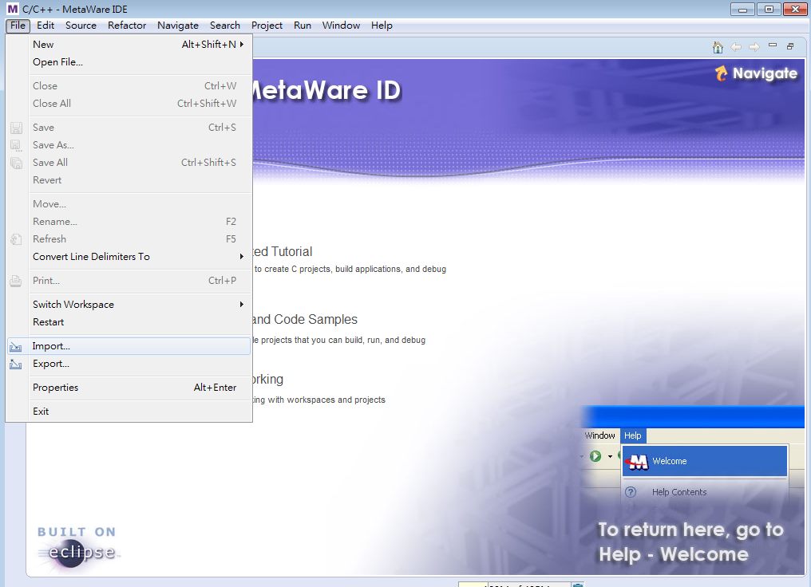
3.Click import

Slide 4
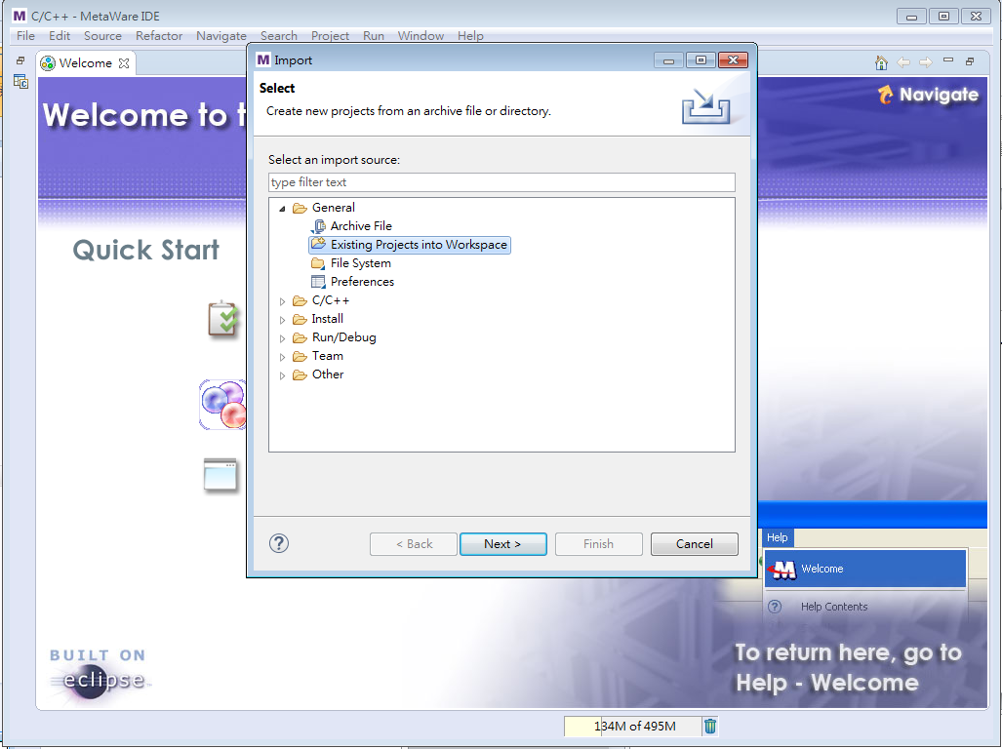
4.Select ”Existing projects into workspace”

Slide 5
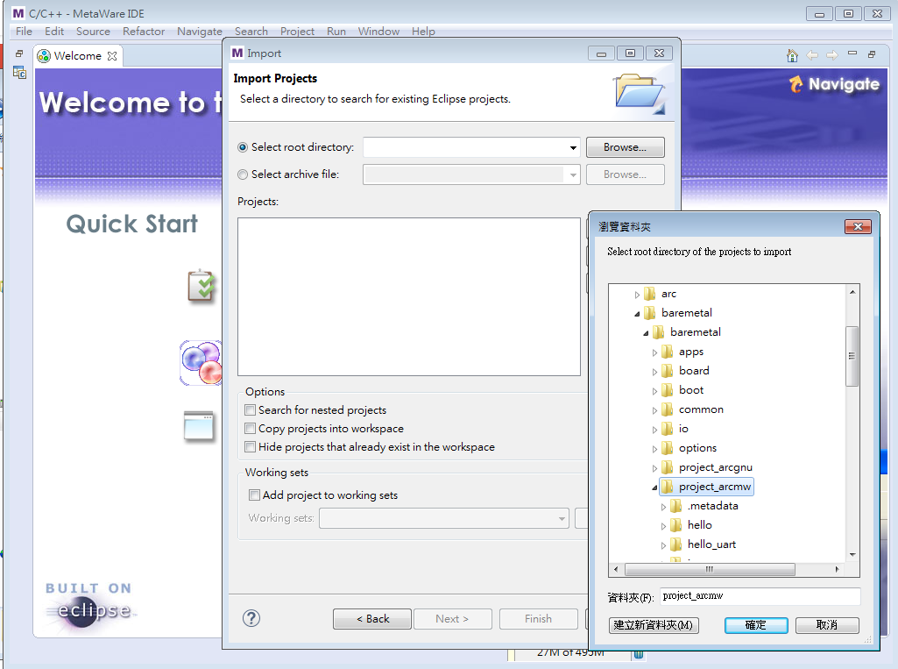
5.Choose import project”baremetal/baremetal/project_arcmw”

Slide 6
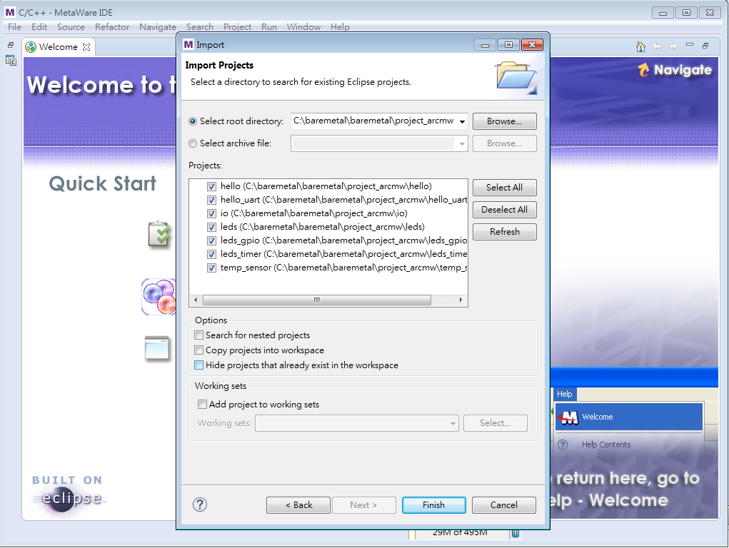
6.Choose all project

Slide 7
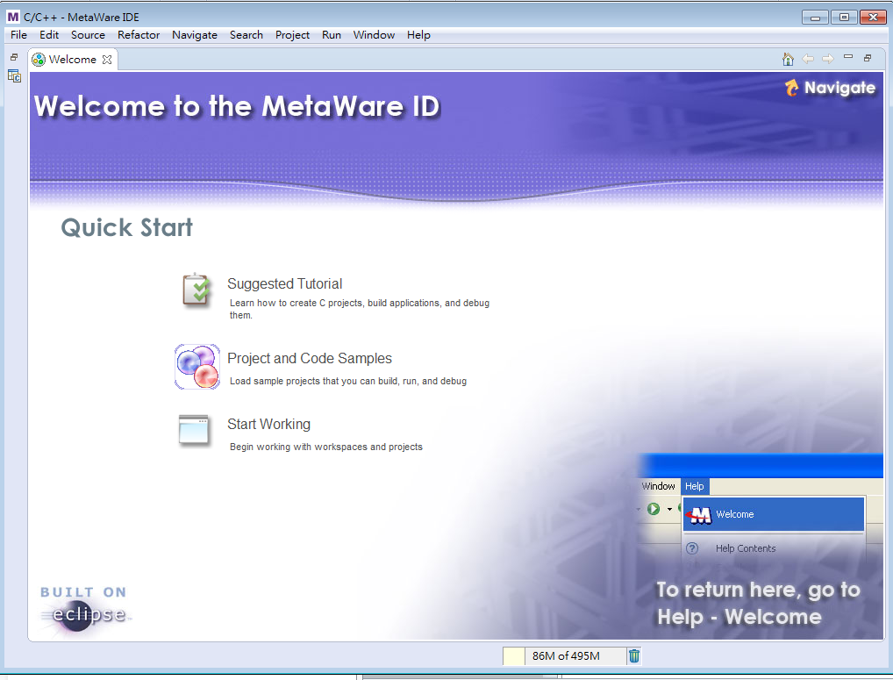
7.Click this!!!!!
Click this!!!

Slide 8
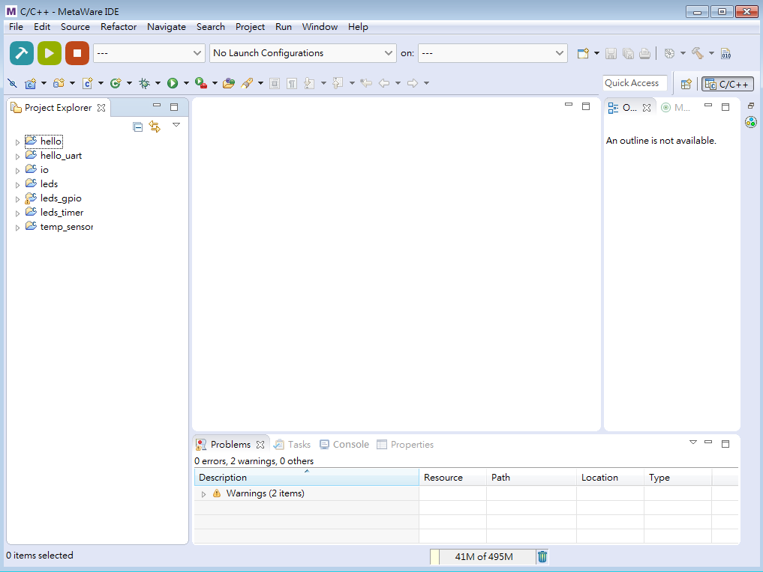
8.OK!!!!!!!!

