Slide 1
AI on Chip Lab2
Convolutional Neuron Network - LeNet-5
2021/03/03

Slide 2
Outlines
Transfer Learning
Advanced Topics
Convolutional Neuron Network
Lab: Implement LeNet-5 in Keras

Slide 3
Transfer Learning

Slide 4
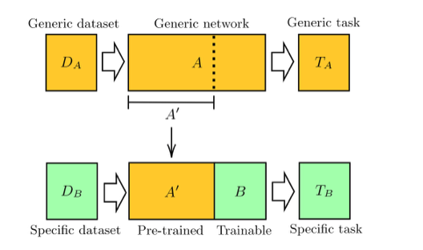
Transfer Learning

Slide 5
Transfer Learning Practice
https://blog.gtwang.org/programming/keras-resnet-50-pre-trained-model-build-dogs-cats-image-classification-system/
Pretrained model: ResNet50
Specific dataset: dogs, cats

Slide 6
Advanced Topics in ML

Slide 7
Training Algorithm
Basic Concept and Terminology
Batch, epoch, plateau, saddle point, local minimum
Overfitting
Backpropagation
Advance skills
Optimizers: Adam, RMSprop, Adagrad
Dropout, Batch Normalization, Regularization
Callback function, momentum
Reinforce Learning

Slide 8
Common Neural Network Models
Classifier
LeNet5, VGG, ResNet, AlexNet…
Object detection
YOLO, RCNN, CornerNet…
Audio
RNN, LSTM…

Slide 9
Learning Materials
Machine Learning - Hung-yi Lee
https://www.youtube.com/watch?v=CXgbekl66jc&list=PLJV_el3uVTsPy9oCRY30oBPNLCo89yu49
Andrew Ng
https://www.youtube.com/watch?v=ArPaAX_PhIs&list=PLkDaE6sCZn6Gl29AoE31iwdVwSG-KnDzF

Slide 10
Convolutional Neuron Network

Slide 11
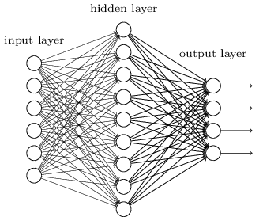
CNN
convolution
pooling
a new image
convolution
Fully Connected
Feedforward network
pooling
can repeat many times
Flatten

Slide 12
Lab: Implement LeNet-5 in Keras
Hands-Writing Recognition

Slide 13
LeNet - 5

Slide 14
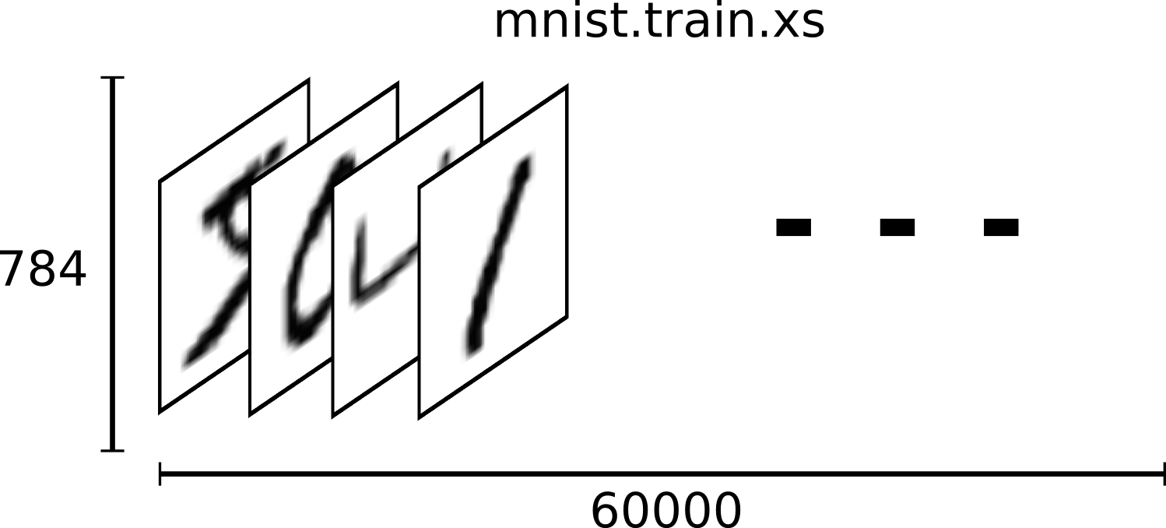
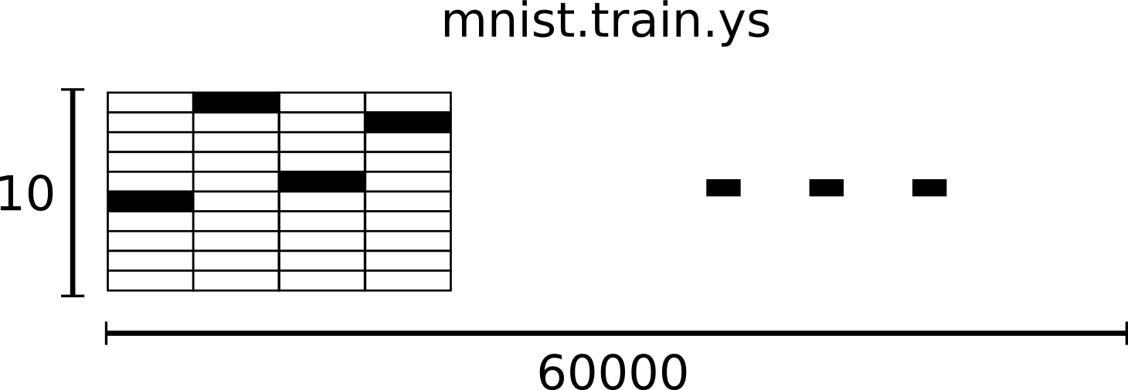
MNIST datasets

Slide 15
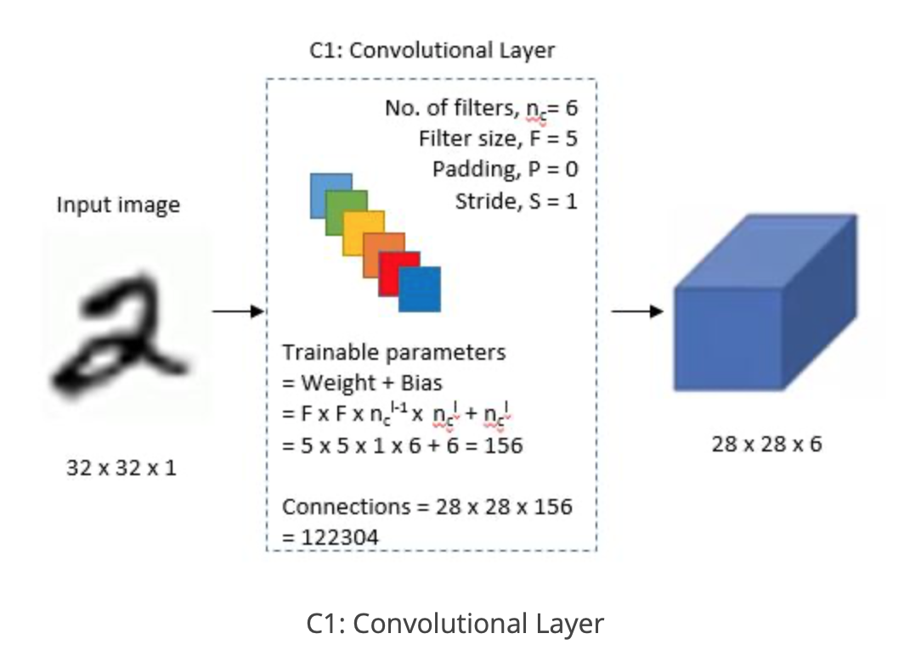
LeNet-5 layer1
Convolution Layer
filter_size: 5 * 5
num of filters: 6

Slide 16
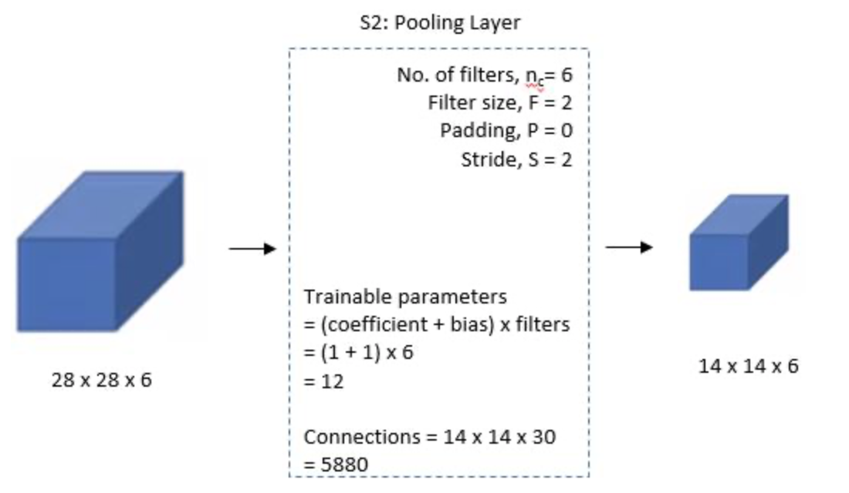
LeNet-5 layer2
Average Pooling
filter_size: 2 * 2
num of filters: 6
stride: 2
output: 14 * 14 * 6

Slide 17
LeNet-5 - Layer3
Convolution Layer
filter_size: 5 * 5
num of filters: 16

Slide 18
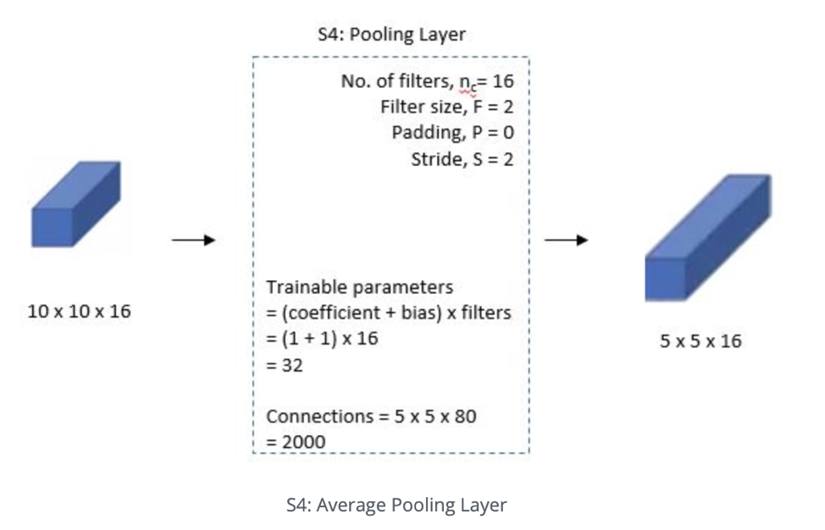
LeNet-5 - Layer4
Average Pooling Layer
filter_size: 2 * 2
num of filters: 16
stride: 2
output: 5 * 5 * 16

Slide 19
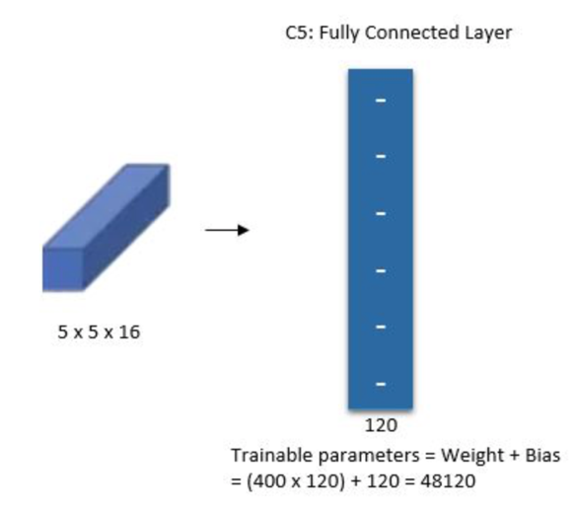
LeNet-5 - Layer5
Fully Connected Layer
filter_size: 5*5
num of filters: 120

Slide 20
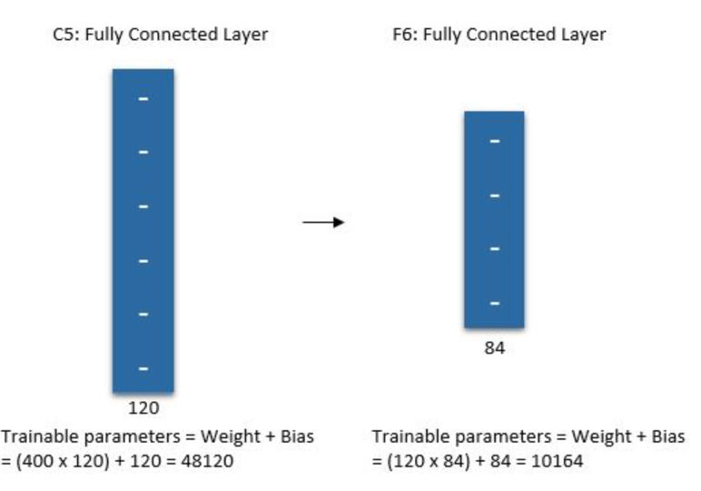
LeNet-5 - Layer6
Fully Connected Layer
num of neorons - 84

Slide 21
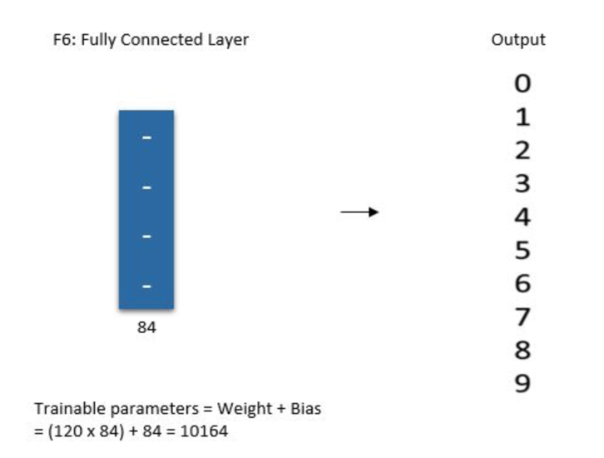
LeNet-5 - Output Layer
Fully Connected Softmax Layer
num of Output - 10

Slide 22
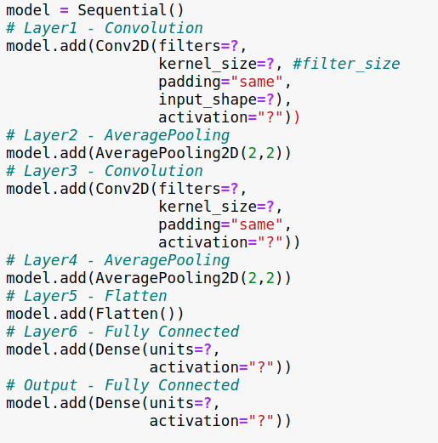
LeNet-5 Network
You can go to course website to download source code

Slide 23
Utilizing GPU
Export Cuda Library
You can add the command below into .bashrc
Check GPU availability
Disable GPU
method 1
method 2

Slide 24
Thank You for your listening

