Slide 1
AI on Chip Lab1
Getting start to use CASGPU for Machine Learning
2021/2/23

Slide 2
Outlines
Login to CASGPU container
Jupyter Notebook
How to bring TAs code to CASGPU
TensorFlow application on GPU

Slide 3
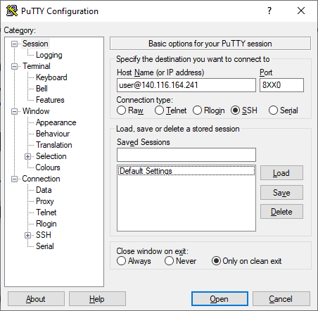
Login to CASGPU container
Windows system:
Putty or Xshell is recommended
Ubuntu system:
Ctrl + Atl + t
ssh user@140.116.164.241 –p 8xx0
xx is your group number
Ex. I’m group 8
ssh user@140.116.164.241 –p 8080
user password:
reveal on class 2021/2/23

Slide 4
Login to CASGPU container
What should I do on first login?
Change password
passwd
Install tensorflow-gpu
pip3 install tensorflow-gpu
pip3 list | grep –n tensorflow-gpu
Setup Cuda library path
export LD_LIBRARY_PATH=/usr/local/cuda/lib64

Slide 5
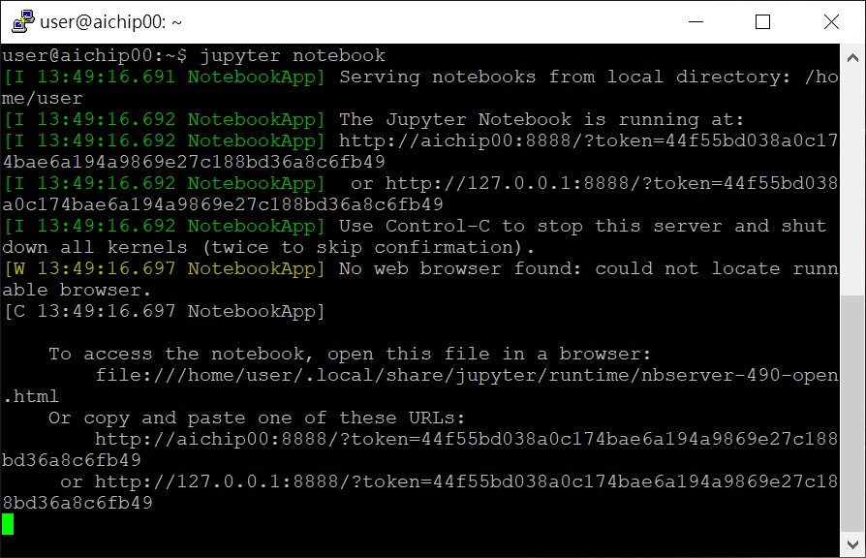
Jupyter Notebook
In Putty
jupyter notebook
Open a browser & go to
140.116.164.241:8xx1
[8xx1] port is forwarded for jupyter notebook
Make sure it is listened on 8888 port

Slide 6
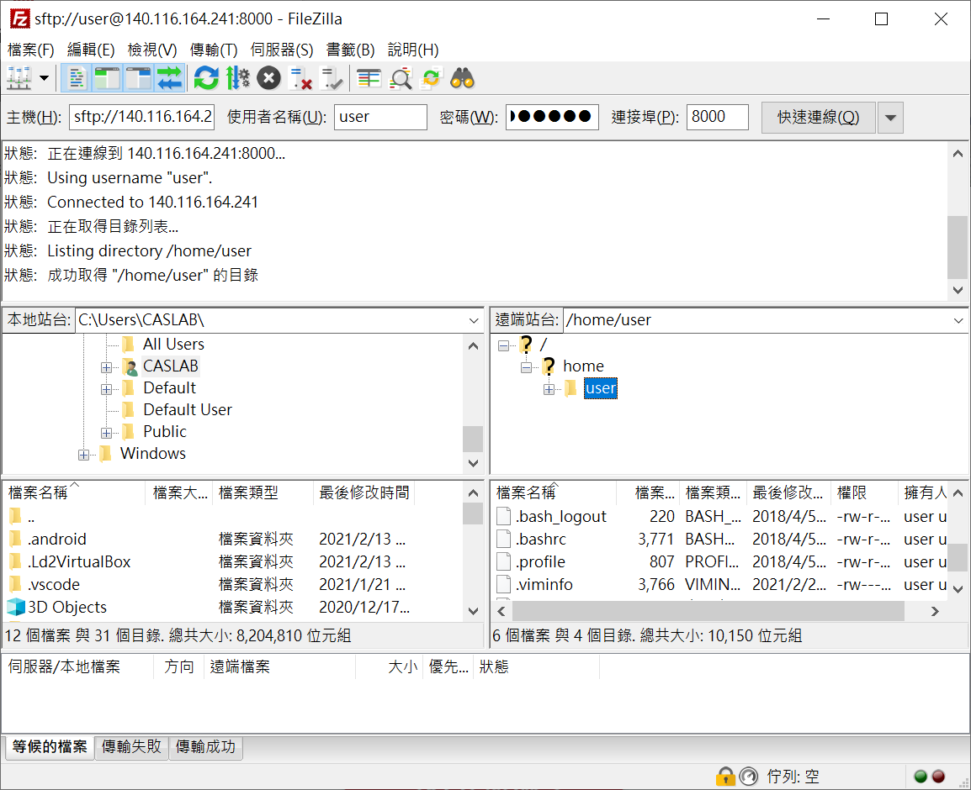
How to bring TAs code to CASGPU
Windows system:
Filezilla or Xftp is recommended
sftp://140.116.164.241
port: 8xx0
Ubuntu system:
scp
wget [links on caslab website]

Slide 7
Tensorflow application on GPU
Check if the GPU is available. if the output is FALSE, make sure that the cuda library path is set up.
Limit GPU usage

Slide 8
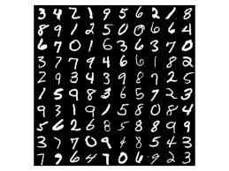
Tensorflow application on GPU
Practice 1:
Use tensorflow API to do matrix multiplication
Practice 2:
MNIST model

Slide 9
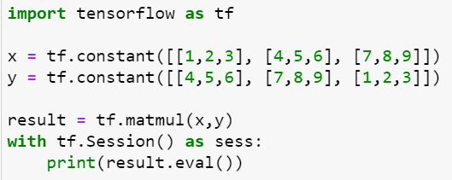
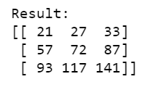
Practice 1
https://www.tensorflow.org/api_docs/python/tf/linalg/matmul
Use the APIs to do matrix multiplication

Slide 10
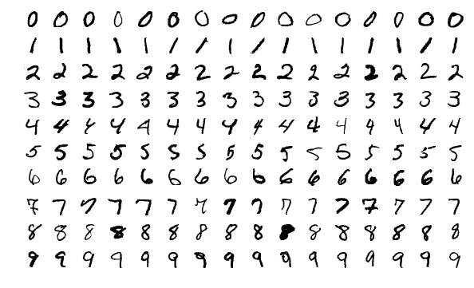
Practice 2
MNIST dataset
The MNIST database is a large database of handwritten digits that is commonly used for training various image processing systems.
Image size: 28*28

Slide 11
Practice 2 – Code(1/10)
Limit GPU usage

Slide 12
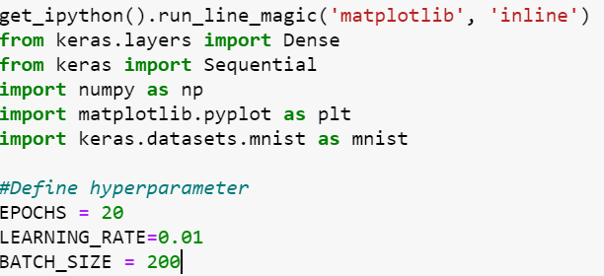
Practice 2 – Code(2/10)
Import libraries

Slide 13
Practice 2 – Code(3/10)
Read MNIST dataset

Slide 14
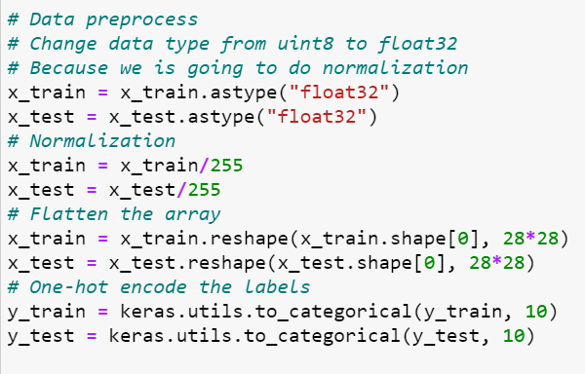
Practice 2 – Code(4/10)
Data preprocessing

Slide 15
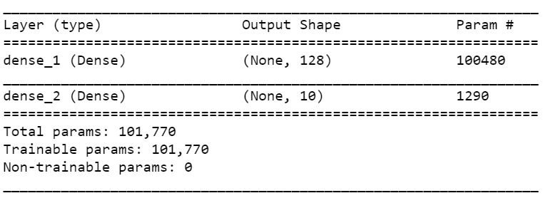
Practice 2 – Code(5/10)
Build the model

Slide 16
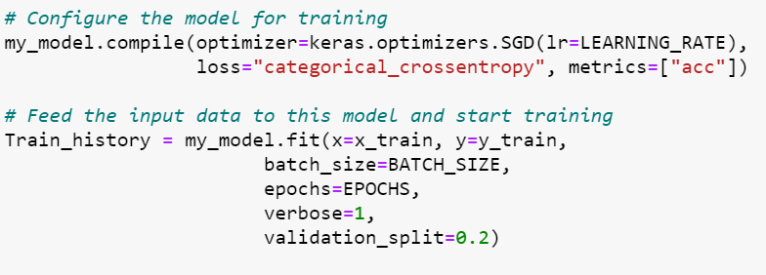
Practice 2 – Code(6/10)
Configure and Fit the Model

Slide 17
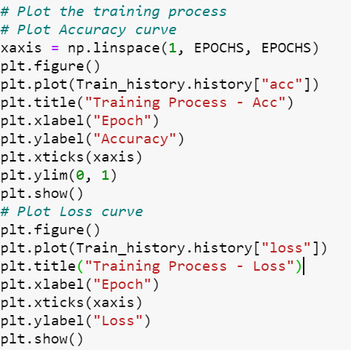
Practice 2 – Code(7/10)
Plot the training process

Slide 18
Practice 2 – Code(9/10)
Evaluation and save the model

Slide 19
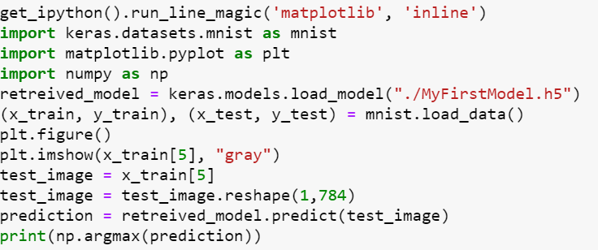
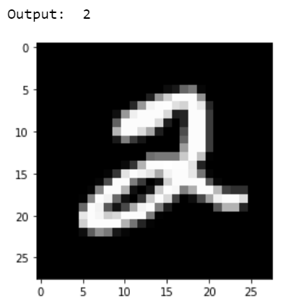
Practice 2 – Code(10/10)
Reuse the model

Slide 20
Contacts
計算機架構與系統實驗室 CASLab
EE 6F room 92617
陳中和教授
Lab1 TAs
蔡期開 deekai9139@gmail.com
粘舒涵 jjs93126@gmail.com

Slide 21
Thank You for your listening

