Slide 1
Lecture 2
Domain Specific Computing
Case study: 1D-PE Design for Convolution Layer part of the work from T-C Wu
Chung-Ho Chen
NCKU EE

Slide 2
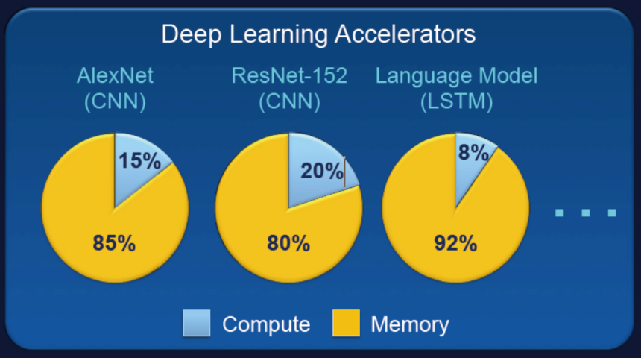
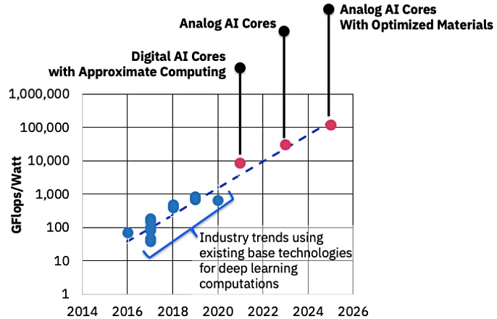
Deep Learning Accelerators
Intensive Memory Access and Computation
AI accelerator
development challenges
Intelligent data fetcher
Data placement for PEs
Data reuse strategies in MAC (Multiply-Accumulate) PE arrays
Quantization scheme in MAC
Design and simulation platform (tools and software)
Advanced in-memory computing
S. Mitra/Standford
Abundant-Data Computing
https://beyondcmos.ornl.gov/documents/Panel_Session-Mitra.pdf
Source: https://blocksandfiles.com/2019/02/11/ibms-ai-chips-change-phase/

Slide 3



Putting into Perspective
DRAM/SRAM
Physical
Data
Physical
Data
Weight (Digital)
Weight (Digital)
Input (Digital)
Input (Analog)
Interface
Interface
Digital, Analog MAC
Analog MAC
ADC
Weight (Analog)
Weight (Analog)
Input (Digital)
Input (Analog)
Inter-
face
Analog MAC
Analog MAC
Analog signal
Digital code
Flash/RRAM

Slide 4
AI Accelerator Design/Simulation Framework
Memory technologies
SRAM
Flash
Non-volatiles
DRAM
Deep Learning
System-Level Analysis
DL applications
Yolov3,
GAN…..
Architecture Exploration
Input type (A or D), data reuse, execution time, energy
Implementation
RTL, FPGA, Silicon

Slide 5
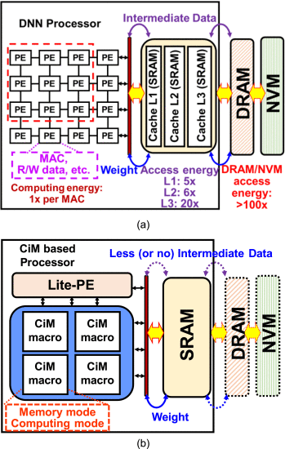
Compute in Memory (CIM)
Why CIM?
  Data movement causes time and energy consumption
  Memory wall
  CiM advantages: 1) improve speed and area efficiency, due to computation directly in memory, and 2) very good energy efficiency, thanks to the analog MAC operations.
(a) Data movement from SRAM buffer to the processing elements in the conventional von Neumann architecture makes it the primary performance bottleneck in the execution of data-intensive workloads.
(b) The memory macros in a CiM structure are not limited to normal read and write operations. They can operate as a computing engine to perform MAC operations and minimize the amount of data that needs to be moved between the processor and the SRAMs.
Cons: PVT variation impact on analog computing. (Process, Voltage, Temperature)
  PVT-aware quantization training
IEEE Micro 2019 Zhixiao Zhang; Xin Si; Srivatsa Srinivasa; Akshay Krishna Ramanathan; Meng-Fan Chang
Recent Advances in Compute-in-Memory Support for SRAM Using Monolithic 3-D Integration

Slide 6




TVM (Tensor Virtual Machine): An Automated End-to-End Optimizing Compiler for Deep Learning
Facebook ML
Compiler:
Glow
Google
TensorFlow
A tensor is a generalization of vectors and matrices and is easily understood as a multidimensional array. It is a term and set of techniques known in machine learning in the training and operation of deep learning models can be described in terms of tensors.
University of Washington- CSE
  Tianqi Chen and Thierry Moreau, University of Washington; Ziheng Jiang, University of Washington, AWS; Lianmin Zheng, Shanghai Jiao Tong University; Eddie Yan, Haichen Shen, and Meghan Cowan, University of Washington; Leyuan Wang, UC Davis, AWS; Yuwei Hu, Cornell; Luis Ceze, Carlos Guestrin, and Arvind Krishnamurthy, University of Washington
Frameworks
Deployable Module
TVM

Slide 7
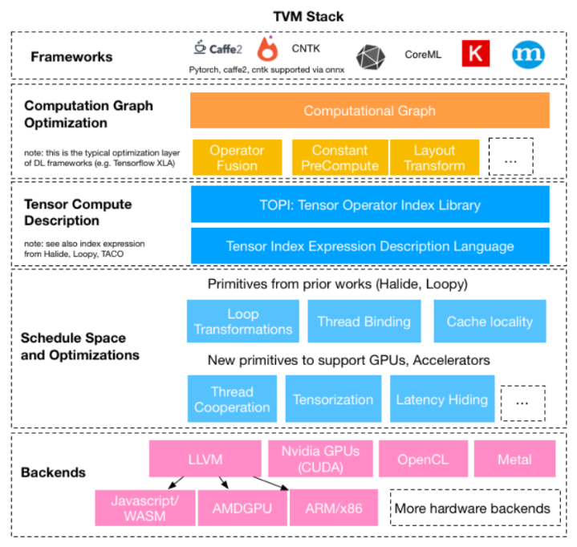
TVM
Relay IR (Parsing different frameworks into Relay IR))
Graph level optimization: operator fusion (conv+Relu. e.g.),
constant folding, quantization (ft32 to int8 or ft16)
Tensor Compute Description (algorithm)
tensor compute library,
tensor index expression.
Tensor level (MAC, e.g.) optimization, scheduling
according to your hardware (SIMD, vector, e.g.)
CodeGen: Produce platform-specific code
Runtime
Hardware

Slide 8
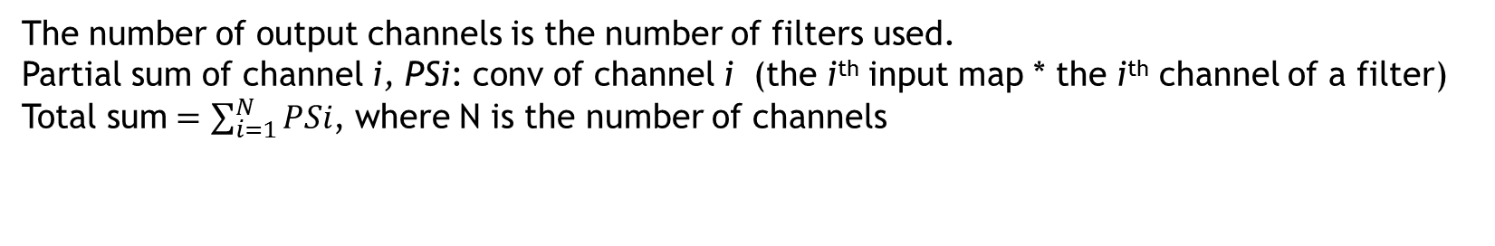
Revisit Convolution Operation
N: # of channels for input map as well as kernel
M: # of filters or kernels, K: size of a filter, which keeps weights
The number of output channels is the number of filters used.
Partial sum of channel i, PSi: conv of channel i (the i^{th} input map * the i^{th} channel of a filter)
Total sum$=\sum_{i=1}^{N}{PSi}$, where N is the number of channels
Total sum: sum of element-wise multiplications
N: # of channels
…
…
*
K
=
K
M: # of filters
H
I
N
…
N channels
M
…
W
J
Input Size = H*W*N
Kernel Size = K*K*N*M
Output Size = I*J*M

Slide 9
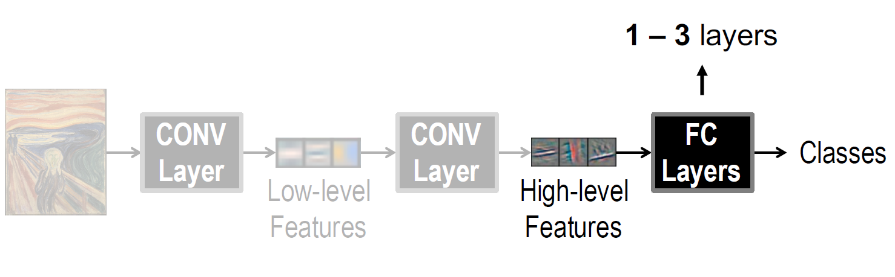
Deep Convolution NNs
How deep is deep?
Up to 1000 layers of CNNs
Fig. from Yu-Hsin Chen, Eyeriss

Slide 10
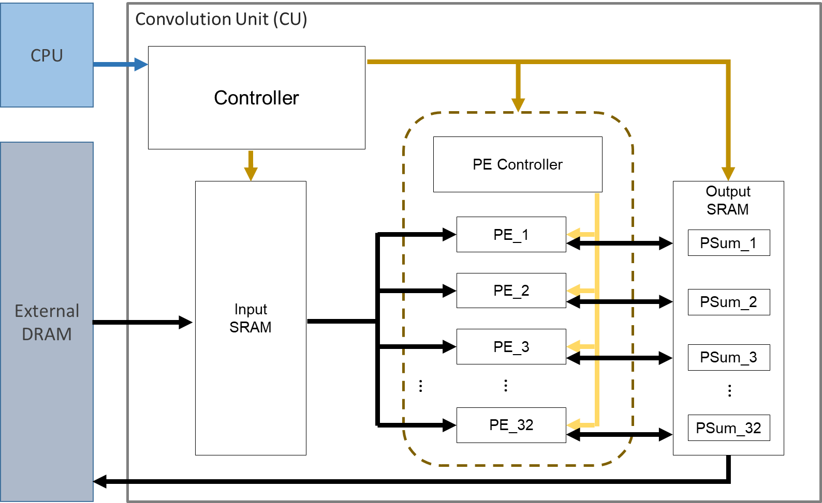
A Convolution Unit; things to ponder
PE structure (fixed MACs or not)
  Determine how many MACs in a PE
Single PE array structure (parallelism)
Multiple PE arrays (scalable performance)
More importantly,
  how to reuse data
  how to operate on various size of kernels
  how to effectively use the PEs
Hardwired or software (CPU) controller
  So that runtime can call,
  or APIs that a code generator can use
  and hence produce the runtime library

Slide 11
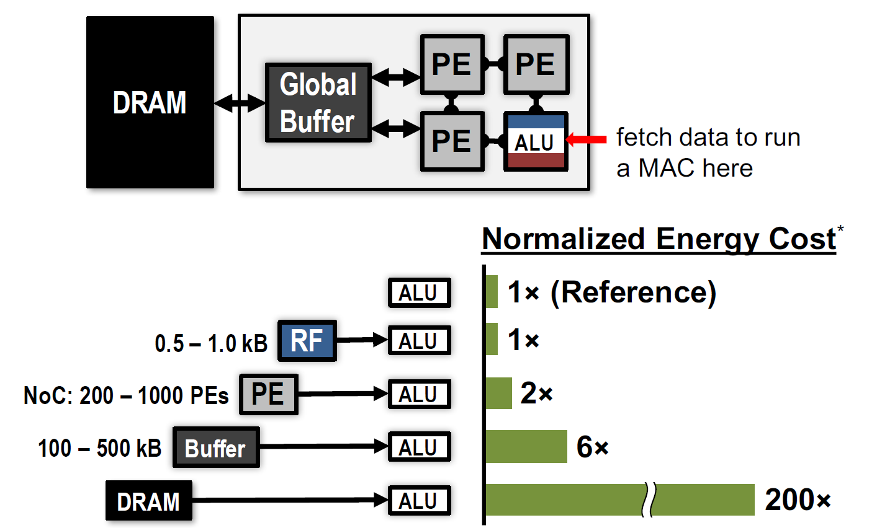
Energy Cost
Memory hierarch makes sense
  65 nm process
Fig. from Yu-Hsin Chen, Eyeriss

Slide 12
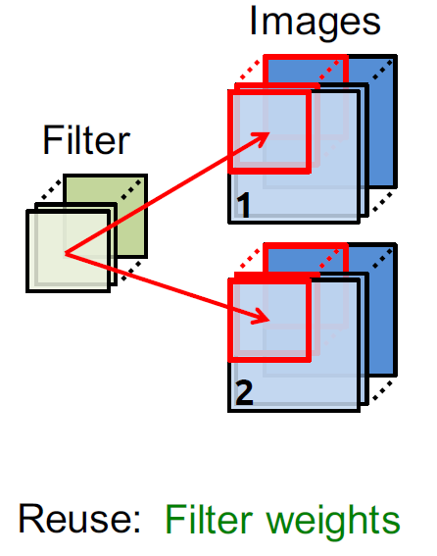
Weight Stationary
Filters of different dimension keep weights
Minimize weight read energy consumption
Weights are with the PEs.
Ex: Different pixel enters different MAC and accumulates PS for a convolution block here.
  Then go for a different CB of the same channel, but weights stay. If you switch channel, then weights change.
Weight stationary example
  Google TPU
Fig. from Yu-Hsin Chen, Eyeriss

Slide 13
Output Stationary
What is partial sum?
  A multiplication output
  Accumulated output of a convolutional block for multiple channel format
minimize partial sum read/write energy consumption.
Partial sum is accumulated with the PEs.
  Systolic array
Fig. from Yu-Hsin Chen, Eyeriss

Slide 14
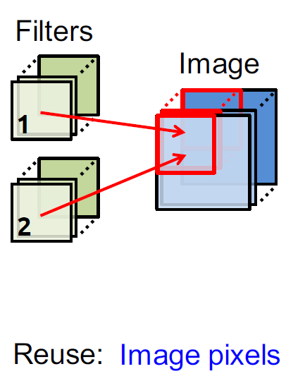
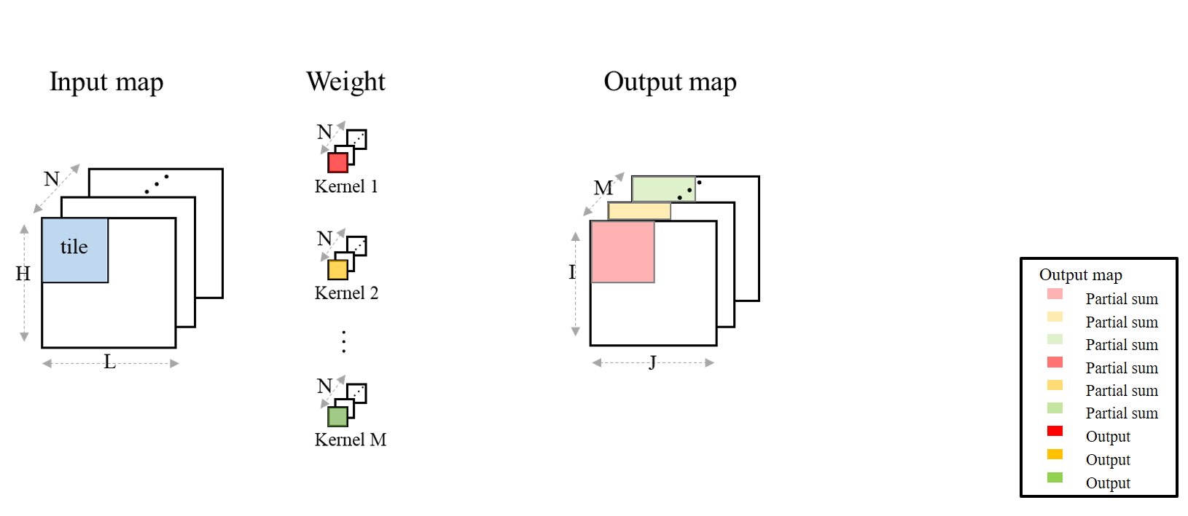
Tile Reuse: Operation from Tile View
Tile reuse: An input map is divided into Tiles.
Tile Reuse: A tile is brought in from DRAM and stays stationary.
To do this, M copies of weights of the same channel are made ready. Weights are stationary for the same input tile. (what if M < = # of PEs?)
How to allocate convolution task to PEs?

Slide 15
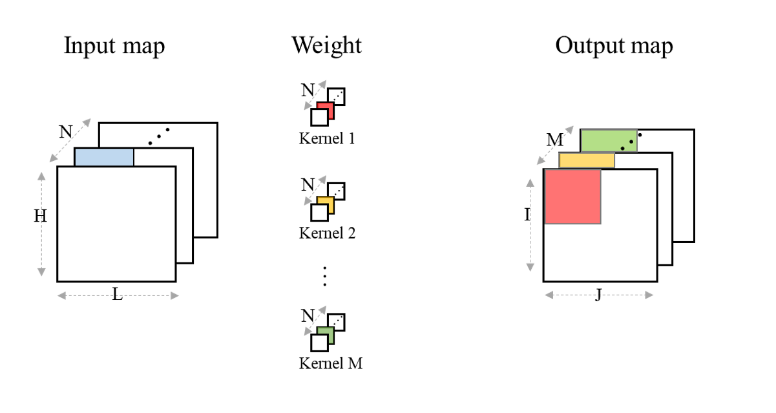
Tile Reuse : Next tile
Order of tile processing: Same tile position of the next channel
Load new weights for the corresponding channel
For this channel, we can accumulate partial sum from the previous channel
M (number of filters) copies of the partial sum are produced
Partial sum of ch1 + ch2

Slide 16
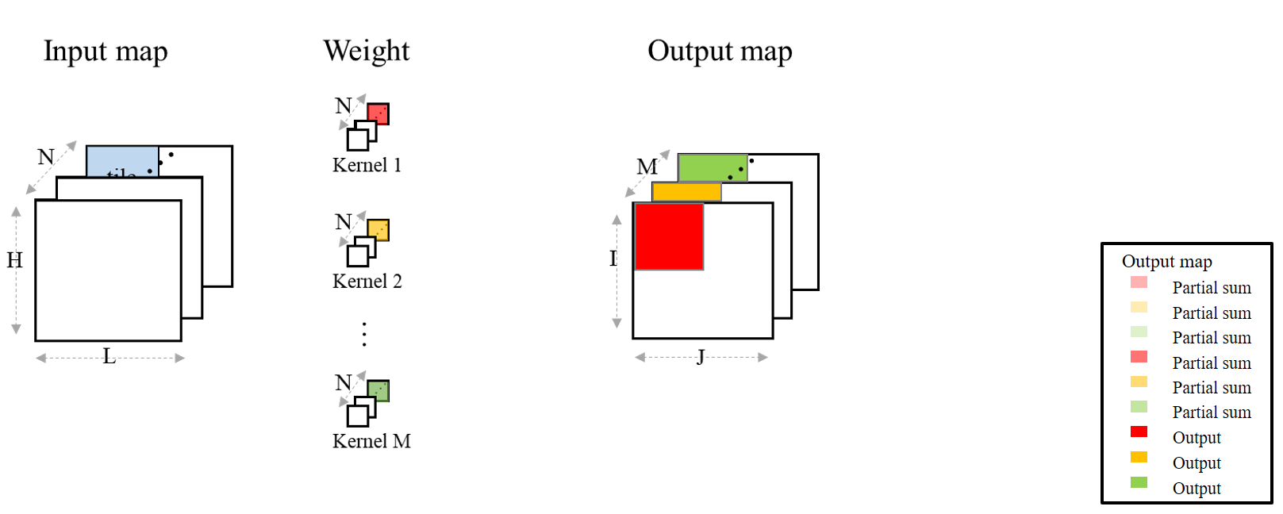
Tile view: Last tile of the last channel
At the end of last tile of the last channel: accumulate the total SUM for output
for that tile.
M output maps

Slide 17
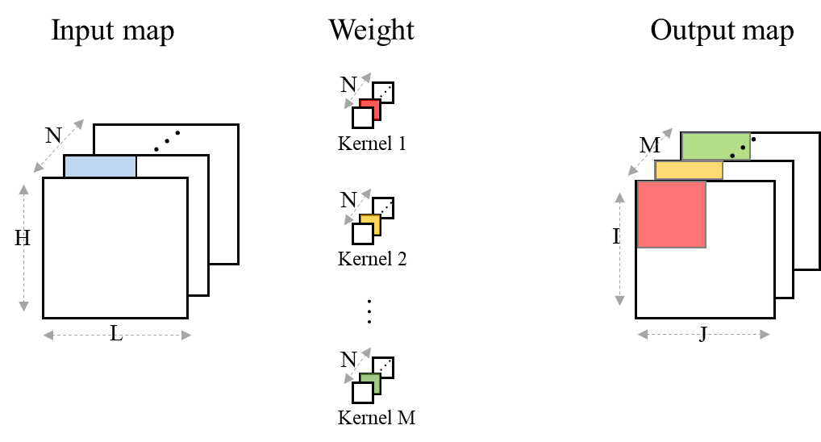
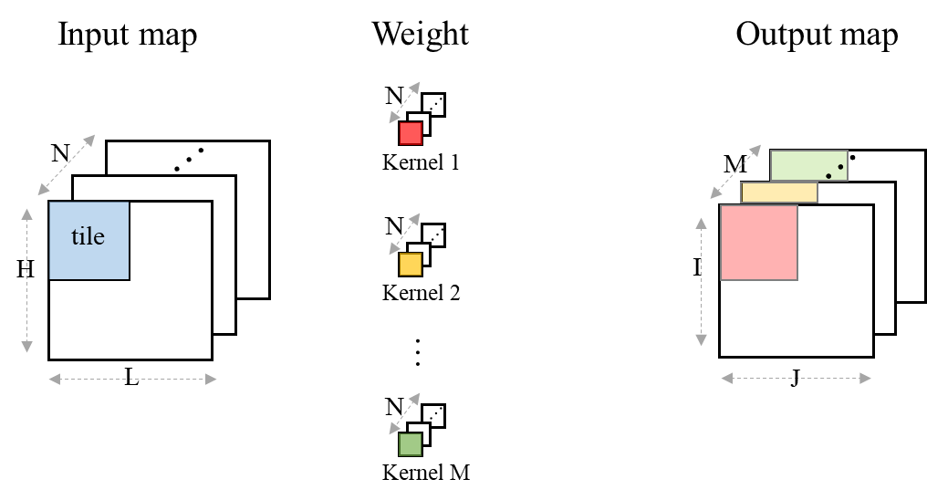
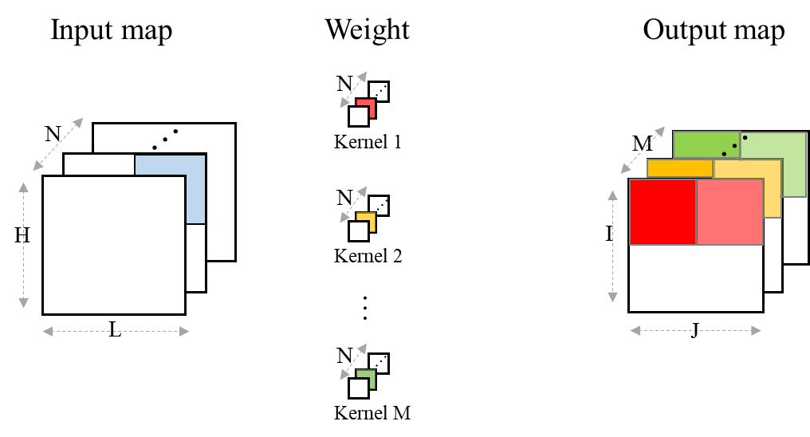
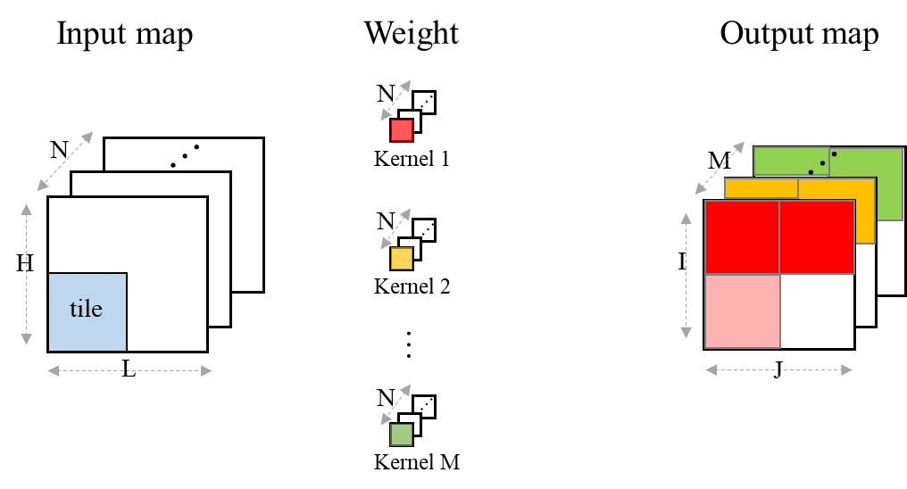
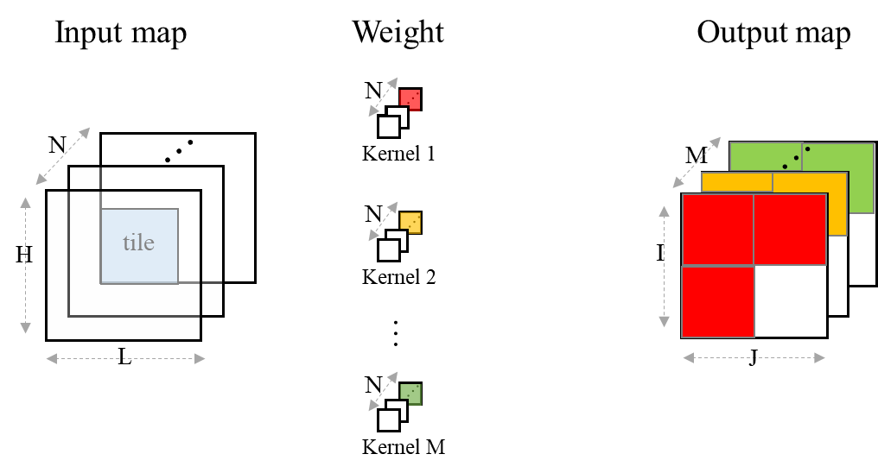
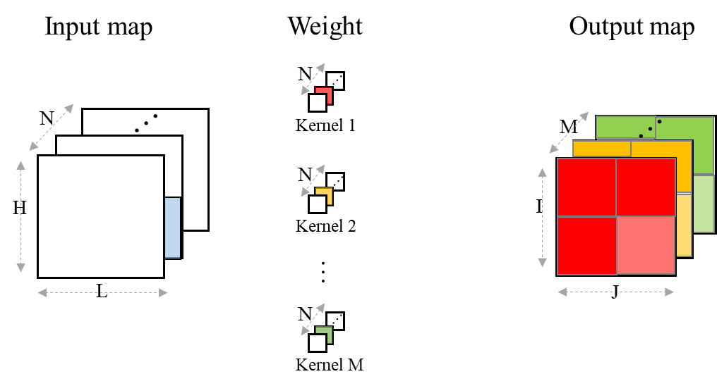
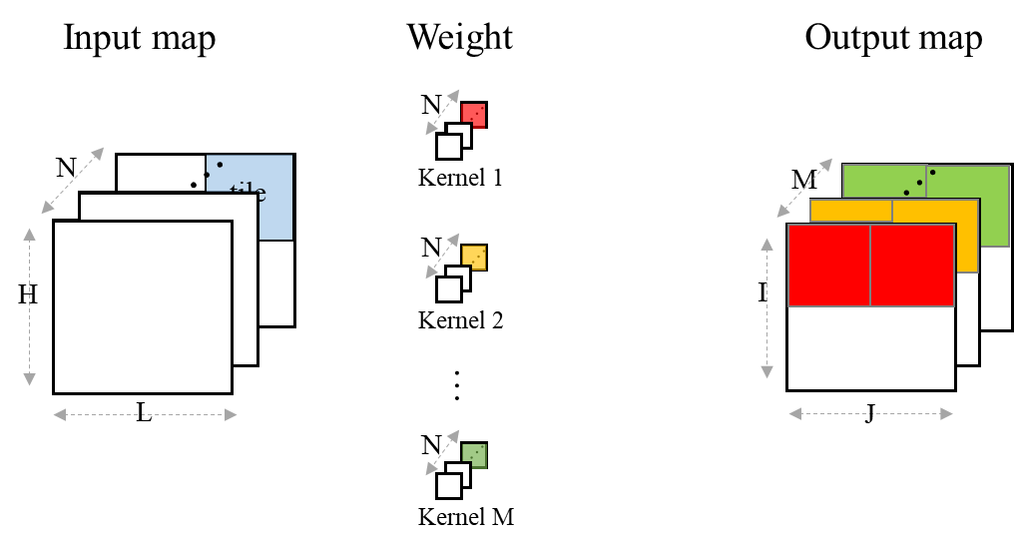
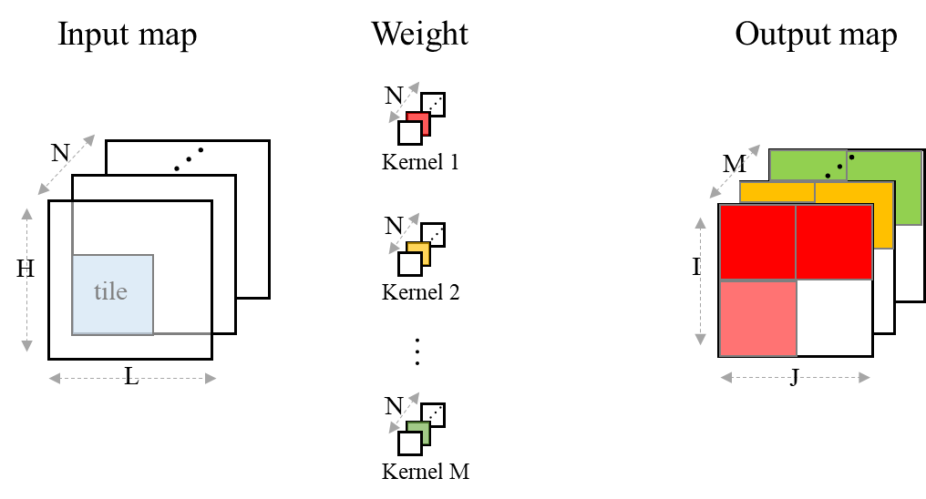
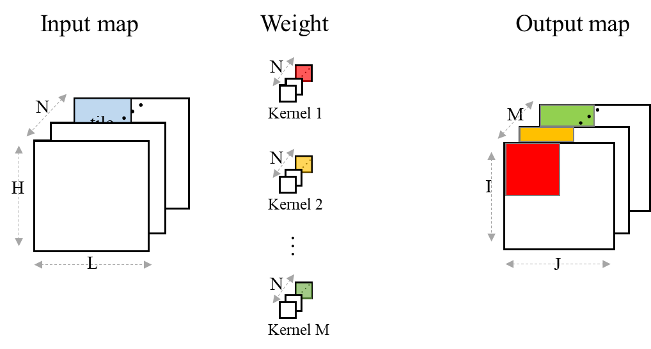
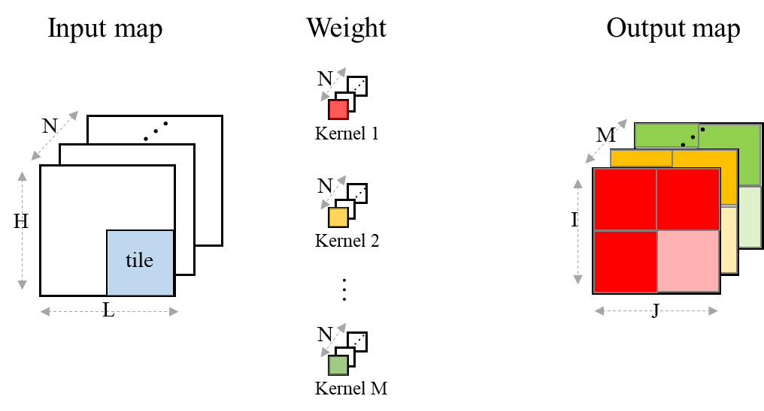
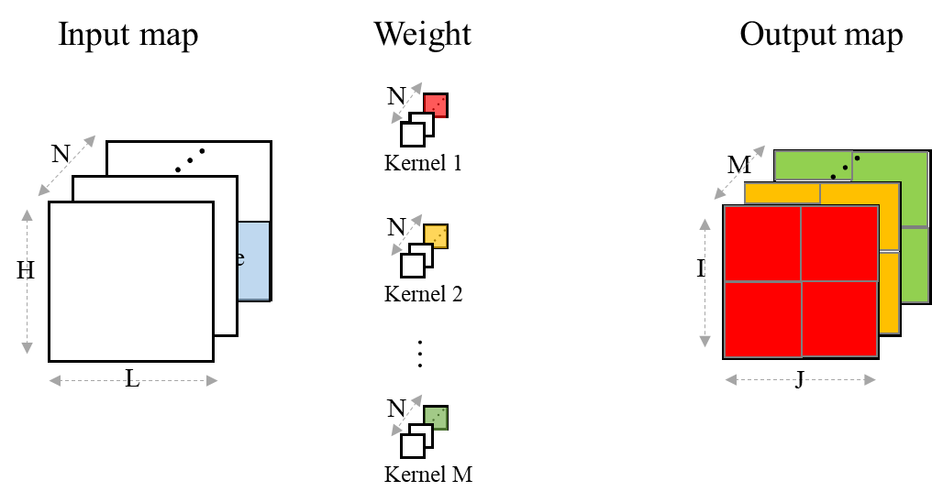
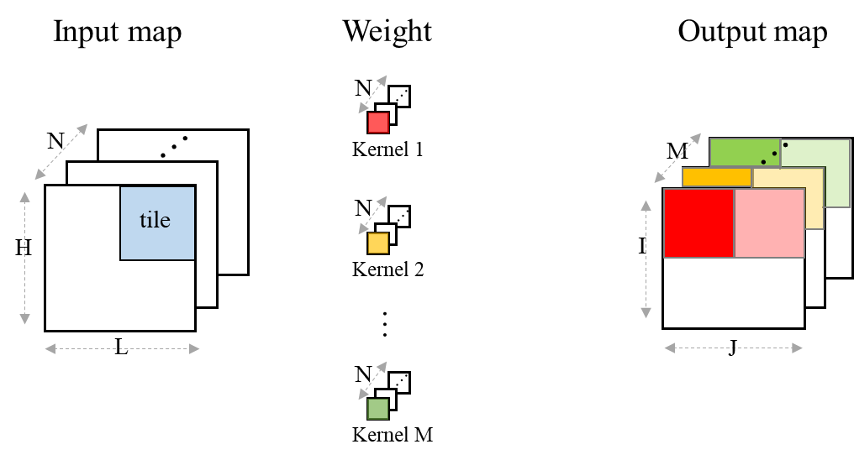
Tile Reuse in Action
Output map
Partial sum
Partial sum
Partial sum
Partial sum
Partial sum
Partial sum
Output
Output
Output

Slide 18
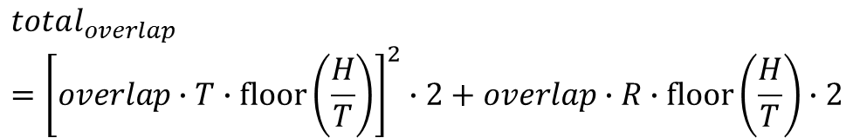
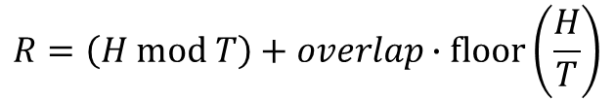

Tile Reuse - Tile Overlap
Overhead for tile 2= 7.7 % (4/52) for T = 52, K= 3, S= 1
overlap
H : input map height
L : input map width
T : tile size
R : remainder tile height or width
K : kernel size
S : stride
T
T
T
R
Input tile
1
Input tile
2
Input Map
T
T
$$overlap=K−S+[(T−K) mod S]$$
L
$$R=\left(H mod T\right)+overlap∙floor\left(\frac{H}{T}\right)$$
T
$$total_{overlap}={\left[overlap∙T∙floor\left(\frac{H}{T}\right)\right]}^{2}∙2+overlap∙R∙floor\left(\frac{H}{T}\right)∙2$$
R
H
in term of pixels

Slide 19
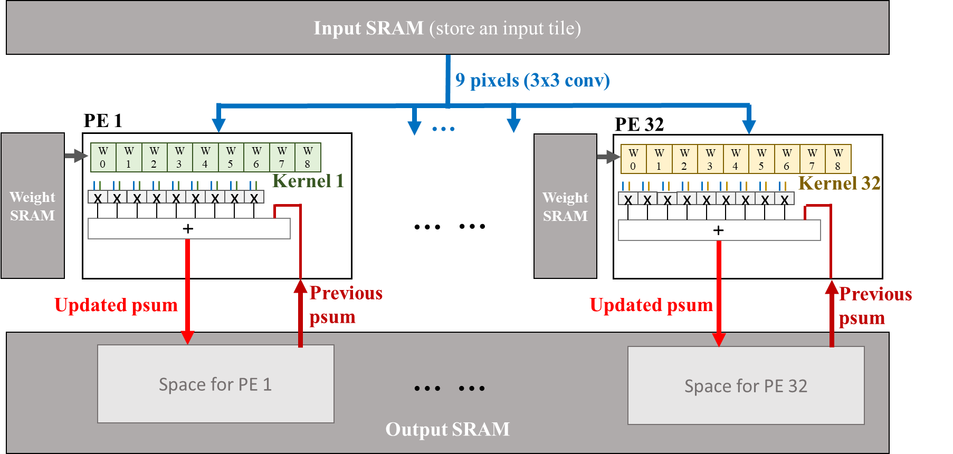
Convolution PE Unit
Per-filter based convolution task allocation to a PE (9 MACs)
The same input is broadcast to all PEs for convolution operations
Parallel convolution operations on multiple filters for the same input data
Weight registers
Broadcast from SRAM bus

Slide 20
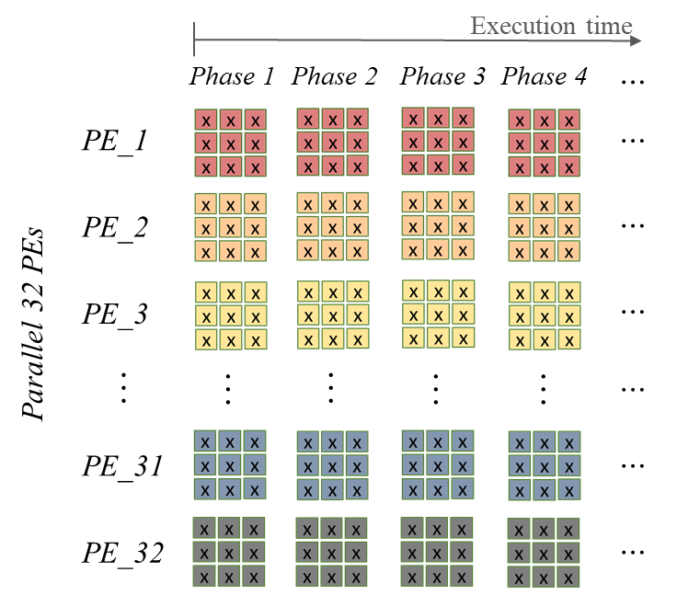
Per-filter based conv. task allocation
Assume # of filters M=32, # of PEs =32
  If M >= 32, then batch
  If M < 32, 32-M PEs idle
Allocate one filter to a PE and compute channel by channel for tile-sized input
Synchronization of all PEs to the same input
  Each PE receives the same 9 input pixels
Tile order: channel by channel tile order (why? easy to accumulate PS)
filter 1
filter 2
Load all 32 filters
PE1
PE2

Slide 21
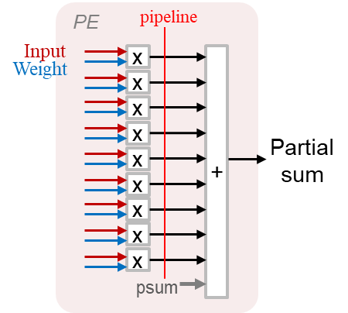
Partial sum accumulated PE design
Partial sum from the previous channel tile is added with the current channel convolution result.
  For a PE, it needs only one partial sum output memory which is reused until the total sum is accumulated.
  To reduce output SRAM access, we can add an RF to accumulated PSs in a tile, what is the size of this RF?

Slide 22
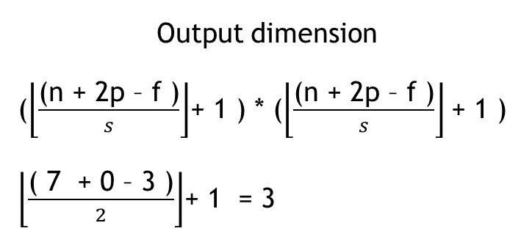
Optimization for partial sum accumulation in RF
Add a RF of size of
  p = 1, s = 1, f = 1, for a tile n = 64
  Need to buffer : 64 + 2 -1 +1 x () = 66 x 66 per PE, too expensive?
Can we tradeoff for a smaller size?
  Smaller n,
  Or processing order, C wise first. Need an operation mapping strategy.
Output dimension
($\left\lfloor \frac{\text{(}\text{n}\text{ + 2}\text{p}\text{ – }\text{f}\text{ )}}{s}\right\rfloor$+ 1 ) * ($\left\lfloor \frac{\text{(}\text{n}\text{ + 2}\text{p}\text{ – }\text{f}\text{ )}}{s}\right\rfloor$+ 1 )
$\left\lfloor \frac{\text{( 7 + 0 – 3 )}}{2}\right\rfloor$+ 1 = 3
64
64

Slide 23
Tile view: Operation within a Tile (1/2)
Output SRAM Write
Input SRAM Read
PEs
(multiply-and-accumulate)
tile i output in output SRAM for Kernel 1
P₀
P₁
P₂
P₃
P₄
…
…
Input tile i of input channel j
PE 1
P₅₀
P₅₁
P₅₂
P₅₃
P₅₄
…
…
Kernel 1
P₁₀₀
P₁₀₁
P₁₀₂
P₁₀₃
P₁₀₄
…
…
Sliding
I₀
x
W₀
+
P₁₅₀
P₁₅₁
P₁₅₂
P₁₅₃
P₁₅₄
…
…
52
I₁
x
W₁
I₀
I₁
I₂
I₃
I₄
I₅₁
I₂
x
W₂
P₂₀₀
P₂₀₁
P₂₀₂
P₂₀₃
P₂₀₄
…
…
…
…
I₀
I₅₂
x
W₃
Updated psum
I₅₂
I₅₃
I₅₄
I₅₅
I₅₆
…
…
I₁₀₃
I₁
I₅₃
x
W₄
…
…
…
…
…
I₂
I₅₄
x
W₅
…
…
…
…
…
I₁₀₄
I₁₀₅
I₁₀₆
I₁₀₇
I₁₀₈
…
…
I₁₅₅
I₅₂
I₁₀₄
x
W₆
I₁₀₅
x
W₇
I₁₅₆
I₁₅₇
I₁₅₈
I₁₅₉
I₁₆₀
…
…
I₂₀₇
I₅₃
I₁₀₆
x
W₈
…
I₂₀₈
I₂₀₉
I₂₁₀
I₂₁₁
I₂₁₂
…
…
I₂₅₉
I₅₄
psum
52
I₁₀₄
…
…
…
tile i output in output SRAM for Kernel 32
…
…
…
…
…
…
I₁₀₅
PE 32
Kernel 32
P₀
P₁
P₂
P₃
P₄
…
…
…
…
…
…
…
…
I₁₀₆
I₀
W₀
P₅₀
P₅₁
P₅₂
P₅₃
P₅₄
…
…
x
+
I₂₆₅₂
I₂₆₅₃
I₂₆₅₄
I₂₆₅₅
I₂₆₅₆
…
…
I₂₇₀₃
I₁
x
W₁
P₁₀₀
P₁₀₁
P₁₀₂
P₁₀₃
P₁₀₄
…
…
I₂
x
W₂
I₅₂
x
W₃
Updated psum
P₁₅₀
P₁₅₁
P₁₅₂
P₁₅₃
P₁₅₄
…
…
I₅₃
x
W₄
P₂₀₀
P₂₀₁
P₂₀₂
P₂₀₃
P₂₀₄
…
…
I₅₄
x
W₅
Input broadcast
I₁₀₄
x
W₆
…
…
…
…
…
I₁₀₅
x
W₇
I₁₀₆
x
W₈
…
…
…
…
…
psum

Slide 24
Tile view: Operation within a Tile (2/2)
Output SRAM Write
Input SRAM Read
PEs
(multiply-and-accumulate)
tile i output in output SRAM for Kernel 1
P₀
P₁
P₂
P₃
P₄
…
…
Input tile i of channel j
PE 1
P₅₀
P₅₁
P₅₂
P₅₃
P₅₄
…
…
Kernel 1
P₁₀₀
P₁₀₁
P₁₀₂
P₁₀₃
P₁₀₄
…
…
sliding
I₁
x
W₀
+
P₁₅₀
P₁₅₁
P₁₅₂
P₁₅₃
P₁₅₄
…
…
52
I₂
x
W₁
I₀
I₁
I₂
I₃
I₄
I₅₁
I₃
x
W₂
P₂₀₀
P₂₀₁
P₂₀₂
P₂₀₃
P₂₀₄
…
…
…
…
I₁
I₅₃
x
W₃
Updated psum
I₅₂
I₅₃
I₅₄
I₅₅
I₅₆
…
…
I₁₀₃
I₂
I₅₄
x
W₄
…
…
…
…
…
I₃
I₅₅
x
W₅
…
…
…
…
…
I₁₀₄
I₁₀₅
I₁₀₆
I₁₀₇
I₁₀₈
…
…
I₁₅₅
I₅₃
I₁₀₅
x
W₆
I₁₀₆
x
W₇
I₁₅₆
I₁₅₇
I₁₅₈
I₁₅₉
I₁₆₀
…
…
I₂₀₇
I₅₄
I₁₀₇
x
W₈
…
I₂₀₈
I₂₀₉
I₂₁₀
I₂₁₁
I₂₁₂
…
…
I₂₅₉
I₅₅
psum
tile i output in output SRAM for Kernel 32
52
I₁₀₅
…
…
…
…
…
…
…
…
…
I₁₀₆
PE 32
P₀
P₁
P₂
P₃
P₄
…
…
I₁₀₇
Kernel 32
…
…
…
…
…
…
I₁
x
W₀
+
P₅₀
P₅₁
P₅₂
P₅₃
P₅₄
…
…
I₂₆₅₂
I₂₆₅₃
I₂₆₅₄
I₂₆₅₅
I₂₆₅₆
…
…
I₂₇₀₃
I₂
x
W₁
P₁₀₀
P₁₀₁
P₁₀₂
P₁₀₃
P₁₀₄
…
…
I₃
x
W₂
I₅₃
x
W₃
Updated psum
P₁₅₀
P₁₅₁
P₁₅₂
P₁₅₃
P₁₅₄
…
…
Input broadcast
I₅₄
x
W₄
P₂₀₀
P₂₀₁
P₂₀₂
P₂₀₃
P₂₀₄
…
…
I₅₅
x
W₅
I₁₀₅
x
W₆
…
…
…
…
…
I₁₀₆
x
W₇
I₁₀₇
x
W₈
…
…
…
…
…
psum

Slide 25
Tile view: Operation within a Tile (2/2)
Revision
Output SRAM Write
Input SRAM Read
PEs
(multiply-and-accumulate)
tile i output in output SRAM for Kernel 1
Input broadcast
P₀
P₁
P₂
P₃
P₄
…
…
Input tile i of channel j
PE 1
P₅₀
P₅₁
P₅₂
P₅₃
P₅₄
…
…
Kernel 1
P₁₀₀
P₁₀₁
P₁₀₂
P₁₀₃
P₁₀₄
…
…
sliding
I₁
x
W₀
+
P₁₅₀
P₁₅₁
P₁₅₂
P₁₅₃
P₁₅₄
…
…
52
MUX
I₂
x
W₁
I₀
I₁
I₂
I₃
I₄
I₅₁
I₃
x
W₂
P₂₀₀
P₂₀₁
P₂₀₂
P₂₀₃
P₂₀₄
…
…
…
…
I₁
I₅₃
x
W₃
Updated psum
I₅₂
I₅₃
I₅₄
I₅₅
I₅₆
…
…
I₁₀₃
I₂
I₅₄
x
W₄
…
…
…
…
…
I₃
I₅₅
x
W₅
…
…
…
…
…
I₁₀₄
I₁₀₅
I₁₀₆
I₁₀₇
I₁₀₈
…
…
I₁₅₅
I₅₃
I₁₀₅
x
W₆
I₁₀₆
x
W₇
I₁₅₆
I₁₅₇
I₁₅₈
I₁₅₉
I₁₆₀
…
…
I₂₀₇
I₅₄
I₁₀₇
x
W₈
…
I₂₀₈
I₂₀₉
I₂₁₀
I₂₁₁
I₂₁₂
…
…
I₂₅₉
I₅₅
psum
tile i output in output SRAM for Kernel 32
52
I₁₀₅
…
…
…
…
…
…
…
…
…
I₁₀₆
PE 32
P₀
P₁
P₂
P₃
P₄
…
…
I₁₀₇
Kernel 32
…
…
…
…
…
…
I₁
x
W₀
+
P₅₀
P₅₁
P₅₂
P₅₃
P₅₄
…
…
I₂₆₅₂
I₂₆₅₃
I₂₆₅₄
I₂₆₅₅
I₂₆₅₆
…
…
I₂₇₀₃
I₂
x
W₁
P₁₀₀
P₁₀₁
P₁₀₂
P₁₀₃
P₁₀₄
…
…
I₃
x
W₂
I₅₃
x
W₃
P₁₅₀
P₁₅₁
P₁₅₂
P₁₅₃
P₁₅₄
…
…
This move has fetched
2/3 of the same pixels again.
This increases the on-chip SRAM accesses.
Remedy: See if the following possible.
Add 9 FFs btw input SRAM and PEs, and MUX the FFs output to the PE. Weights remain.
This time only fetches the required new pixels, I₃, I₅₅, I_{107.}
I₅₄
x
W₄
Updated psum
P₂₀₀
P₂₀₁
P₂₀₂
P₂₀₃
P₂₀₄
…
…
I₅₅
x
W₅
I₁₀₅
x
W₆
…
…
…
…
…
I₁₀₆
x
W₇
I₁₀₇
x
W₈
…
…
…
…
…
psum

Slide 26
Optimization of Data Streaming From SRAM
Convolution block: D/D1/D2 column
Problem: To reduce 2/3 fetches of data from SRAM
New column data D2 are loaded into the FFs that release D0 for S=1
D0 D1 D2
Filter 3x3
FFs
FFs
Line Buffer
D1
D0
Feeding
D0/D1/D2 to PEs
D0
D2
PED0
Allocated to process
Column D0
MUX
D2
D1
PED2
Weights remain at their position

Slide 27
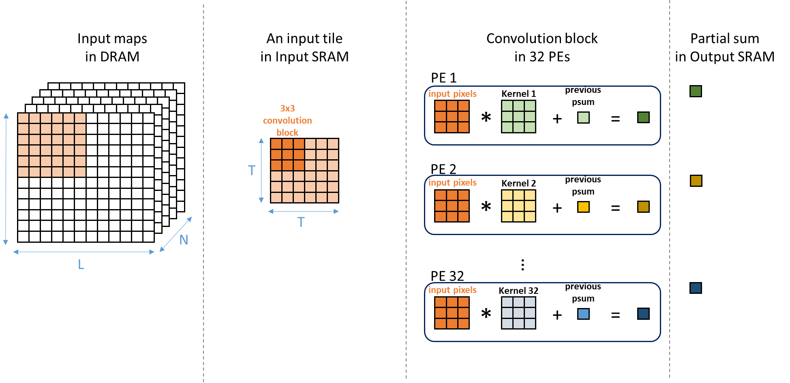
Global view: Per-filter Based Computation In a tile 1/5
3x3 kernel

Slide 28
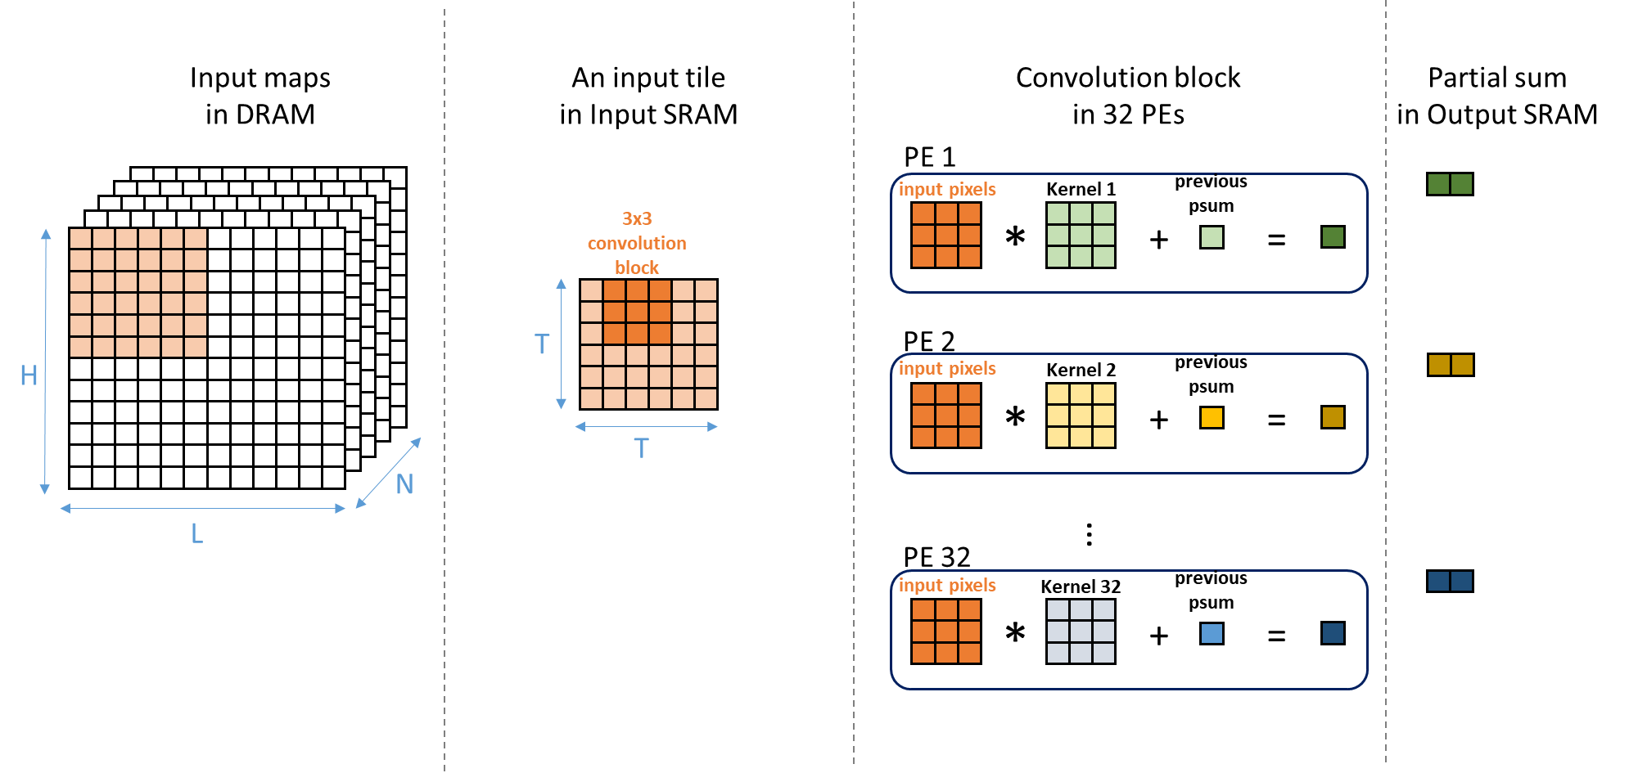
Global view: Per-filter Based Computation in the same tile 2/5
3x3 kernel

Slide 29
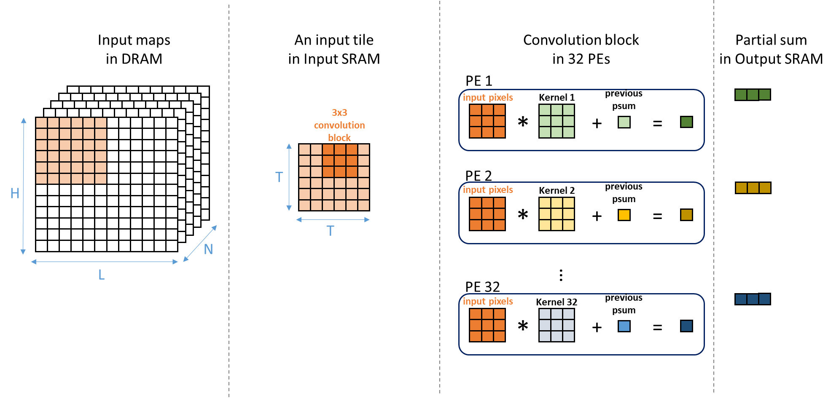
Global view: Per-filter Based Computation in the same tile 3/5
3x3 kernel

Slide 30
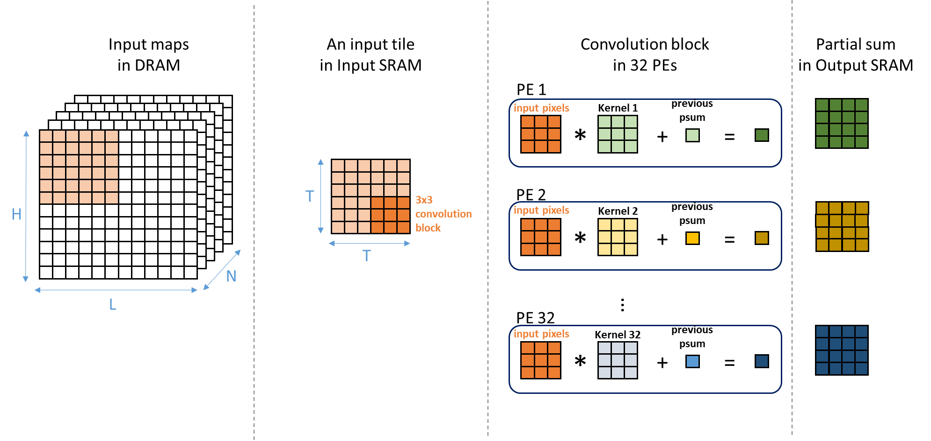
Global view: Per-filter Based Computation in the same tile 4/5
3x3 kernel

Slide 31
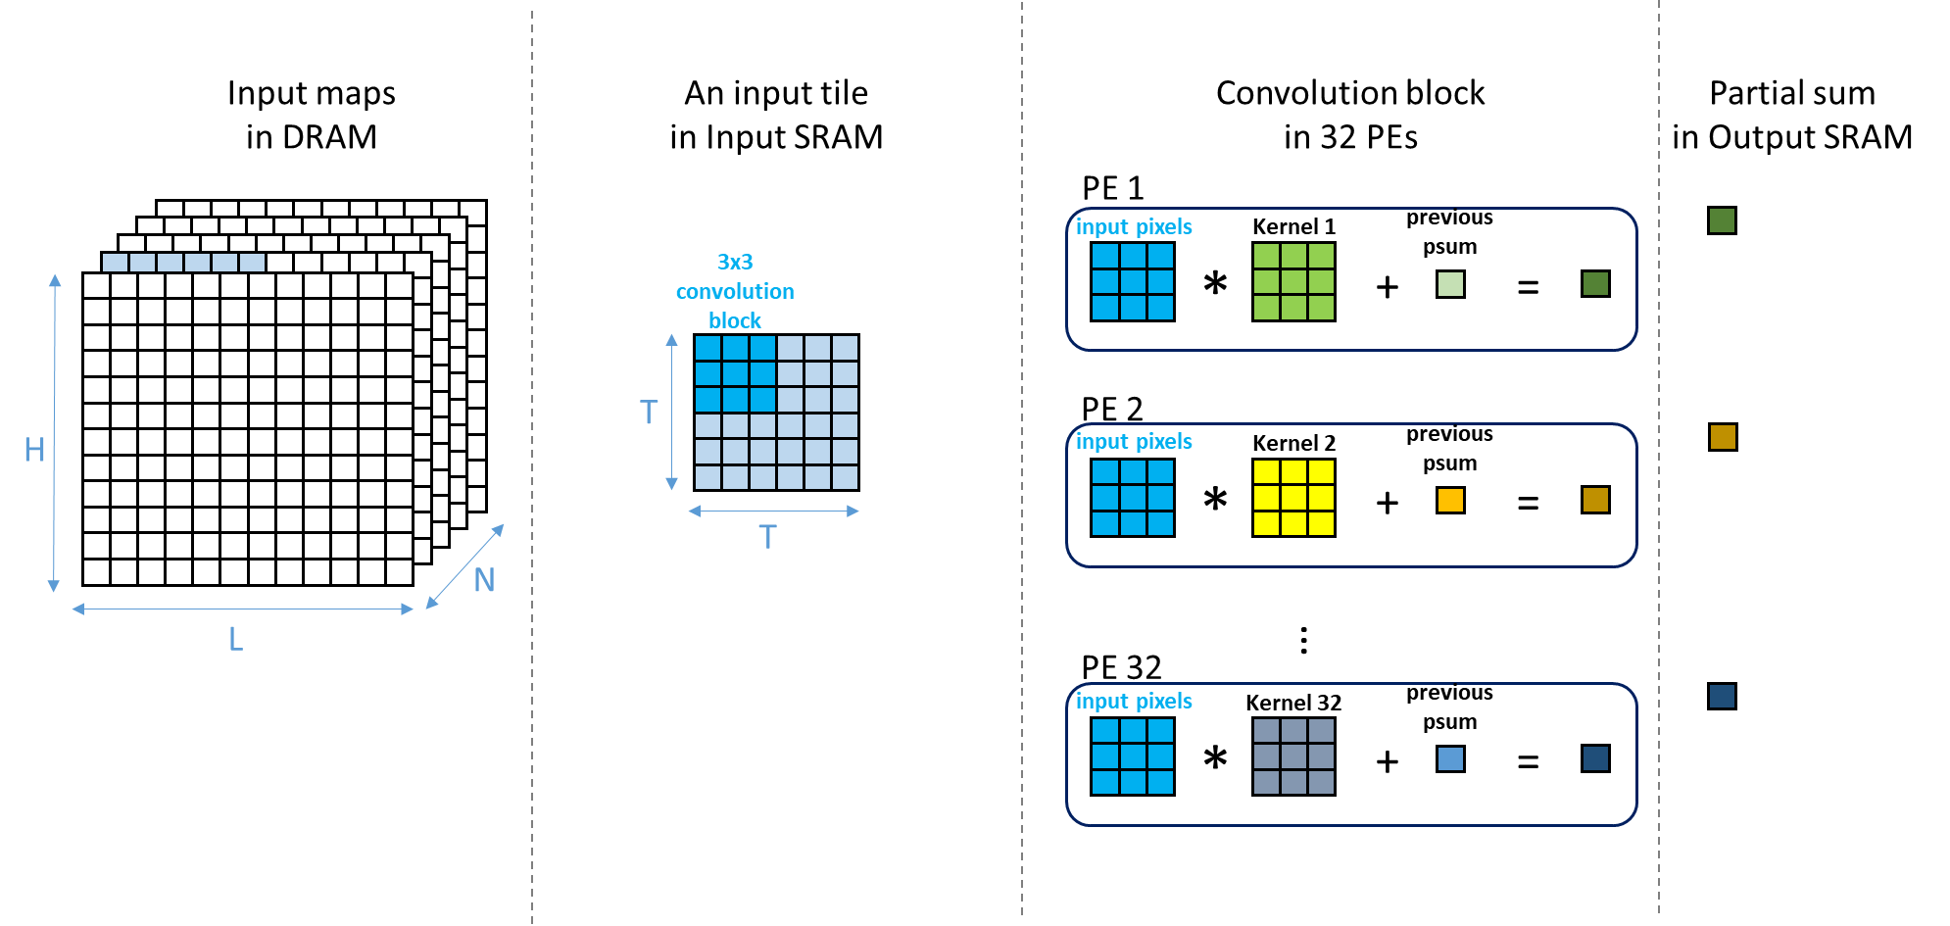
Global view: Per-filter Based Computation change channel 5/5
3x3 kernel
Same input
Change channel kernels

Slide 32
How about oversize or small size kernel ?
>3x3, <3x3
Filters that have size large than 3x3 or less than 3x3?

Slide 33
Kernel View: Oversize Kernel Handling (1/2)
Geometric directly mapping on 3x3 PEs
Example: 5x5 kernels (filters are colored)
Low PE utilization = 25/36 = 69.4%
x
x
x
A 3x3 PE core
x
x
x
x
x
x
5
x
x
x
x
x
x
x
x
x
x
x
x
x
x
x
x
x
x
x
x
x
x
x
x
8 x 4 (32) PE array
x
x
x
x
x
x
x
x
x
x
x
x
x
x
x
x
x
x
x
x
x
x
x
x
5
x
x
x
x
x
x
x
x
x
x
x
x
x
x
x
x
x
x
x
x
x
x
x
x
x
x
x
x
x
x
x
x
x
x
x
x
x
x
x
x
x
x
x
x
x
x
x
x
x
x
x
x
x
x
x
x
x
x
x
x
x
x
x
x
x
x
x
x
x
x
x
x
x
x
x
x
x
x
x
x
x
x
x
x
x
x
x
x
x
x
x
x
x
x
x
x
x
x
x
x
x
x
x
x
x
x
x
x
x
x
x
x
x
x
x
x
x
x
x
x
x
x
x
x
x
x
x
x
x
x
x
x
x
x
x
x
x
x
x
x
x
x
x
x
x
x
x
x
x
x
x
x
x
x
x
x
x
x
x
x
x
x
x
x
x
x
x
x
x
x
x
x
x
x
x
x
x
x
x
x
x
x
x
x
x
x
x
x
x
x
x
x
x
x
x
x
x
x
x
x
x
x
x
x
x
x
x
x
x
x
x
x
x
x
x
x
x
x
x
x
x
x
x
x
x
x
x
x
x
x
x
x
x
x
x
x
x
x
x
x

Slide 34
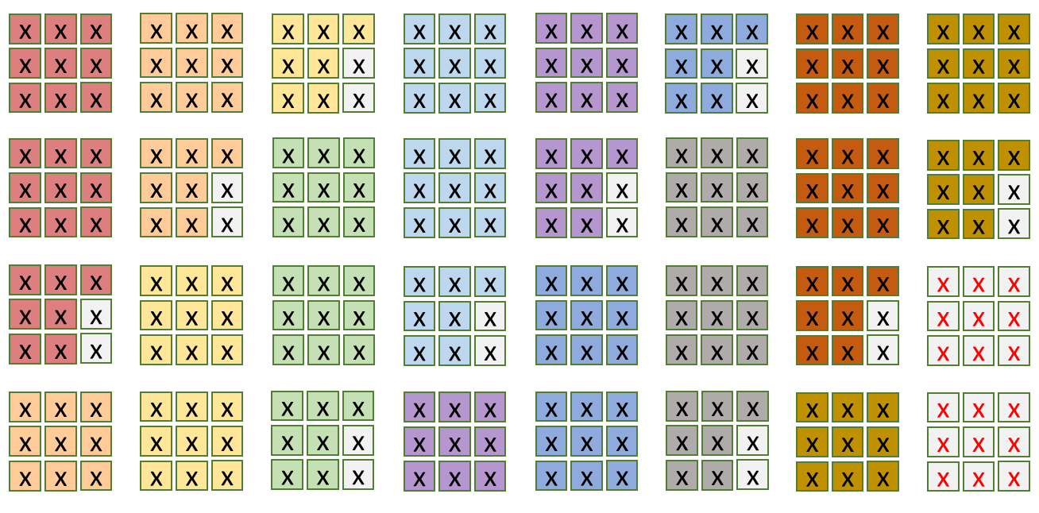
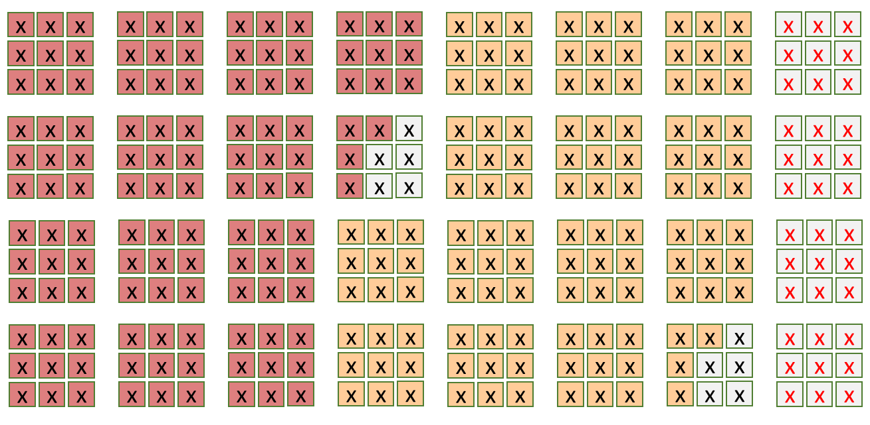
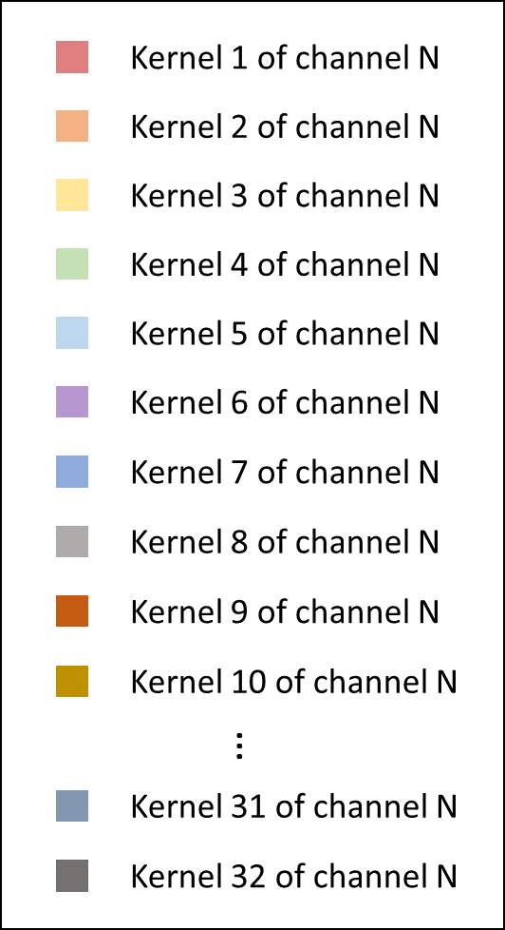
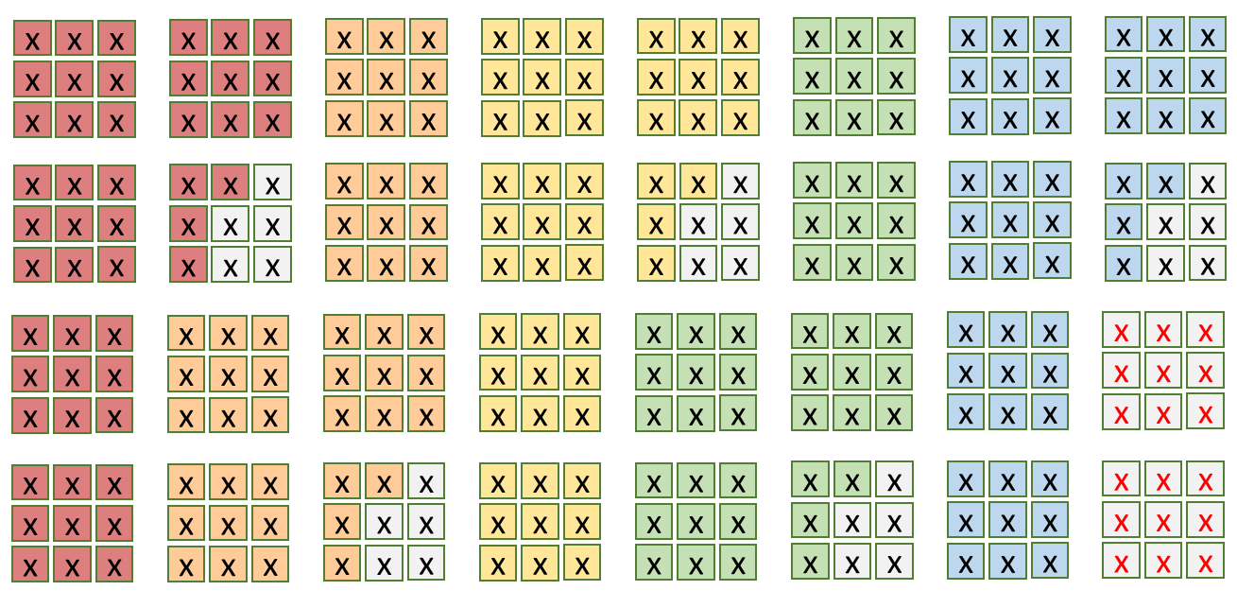
Kernel View: Row-major Order Kernel in Geometric Mapping, on different PEs (2/2)
32 PEs, each 9 MACs
32 PEs
Spatial mapping
5x5
11x11
7x7
Different color
means different kernels
10 kernels at a time
Run from channel 1 to N
for the given kernel. Then
go for another 10 kernels
if any

Slide 35
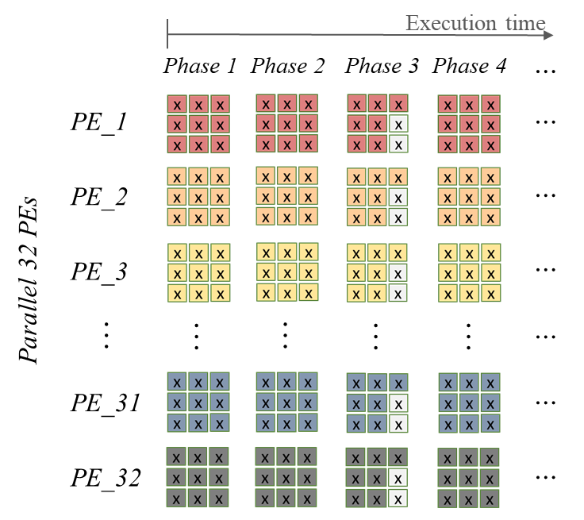
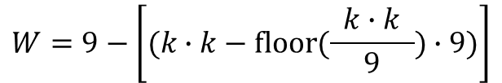

Kernel View: Row-major Order Kernel Mapping on the Same PE for Oversize Kernel (1/2)
P: needed phases for oversize kernel
W: waste multiplier number for oversize kernel
k: kernel size
convolute a 5x5
kernel size
$$P=ceil(\frac{ k∙k }{9})$$
$$W=9−\left[(k∙k−floor(\frac{ k∙k }{9})∙9\text{)}\right]$$
Kernel size | P | W
5 | 3 | 2
7 | 6 | 5
11 | 14 | 5
P
W
Same input broadcast to all PEs.
Suggesting that weights are loaded to PEs of the same row-major order.

Slide 36
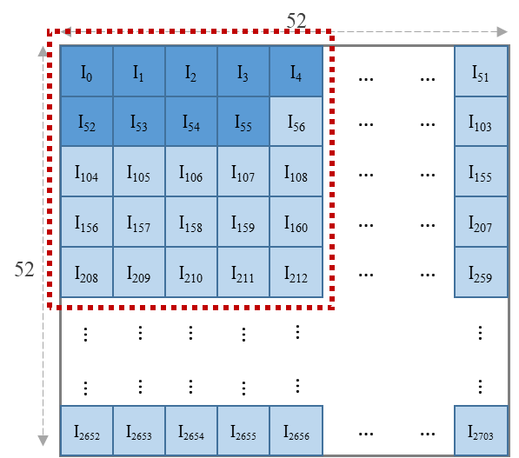
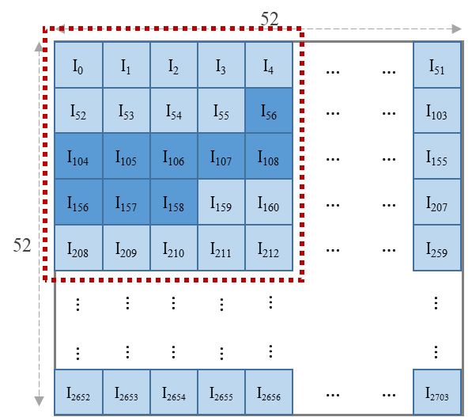
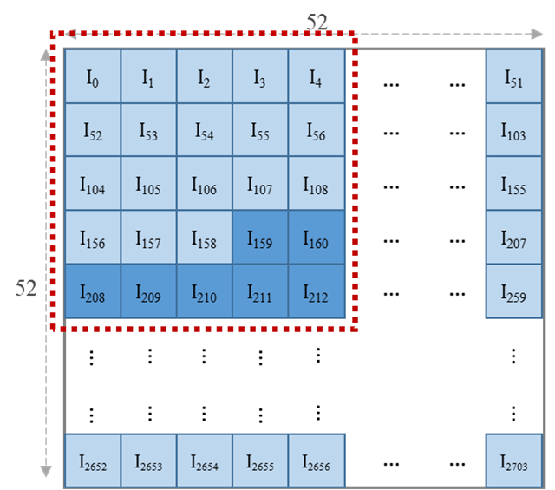
Kernel Row-major Order Mapping on the same 3x3 PE for Oversize Kernel (kernel + input view)
Get 9 tile pixel in row-major ordering of the kernel and send to all 32 PEs.
PE utilization = 25/27
5x5 kernel example: 1st batch
2nd batch
get the part of weights for 2nd batch
3rd batch

Slide 37
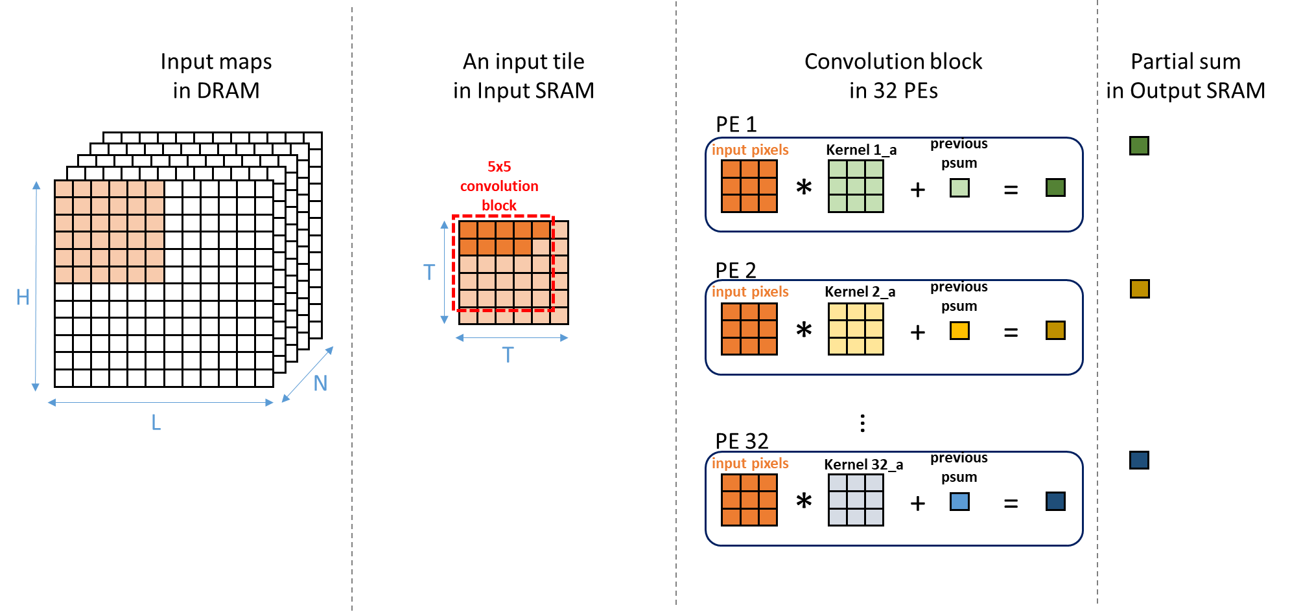
Kernel Row-major Order Mapping on the Same PE for Oversize Kernel in Action (1/6)
Get the first 9 weights for each PE
Input broadcast
to all PEs
A filter on a PE

Slide 38
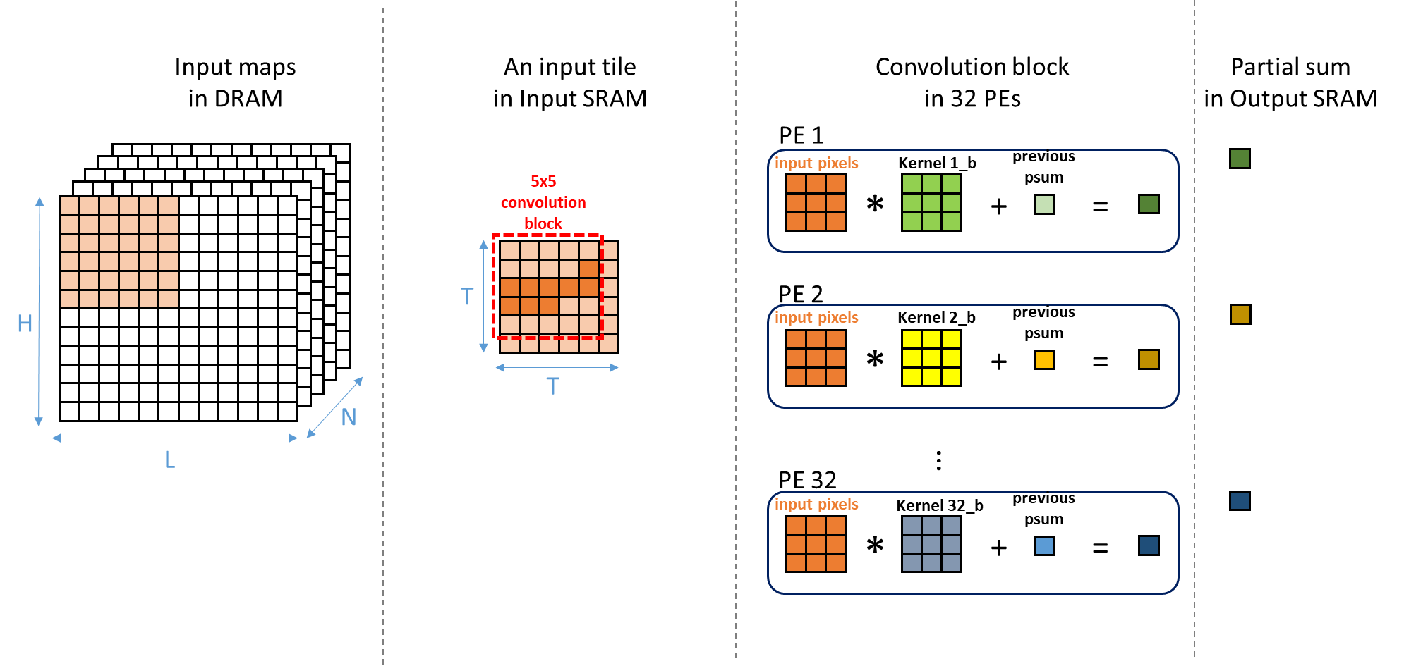
Kernel Row-major Order Mapping on the Same PE for Oversize Kernel in Action (2/6)
Get the next 9 weights for each PE

Slide 39
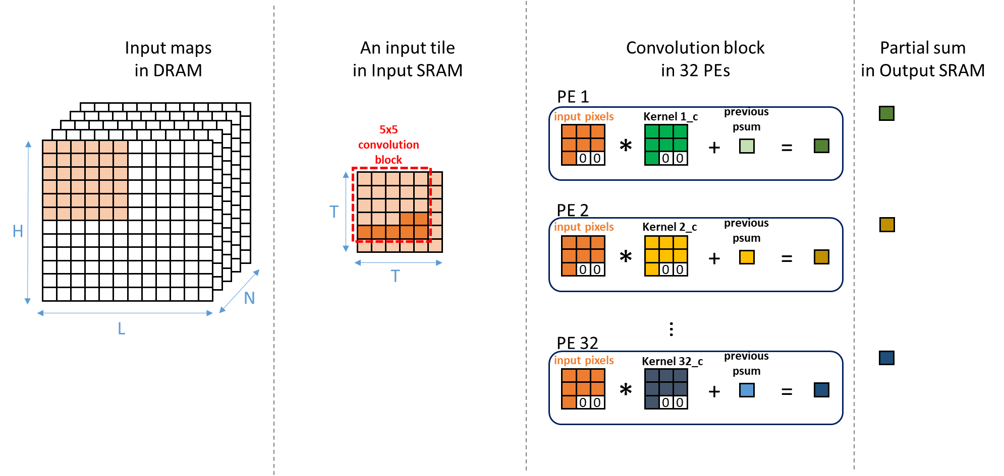
Kernel Row-major Order Mapping on the Same PE for Oversize Kernel in Action (3/6)
Get the last 7 weights for each PE

Slide 40
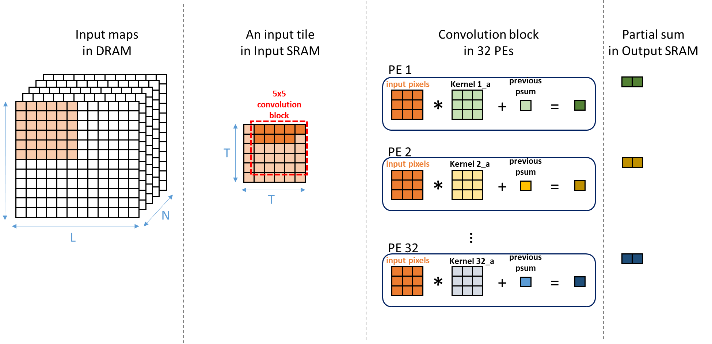
Kernel Row-major Order Mapping on the Same PE for Oversize Kernel (4/6)
Get the first 9 weights for each PE again
Let’s move the
box for 1 pixel
Stride = 1

Slide 41
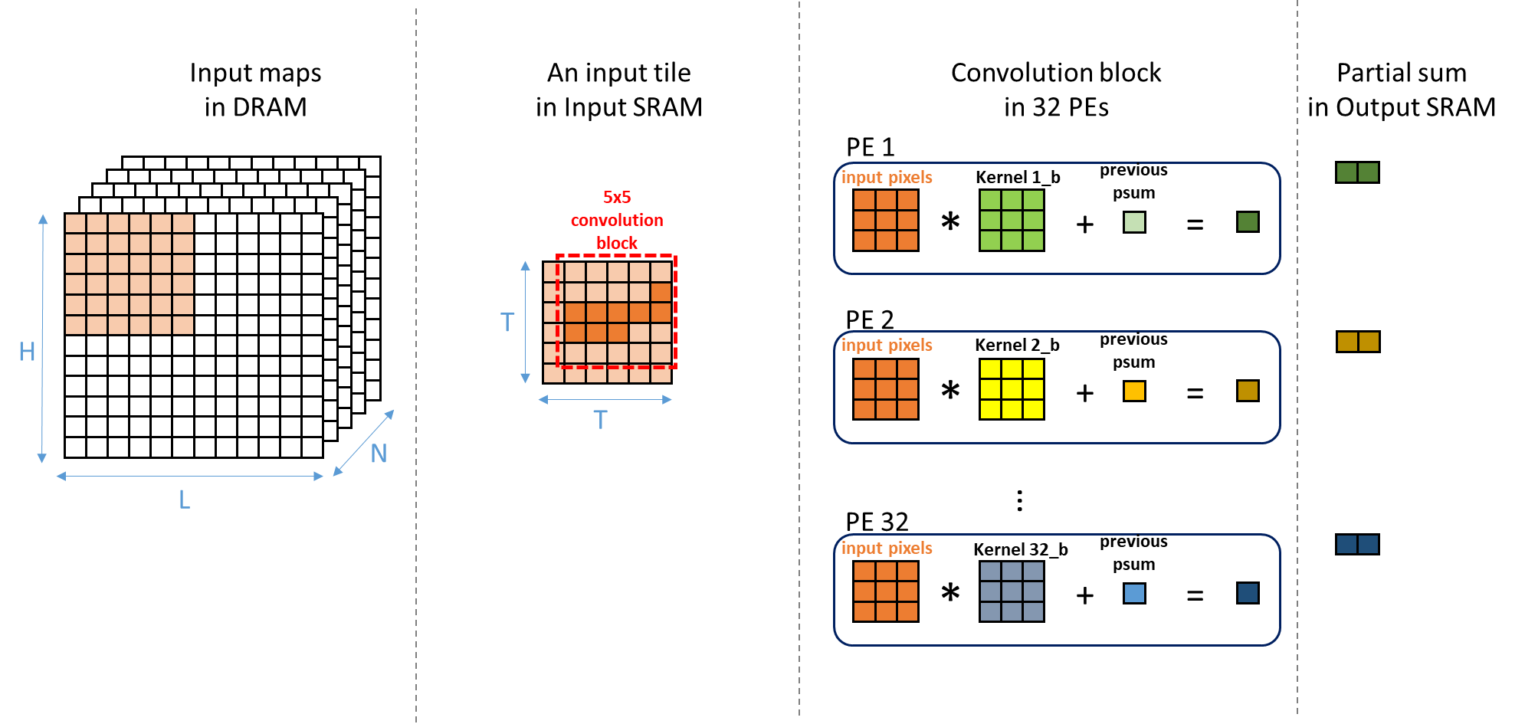
Kernel Row-major Order Mapping on the Same PE for Oversize Kernel (5/6)
Get the next 9 weights for each PE again

Slide 42

Kernel Row-major Order Mapping on the Same PE for Oversize Kernel (6/6)
Get the last 7 weights for each PE again

Slide 43

Kernel Row-major Order Mapping on the Same PE for Oversize Kernel
Observations:
Reload 9 weights when switching to the next batch
Reload weights when striding
Next convolution
B1
B2
B3
B1
B2
B3
5x5:
5x5:
After first batch B1, need to load the next 9 weights for batch B2. This is a read
for weight SRAM.

Slide 44
Optimization: Weight Stationary for Oversize Kernel
Optimization: Group the same batches in all different conv blocks in a tile together
Bi: batch order (or phase order) for an oversize kernel
Striding
A conv. block
B1
B2
B3
B1
B2
B3
B1
B2
B3
Original
=> 3 * 3 = 9 times
B1
B1
B1
B2
B2
B2
B3
B3
B3
Optimized
=> 3 times

Slide 45
Optimization: Weight Stationary for Oversize Kernel
Optimization: Group the same batches in all different conv blocks in a tile together
Advantage:
  1: Address generation for input data becomes easy by using conv. block size as an offset.
  2: Avoid weight thrashing

Slide 46
Data Streaming to PEs
Things to ponder
Previous switching FF scheme good for 3x3 kernel with 3x3 PE
How to make it work for kernel size other than 3x3?
  Configurable PE size that tailors to kernel size? Impact?

Slide 47
How about 1x1 kernels? The PE is 3x3.
YOLOv3-tiny | Model parameter |  |  | Utilization rate of 32 PEs | Utilization rate of 288 multipliers
 | Input map | Kernel size | Output map
conv1 | 416 x 416 x 3 | 3 | 416 x 416 x 16 | 50 % | 50 %
conv2 | 208 x 208 x 16 | 3 | 208 x 208 x 32 | 100 % | 100 %
conv3 | 104 x 104 x 32 | 3 | 104 x 104 x 64 | 100 % | 100 %
conv4 | 52 x 52 x 64 | 3 | 52 x 52 x 128 | 100 % | 100 %
conv5 | 26 x 26 x 128 | 3 | 26 x 26 x 256 | 100 % | 100 %
conv6 | 13 x 13 x 256 | 3 | 13 x 13 x 512 | 100 % | 100 %
conv7 | 13 x 13 x 512 | 3 | 13 x 13 x 1024 | 100 % | 100 %
conv8 | 13 x 13 x 1024 | 1 | 13 x 13 x 256 | 100 % | 11.11 %
conv9 | 13 x 13 x 256 | 3 | 13 x 13 x 512 | 100 % | 100 %
conv10 | 13 x 13 x 512 | 1 | 13 x 13 x 255 | 99.6 % | 11.07 %
conv11 | 13 x 13 x 256 | 1 | 13 x 13 x 128 | 100 % | 11.11 %
conv12 | 26 x 26 x 384 | 3 | 26 x 26 x 256 | 100 % | 100 %
conv13 | 26 x 26 x 256 | 1 | 26 x 26 x 255 | 99.6 % | 11.07 %
99.09 % | 68.8 %

Slide 48
Optimization for 1x1 Kernel Size
When input map size is smaller than 52x52 (input tile size) and kernel size is 1x1, transfer more then 1 input map of different input channels to Input SRAM. The convolution of these input maps in the input SRAM would be executed at the same time. Assume Input SRAM size = tile size.
Example
YOLOv3-tiny | Input map | Kernel size | Max input map # that Input SRAM can store | Input map # stored in Input SRAM
conv8 | 13x13 | 1 | 16 | 9
conv10 | 13x13 | 1 | 16 | 9
conv11 | 13x13 | 1 | 16 | 9
conv13 | 26x26 | 1 | 4 | 4
Limited by:
each PE has
9 MACs.
52x52 /(13x13) = 16 ( of different channels)

Slide 49
Optimization for 1x1 Kernel Size (1/4)
Get at max 9 channels of
kernel 1
Input maps
in DRAM
IR input maps
in Input SRAM
Partial sum
in Output SRAM
PE 1
input pixels
Kernel 1
previous
psum
*
+
=
PE 2
input pixels
Kernel 2
previous
psum
H
N
H
*
+
=
IR
(max=9)
…
L
L
H x L is the dimension
of input map, e.g., 13x13
Less than tile size
PE 32
input pixels
Kernel 32
previous
psum
*
+
=

Slide 50
Optimization for 1x1 Kernel Size (2/4)
Move for Stride = 1
Weight stationary
Input maps
in DRAM
IR input maps
in Input SRAM
Partial sum
in Output SRAM
PE 1
input pixels
Kernel 1
previous
psum
*
+
=
PE 2
input pixels
Kernel 2
previous
psum
H
N
H
*
+
=
IR
(max=9)
L
L
…
PE 32
input pixels
Kernel 32
previous
psum
*
+
=

Slide 51
Optimization for 1x1 Kernel Size (3/4)
End of H x L convolutions
Input maps
in DRAM
IR input maps
in Input SRAM
Partial sum
in Output SRAM
PE 1
input pixels
Kernel 1
previous
psum
*
+
=
PE 2
input pixels
Kernel 2
previous
psum
H
N
H
*
+
=
IR
(max=9)
L
L
…
PE 32
input pixels
Kernel 32
previous
psum
*
+
=

Slide 52
Optimization for 1x1 Kernel Size (4/4)
The rest of channels
Load channel weights
Input maps
in DRAM
IR input maps
in Input SRAM
Partial sum
in Output SRAM
PE 1
input pixels
Kernel 1
previous
psum
0
0
*
0
0
+
=
0
0
0
0
0
0
PE 2
input pixels
Kernel 2
previous
psum
H
N
H
*
+
=
0
0
0
0
0
IR
0
0
0
0
0
L
L
…
PE 32
input pixels
Kernel 32
previous
psum
0
0
*
0
0
+
=
0
0
0
0
0
0

Slide 53


Input SRAM Example:
Line Buffer Design
Pros
  Can get all data in a cycle
Cons
  Power consumption, datapath,
  Mux tree delay
Notes:
Register File 2.704KB左右

Slide 54
PEs’ utilization rate of YOLOv3-tiny
YOLOv3-tiny | Model parameter |  |  | Utilization rate of 32 PEs | Utilization rate of 288 multipliers | 2D PE- Utilization rate of 32x32 PEs
 | Input map | Kernel size | Output map
conv1 | 416 x 416 x 3 | 3 | 416 x 416 x 16 | 50 % | 50 % | 49.992 %
conv2 | 208 x 208 x 16 | 3 | 208 x 208 x 32 | 100 % | 100 % | 99.968 %
conv3 | 104 x 104 x 32 | 3 | 104 x 104 x 64 | 100 % | 100 % | 99.935 %
conv4 | 52 x 52 x 64 | 3 | 52 x 52 x 128 | 100 % | 100 % | 99.871 %
conv5 | 26 x 26 x 128 | 3 | 26 x 26 x 256 | 100 % | 100 % | 99.742 %
conv6 | 13 x 13 x 256 | 3 | 13 x 13 x 512 | 100 % | 100 % | 99.485 %
conv7 | 13 x 13 x 512 | 3 | 13 x 13 x 1024 | 100 % | 100 % | 99.742 %
conv8 | 13 x 13 x 1024 | 1 | 13 x 13 x 256 | 100 % | 11.11 % → 99.81 % | 98.848 %
conv9 | 13 x 13 x 256 | 3 | 13 x 13 x 512 | 100 % | 100 % | 99.485 %
conv10 | 13 x 13 x 512 | 1 | 13 x 13 x 255 | 99.6 % | 11.07 % → 99.41 % | 97.722 %
conv11 | 13 x 13 x 256 | 1 | 13 x 13 x 128 | 100 % | 11.11 % → 98.08 % | 95.545 %
conv12 | 26 x 26 x 384 | 3 | 26 x 26 x 256 | 100 % | 100 % | 99.914 %
conv13 | 26 x 26 x 256 | 1 | 26 x 26 x 255 | 99.6 % | 11.07 % → 44.27 % | 98.848 %
99.09 % | 91.66 % | 95.952 %

Slide 55
PEs’ utilization rate of VGG16
VGG16 | Model parameter |  |  | Utilization rate of 32 PEs | Utilization rate of 288 multipliers | 2D PE- Utilization rate of 32x32 PEs | Eyeriss Num. of active PEs
 | Input map | Kernel size | Output map
conv1 | 224 x 224 x 3 | 3 | 224 x 224 x 64 | 100 % | 100 % | 86.182 % | 156 (93%)
conv2 | 224 x 224 x 64 | 3 | 224 x 224 x 64 | 100 % | 100 % | 99.995 % | 156 (93%)
conv3 | 112 x 112 x 64 | 3 | 112 x 112 x 128 | 100 % | 100 % | 99.992 % | 156 (93%)
conv4 | 112 x 112 x 128 | 3 | 112 x 112 x 128 | 100 % | 100 % | 99.996 % | 156 (93%)
conv5 | 56 x 56 x 128 | 3 | 56 x 56 x 256 | 100 % | 100 % | 99.990 % | 156 (93%)
conv6 | 56 x 56 x 256 | 3 | 56 x 56 x 256 | 100 % | 100 % | 99.995 % | 156 (93%)
conv7 | 56 x 56 x 256 | 3 | 56 x 56 x 256 | 100 % | 100 % | 99.995 % | 156 (93%)
conv8 | 28 x 28 x 256 | 3 | 28 x 28 x 512 | 100 % | 100 % | 99.990 % | 168 (100%)
conv9 | 28 x 28 x 512 | 3 | 28 x 28 x 512 | 100 % | 100 % | 99.995 % | 168 (100%)
conv10 | 28 x 28 x 512 | 3 | 28 x 28 x 512 | 100 % | 100 % | 99.995 % | 168 (100%)
conv11 | 14 x 14 x 512 | 3 | 14 x 14 x 512 | 100 % | 100 % | 99.982 % | 168 (100%)
conv12 | 14 x 14 x 512 | 3 | 14 x 14 x 512 | 100 % | 100 % | 99.982 % | 168 (100%)
conv13 | 14 x 14 x 512 | 3 | 14 x 14 x 512 | 100 % | 100 % | 99.982 % | 168 (100%)
100 % | 100 % | 98.928 % | 96.23 %

Slide 56
PEs’ utilization rate of AlexNet
AlexNet | Model parameter |  |  | Utilization rate of 32 PEs | Utilization rate of 288 multipliers | 2D PE- Utilization rate of 32x32 PEs | Eyeriss Num. of active PEs
 | Input map | Kernel size | Output map
conv1 | 227 x 227 x 3 | 11 | 55 x 55 x 96 | 100 % | 96.03 % | 70.542 % | 154 (92%)
conv2 | 31 x 31 x 48 | 5 | 27 x 27 x 256 | 100 % | 92.6 % | 99.957 % | 135 (80%)
conv3 | 15 x 15 x 256 | 3 | 13 x 13 x 384 | 100 % | 100 % | 99.943 % | 156 (93%)
conv4 | 15 x 15 x 192 | 3 | 13 x 13 x 384 | 100 % | 100 % | 99.924 % | 156 (93%)
conv5 | 15 x 15 x 192 | 3 | 13 x 13 x 256 | 100 % | 100 % | 99.886 % | 156 (93%)
100 % | 97.726 % | 94.050 % | 90.2 %

Slide 57

Convolution, Bias Addition, and ReLU PE Core
Convolution, bias ,and ReLU in PE

Slide 58


Advanced DL Accelerator Version
1D PE Array Accelerator
  2021 US Provisional patent application (processing)
    Methods and Devices of Deep Learning and Inference Acceleration
  Micro-architecture
    Accelerator and PE micro-architecture
    Floating point data type (V1)
    Int-8-16-8 data type (V2)
  IPW data reuse scheme
    IPW reuses the Input feature map, Partial sum, and Weight to maximize the performance and efficiency.
  Computational data flow integration
    Conv, DW Conv, Activation, Pooling, FC, Re-quantization (output 8 bits) in PE (V2)
  Different kernel size mapping
  Data placement strategy for different input map size
  1x1 kernel optimization
64x64 tile

Slide 59
Memory System
Data fetcher and data placement is as critical as the MAC PE micro-architecture
Memory bandwidth requirement
  In an SoC system, accelerator may not get the use of the DRAM memory right away.
Use DMA operation scheduling to hide the DRAM memory access latency
Arbiter
Memory
bus
DMA controller
Intelligent fetcher
DRAM
Accelerator
SRAM

Slide 60

Kneron Example:
Larger kernel, geometric directly mapping on 3x3 PEs

Slide 61

Kneron Patent
x
x
x
x
x
x
x
x
x
x
x
x
x
x
x
x
x
x
x
x
x
x
x
x
x
x
x
x
x
x
x
x
x
x
x
x
x
x
x
x
x
x
x
x
x
x
x
x
x
x
x
x
x
x
x
x
x
x
x
x
x
x
x
x
x
x
x
x
x
x
x
x
x
x
x
x
x
x
x
x
x
x
x
x
x
x
x
x
x
x
x
x
x
x
x
x
x
x
x
x
x
x
x
x
x
x
x
x
x
x
x
x
x
x
x
x
x
x
x
x
x
x
x
x
x
x
x
x
x
x
x
x
x
x
x
x
x
x
x
x
x
x
x
x
x
x
x
x
x
x
x
x
x
x
x
x
x
x
x
x
x
x
x
x
x
x
x
x
x
x
x
x
x
x
x
x
x
x
x
x
x
x
x
x
x
x
x
x
x
x
x
x
x
x
x
x
x
x
x
x
x
x
x
x
x
x
x
x
x
x
x
x
x
x
x
x
x
x
x
x
x
x
x
x
x
x
x
x
x
x
x
x
x
x
x
x
x
x
x
x
x
x
x
x
x
x
x
x
x
x
x
x
x
x
x
x
x
x
x
x
x
x
x
x
x
x
x
x
x
x
x
x
x
x
x
x
x
x
x
x
x
x
x
x
x
x
x
x

Slide 62

Thank You
Machine Learning
Hello!! R2-D2

