Slide 1
Lecture 2 Case study : 1D-PE Design for Convolution Layer work from T-C Wu
Chung-Ho Chen
NCKU EE

Slide 2
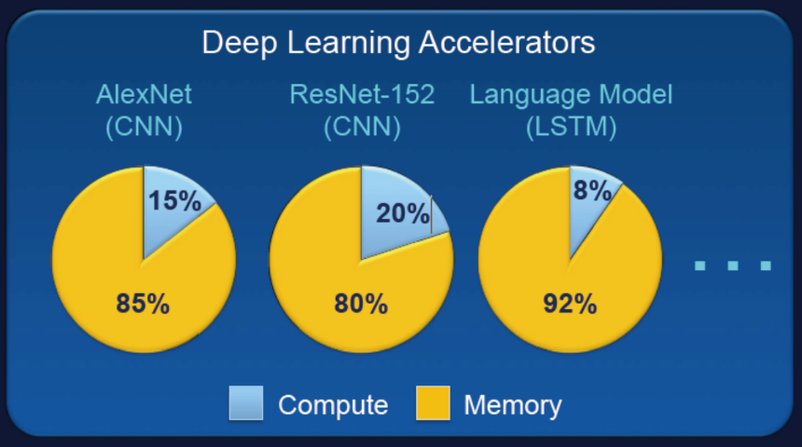
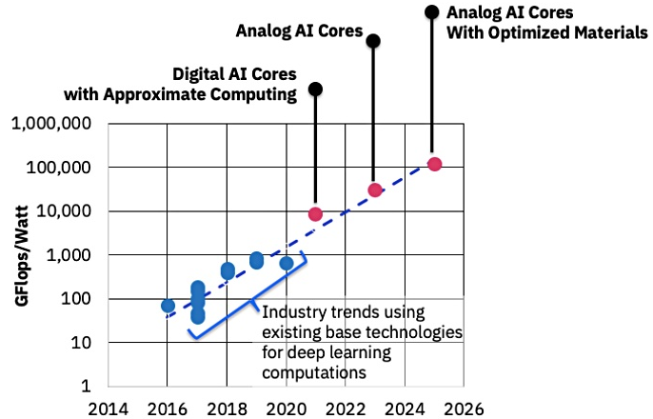
Deep Learning Accelerators
Intensive Memory Access and Computation
S. Mitra/Standford
Abundant-Data Computing
https://beyondcmos.ornl.gov/documents/Panel_Session-Mitra.pdf
AI accelerator
development challenges
Intelligent data fetcher
Data reuse strategies in MAC (Multiply-Accumulate) PE arrays
Quantization scheme in MAC
Advanced in-memory computing analog PE
Design and simulation platform
Source: https://blocksandfiles.com/2019/02/11/ibms-ai-chips-change-phase/

Slide 3
Putting into Perspective
DRAM/SRAM
Physical
Data
Physical
Data
Weight (Digital)
Weight (Digital)
Input (Digital)
Input (Analog)
Interface
Interface
Digital, Analog MAC
Analog MAC
ADC
Weight (Analog)
Weight (Analog)
Input (Digital)
Input (Analog)
Inter-
face
Analog MAC
Analog MAC
Analog signal
Digital code
Flash/RRAM

Slide 4
AI Accelerator Design/Simulation Framework
Memory technologies
SRAM
Flash
Non-volatiles
DRAM
Deep Learning
System-Level Analysis
DL applications
Yolov3,
GAN…..
Architecture Exploration
Input type (A or D), data reuse, execution time, energy
Implementation
RTL, FPGA, Silicon

Slide 5
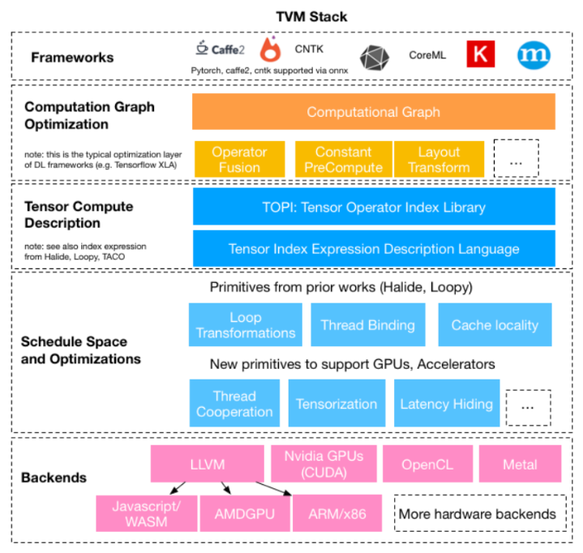
TVM: An Automated End-to-End Optimizing Compiler for Deep Learning
University of Washington- CSE
Graph optimization
operator fusion, constant precompute, layout transform
Tensor Compute Description: tensor compute library,
tensor index expression (description language for
scheduling and optimization)
TVM Tuning
VTA as example -> Qbit DLA
LLVM intrinsic support for NNP instruction
Define intrinsic function for convolution, for instance, in LLVM, so that it can generate the assembly code for NNP.
to go with RISC-V or ARM
DLA

Slide 6
DL Graph Compiler for AI ASIC
C Code Based Compiler
Given the interface spec or API of DMA and DL NNP
Read DL optimizer IR, or DL model config./weight, generate the sequence control C code
Use C compiler of the target CPU
Assembly Code Based
LLVM intrinsic functions for the target CPU
Adding the instructions for DMA and NNP
LLVM compiler for the target CPU

Slide 7
Neural-Net Processor (NNP) Code Generation
Operators in AI graph are executed in either the RISC-v (or ARM) processor or the NNP
Define instructions for NNP operators.
Define operation granularity for NNP instructions
Large (Convolution)
Small (MAC), should be an enhanced version of RISC-V or ARM’s MAC

Slide 8
Revisit Convolution Operation
N: # of channels for input map as well as kernel
M: # of filters or kernels, K: size of a filter, which keeps weights
The number of output channels is the number of filters used.
Partial sum of channel i, PSi: conv of channel i (the i^{th} input map * the i^{th} channel of a filter)
Total sum$=\sum_{i=1}^{N}{PSi}$, where N is the number of channels
Total sum
N: # of channels
…
…
*
K
=
K
M: # of filters
H
I
N
…
N channels
M
…
L
J
Input Size = H*L*N
Kernel Size = K*K*N*M
Output Size = I*J*M

Slide 9
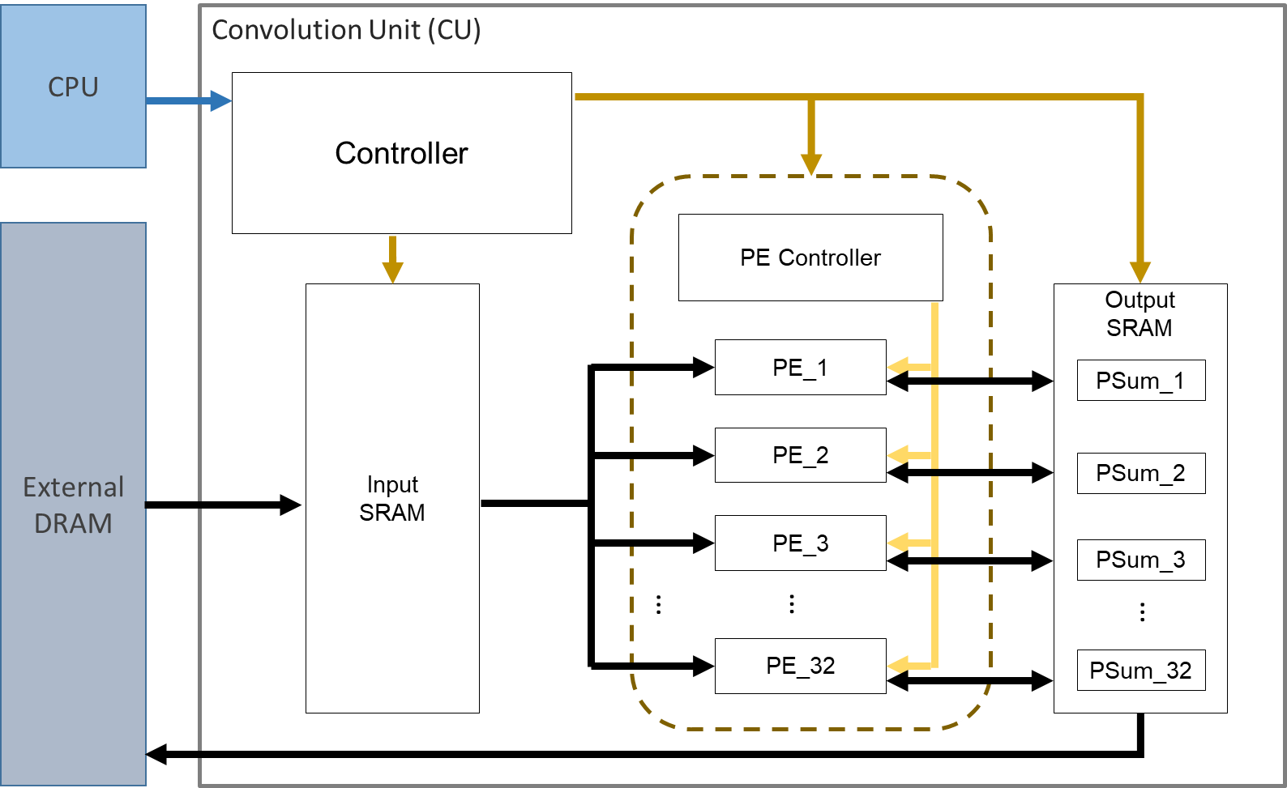
A Convolution Unit; things to ponder
PE structure (fixed MACs or not)
Determine how many MACs in a PE
Single PE array structure (parallelism)
Multiple PE arrays (scalable performance)
More importantly,
how to reuse data
how to operate on various size of kernels
how to effectively use the PEs
Hardwired or software (CPU) controller
So that runtime can call,
or APIs that a code generator can use
and hence produce the runtime library

Slide 10
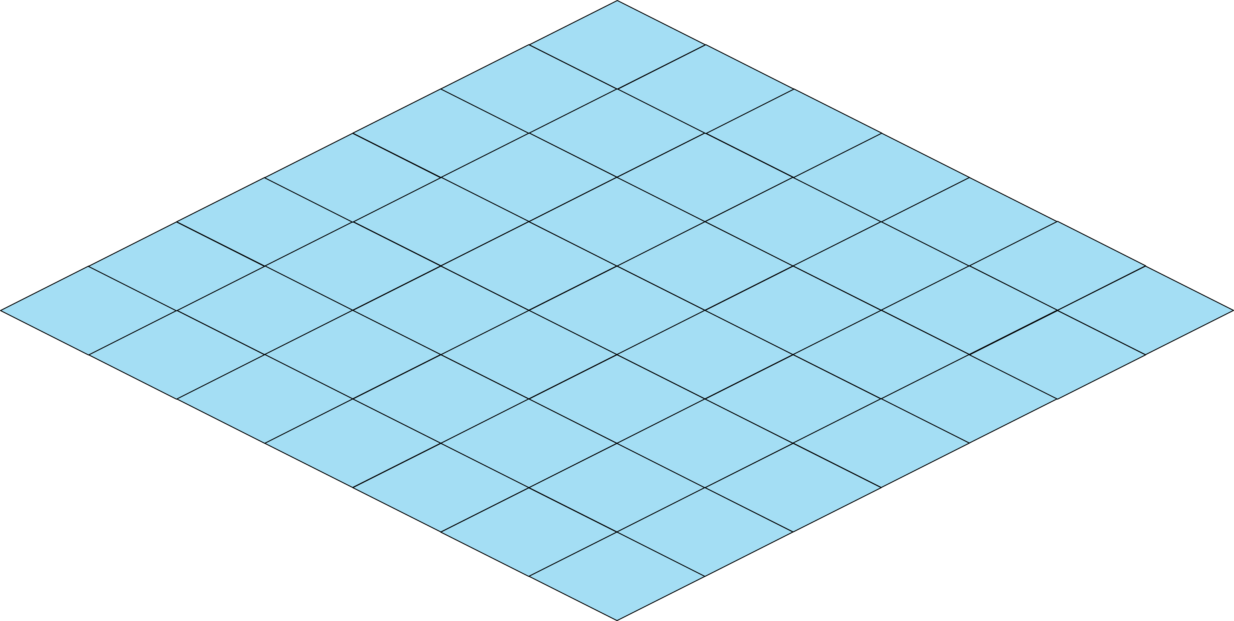
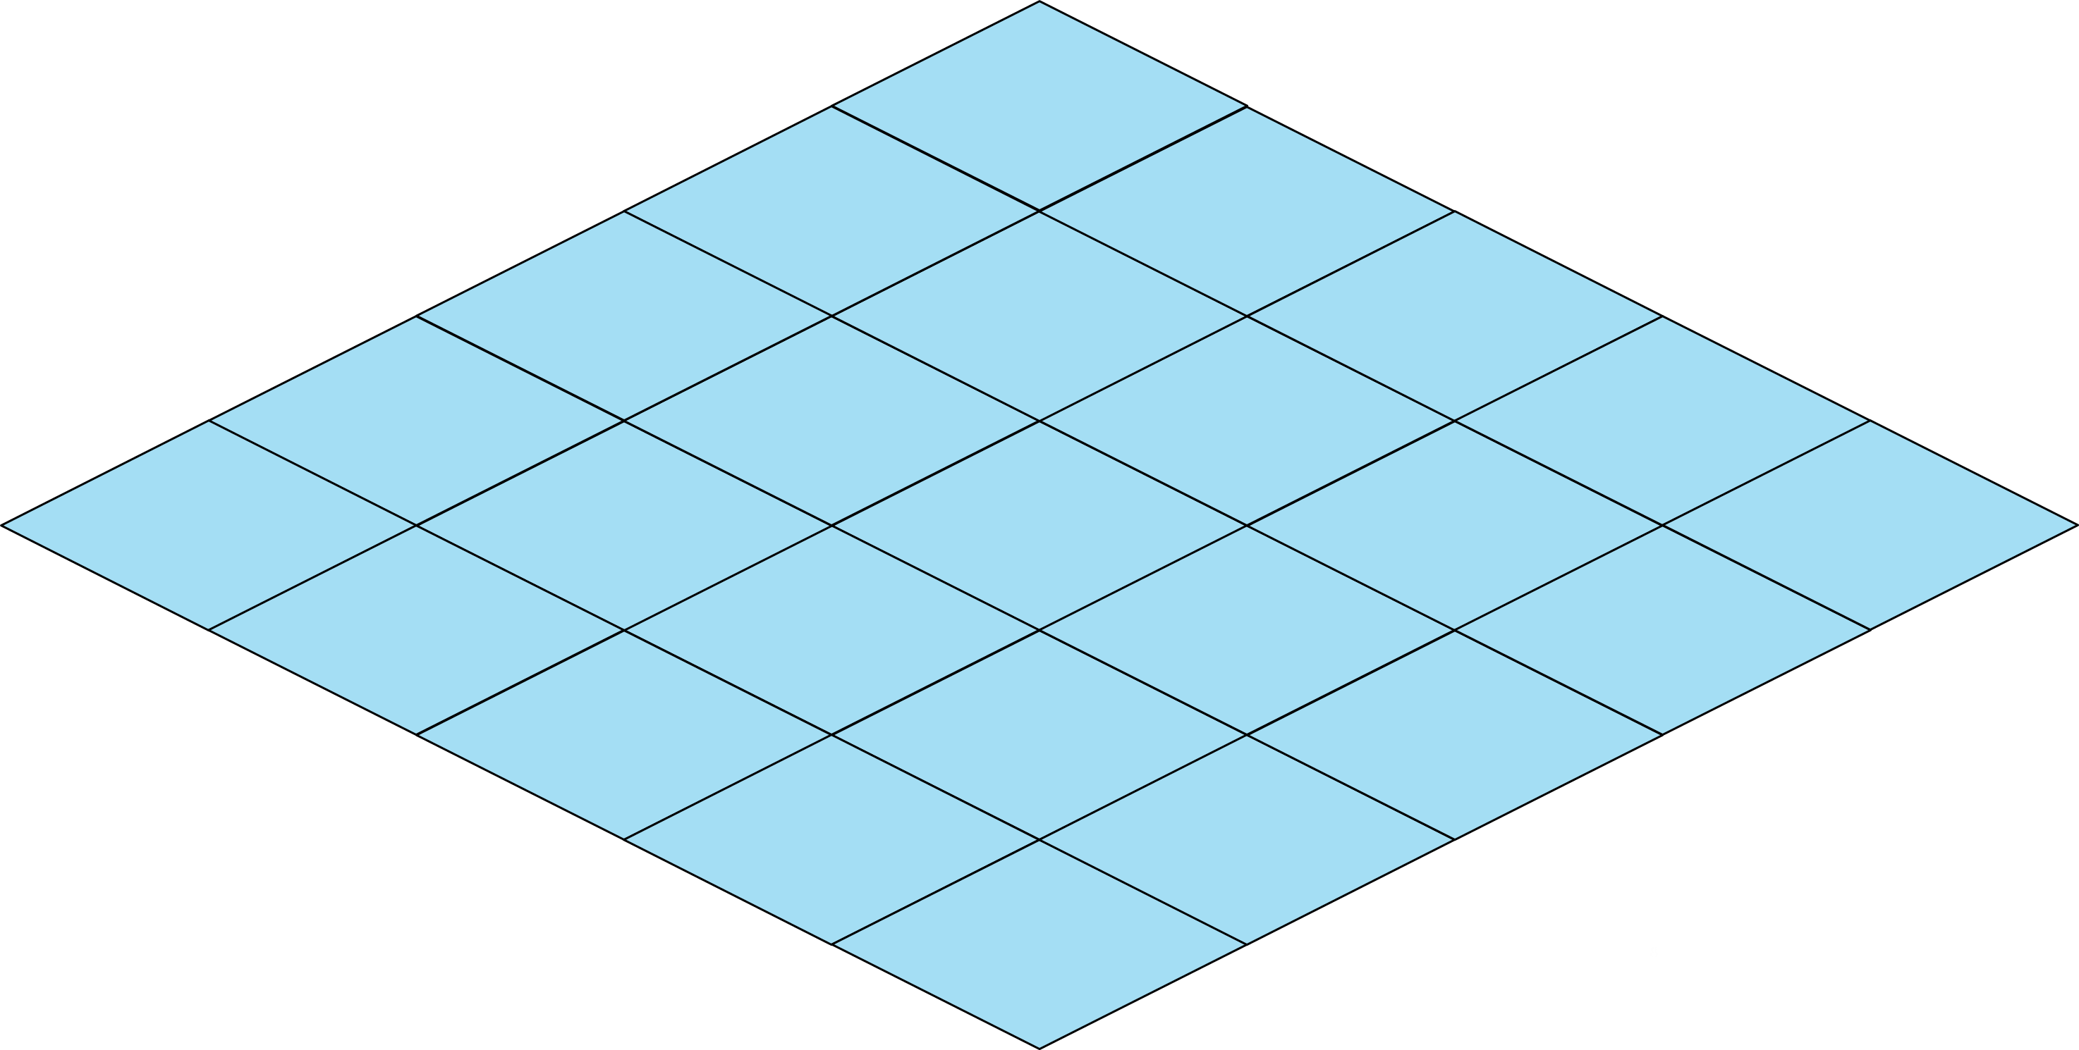
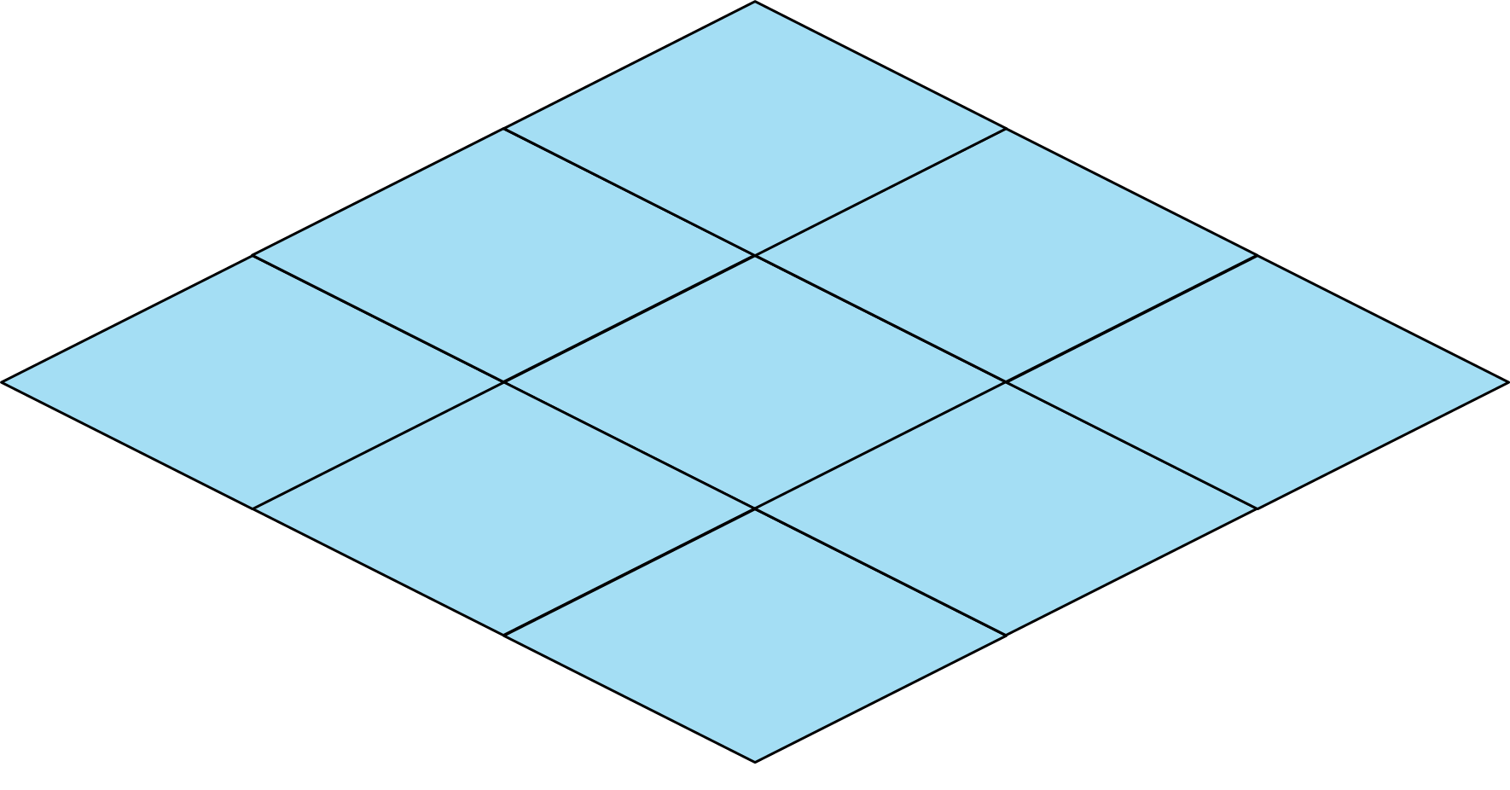
Data Reuse
3 Partial sums from 3 filters
3 channels, 3 filters of their channel 1
Input Reuse (Input stationary)
Load input data only once.
Load all filters of the same channels at the same time.
Need storing all partial sums for all filters.
Output Reuse (Output stationary)
One filter (of its all channels) at a time.
Weight Reuse (Weight stationary)
Weight are loaded only once, and stored in the Weight SRAM.
Layer Reuse
The input and output of the two adjacent layers are the same.
Only the first input and the last output need to transmission with the external memory.
May need a huge internal memory space.
1
Input Reuse
Output Reuse
filter 1 of all its channels
Weight
Partial Sum
Input
Weight
Partial Sum
Input
Output
1
Output
Ch1
Ch1
Ch2
2
Ch2
Ch3
Ch3
3
Weight Reuse
Layer Reuse
Input
Weight
Partial Sum
Output
Layer 1
DRAM
Layer 2
Layer 3
Layer 4
DRAM

Slide 11
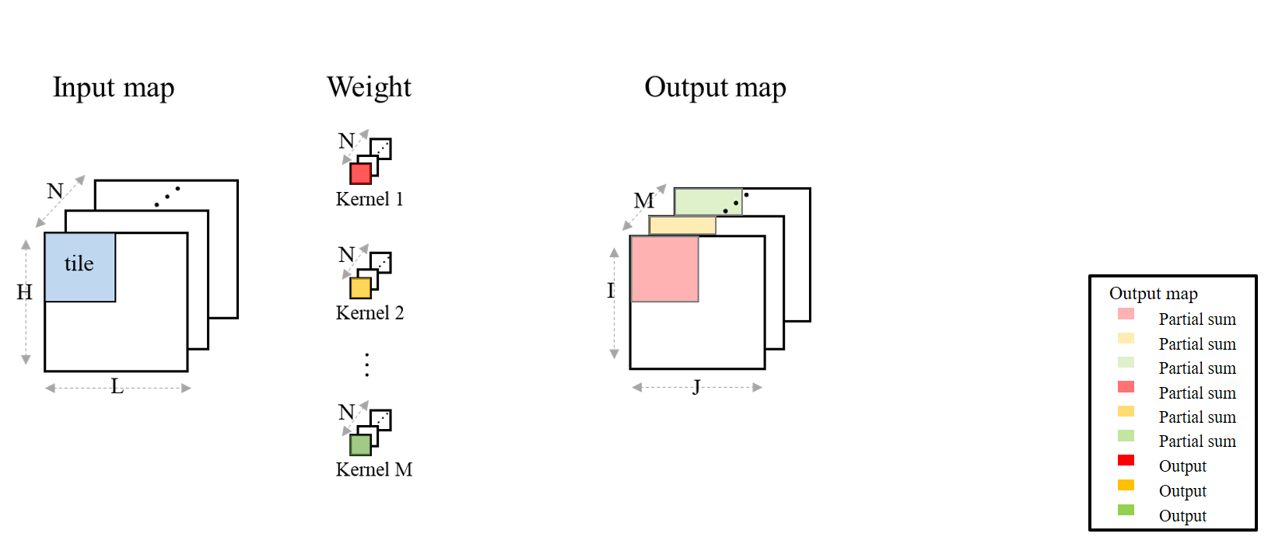
Tile Reuse: Operation from Tile View
Tile reuse: An input map is divided into Tiles.
Tile Reuse: A tile is brought in from DRAM and stays stationary.
To do this, M copies of weights of the same channel are made ready. Weights are stationary for the same input tile. (what if M < = # of PEs?)
How to allocate convolution task to PEs?

Slide 12
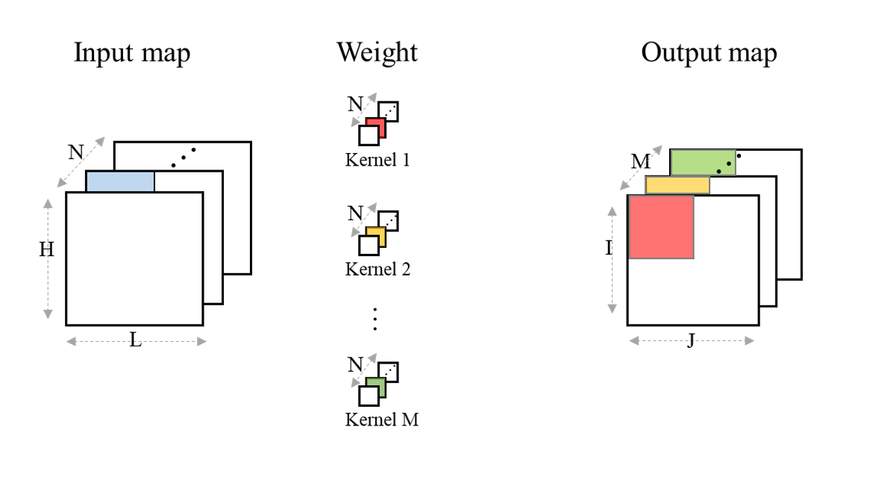
Tile Reuse : Next tile
Order of tile processing: Same tile position of the next channel
Load new weights for the corresponding channel
For this channel, we can accumulate partial sum from the previous channel
M (number of filters) copies of the partial sum are produced
Partial sum of ch1 + ch2

Slide 13
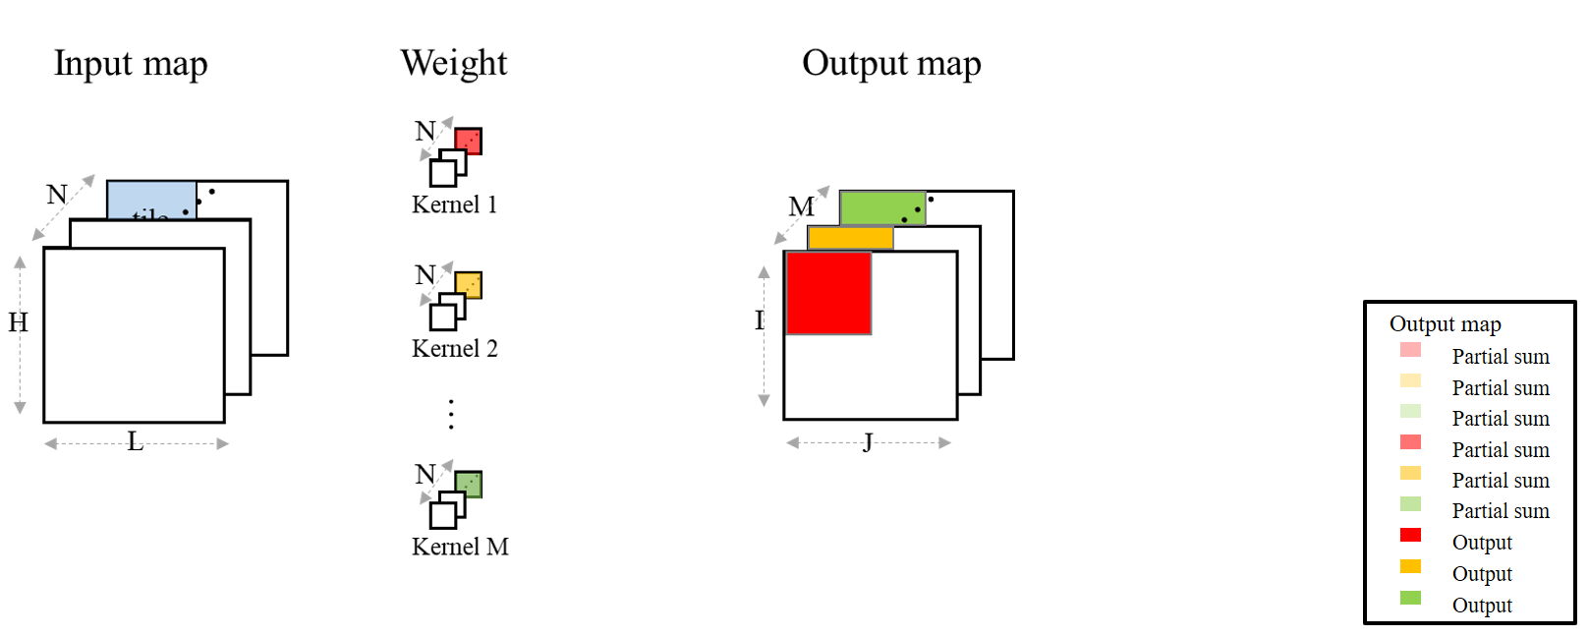
Tile view: Last tile of the last channel
At the end of last tile of the last channel: accumulate the total SUM for output
for that tile.
M output maps

Slide 14
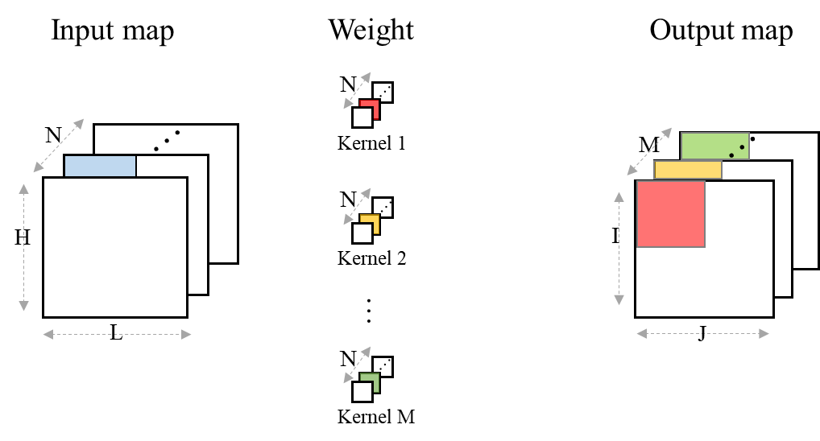
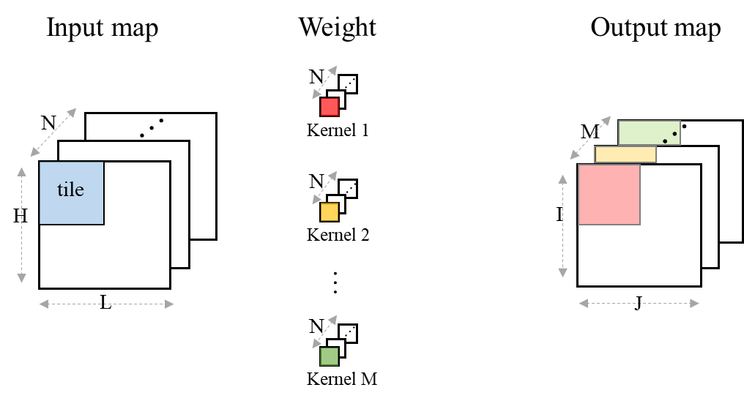
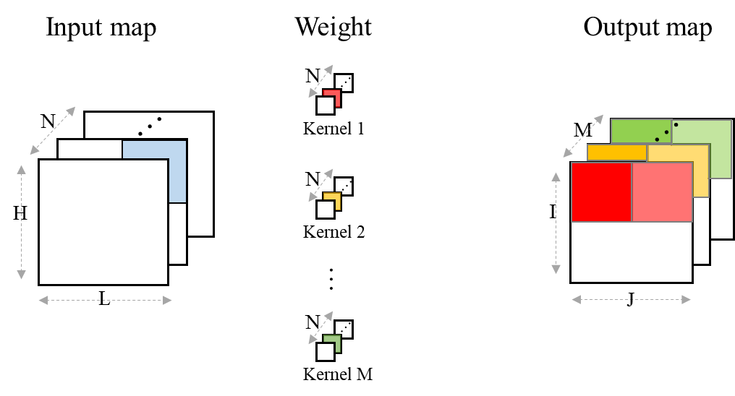
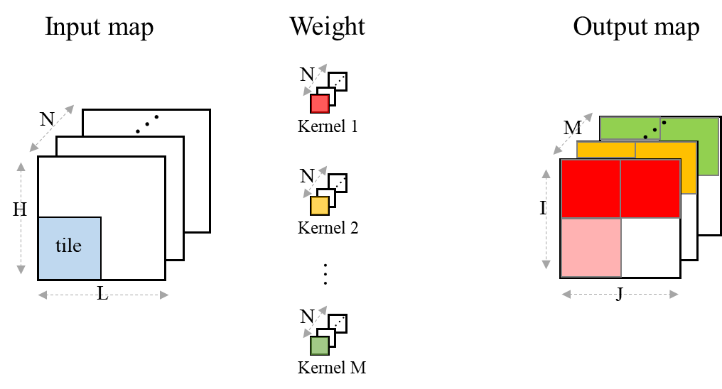
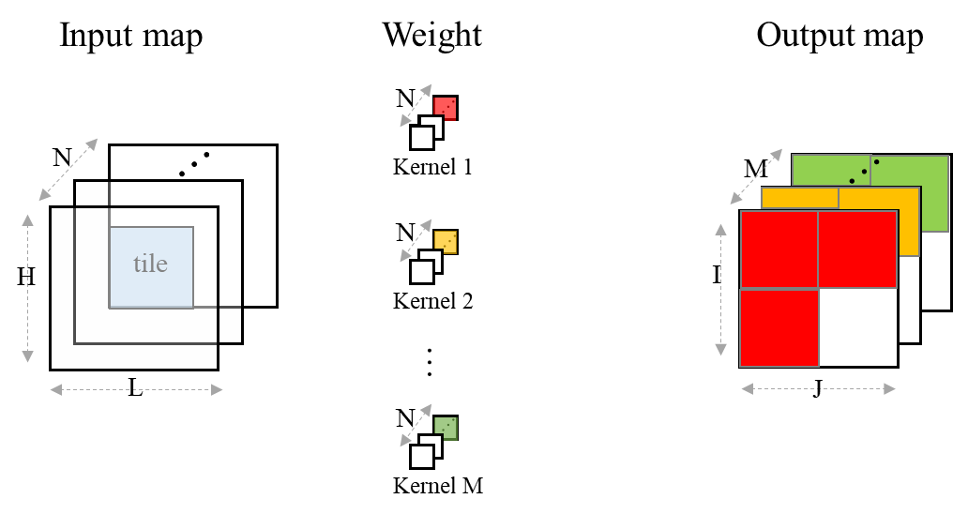
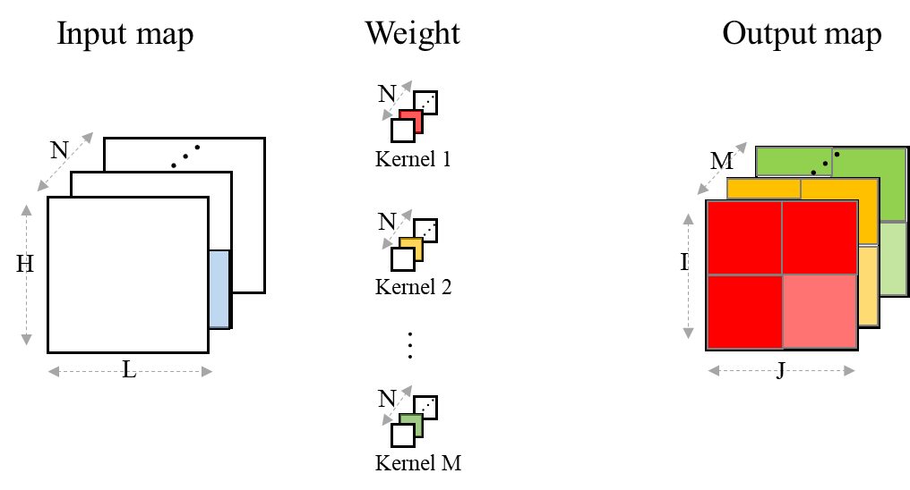
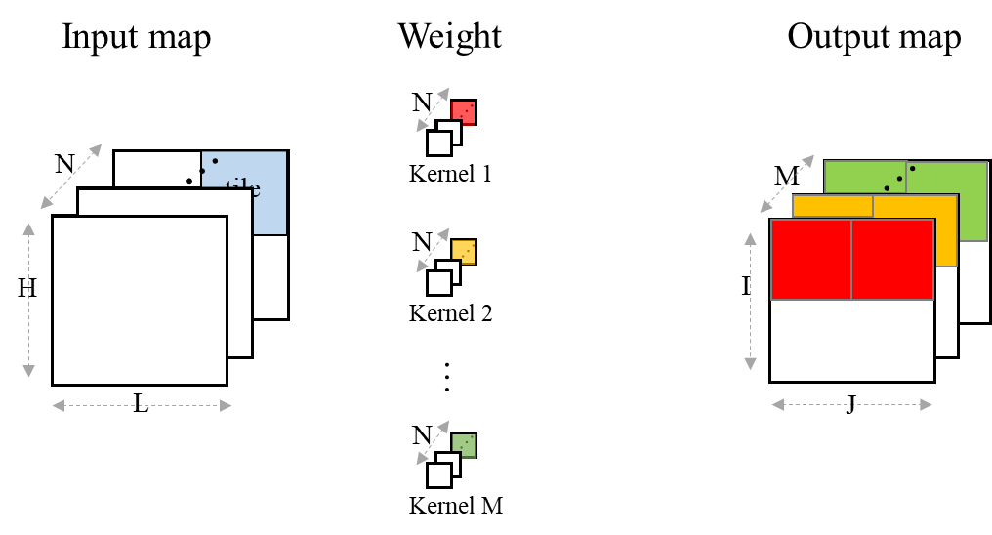
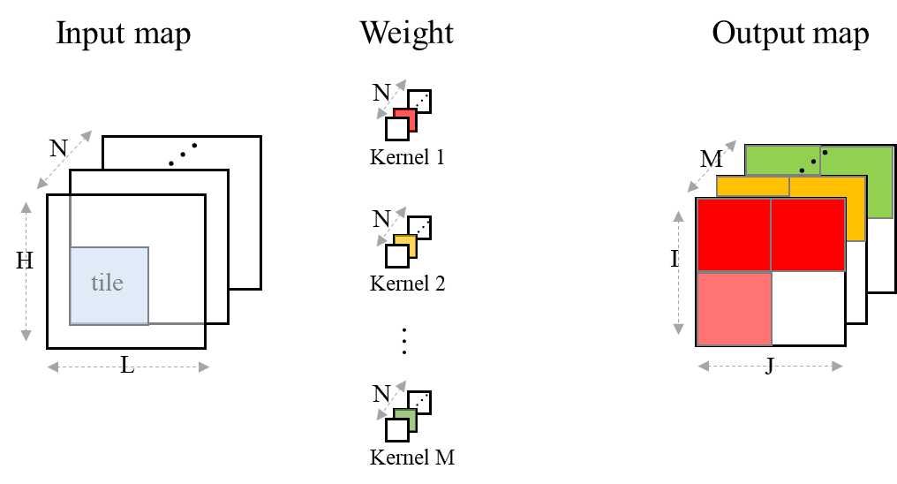
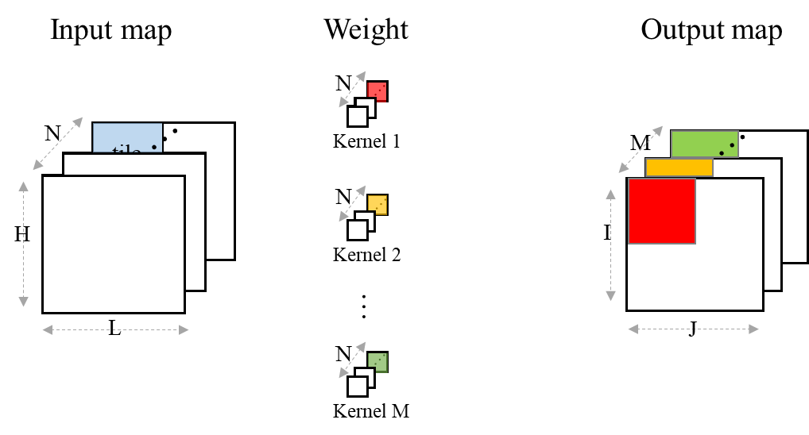
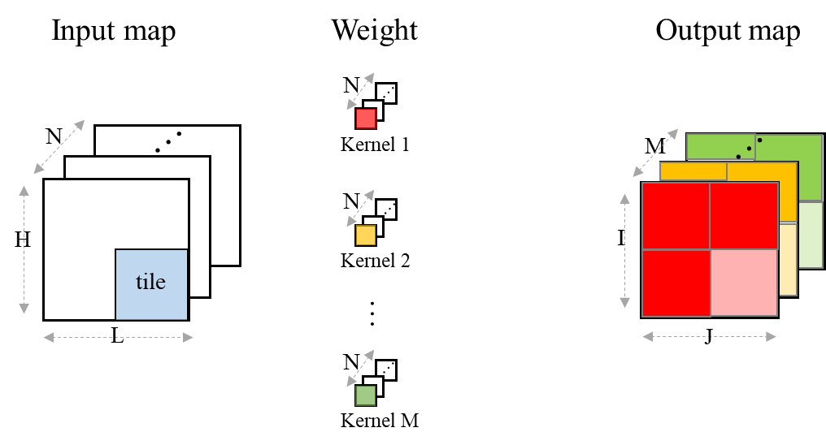
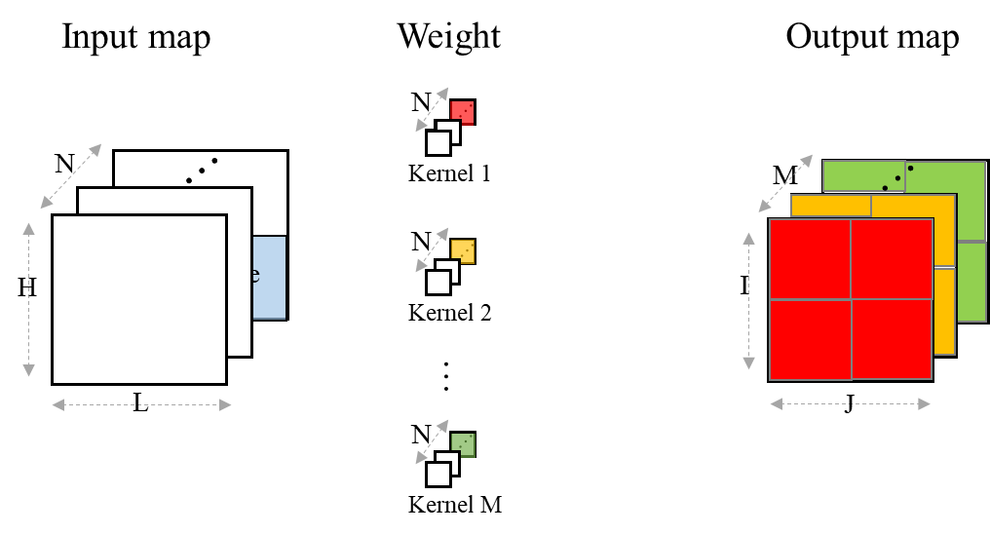
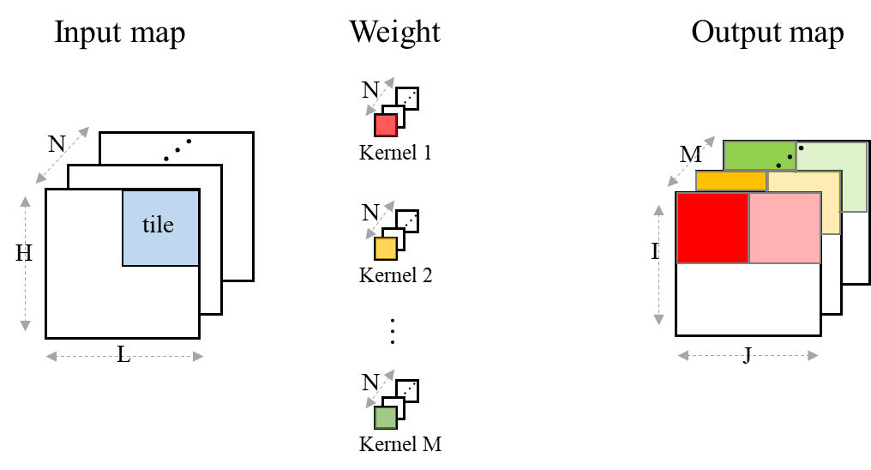
Tile Reuse in Action
Output map
Partial sum
Partial sum
Partial sum
Partial sum
Partial sum
Partial sum
Output
Output
Output

Slide 15
Tile Reuse - Tile Overlap
Overhead for tile 2= 7.7 % (4/52) for T = 52, K= 3, S= 1
overlap
H : input map height
L : input map width
T : tile size
R : remainder tile height or width
K : kernel size
S : stride
T
T
T
R
Input tile
1
Input tile
2
Input Map
T
T
$$overlap=K−S+[(T−K) mod S]$$
L
$$R=\left(H mod T\right)+overlap∙floor\left(\frac{H}{T}\right)$$
T
$$total_{overlap}={\left[overlap∙T∙floor\left(\frac{H}{T}\right)\right]}^{2}∙2+overlap∙R∙floor\left(\frac{H}{T}\right)∙2$$
R
H
in term of pixels

Slide 16
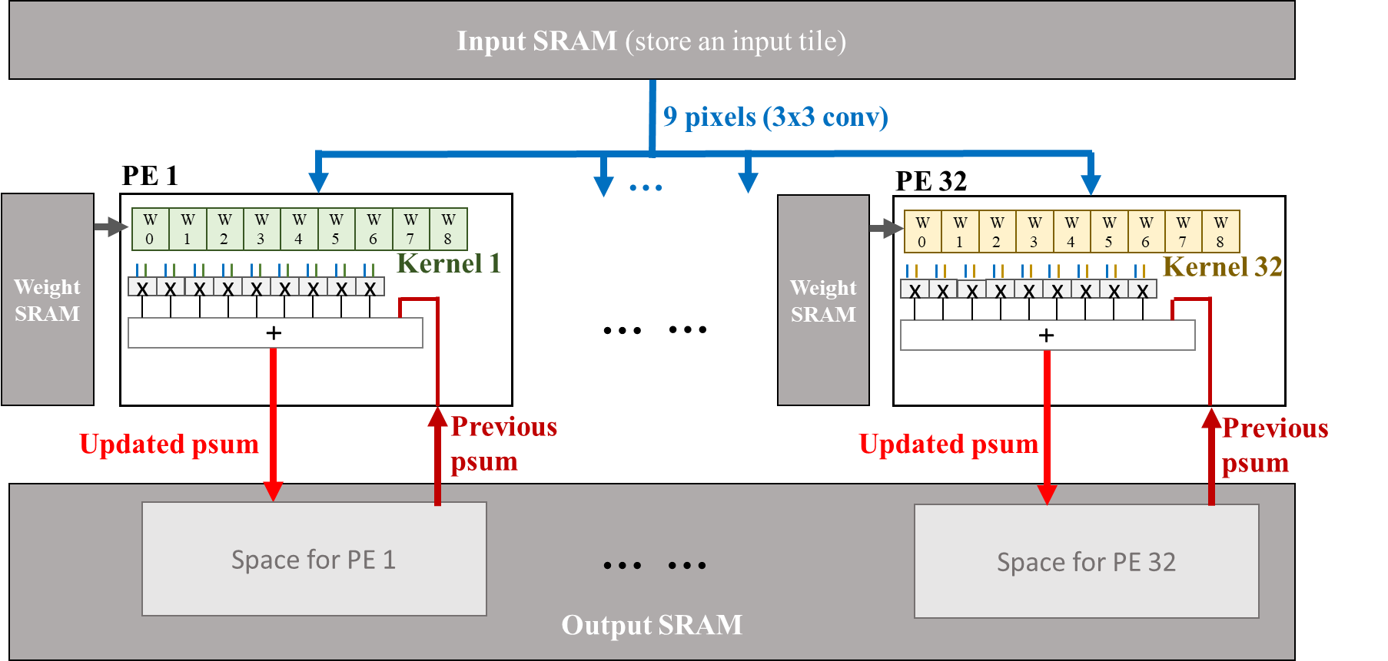
Convolution PE Unit
Per-filter based convolution task allocation to a PE
The same input is broadcast to all PEs for convolution operations
Parallel convolution operations on multiple filters for the same input data
Weight registers
Broadcast from SRAM bus

Slide 17
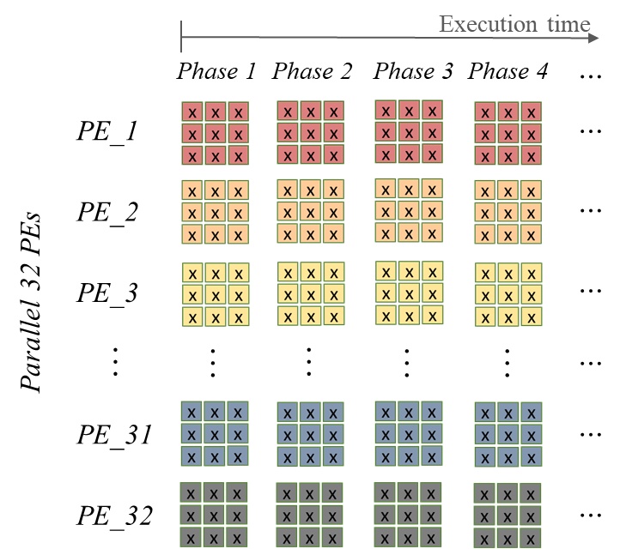
Per-filter based conv. task allocation
Assume # of filters M=32, # of PEs =32
If M >= 32, then batch
If M < 32, 32-M PEs idle
Allocate one filter to a PE and compute channel by channel for tile-sized input
Synchronization of all PEs to the same input.
Each PE receives the same 9 input pixels
Tile order: channel by channel tile order (why? easy to accumulate PS)
filter 1
filter 2
Load all 32 filters
PE1
PE2

Slide 18
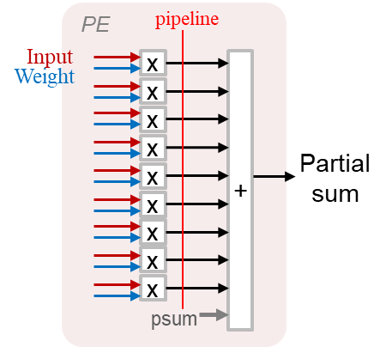
Partial sum accumulated PE design
Partial sum from the previous channel tile is added with the current channel convolution result.
For a PE, it needs only one partial sum output memory which is reused until the total sum is accumulated.

Slide 19
Tile view: Operation within a Tile (1/2)
Output SRAM Write
Input SRAM Read
PEs
(multiply-and-accumulate)
tile i output in output SRAM for Kernel 1
P₀
P₁
P₂
P₃
P₄
…
…
Input tile i of input channel j
PE 1
P₅₀
P₅₁
P₅₂
P₅₃
P₅₄
…
…
Kernel 1
P₁₀₀
P₁₀₁
P₁₀₂
P₁₀₃
P₁₀₄
…
…
Sliding
I₀
x
W₀
+
P₁₅₀
P₁₅₁
P₁₅₂
P₁₅₃
P₁₅₄
…
…
52
I₁
x
W₁
I₀
I₁
I₂
I₃
I₄
I₅₁
I₂
x
W₂
P₂₀₀
P₂₀₁
P₂₀₂
P₂₀₃
P₂₀₄
…
…
…
…
I₀
I₅₂
x
W₃
Updated psum
I₅₂
I₅₃
I₅₄
I₅₅
I₅₆
…
…
I₁₀₃
I₁
I₅₃
x
W₄
…
…
…
…
…
I₂
I₅₄
x
W₅
…
…
…
…
…
I₁₀₄
I₁₀₅
I₁₀₆
I₁₀₇
I₁₀₈
…
…
I₁₅₅
I₅₂
I₁₀₄
x
W₆
I₁₀₅
x
W₇
I₁₅₆
I₁₅₇
I₁₅₈
I₁₅₉
I₁₆₀
…
…
I₂₀₇
I₅₃
I₁₀₆
x
W₈
…
I₂₀₈
I₂₀₉
I₂₁₀
I₂₁₁
I₂₁₂
…
…
I₂₅₉
I₅₄
psum
52
I₁₀₄
…
…
…
tile i output in output SRAM for Kernel 32
…
…
…
…
…
…
I₁₀₅
PE 32
Kernel 32
P₀
P₁
P₂
P₃
P₄
…
…
…
…
…
…
…
…
I₁₀₆
I₀
W₀
P₅₀
P₅₁
P₅₂
P₅₃
P₅₄
…
…
x
+
I₂₆₅₂
I₂₆₅₃
I₂₆₅₄
I₂₆₅₅
I₂₆₅₆
…
…
I₂₇₀₃
I₁
x
W₁
P₁₀₀
P₁₀₁
P₁₀₂
P₁₀₃
P₁₀₄
…
…
I₂
x
W₂
I₅₂
x
W₃
Updated psum
P₁₅₀
P₁₅₁
P₁₅₂
P₁₅₃
P₁₅₄
…
…
I₅₃
x
W₄
P₂₀₀
P₂₀₁
P₂₀₂
P₂₀₃
P₂₀₄
…
…
I₅₄
x
W₅
Input broadcast
I₁₀₄
x
W₆
…
…
…
…
…
I₁₀₅
x
W₇
I₁₀₆
x
W₈
…
…
…
…
…
psum

Slide 20
Tile view: Operation within a Tile (2/2)
Output SRAM Write
Input SRAM Read
PEs
(multiply-and-accumulate)
tile i output in output SRAM for Kernel 1
P₀
P₁
P₂
P₃
P₄
…
…
Input tile i of channel j
PE 1
P₅₀
P₅₁
P₅₂
P₅₃
P₅₄
…
…
Kernel 1
P₁₀₀
P₁₀₁
P₁₀₂
P₁₀₃
P₁₀₄
…
…
sliding
I₁
x
W₀
+
P₁₅₀
P₁₅₁
P₁₅₂
P₁₅₃
P₁₅₄
…
…
52
I₂
x
W₁
I₀
I₁
I₂
I₃
I₄
I₅₁
I₃
x
W₂
P₂₀₀
P₂₀₁
P₂₀₂
P₂₀₃
P₂₀₄
…
…
…
…
I₁
I₅₃
x
W₃
Updated psum
I₅₂
I₅₃
I₅₄
I₅₅
I₅₆
…
…
I₁₀₃
I₂
I₅₄
x
W₄
…
…
…
…
…
I₃
I₅₅
x
W₅
…
…
…
…
…
I₁₀₄
I₁₀₅
I₁₀₆
I₁₀₇
I₁₀₈
…
…
I₁₅₅
I₅₃
I₁₀₅
x
W₆
I₁₀₆
x
W₇
I₁₅₆
I₁₅₇
I₁₅₈
I₁₅₉
I₁₆₀
…
…
I₂₀₇
I₅₄
I₁₀₇
x
W₈
…
I₂₀₈
I₂₀₉
I₂₁₀
I₂₁₁
I₂₁₂
…
…
I₂₅₉
I₅₅
psum
tile i output in output SRAM for Kernel 32
52
I₁₀₅
…
…
…
…
…
…
…
…
…
I₁₀₆
PE 32
P₀
P₁
P₂
P₃
P₄
…
…
I₁₀₇
Kernel 32
…
…
…
…
…
…
I₁
x
W₀
+
P₅₀
P₅₁
P₅₂
P₅₃
P₅₄
…
…
I₂₆₅₂
I₂₆₅₃
I₂₆₅₄
I₂₆₅₅
I₂₆₅₆
…
…
I₂₇₀₃
I₂
x
W₁
P₁₀₀
P₁₀₁
P₁₀₂
P₁₀₃
P₁₀₄
…
…
I₃
x
W₂
I₅₃
x
W₃
Updated psum
P₁₅₀
P₁₅₁
P₁₅₂
P₁₅₃
P₁₅₄
…
…
Input broadcast
I₅₄
x
W₄
P₂₀₀
P₂₀₁
P₂₀₂
P₂₀₃
P₂₀₄
…
…
I₅₅
x
W₅
I₁₀₅
x
W₆
…
…
…
…
…
I₁₀₆
x
W₇
I₁₀₇
x
W₈
…
…
…
…
…
psum

Slide 21
Tile view: Operation within a Tile (2/2) Revision
Output SRAM Write
Input SRAM Read
PEs
(multiply-and-accumulate)
tile i output in output SRAM for Kernel 1
Input broadcast
P₀
P₁
P₂
P₃
P₄
…
…
Input tile i of channel j
PE 1
P₅₀
P₅₁
P₅₂
P₅₃
P₅₄
…
…
Kernel 1
P₁₀₀
P₁₀₁
P₁₀₂
P₁₀₃
P₁₀₄
…
…
sliding
I₁
x
W₀
+
P₁₅₀
P₁₅₁
P₁₅₂
P₁₅₃
P₁₅₄
…
…
52
MUX
I₂
x
W₁
I₀
I₁
I₂
I₃
I₄
I₅₁
I₃
x
W₂
P₂₀₀
P₂₀₁
P₂₀₂
P₂₀₃
P₂₀₄
…
…
…
…
I₁
I₅₃
x
W₃
Updated psum
I₅₂
I₅₃
I₅₄
I₅₅
I₅₆
…
…
I₁₀₃
I₂
I₅₄
x
W₄
…
…
…
…
…
I₃
I₅₅
x
W₅
…
…
…
…
…
I₁₀₄
I₁₀₅
I₁₀₆
I₁₀₇
I₁₀₈
…
…
I₁₅₅
I₅₃
I₁₀₅
x
W₆
I₁₀₆
x
W₇
I₁₅₆
I₁₅₇
I₁₅₈
I₁₅₉
I₁₆₀
…
…
I₂₀₇
I₅₄
I₁₀₇
x
W₈
…
I₂₀₈
I₂₀₉
I₂₁₀
I₂₁₁
I₂₁₂
…
…
I₂₅₉
I₅₅
psum
tile i output in output SRAM for Kernel 32
52
I₁₀₅
…
…
…
…
…
…
…
…
…
I₁₀₆
PE 32
P₀
P₁
P₂
P₃
P₄
…
…
I₁₀₇
Kernel 32
…
…
…
…
…
…
I₁
x
W₀
+
P₅₀
P₅₁
P₅₂
P₅₃
P₅₄
…
…
I₂₆₅₂
I₂₆₅₃
I₂₆₅₄
I₂₆₅₅
I₂₆₅₆
…
…
I₂₇₀₃
I₂
x
W₁
P₁₀₀
P₁₀₁
P₁₀₂
P₁₀₃
P₁₀₄
…
…
I₃
x
W₂
I₅₃
x
W₃
P₁₅₀
P₁₅₁
P₁₅₂
P₁₅₃
P₁₅₄
…
…
This move has fetched
2/3 of the same pixels again.
This increases the on-chip SRAM accesses.
Remedy: See if the following possible.
Add 9 FFs btw input SRAM and PEs, and MUX the FFs output to the PE. Weights remain.
This time only fetches the required new pixels, I₃, I₅₅, I_{107.}
I₅₄
x
W₄
Updated psum
P₂₀₀
P₂₀₁
P₂₀₂
P₂₀₃
P₂₀₄
…
…
I₅₅
x
W₅
I₁₀₅
x
W₆
…
…
…
…
…
I₁₀₆
x
W₇
I₁₀₇
x
W₈
…
…
…
…
…
psum

Slide 22
Optimization of Data Streaming From SRAM
Convolution block: Column data
A scheme to reduce 2/3 fetches of data from SRAM
New column data D2 are loaded into the FFs that release D0 for S=1
D0 D1 D2
FFs
FFs
D1
D0
D0
D2
PED0
Allocated to process D0
MUX
D2
D1
PED2
Weights remain at their position

Slide 23
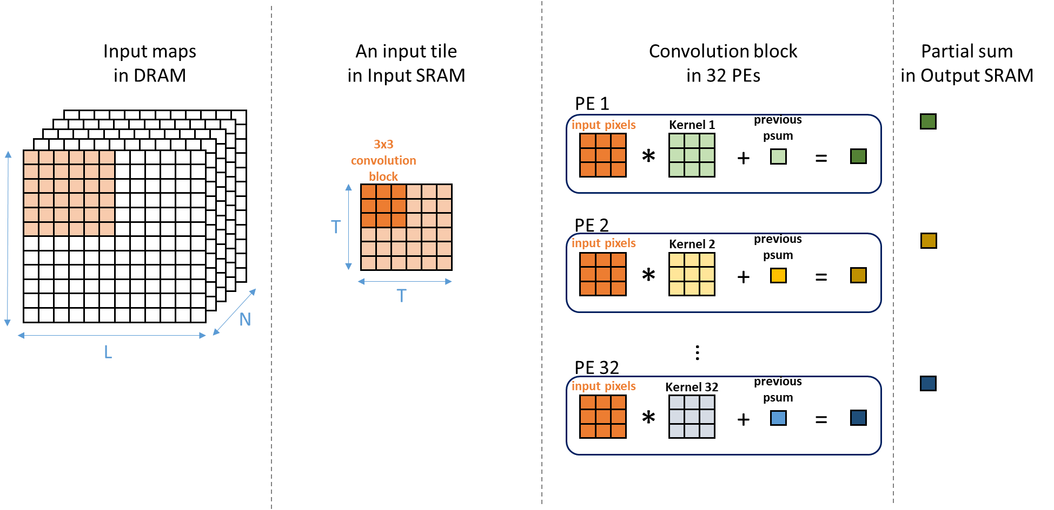
Global view: Per-filter Based Computation In a tile 1/5
3x3 kernel

Slide 24
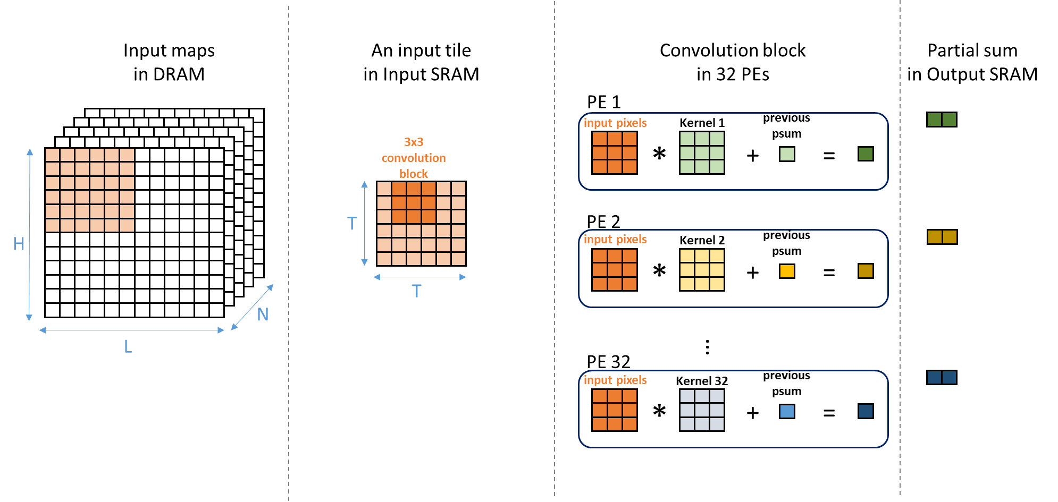
Global view: Per-filter Based Computation in the same tile 2/5
3x3 kernel

Slide 25
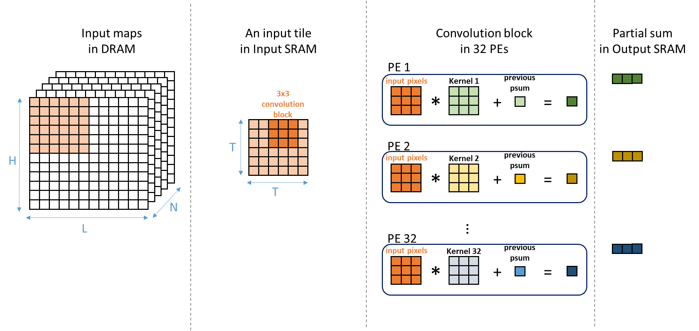
Global view: Per-filter Based Computation in the same tile 3/5
3x3 kernel

Slide 26
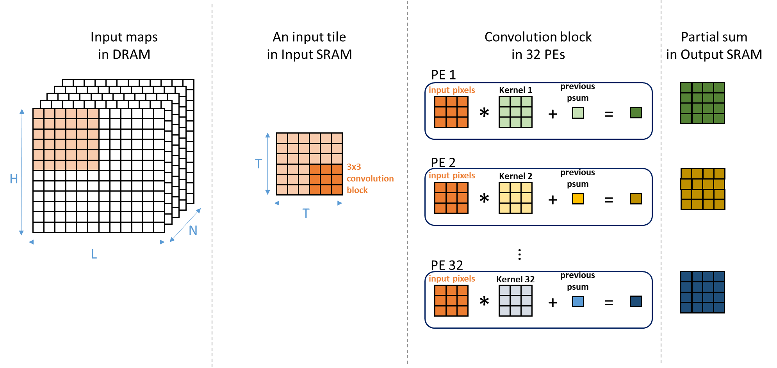
Global view: Per-filter Based Computation in the same tile 4/5
3x3 kernel

Slide 27
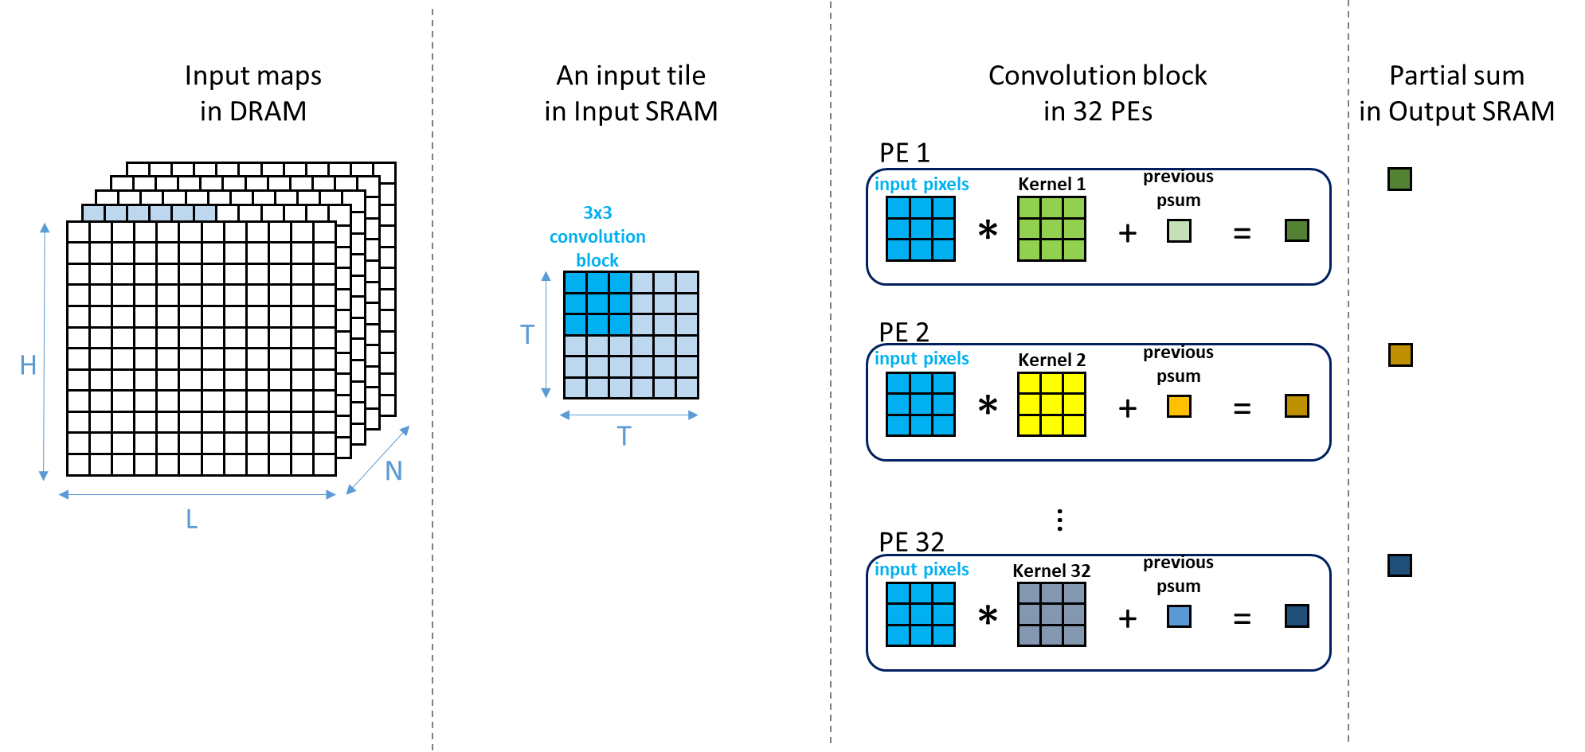
Global view: Per-filter Based Computation change channel 5/5
3x3 kernel
Same input
Change channel kernels

Slide 28
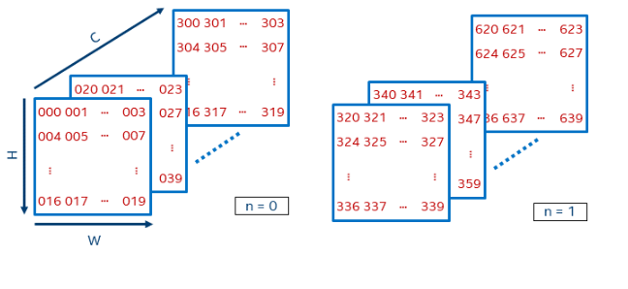
Project – part A: Intelligent Data Fetcher (1/3)
Problem statement: Propose a SRAM memory system and intelligent data fetcher design that can effectively prepare and align data to the PEs.
At the beginning we will provide you the DRAM model of Verilog and SystemC code. You need to put the input data and weights we provided into DRAM.
Different framework’s data formats will be placed in memory in different ways. The two most common data formats are NCHW and NHWC, so you need to choose one of the following data formats and your data should be placed like the form below.

Slide 29
Project – part A: Intelligent Data Fetcher (2/3)
Propose a SRAM memory system. You can analyze which data reuse method is better and evaluate the SRAM size before designing, because this may affect your performance.(ex. Ping-pong Input SRAM, Weight SRAM)
Design an intelligent data fetcher(DMA) which can fetch data from DRAM then stores it into the SRAM in the proper order needed for the PE unit.
Since project part-B and part-C require you to design a PE accelerator, you need to think about a complete process to allow PE to receive data efficiently.

Slide 30
Project – part A: Intelligent Data Fetcher (3/3)
Input image size : 416(height) * 416(width) * 3(channel)
Filter : 16 3(height) * 3(width) * 3(channel)
Padding = 0 , Stride = 1
Size of input SRAM and weight SRAM :
You can decide the SRAM size and how to design it, but you need to explain why you want to do this and write it into the report.
DMA :
You can use a start signal to tell DMA to start moving data. When all data is moved, you need an interrupt signal to inform the CPU that the task is complete.
Can be designed with RTL or SystemC code
Report due in 4 weeks.

Slide 31
Kernel View: Oversize Kernel Handling (1/2)
Geometric directly mapping on 3x3 PEs
Example: 5x5 kernels (filters are colored)
Low PE utilization = 25/36 = 69.4%
x
x
x
A 3x3 PE core
x
x
x
x
x
x
5
x
x
x
x
x
x
x
x
x
x
x
x
x
x
x
x
x
x
x
x
x
x
x
x
x
x
x
x
x
x
x
x
x
x
x
x
x
x
x
x
x
x
x
x
x
x
x
x
5
x
x
x
x
x
x
x
x
x
x
x
x
x
x
x
x
x
x
x
x
x
x
x
x
x
x
x
x
x
x
x
x
x
x
x
x
x
x
x
x
x
x
x
x
x
x
x
x
x
x
x
x
x
x
x
x
x
x
x
x
x
x
x
x
x
x
x
x
x
x
x
x
x
x
x
x
x
x
x
x
x
x
x
x
x
x
x
x
x
x
x
x
x
x
x
x
x
x
x
x
x
x
x
x
x
x
x
x
x
x
x
x
x
x
x
x
x
x
x
x
x
x
x
x
x
x
x
x
x
x
x
x
x
x
x
x
x
x
x
x
x
x
x
x
x
x
x
x
x
x
x
x
x
x
x
x
x
x
x
x
x
x
x
x
x
x
x
x
x
x
x
x
x
x
x
x
x
x
x
x
x
x
x
x
x
x
x
x
x
x
x
x
x
x
x
x
x
x
x
x
x
x
x
x
x
x
x
x
x
x
x
x
x
x
x
x
x
x
x
x
x
x
x
x
x
x
x
x
x
x
x
x
x
x
x
x
x
x
x
x

Slide 32
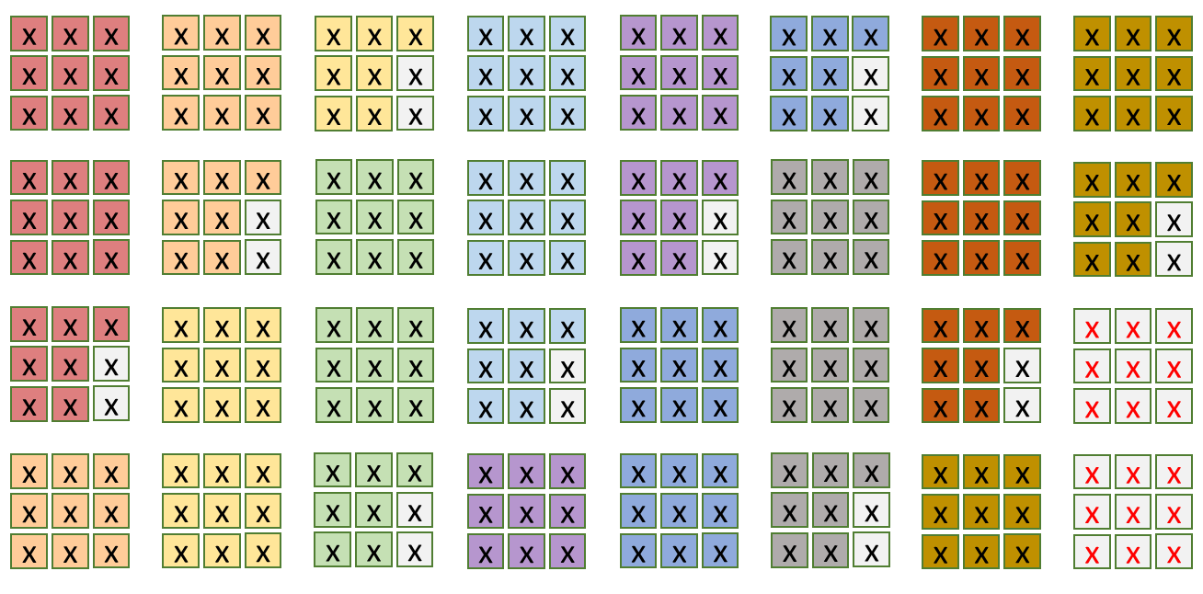
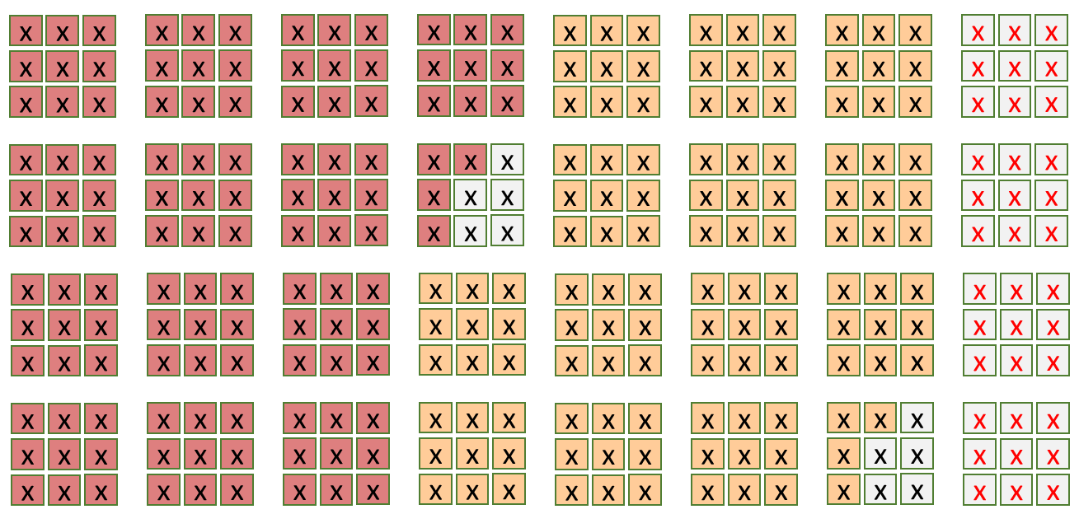
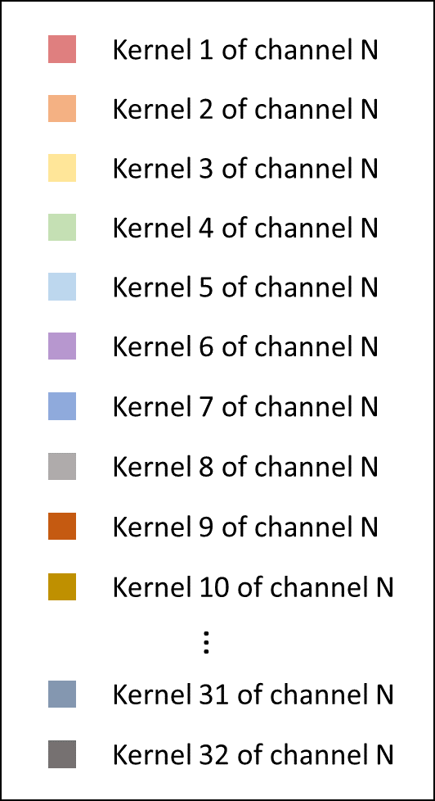
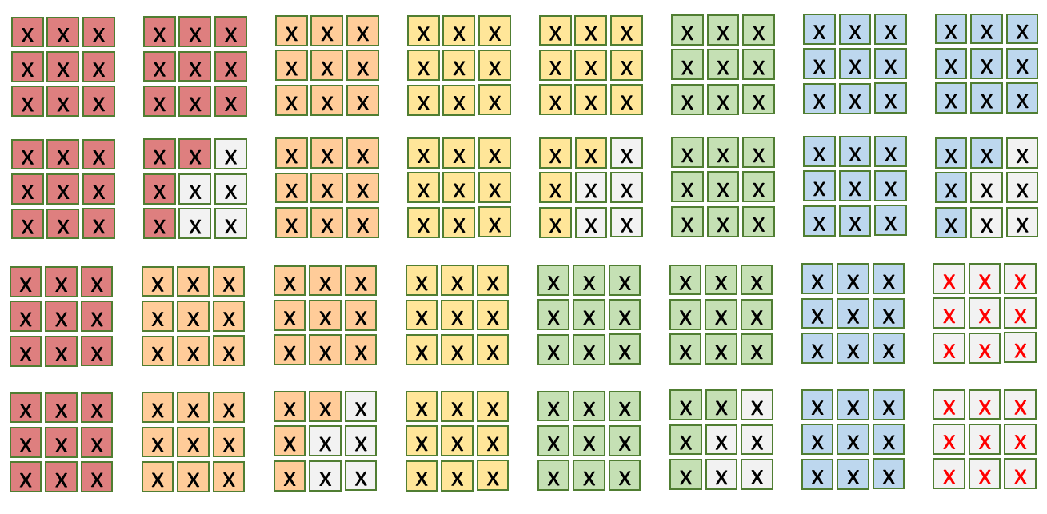
Kernel View: Row-major Order Kernel in Geometric Mapping, on different PEs (2/2)
32 PEs, each 9 MACs
32 PEs
Spatial mapping
5x5
11x11
7x7
Different color
means different kernels
10 kernels at a time
Run from channel 1 to N
for the given kernel. Then
go for another 10 kernels
if any

Slide 33
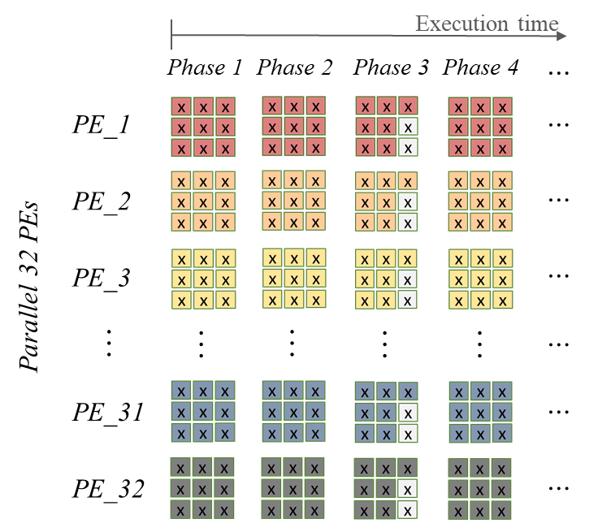
Kernel View: Row-major Order Kernel Mapping on the Same PE for Oversize Kernel (1/2)
P: needed phases for oversize kernel
W: waste multiplier number for oversize kernel
k: kernel size
convolute a 5x5
kernel size
$$P=ceil(\frac{ k∙k }{9})$$
$$W=9−\left[(k∙k−floor(\frac{ k∙k }{9})∙9\text{)}\right]$$
Kernel size | P | W
5 | 3 | 2
7 | 6 | 5
11 | 14 | 5
P
W
Same input broadcast to all PEs.
Suggesting that weights are loaded to PEs of the same row-major order.

Slide 34
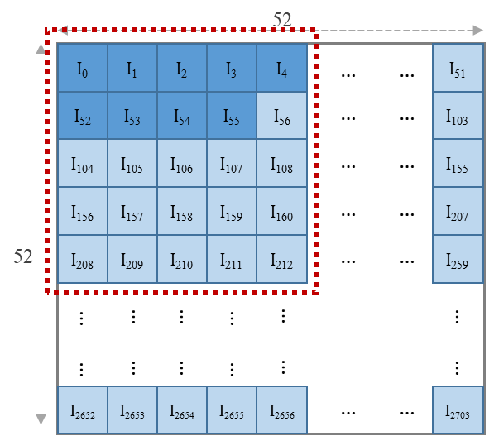
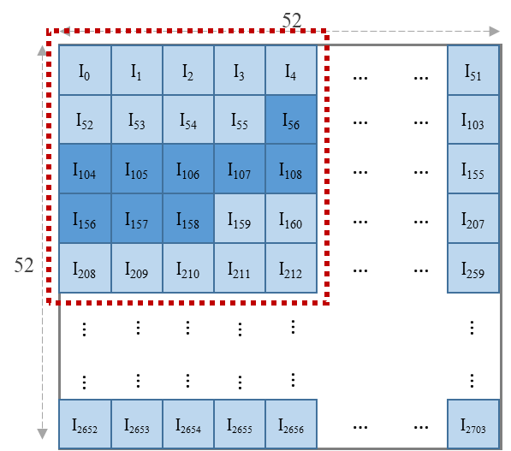
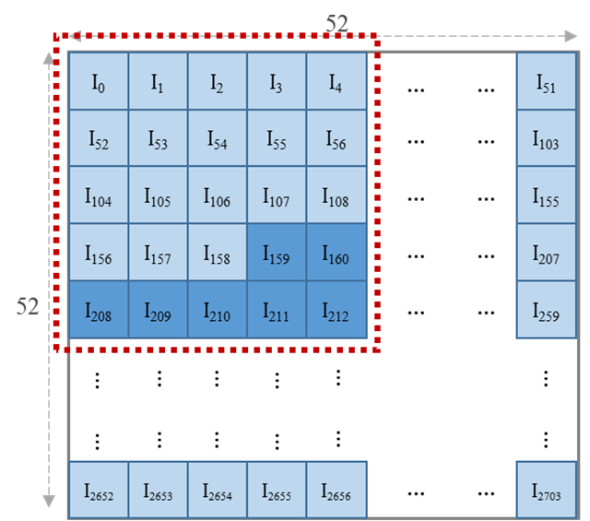
Kernel Row-major Order Mapping on the same 3x3 PE for Oversize Kernel (kernel + input view)
Get 9 tile data in row-major ordering of the kernel and send to all 32 PEs.
PE utilization = 25/27
5x5 kernel example: 1st batch
2nd batch
get the part of weights for 2nd batch
3rd batch

Slide 35
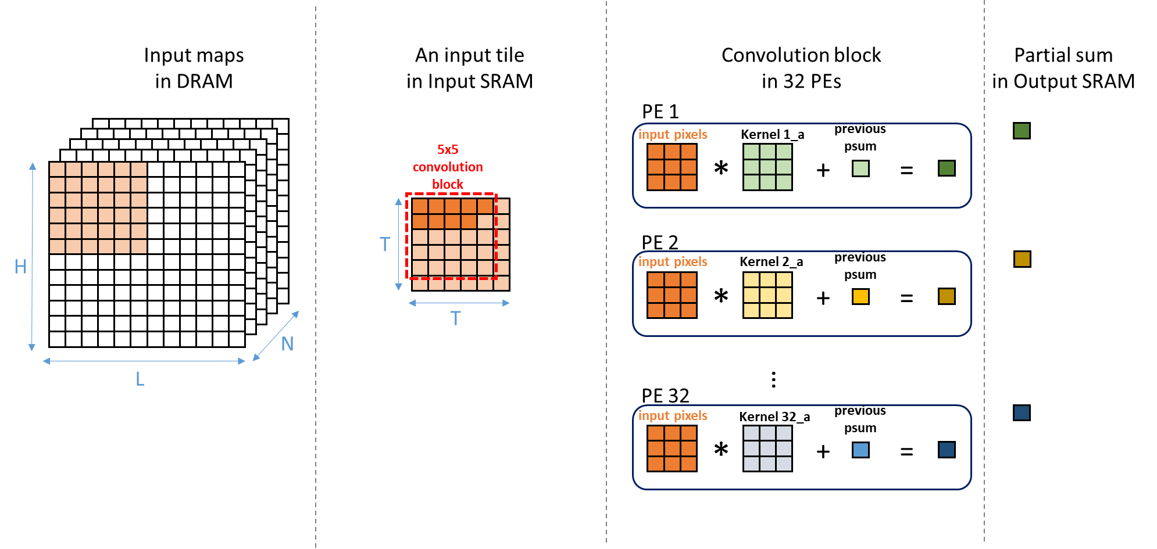
Kernel Row-major Order Mapping on the Same PE for Oversize Kernel in Action (1/6)
Get the first 9 weights for each PE
Input broadcast
to all PEs
A filter on a PE

Slide 36
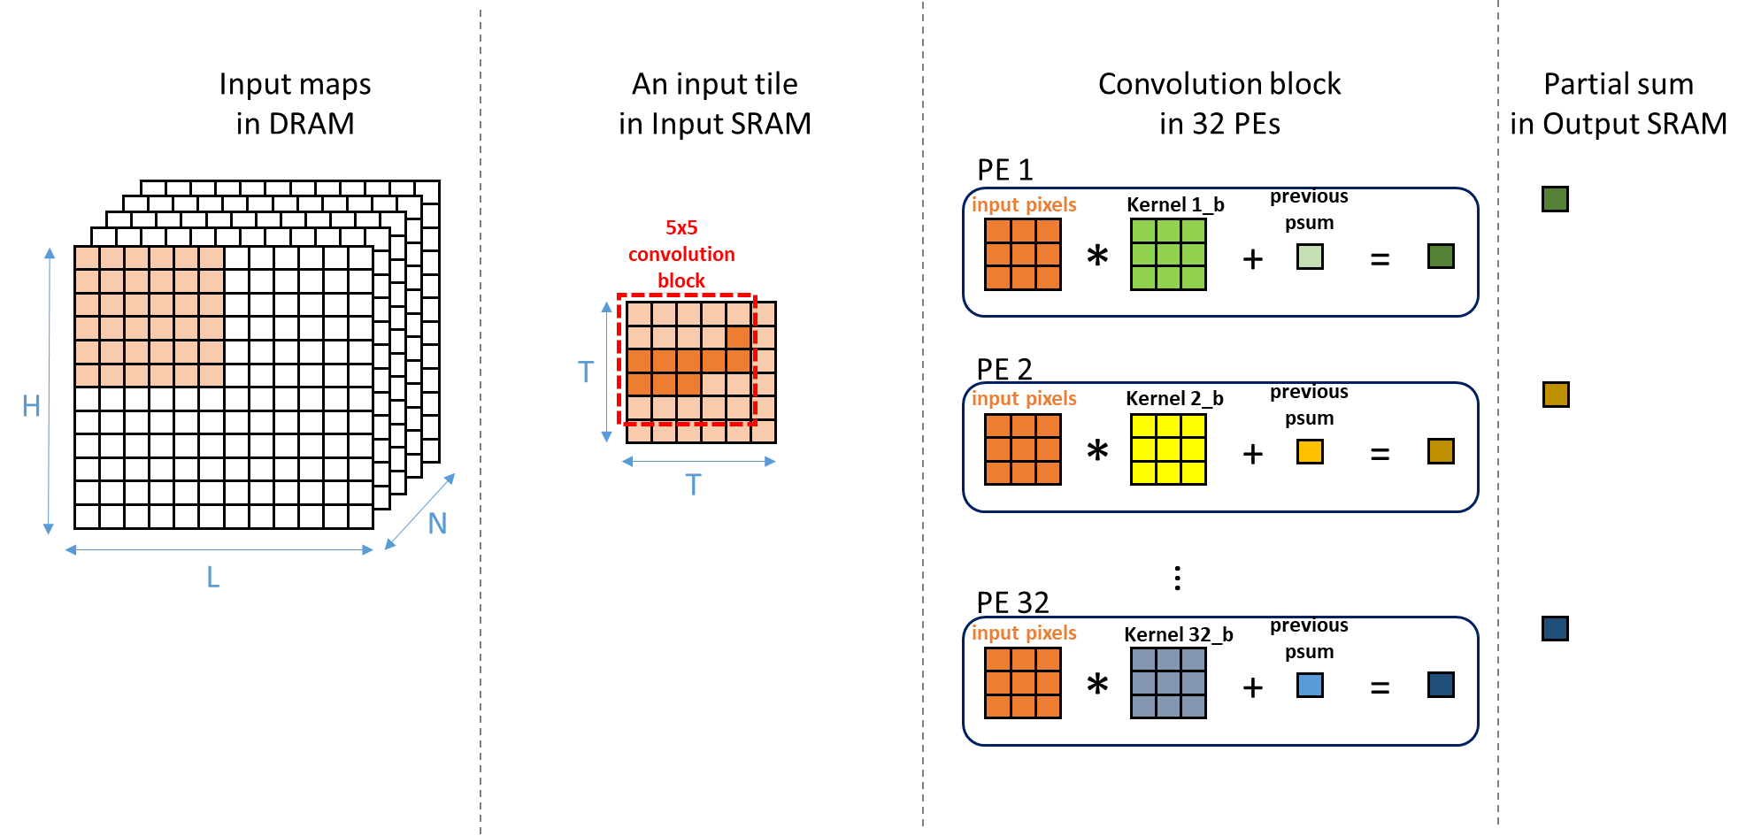
Kernel Row-major Order Mapping on the Same PE for Oversize Kernel in Action (2/6)
Get the next 9 weights for each PE

Slide 37
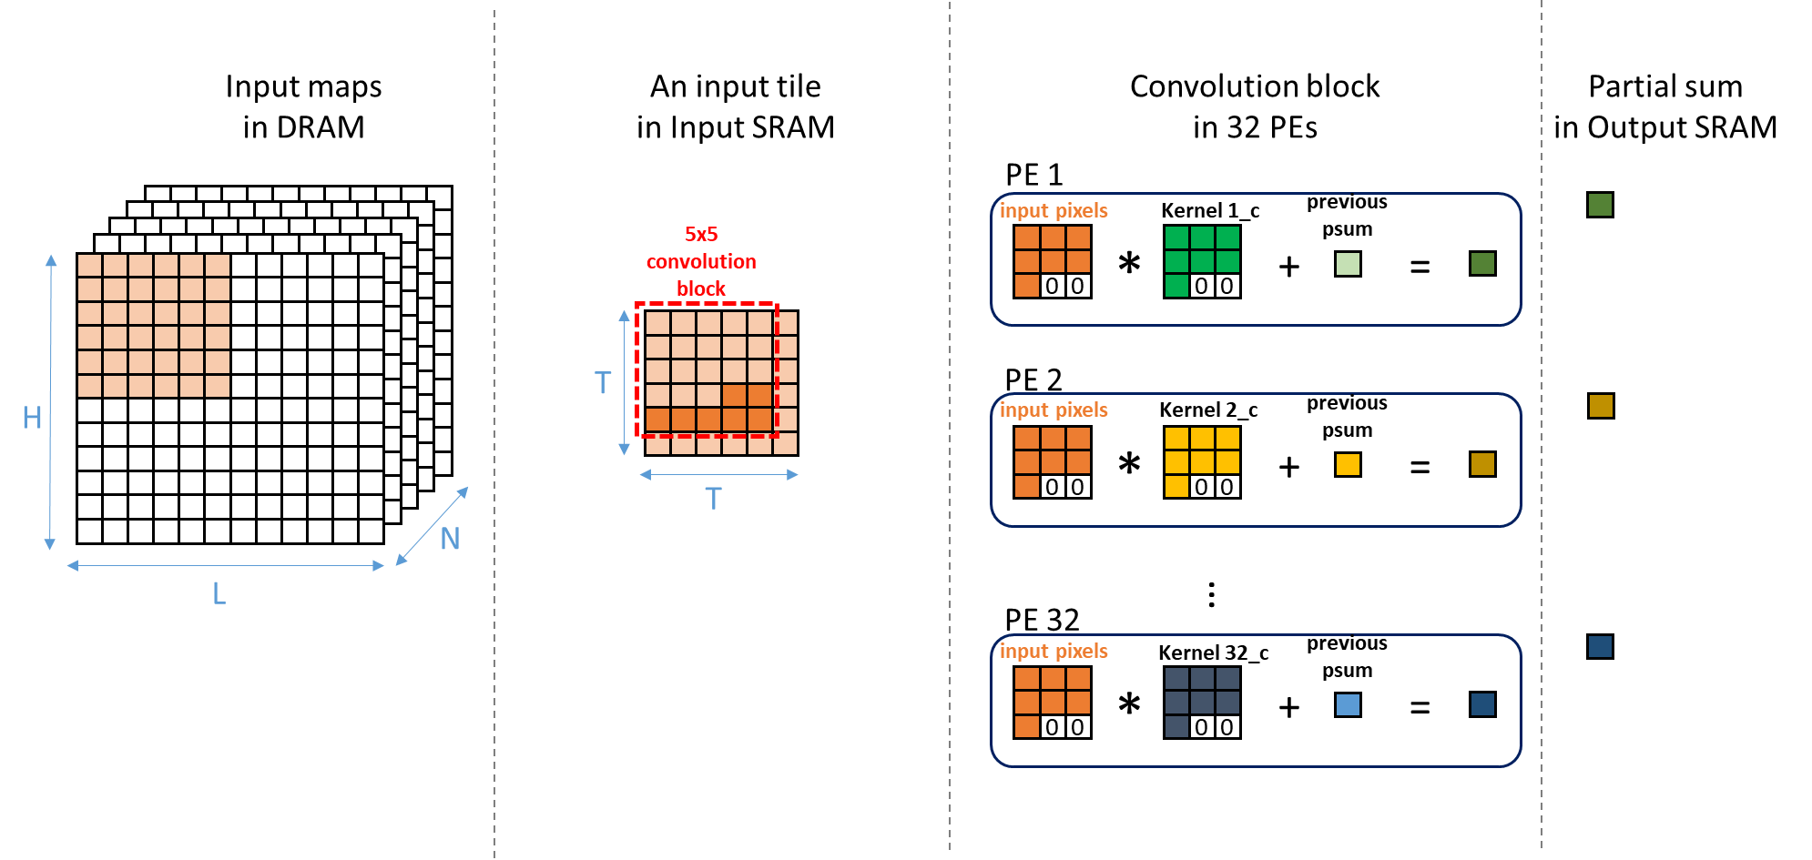
Kernel Row-major Order Mapping on the Same PE for Oversize Kernel in Action (3/6)
Get the last 7 weights for each PE

Slide 38
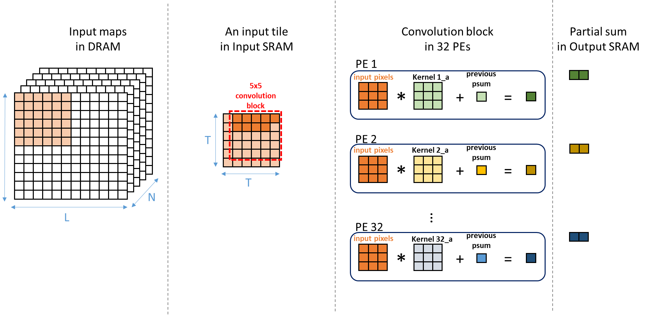
Kernel Row-major Order Mapping on the Same PE for Oversize Kernel (4/6)
Get the first 9 weights for each PE again
Let’s move the
box for 1 pixel
Stride = 1

Slide 39
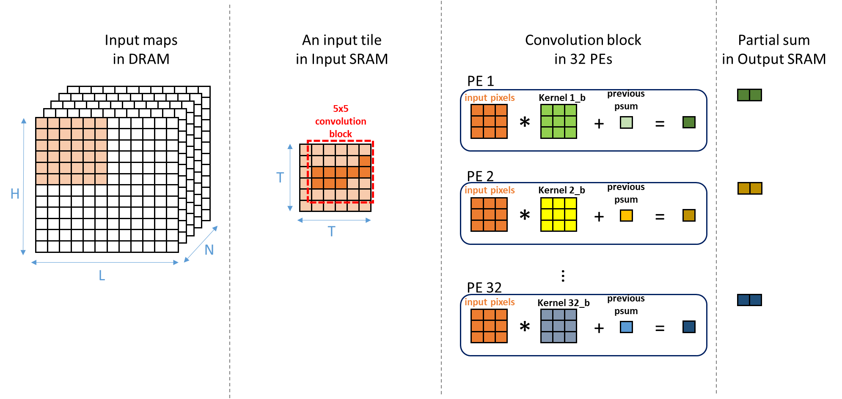
Kernel Row-major Order Mapping on the Same PE for Oversize Kernel (5/6)
Get the next 9 weights for each PE again

Slide 40
Kernel Row-major Order Mapping on the Same PE for Oversize Kernel (6/6)
Get the last 7 weights for each PE again

Slide 41
Kernel Row-major Order Mapping on the Same PE for Oversize Kernel
Observations:
Reload 9 weights when switching to the next batch
Reload weights when striding
Next convolution
B1
B2
B3
B1
B2
B3
5x5:
5x5:
After first batch B1, need to load the next 9 weights for batch B2. This is a read
for weight SRAM.

Slide 42
Optimization: Weight Stationary for Oversize Kernel
Optimization: Group the same batches in all different conv blocks in a tile together
Bi: batch order (or phase order) for a oversize kernel
Striding
A conv. block
B1
B2
B3
B1
B2
B3
B1
B2
B3
Original
=> 3 * 3 = 9 times
B1
B1
B1
B2
B2
B2
B3
B3
B3
Optimized
=> 3 times

Slide 43
Optimization: Weight Stationary for Oversize Kernel
Optimization: Group the same batches in all different conv blocks in a tile together
Advantage:
1: Address generation for input data becomes easy by using conv. block size as an offset.
2: Avoid weight thrashing

Slide 44
How about 1x1 kernels? The PE is 3x3.
YOLOv3-tiny | Model parameter |  |  | Utilization rate of 32 PEs | Utilization rate of 288 multipliers
 | Input map | Kernel size | Output map
conv1 | 416 x 416 x 3 | 3 | 416 x 416 x 16 | 50 % | 50 %
conv2 | 208 x 208 x 16 | 3 | 208 x 208 x 32 | 100 % | 100 %
conv3 | 104 x 104 x 32 | 3 | 104 x 104 x 64 | 100 % | 100 %
conv4 | 52 x 52 x 64 | 3 | 52 x 52 x 128 | 100 % | 100 %
conv5 | 26 x 26 x 128 | 3 | 26 x 26 x 256 | 100 % | 100 %
conv6 | 13 x 13 x 256 | 3 | 13 x 13 x 512 | 100 % | 100 %
conv7 | 13 x 13 x 512 | 3 | 13 x 13 x 1024 | 100 % | 100 %
conv8 | 13 x 13 x 1024 | 1 | 13 x 13 x 256 | 100 % | 11.11 %
conv9 | 13 x 13 x 256 | 3 | 13 x 13 x 512 | 100 % | 100 %
conv10 | 13 x 13 x 512 | 1 | 13 x 13 x 255 | 99.6 % | 11.07 %
conv11 | 13 x 13 x 256 | 1 | 13 x 13 x 128 | 100 % | 11.11 %
conv12 | 26 x 26 x 384 | 3 | 26 x 26 x 256 | 100 % | 100 %
conv13 | 26 x 26 x 256 | 1 | 26 x 26 x 255 | 99.6 % | 11.07 %
99.09 % | 68.8 %

Slide 45
Optimization for 1x1 Kernel Size
When input map size is smaller than 52x52 (input tile size) and kernel size is 1x1, transfer more then 1 input map of different input channels to Input SRAM. The convolution of these input maps in the input SRAM would be executed at the same time. Assume Input SRAM size = tile size.
Example
YOLOv3-tiny | Input map | Kernel size | Max input map # that Input SRAM can store | Input map # stored in Input SRAM
conv8 | 13x13 | 1 | 16 | 9
conv10 | 13x13 | 1 | 16 | 9
conv11 | 13x13 | 1 | 16 | 9
conv13 | 26x26 | 1 | 4 | 4

Slide 46
Optimization for 1x1 Kernel Size (1/4)
Get at max 9 channels of
kernel 1
Input maps
in DRAM
IR input maps
in Input SRAM
Partial sum
in Output SRAM
PE 1
input pixels
Kernel 1
previous
psum
*
+
=
PE 2
input pixels
Kernel 2
previous
psum
H
N
H
*
+
=
IR
(max=9)
…
L
L
H x L is the dimension
of input map, e.g., 13x13
Less than tile size
PE 32
input pixels
Kernel 32
previous
psum
*
+
=

Slide 47
Optimization for 1x1 Kernel Size (2/4)
Move for Stride = 1
Weight stationary
Input maps
in DRAM
IR input maps
in Input SRAM
Partial sum
in Output SRAM
PE 1
input pixels
Kernel 1
previous
psum
*
+
=
PE 2
input pixels
Kernel 2
previous
psum
H
N
H
*
+
=
IR
(max=9)
L
L
…
PE 32
input pixels
Kernel 32
previous
psum
*
+
=

Slide 48
Optimization for 1x1 Kernel Size (3/4)
End of H x L convolutions
Input maps
in DRAM
IR input maps
in Input SRAM
Partial sum
in Output SRAM
PE 1
input pixels
Kernel 1
previous
psum
*
+
=
PE 2
input pixels
Kernel 2
previous
psum
H
N
H
*
+
=
IR
(max=9)
L
L
…
PE 32
input pixels
Kernel 32
previous
psum
*
+
=

Slide 49
Optimization for 1x1 Kernel Size (4/4)
The rest of channels
Load channel weights
Input maps
in DRAM
IR input maps
in Input SRAM
Partial sum
in Output SRAM
PE 1
input pixels
Kernel 1
previous
psum
0
0
*
0
0
+
=
0
0
0
0
0
0
PE 2
input pixels
Kernel 2
previous
psum
H
N
H
*
+
=
0
0
0
0
0
IR
0
0
0
0
0
L
L
…
PE 32
input pixels
Kernel 32
previous
psum
0
0
*
0
0
+
=
0
0
0
0
0
0

Slide 50
Project – part B: PE accelerator
Continuing what you did last time with project-partA. You need to add PE unit to your design, then you need an output SRAM to store the partial sum or the result of the operation, and finally write it back to the DRAM.
You need to consider the following issues:
1. how to dispatch different kernel size to pe for calculation(3x3, 5x5)
2. PE array structure
3. PE utilization
4. data reuse
5. data streaming from SRAM to PE
RTL or SystemC code design
Report due in 4 weeks.

Slide 51
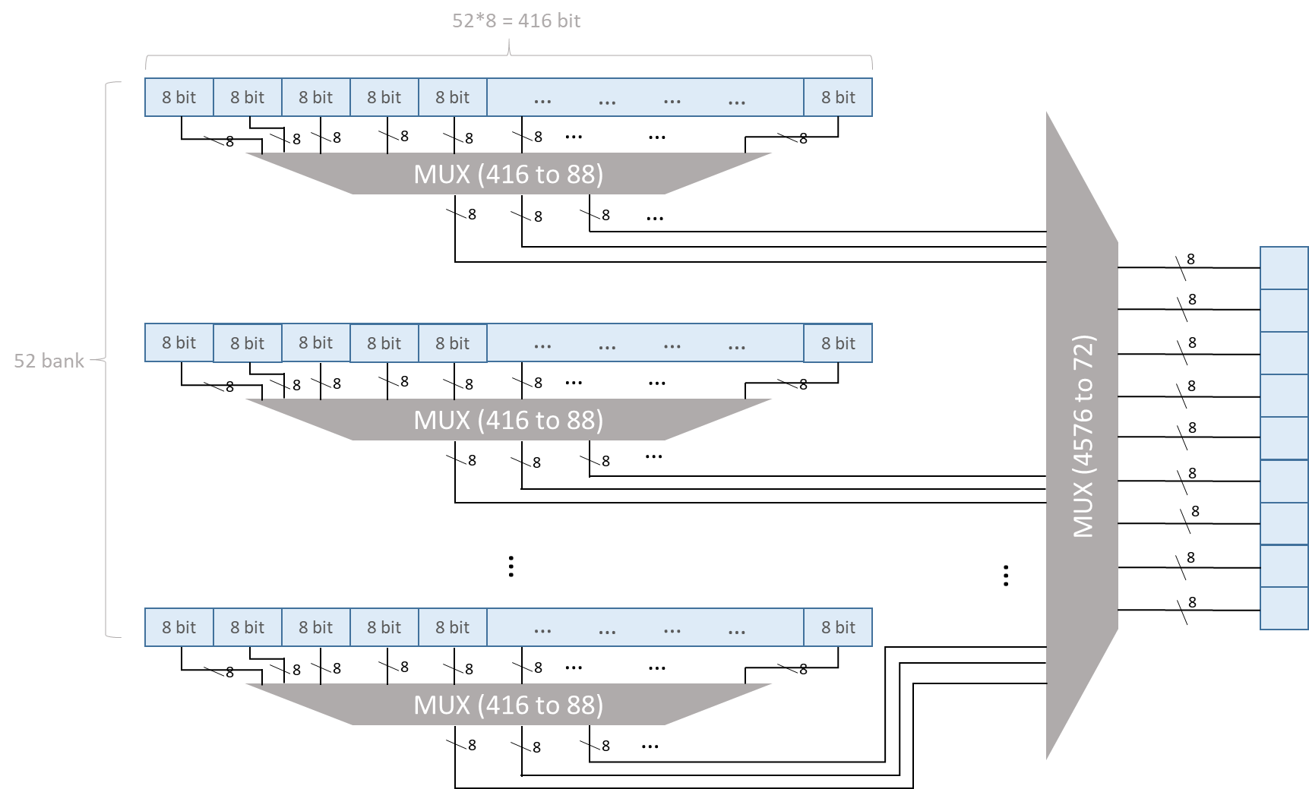
Input SRAM Example
Pros
Can get all data in a cycle
Cons
Power consumption, datapath,
Mux tree delay
Notes:
Register File 2.704KB左右

Slide 52
PEs’ utilization rate of YOLOv3-tiny
YOLOv3-tiny | Model parameter |  |  | Utilization rate of 32 PEs | Utilization rate of 288 multipliers | 2D PE- Utilization rate of 32x32 PEs
 | Input map | Kernel size | Output map
conv1 | 416 x 416 x 3 | 3 | 416 x 416 x 16 | 50 % | 50 % | 49.992 %
conv2 | 208 x 208 x 16 | 3 | 208 x 208 x 32 | 100 % | 100 % | 99.968 %
conv3 | 104 x 104 x 32 | 3 | 104 x 104 x 64 | 100 % | 100 % | 99.935 %
conv4 | 52 x 52 x 64 | 3 | 52 x 52 x 128 | 100 % | 100 % | 99.871 %
conv5 | 26 x 26 x 128 | 3 | 26 x 26 x 256 | 100 % | 100 % | 99.742 %
conv6 | 13 x 13 x 256 | 3 | 13 x 13 x 512 | 100 % | 100 % | 99.485 %
conv7 | 13 x 13 x 512 | 3 | 13 x 13 x 1024 | 100 % | 100 % | 99.742 %
conv8 | 13 x 13 x 1024 | 1 | 13 x 13 x 256 | 100 % | 11.11 % → 99.81 % | 98.848 %
conv9 | 13 x 13 x 256 | 3 | 13 x 13 x 512 | 100 % | 100 % | 99.485 %
conv10 | 13 x 13 x 512 | 1 | 13 x 13 x 255 | 99.6 % | 11.07 % → 99.41 % | 97.722 %
conv11 | 13 x 13 x 256 | 1 | 13 x 13 x 128 | 100 % | 11.11 % → 98.08 % | 95.545 %
conv12 | 26 x 26 x 384 | 3 | 26 x 26 x 256 | 100 % | 100 % | 99.914 %
conv13 | 26 x 26 x 256 | 1 | 26 x 26 x 255 | 99.6 % | 11.07 % → 44.27 % | 98.848 %
99.09 % | 91.66 % | 95.952 %

Slide 53
PEs’ utilization rate of VGG16
VGG16 | Model parameter |  |  | Utilization rate of 32 PEs | Utilization rate of 288 multipliers | 2D PE- Utilization rate of 32x32 PEs | Eyeriss Num. of active PEs
 | Input map | Kernel size | Output map
conv1 | 224 x 224 x 3 | 3 | 224 x 224 x 64 | 100 % | 100 % | 86.182 % | 156 (93%)
conv2 | 224 x 224 x 64 | 3 | 224 x 224 x 64 | 100 % | 100 % | 99.995 % | 156 (93%)
conv3 | 112 x 112 x 64 | 3 | 112 x 112 x 128 | 100 % | 100 % | 99.992 % | 156 (93%)
conv4 | 112 x 112 x 128 | 3 | 112 x 112 x 128 | 100 % | 100 % | 99.996 % | 156 (93%)
conv5 | 56 x 56 x 128 | 3 | 56 x 56 x 256 | 100 % | 100 % | 99.990 % | 156 (93%)
conv6 | 56 x 56 x 256 | 3 | 56 x 56 x 256 | 100 % | 100 % | 99.995 % | 156 (93%)
conv7 | 56 x 56 x 256 | 3 | 56 x 56 x 256 | 100 % | 100 % | 99.995 % | 156 (93%)
conv8 | 28 x 28 x 256 | 3 | 28 x 28 x 512 | 100 % | 100 % | 99.990 % | 168 (100%)
conv9 | 28 x 28 x 512 | 3 | 28 x 28 x 512 | 100 % | 100 % | 99.995 % | 168 (100%)
conv10 | 28 x 28 x 512 | 3 | 28 x 28 x 512 | 100 % | 100 % | 99.995 % | 168 (100%)
conv11 | 14 x 14 x 512 | 3 | 14 x 14 x 512 | 100 % | 100 % | 99.982 % | 168 (100%)
conv12 | 14 x 14 x 512 | 3 | 14 x 14 x 512 | 100 % | 100 % | 99.982 % | 168 (100%)
conv13 | 14 x 14 x 512 | 3 | 14 x 14 x 512 | 100 % | 100 % | 99.982 % | 168 (100%)
100 % | 100 % | 98.928 % | 96.23 %

Slide 54
PEs’ utilization rate of AlexNet
AlexNet | Model parameter |  |  | Utilization rate of 32 PEs | Utilization rate of 288 multipliers | 2D PE- Utilization rate of 32x32 PEs | Eyeriss Num. of active PEs
 | Input map | Kernel size | Output map
conv1 | 227 x 227 x 3 | 11 | 55 x 55 x 96 | 100 % | 96.03 % | 70.542 % | 154 (92%)
conv2 | 31 x 31 x 48 | 5 | 27 x 27 x 256 | 100 % | 92.6 % | 99.957 % | 135 (80%)
conv3 | 15 x 15 x 256 | 3 | 13 x 13 x 384 | 100 % | 100 % | 99.943 % | 156 (93%)
conv4 | 15 x 15 x 192 | 3 | 13 x 13 x 384 | 100 % | 100 % | 99.924 % | 156 (93%)
conv5 | 15 x 15 x 192 | 3 | 13 x 13 x 256 | 100 % | 100 % | 99.886 % | 156 (93%)
100 % | 97.726 % | 94.050 % | 90.2 %

Slide 55
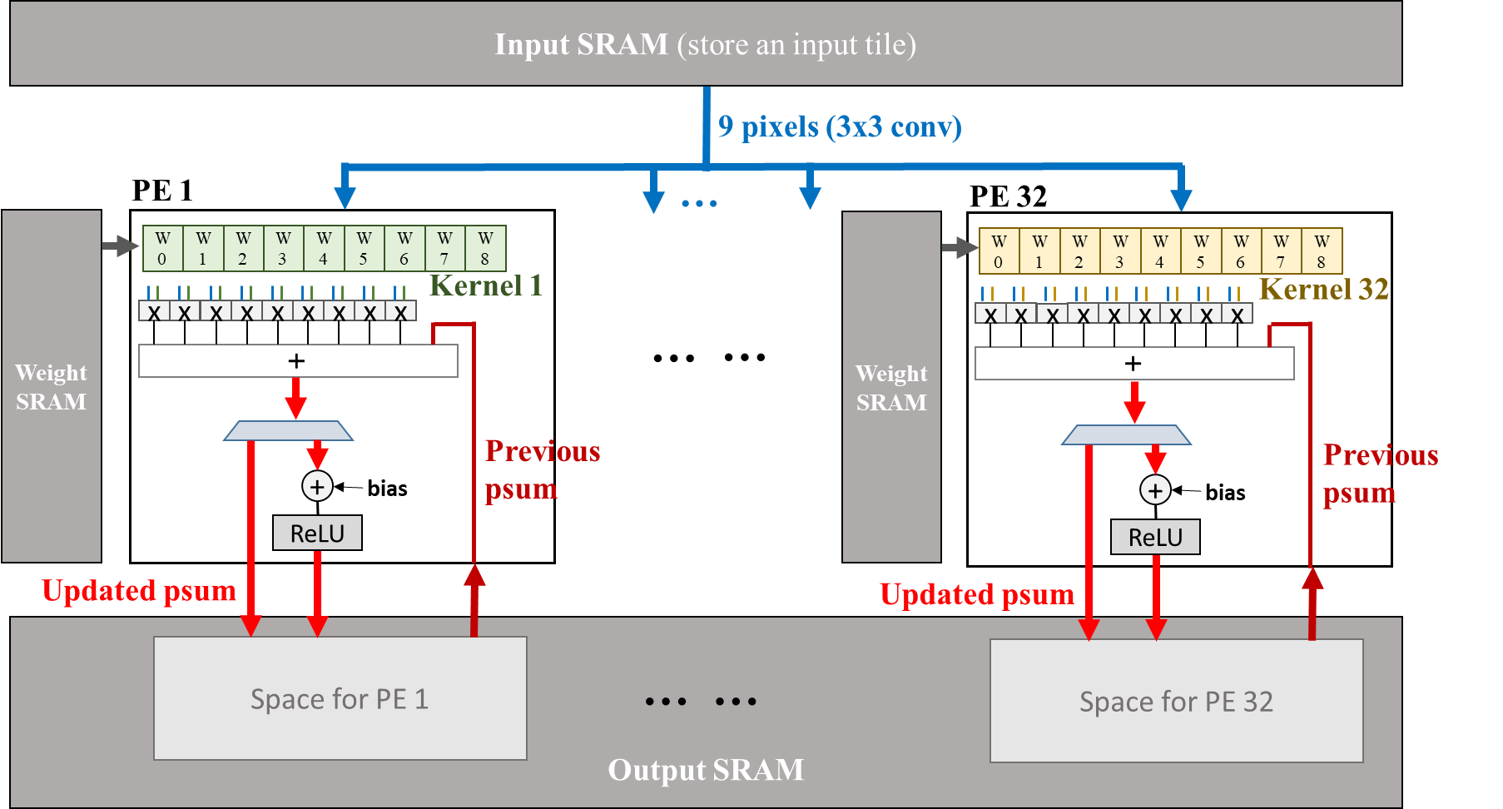
Convolution, Bias Addition, and ReLU PE Core
Convolution, bias ,and ReLU in PE

Slide 56
Memory System
Arbiter
Data fetcher
Memory
bus
DMA controller
Intelligent fetcher
DRAM
Accelerator
SRAM

Slide 57
Project – part C: Complete 1D PE accelerator
Continue project partA and partB, this time you need to finish a complete PE accelerator.
Your accelerator needs to be able to apply to different input map size and kernel size, and able to do the following things:
1. convolution
2. bias
3. Relu
In order to make your design more complete, you need to add bus and arbiter to your design.
Enhance your design by considering all the optimizations addressed so far.
Can be designed with RTL or SystemC code
Presentation due in final week.

Slide 58
Thanks You
Machine Learning
Hello!! R2-D2

