Slide 1
From ESL to Silicon
Jhe-Yu Liou

Slide 2
Outline
From ESL to Silicon
From SIMD to SIMT
The challenge of SIMT
Conclusion

Slide 3
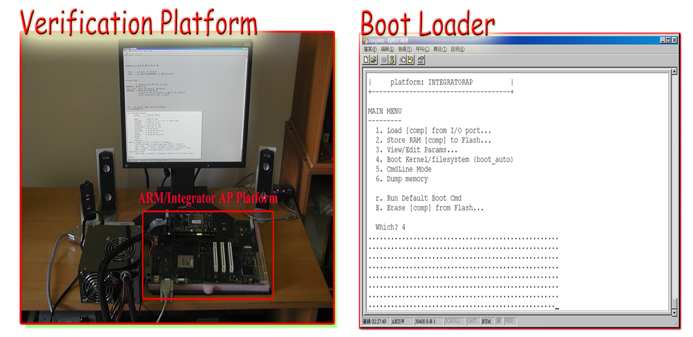
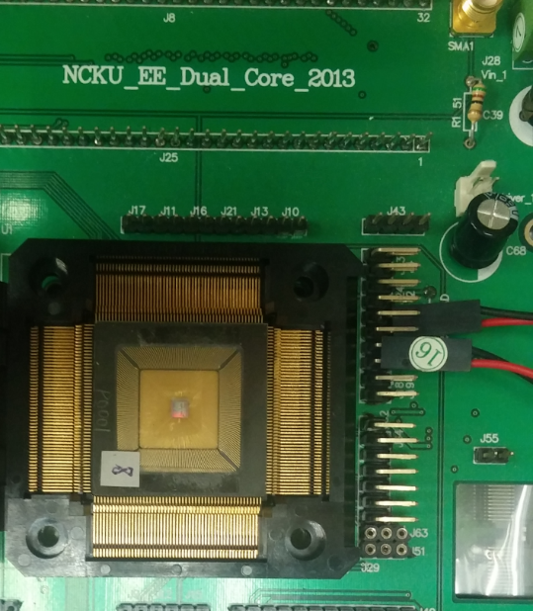
From ESL to Silicon CPU
ARM v5 instruction compatible dual core.
Full-system verification capability
Linux kernel 2.6 boot up.
Continue to focus on issue on power consumption, cache efficiency.

Slide 4
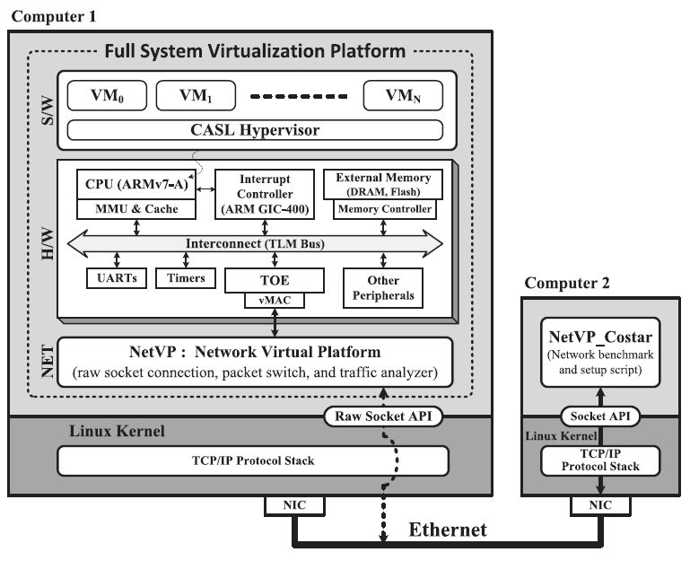
From ESL to Silicon Network and Virtualization
A CASL hypervisor,
so called a Virtual Machine Monitor (VMM).
A timing approximated TCP/IP offload engine.
Full system verification with
Multiple guest OS.
Communication with another computer by real Ethernet interface.

Slide 5
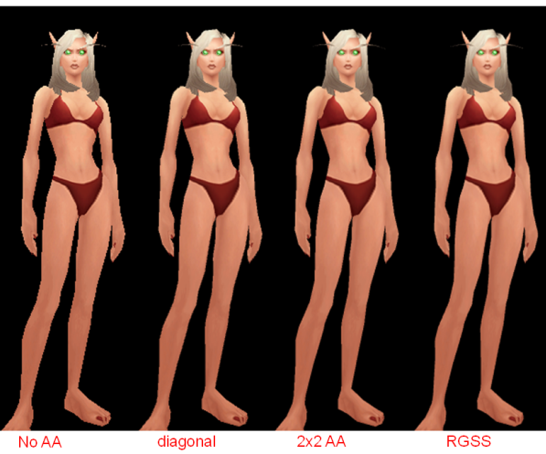
From ESL to Silicon GPU
Support OpenGL ES 1.1
Fixed function pipeline
Both pure C model and gate-level RTL model are presented.
Full system simulation environment with QEMU
Debian, kernel 2.6.18

Slide 6
From SIMD to SIMT
SIMD – single instruction multiple data.
Often referred as vector-based instruction.
High level language:
OpenGL Shading language.
Template-based vector library in C++ (SSE-like instruction wrapper)
Low level language:
x86 SSE or AVX instruction set
ARM NEON instruction set
Nvidia NVGP4 pseudo assembly language.

Slide 7
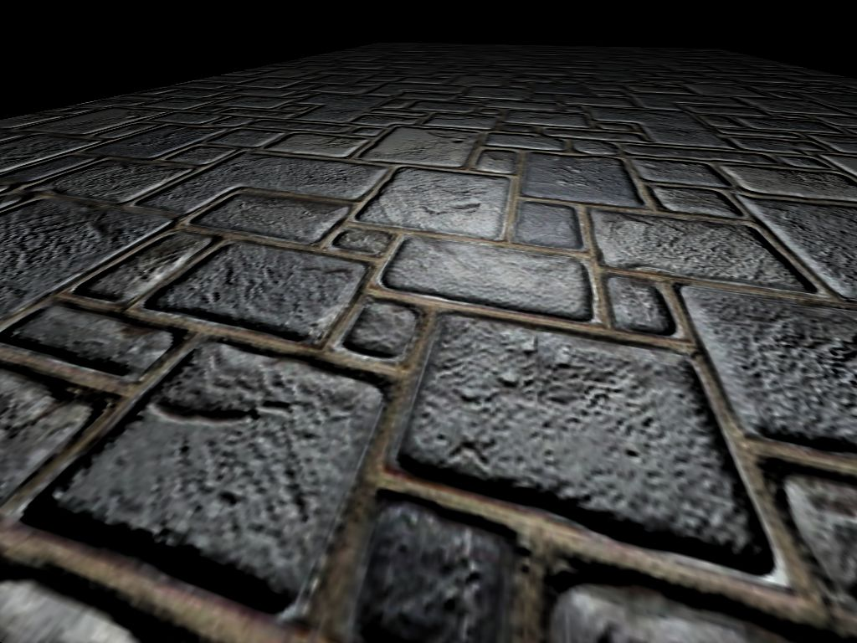
From SIMD to SIMT SIMD example
OpenGL Shading program (fragment) | NVGP4 pseudo assembly
vec3 c1, c2; vec3 eyeVector = vec3(0.0, 0.0, 1.0) c1 = texture2D( ColorMap, UV ).rgb; c2 = texture2D( NormalMap, UV ).rgb; c2 = c2*2 - vec3(1.0, 1.0, 1.0); color = c1 * dot(c2, eyeVector); | TEMP R0, R1; TEX.F R0.xyz, fragment.attrib[0], texture[0], 2D; TEX.F R1.z, fragment.attrib[0], texture[1], 2D; MUL.F R1.xyz, R1.z, R0; MAD.F result_color0.xyz, R1, {2}.x, -R0; END
MUL.F R1.xyz, R1.z, R0
R1.x = R1.z * R0.x
R1.y = R1.z * R0.y
R1.z = R1.z * R0.z
R1.w = (nothing)

Slide 8
From SIMD to SIMT SIMD conclusion
The programmer itself has to take care the vector operation and optimization if possible.
It’s not realistic to fully depend on compiler.
May waste the execution power if only partial vector elements are required.

Slide 9
From SIMD to SIMT SIMD conclusion (cont.)
Our OpenGL GPU simulator shows only about 30%~70% utilization in NVGP4 vector-based shader core.
Part of POM fragment shader in NVGP4 assembly
DP3.F R0.x, frag.attrib[1], frag.attrib[1]; RSQ.F R0.x, R0.x; MUL.F R1.xyz, R0.x, frag.attrib[1]; DIV.F R2.xy, R1, R1.z; RSQ.F R0.x, R0.y; MUL.F R2.zw, R2.xyxy, {-0.0057142857}.x; MUL.F R0.xyz, R0.x, frag.attrib[2]; MOV.F R2.xy, frag.attrib[0]; MOV.F R3.xy, {0}.x; MOV.F R3.z, {1}.x; MOV.F R1.w, {0}.x;

Slide 10
From SIMD to SIMT
SIMT – single instruction multiple thread
This terminology is introduced by Nvidia.
SIMT is a kind of execution model on hardware.
Not an instruction set.
Still within the concept of SIMD.
Working on narrow domain of programming model
Like OpenGL and OpenCL

Slide 11
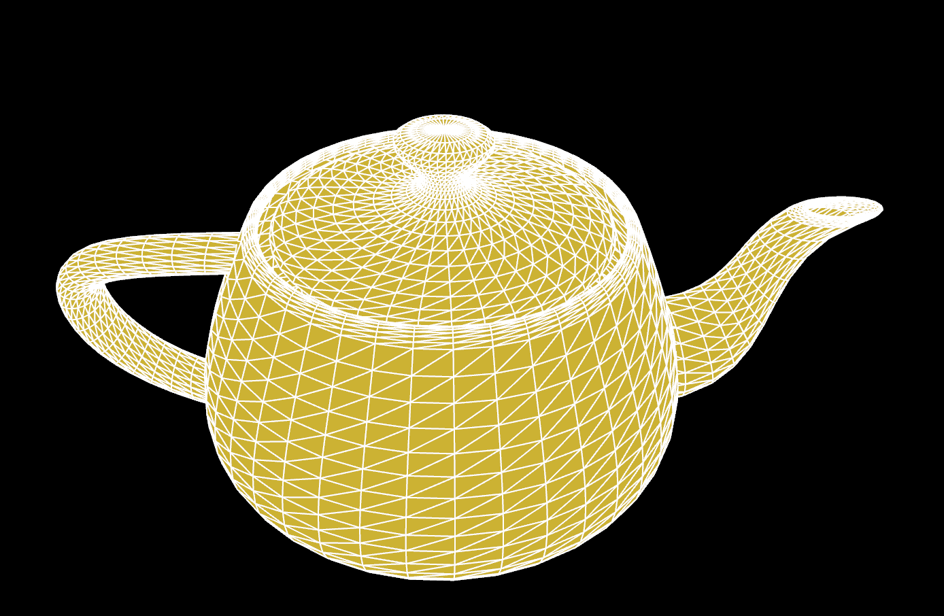
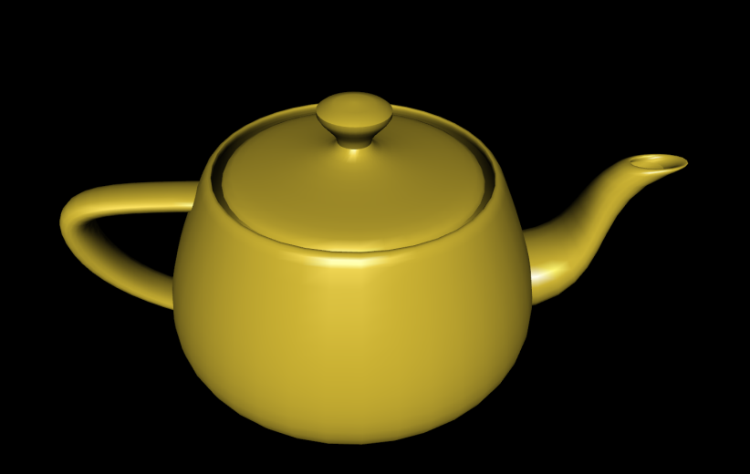
From SIMD to SIMT SIMT execution model
Using OpenGL as example.
19200 vertices => 19200 threads
Each thread has its own data=>
position, normal vector, etc.
Shader program =>
for lighting calculation
Each thread will execute the same program here with different data from its own.

Slide 12
From SIMD to SIMT SIMT execution model
Decode one instruction for multiple execution units.
Ex: 16 exec units
The programmer cares about the programming model, instead of operations.
Hardware controls the execution flow and thread dispatch.
Instruction
Decode
Shared register
Pool
EU
EU
EU
EU
EU
EU
EU
EU
EU
EU
EU
EU
EU
EU
EU
EU

Slide 13
From SIMD to SIMT SIMD instruction + SIMT model?
SIMD/SIMT, they can co-exist with each other.
Instruction
Decode
Shared register
Pool
Vector exec unit
EU
EU
EU
EU
Vector exec unit
EU
EU
EU
EU

Slide 14
From SIMD to SIMT scalar SIMT vs SIMD + SIMT
decode
decode
register
register
EU
EU
EU
EU
Vector exec unit
Vector exec unit
EU
EU
EU
EU
EU
EU
EU
EU
EU
EU
EU
EU
Vector exec unit
Vector exec unit
EU
EU
EU
EU
EU
EU
EU
EU
EU
EU
EU
EU
EU
EU
EU
EU
16 scalar cores vs 4 4-lane vector cores?

Slide 15
From SIMD to SIMT scalar SIMT vs SIMD + SIMT
Using scalar core in SIMT.
Advantage
Increase the execution unit’s utilization.
Even a vector based instruction can be simply divided into scalar part.
Disadvantage
More threads executed at same time means more thread-related data kept in registers.
We have an on-going project worked with ITRI
HSAIL-based SIMT shader processor

Slide 16
The Challenge of SIMT
How SIMT executes a branch instruction?
Which one is the target instruction if condition execution is involved?
Thread 1
R0 = 0
Thread 2
R0 = 0
Thread 3
R0 = 1
Thread 4
R0 = 1
If (R0 == 1)
R1 = 0;
else
R1 = 1;
If (R0 == 1)
R1 = 0;
else
R1 = 1;
If (R0 == 1)
R1 = 0;
else
R1 = 1;
If (R0 == 1)
R1 = 0;
else
R1 = 1;

Slide 17
The Challenge of SIMT divergence
Divergence
Threads are going in different direction and are not uniform anymore.
Naïve Solution – go through every code path.
If (R0 == 1) {
R1 = 0;
if (R7 == 1)
R2 = 1
}
else
R1 = 1;
Cycle 1
Cycle 2
Cycle 3

Slide 18
The Challenge of SIMT divergence
This is why the traditional Ray-tracing is still relied on cluster server (processor)
Photorealistic rendering method
Can be highly parallel. (project million to billion ray around the scene)
extreme high divergence in each ray-casting (thread) on photon collision, reflection, refraction, and diffusion computation.
Trace level: 5
Trace level: 50

Slide 19
The Challenge of SIMT divergence
There is still some solution for divergence
Hardware
Using more instruction issue unit and aggressive scheduler.
Trade-off between silicon area and computation power.
Software
Avoid branch operation. (depend on hardware and instruction architecture)
a = clamp( (b - c)*99999.0, 0.0, 1.0)
if (b-c) > 0
a = 1.0;
else
a = 0.0;

Slide 20
Conclusion
There are lots of issues about trade-off between utilization and computation power.
Deeper data parallel or aggressive scheduler?
Strongly application specific.

Slide 21
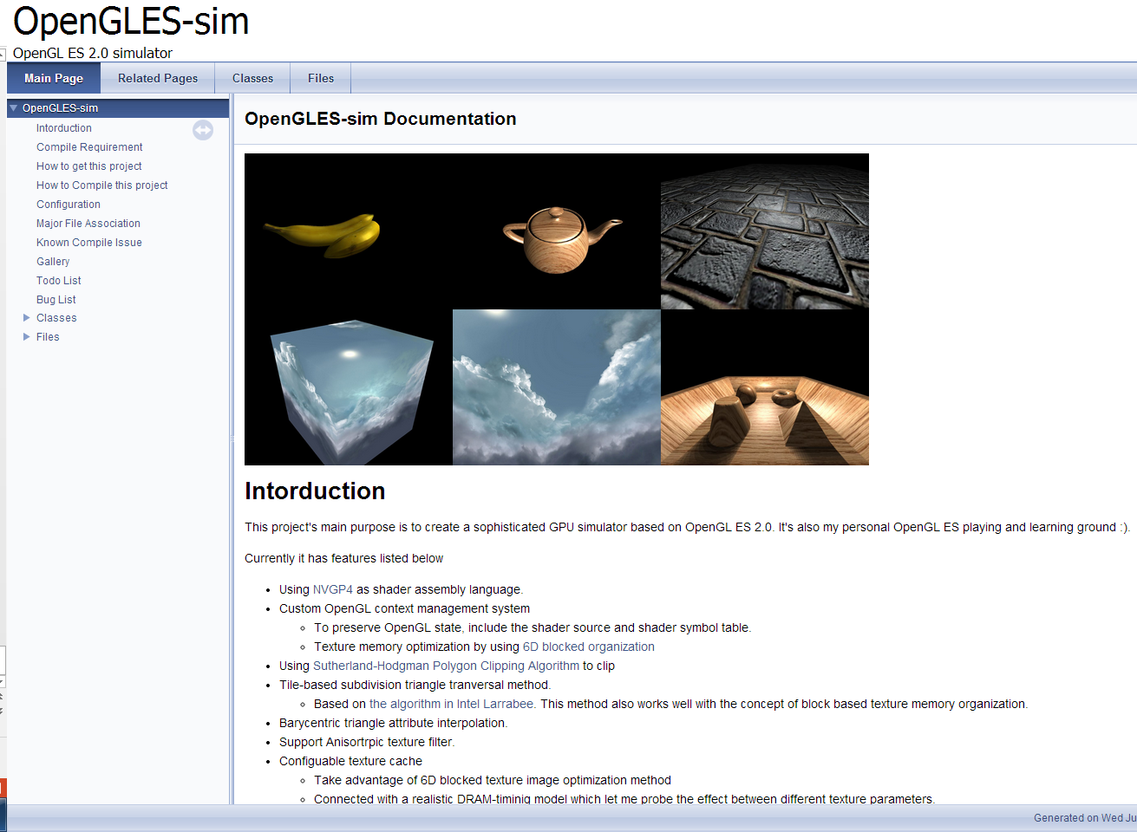
If you are interesting in Graphic
Web: http://lioujheyu.synology.me/~git/ogles1_1/
Git: http://lioujheyu.synology.me/~git/index.cgi/ogles1_1.git/

