Slide 1
3D computer graphic
Basis for real-time rendering and GPU architecture
劉哲宇,Liou Jhe-Yu

Slide 2
Motivation for learning graphics fundamentals
Q: I’m an architect. I do hardware, not algorithms. Can’t we just skip ahead to the case study?
A: Not really. You can’t understand 3D graphics architectures without understanding 3D graphics algorithms.
Q: Could I design my new Acme FlexiGPU architecture by optimizing for current graphics applications/ traces/benchmarks?
A: No, not if you want your architecture to be relevant when it’s done.
3D Graphics Architecture Tutoral(2004), W.Mark and H. Moreton, NVIDIA.

Slide 3
3D Graphics Architecture Tutorial(2004), W. Mark and H. Moreton, NVIDIA.

Slide 4
Outline
3D computer graphic
Real-time rendering – using OpenGL fixed function pipeline(1.5).
Geometry Stage
Rasterization stage
From fixed to Programmable
OpenGL shading pipeline

Slide 5
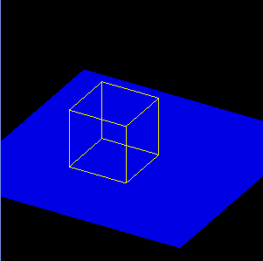
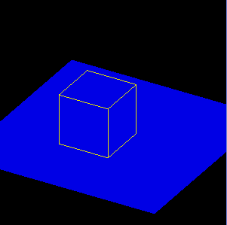
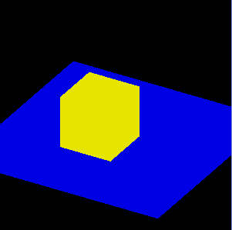
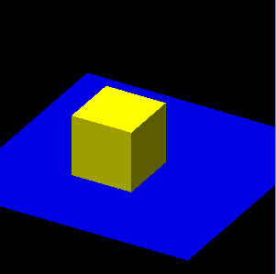
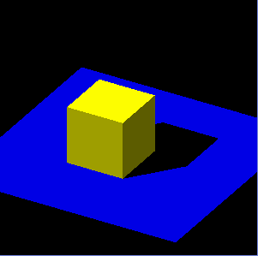
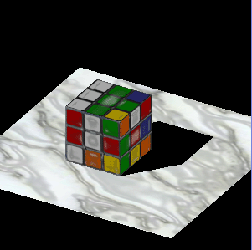
3D computer graphic
OpenGL Super Bible 3rd edition
Use 3D geometric data that are stored in the computer and then perform some specific calculations to render them on a 2D image.

Slide 6
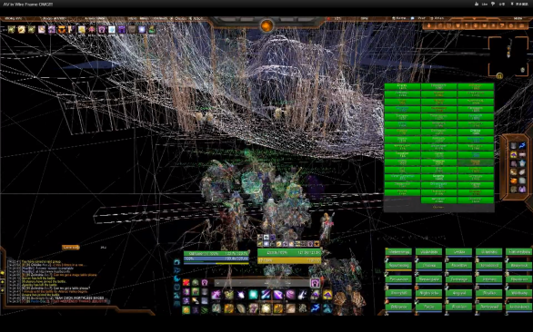
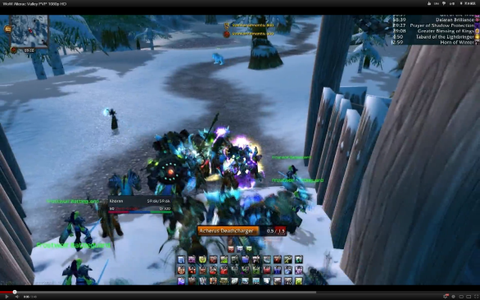
3D computer graphic Phases
3D modeling
Layout and animation
Rendering
World of Warcraft, Blizzard entertainment

Slide 7
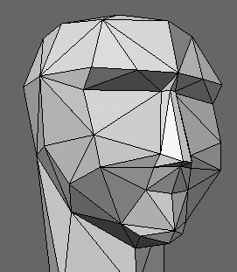
Polygon modeling
Vertex
Basic unit with geometry data
Triangle
3 vertices
Basic polygon
Curve surface
Triangles * N

Slide 8
Layout and animation
Place 3D object or vertex group.
Give them the relationship between time domain and movement vector.
May involve with physic simulation or motion capture on the human or animal movement.

Slide 9
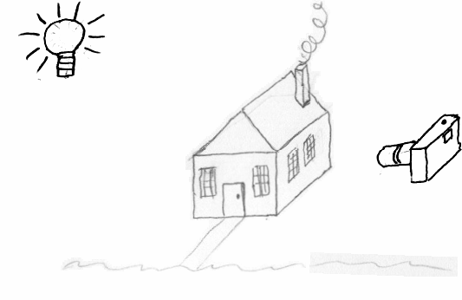
Rendering problem
Given
3D world
(objects and materials)
Light locations
A viewpoint
Compute
2D image scene from the
viewpoint

Slide 10
Rendering
Non real-time rendering
Cannot achieve 15 FPS (Frame per second) in modern GPU.
The most global illumination algorithm
Ray-tracing, radiosity, etc.
EX: movie for realistic image.
Toy Story 3, Pixar Disney
Created by Gilles Tran

Slide 11
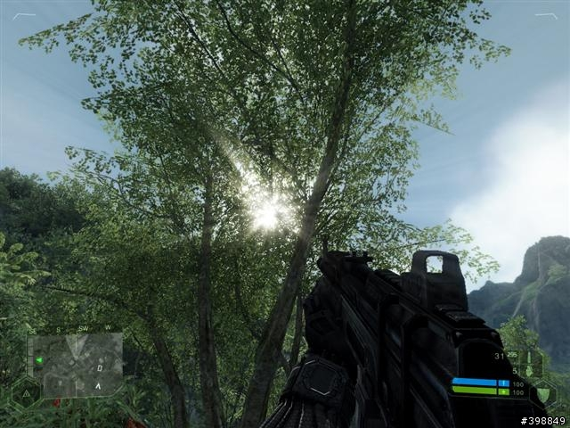
Rendering
Real-time rendering
Can display over 15 FPS.
For those interactive applications.
EX. Video game.
Simplified lighting model
and use texture image.
EX: OpenGL, DirectX
Crysis, Electronic Arts

Slide 12
What is OpenGL
Specify a series of abstract API.
Define its own virtual graphic pipeline.
Use APIs to control this pipeline and draw 3D image
Programmer doesn’t need to communicate directly with real hardware.
Cross-platform, cross-language, royalty-free,…
The OpenGL fixed-function pipeline (before OpenGL 2.0) is a really good entry point to know how the real-time rendering works.

Slide 13
Conventional OpenGL pipeline (OpenGL 1.5)

Slide 14
Processing sequence of OpenGL
Transformation and lighting
Triangle traversal and interpolation
Texture mapping

Slide 15
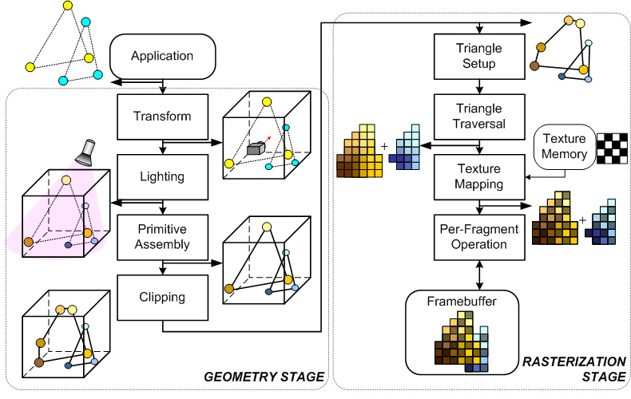
Geometry Stage
Model-view Transformation
Lighting
Projection Transformation
Primitive assemble
Clipping

Slide 16
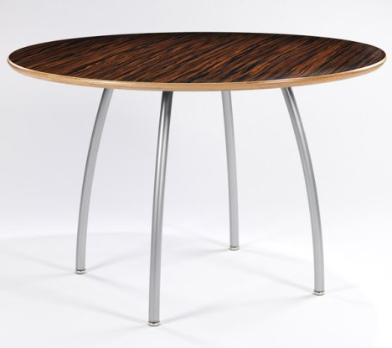
Transformation
Model-view
Transform an object from object coordinate into world coordinate.
Include translate, scale, and rotate matrix operation.
y
y
Translate
x
x
z
z

Slide 17
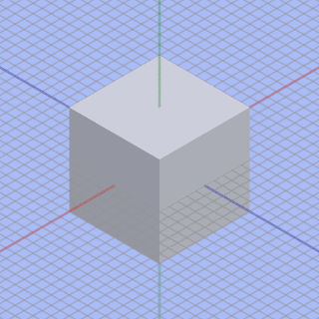
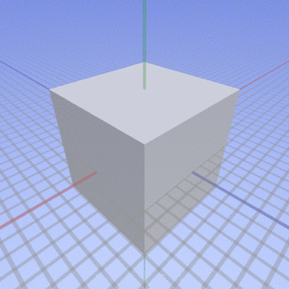
Transformation
Projection
Mapping 3D point onto 2D plane
Orthogonal vs. Perspective
Perspective projection
Objects in the distance appear smaller than objects close by.

Slide 18
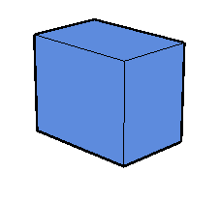
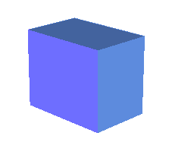
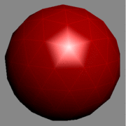
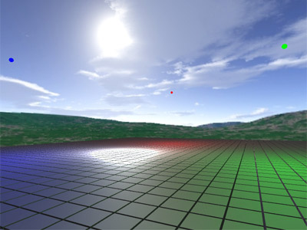
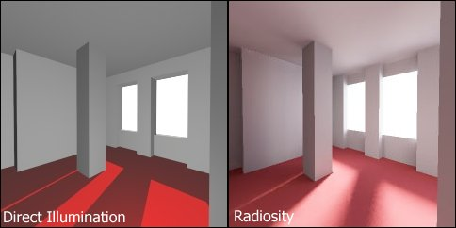
Lighting
Created by Hugo Elias

Slide 19
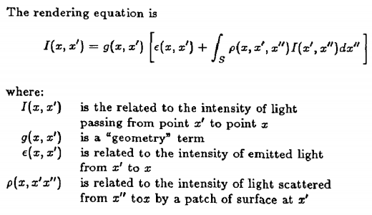
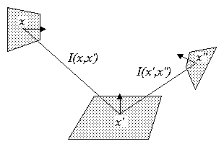
Lighting
Realistic render equation

Slide 20
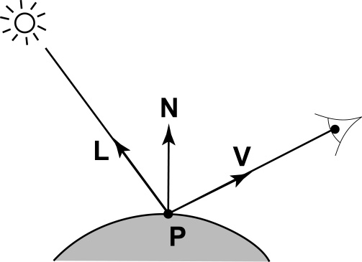
Lighting in OpenGL
OpenGL refines rendering equation
Break optical phenomena into three lighting models.
Break visible spectrum into red, green, and blue component.
Component
Lighting source position
Object position
Observation position
Object surface normal
Color material of light and object
Lighting must be done in world coordinate
After model-view but before projection

Slide 21
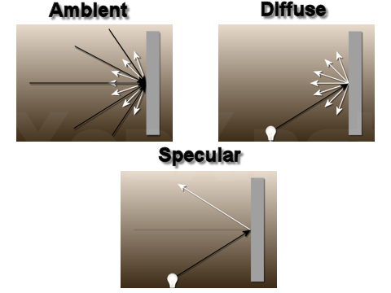
Lighting in OpenGL
3 lighting models in OpenGL
Ambient
Environment lighting
Diffuse
Object receives light effect and reflect its own color.
Specular
In particular angle, object will completely reflect light color.

Slide 22
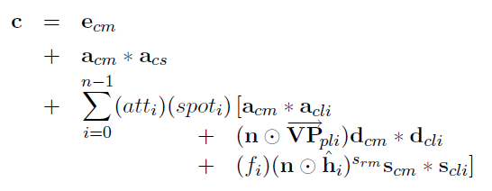
Lighting in OpenGL
OpenGL’s lighting equation
approximated equation to solve rendering problem.
No integrity and recursion.
Ambient
Diffuse
Specular

Slide 23
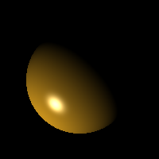
Lighting in OpenGL
Ambient
Diffuse
Specular
Amb + Diff
Diff + Spec
All

Slide 24
Surface shading model
Per-Vertex lighting
Flat shading
One polygon, one surface normal.
Gouraud shading
One polygon, three normals on three vertices.
Per-Pixel lighting
Phong shading
One polygon has lots of normal value for every pixel.

Slide 25
Surface shading model
Flat shading
Gouraud shading
Phong shading

Slide 26
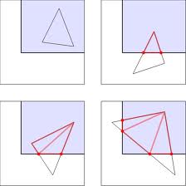
Primitive Assembly and Clipping
Primitive = basic 3D polygon (triangle)
Primitive Assembly
Gather three vertices into one triangle.
Clipping
Clip the triangle which is partially outside the view volume into new triangle set.

Slide 27
Rasterization Stage
Triangle Setup, traverse and interpolation
Anti-aliasing
Texture mapping & filter
Per-fragment operation

Slide 28
Triangle traverse and interpolation
Purpose: decompose a triangle into pixels.
Triangle traverse
Finding whether pixels are inside a triangle or not
Interpolation
Give those pixels property from the original triangle.
Color, texture coordinate, and so on.

Slide 29
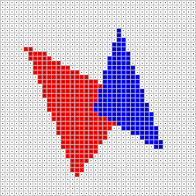
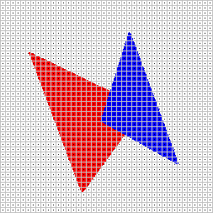
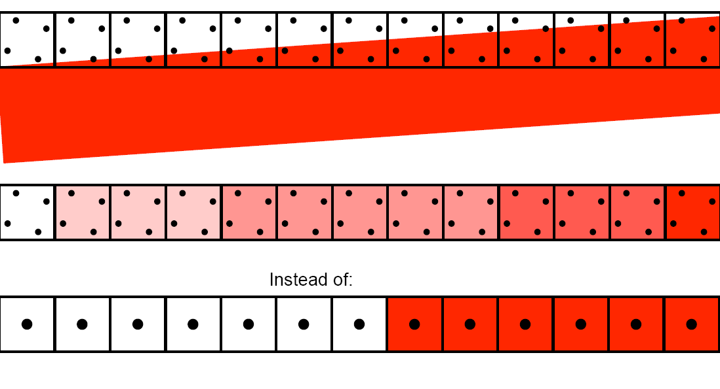
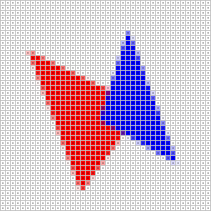
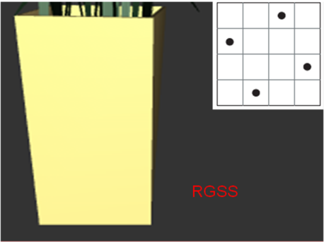
Anti-aliasing
Sample more sub-pixels then
combine them into one final pixel.

Slide 30
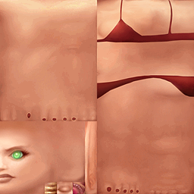
Texture mapping
Texture is not necessary if…
Use lots, lots, lots, of tiny polygons to present a 3D object.
Why do we need texture?
Give the object surface more details.
Decrease polygon complexity, and increase performance.

Slide 31
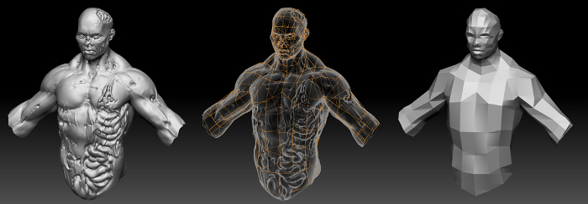
Texture mapping Downgrade polygon complexity and represent the detail
Path of exile, Grinding Gear Games

Slide 32
Texture mapping
Basic texture mapping
Give the fragment color
Procedure texture mapping
Give the fragment physic property and adjust the color.
Ex. Normal mapping

Slide 33
Texture mapping normal mapping
Supported by OpenGL 1.5
An approach to per-pixel lighting.
Have a normal map which restores the original surface normal at each texel.
(R,G,B) -> (x,y,z)
Re-do simplified lighting operation in texture mapping.

Slide 34
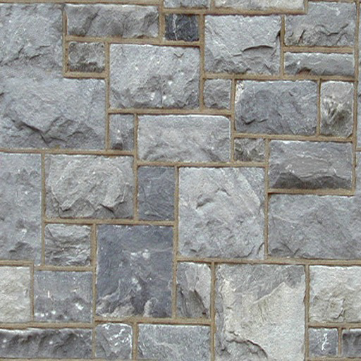
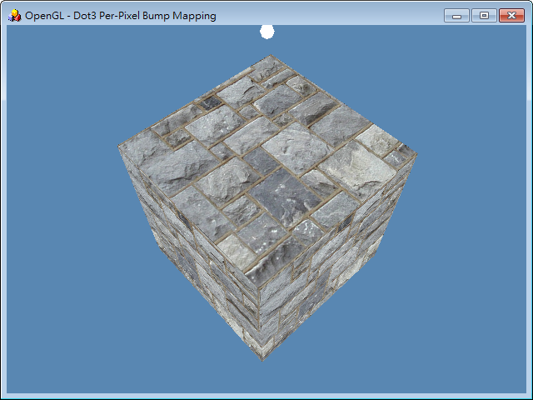
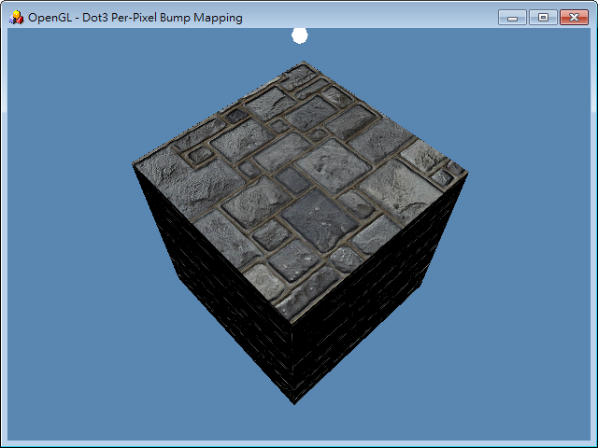
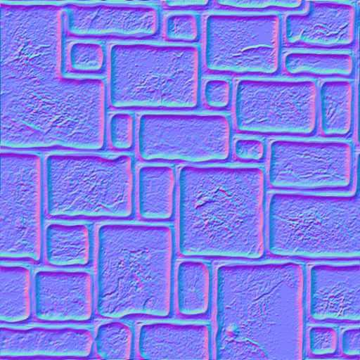
Texture mapping normal mapping example

Slide 35
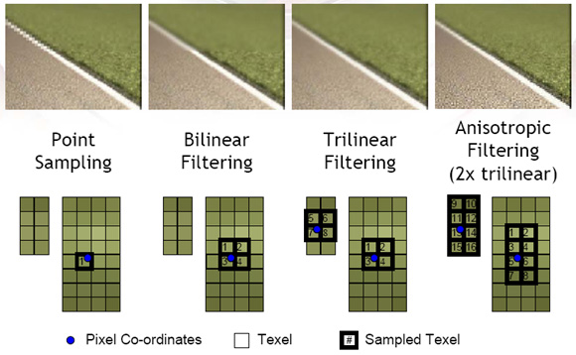
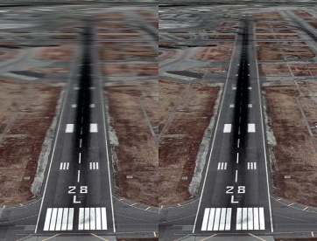
Texture filter
Pixel <-> texel
seldom one by one mapping.
The filter method decides whose texels will map to the specific pixel.

Slide 36
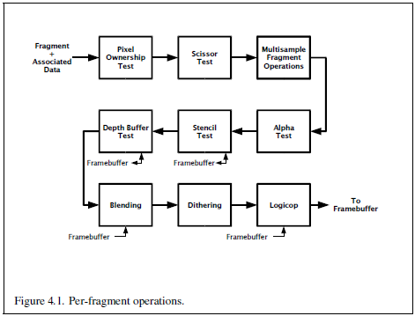
Per-fragment operation
The pixel flying in the OpenGL pipeline is considered as a fragment.

Slide 37
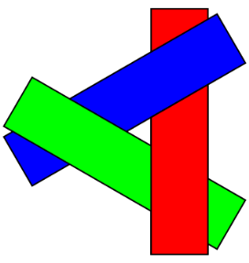
Painter algorithm
Visible problem.
Sorting polygons by depth and paint them in this sorting result.
Unable to solve cyclic overlap or piercing polygons

Slide 38
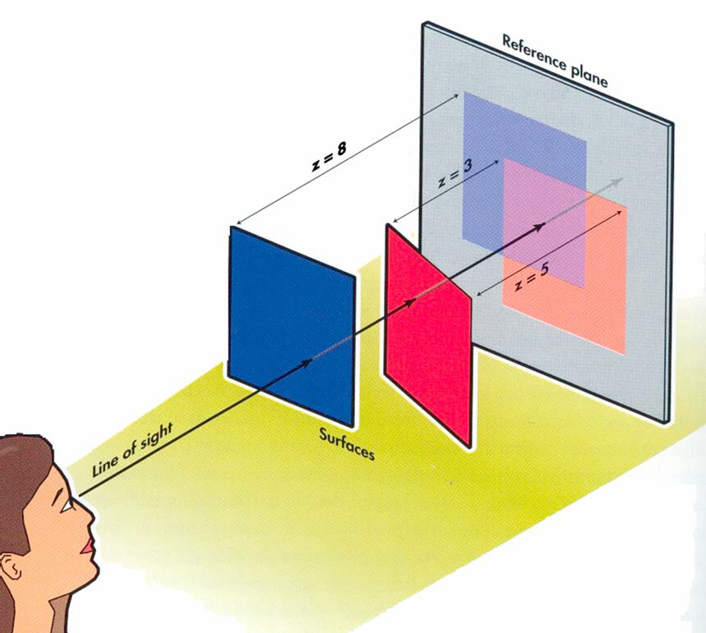
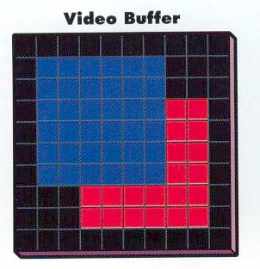
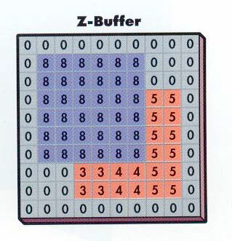
Z-buffer algorithm (Depth Test)
Prosise , How Computer Graphics Work Prosise

Slide 39
Alpha blending
Blend color from fragments and relative pixels in frame buffer.
For transparent object
However, alpha blending has image defect with depth test in some case.

Slide 40
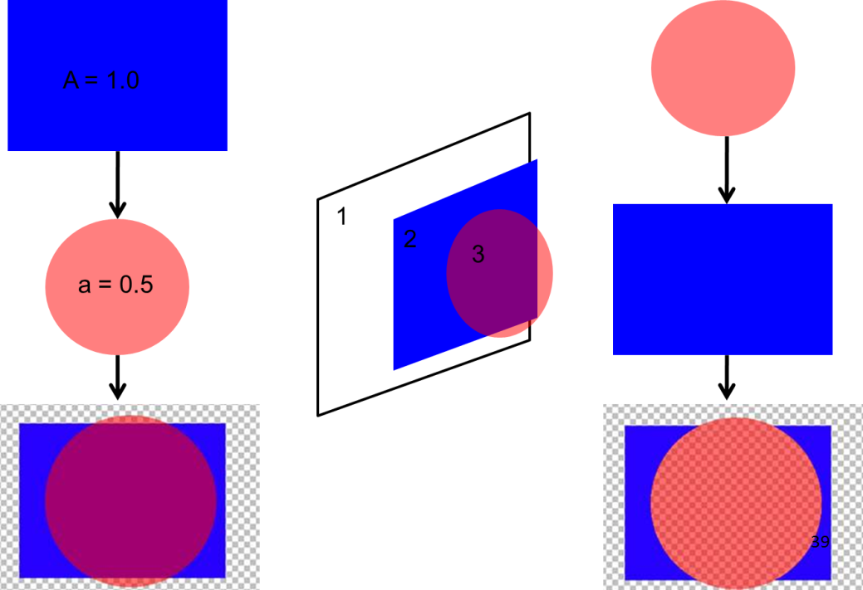
Alpha blending’s race condition (Order-dependent transparent)
Use painter algorithm to fix it (depth sorting)
Draw all opaque objects with depth test on.
Get drawing order by sorting transparent objects.
Draw transparent object in order with depth test on but depth write off.
Take care by programmer, not OpenGL……

Slide 41
OpenGL Conclusion
Programmer:
Prepare raw data.
Place Object and lighting source.
Optional operation.
Sort object if alpha blending is needed.
OpenGL (Hardware)
Calculating the effect between light and object.
Transforming 3D object into 2D image.
Executing texture operation

Slide 42
Outline
3D computer graphic
Real-time rendering – using OpenGL fixed function pipeline(1.5).
Geometry Stage
Rasterization stage
From fixed to Programmable
programmable shading pipeline

Slide 43
Texture operation wants more flexibility
In OpenGL 1.5, normal mapping can be “partially” achieved by calling and setting parameter in glTexEnv API.
API does know what is dot operation.
If I want to execute vecA Ω vecB in texture operation.
OpenGL : Ω ????

Slide 44
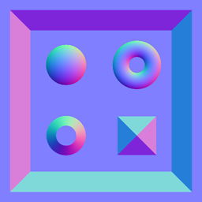
Lots of per-pixel lighting application under texture mapping
Color map, normal map, height map, light map, XXX map, ……, a lots of procedure map.
And their combination.
EX: parallax occlusion mapping.
Combine normal and height map
Normal mapping
Parallax occlusion mapping

Slide 45
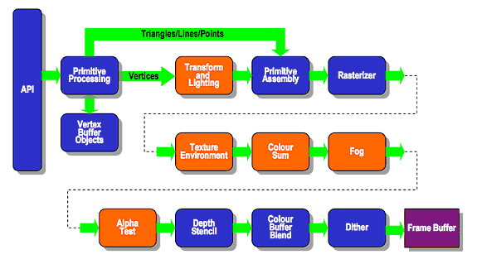
OpenGL 1.5 fixed function pipeline

Slide 46
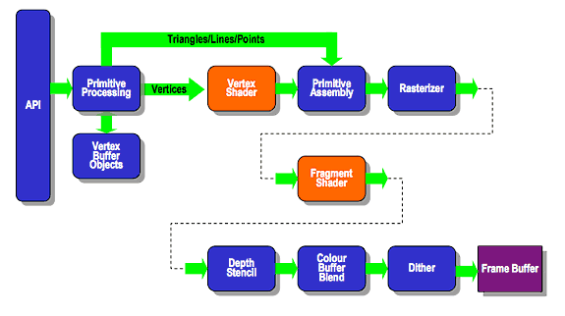
OpenGL 2.0 programmable pipeline

Slide 47
DirectX 10 pipeline (OpenGL 4.0)
Video memory
(Texture,
Buffer,)
Input primitive
Vertex Shader
Geometry Shader
Rasterizer
Fragment Shader
Per-fragment operation

Slide 48
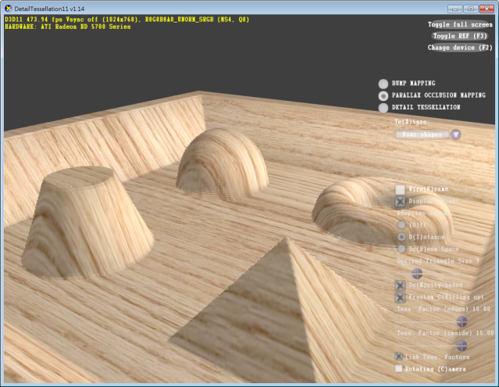
Geometry shader and tessellation
Dynamic Generate/delete polygon.
Parallax occlusion mapping
Tessellation

Slide 49
Programming pipeline with programmer
Advantage:
Freedom
More procedure texture applications, better image quality.
Special post production effect.
A solution for blending’s ordering problem can be made in advanced shader architecture without CPU pre-sorting.
Step forward to ray-tracing.
Disadvantage
No built-in light model and transformation function.

Slide 50
Fixed pipeline’s game example (OpenGL 1.5)
Doom 3 (2003), id Software

Slide 51
Programmable pipeline’s game ex.
Crysis 2 (2011), Crytek, Electronic Arts

Slide 52
Trend of application
Maintain the final image quality but decrease polygon complexity.
Simplify per-vertex lighting algorithm.
Use multi layer texture to reconstruct per-pixel lighting and shadow effect.
Make lighting equation closer to the rendering equation.

Slide 53
Not everything is programmable
Primitive assembly, clipping, and culling.
Triangle traverse and interpolation.
Texture filter
Some per-fragment operation

Slide 54
GPU Architecture?
See you next week
Thank you

