Slide 1
Dependency
Check Unit
Arbitrator
Local Memory
D-Cache
Register
Banks
Load/Store Unit
To Workgroup scheduler
Workgroup Initializer
Fetch Unit
Decoder
Instruction
Buffer
Warp
Scheduler
Crossbar
Dispatcher
Write-back
Unit
Operand
Collect Unit
Execution Unit
I-Cache
SIMT
Stack
Front-end Pipeline
Back-end Pipeline

Slide 2
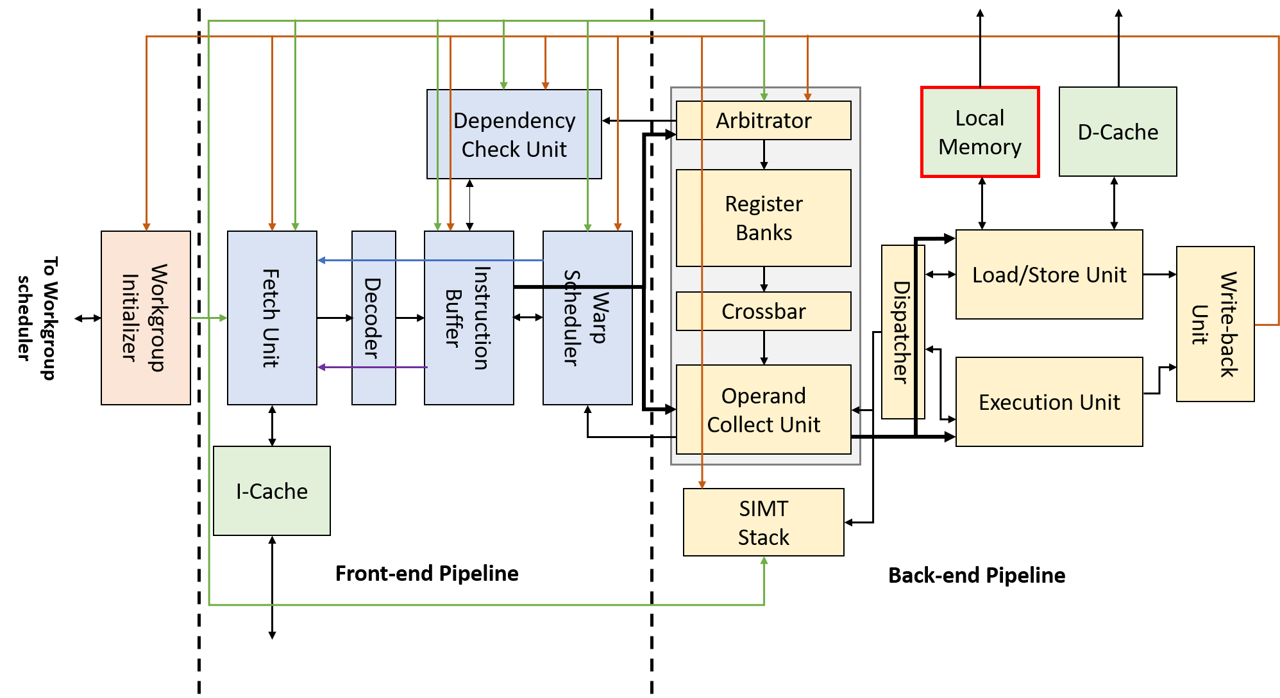
Local Memory
Sequential circuit
a.k.a. shared or group memory
Shared by all warps in same Workgroup
Base address for each Workgroup are stored in special registers

