Slide 1
Supplement on Verilog combinational circuit examples
Based on
Fundamentals of Digital Logic with Verilog Design
By Brown/Vranesic 3rd.
Chung-Ho Chen

Slide 2
Conditional Execution
A = (x1< x2)? (B+1): (B);
If x1 < x2, A = B+1, else
A = B;
A MuX: Form 1
module mux_2to1 (x0, x1, s, f);
input x0, x1, s;
output f;
assign f = s ? x1 : x0;
endmodule
A MuX: Form 2
module mux_2to1 (x0, x1, s, f);
input x0, x1, s;
output reg f;
always @(x0, x1, s)
f = s ? x1 : x0;
endmodule
Continuous assignment
always block

Slide 3
Conditional Execution
A = (x1< x2)? (B+1): (B);
If x1 < x2, A = B+1, else
A = B;
A MuX: Two conditional bits declared in vectored signal
module mux_4to1 (x0, x1, x2, x3, S, f);
input x0, x1, x2, w3;
input [1:0] S;
output f;
assign f = S[1] ? (S[0] ? x3 : x2) : (S[0] ? x1 : x0);
endmodule
s
0
s
1
s
s
f
1
0
x
0
00
0
0
x
x
0
1
01
f
0
1
x
1
x
2
10
1
0
x
x
11
2
3
1
1
x
3
First see if s₁ is 1, if true, then if s₀ is true: then f = x3

Slide 4
Conditional Execution using if else
2to1 MuX
module mux_2to1 (x0, x1, s, f);
input x0, x1, s;
output reg f;
always @(x0, x1, s)
if (s==0)
f = x0;
else
f = x1;
endmodule
module mux_2to1 (x0, x1, s, f);
input x0, x1, s;
output reg f;
always @(x0, x1, s)
f = s ? x1 : x0;
endmodule

Slide 5
Conditional Execution Using case
module mux_4to1 (x, s, f);
input [0:3] x;
input [1:0] s;
output reg f;
always @(x, s)
case (s)
0: f = x[0];
1: f = x[1];
2: f = x[2];
3: f = x[3];
endcase
endmodule
module mux_2to1 (x0, x1, s, f);
input x0, x1, s;
output reg f;
always @(x0, x1, s)
if (s==0)
f = x0;
else
f = x1;
endmodule
2’b00

Slide 6
Signal states: 0, 1, z, or x
High impedance state z: output behaves like an open circuit and not connected to any defined voltage value.
Don’t care state x: does not matter whether a given logic variable has the value of 0 or 1.

Slide 7
Example of using casex
module priority (U, Y, z);
input [3:0] U;
output reg [1:0] Y;
output reg z;
always @(U)
begin
z = 1;
casex (U)
4'b1xxx: Y = 3;
4'b01xx: Y = 2;
4'b001x: Y = 1;
4'b0001: Y = 0;
default: begin
z = 0;
Y = 2'bx;
end
endcase
end
endmodule
U
3
U
2
U
1
U
0
y
y
z
1
0
0
0
0
0
d
d
0
0
0
0
1
0
0
1
0
0
1
x
0
1
1
0
1
x
x
1
0
1
1
x
x
x
1
1
1
U3 has the highest priority.

Slide 8
Verilog Operators
Bitwise AND
Bitwise OR
A[2:0], B[2:0]; f, w is scalar
1. f = A & B, (bitwise and)
only the least significant bits are involved, ie, f = A[0] & B[0];
2. f = !A; f = 1 only if all bits in A are 0, ie,
f = ~(a2 +a1 +a0).
f = A && B; f=(a2+a1+a0) . (b2+b1+b0)
f =&A; f = a2.a1.a0. (reduction and)
Concatenate and Replication: {3{A}}= {A,A,A} = a2a1a0a2a1a0a2a1a0
&
0
1
x
|
0
1
x
0
0
0
0
0
0
1
x
1
0
1
x
1
1
1
1
x
0
x
x
x
x
1
x
Bitwise XOR
Bitwise XNOR
^
0
1
x
~ ^
0
1
x
0
0
1
x
0
1
0
x
1
1
0
x
1
0
1
x
x
x
x
x
x
x
x
x

Slide 9
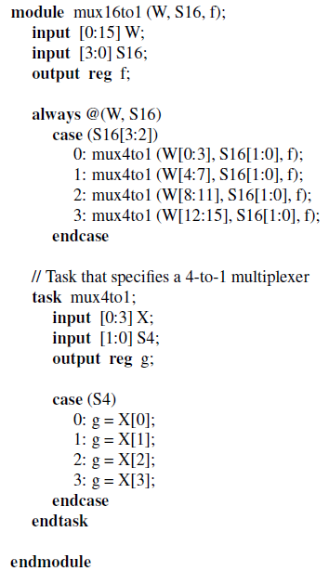
Using Task in Verilog
4 Inputs of 16to1
Task: circuit routine for replication
Output of a task must be a variable.
The task must be included in the module that calls it.
A task can call another task and it may invoke a function.

Slide 10
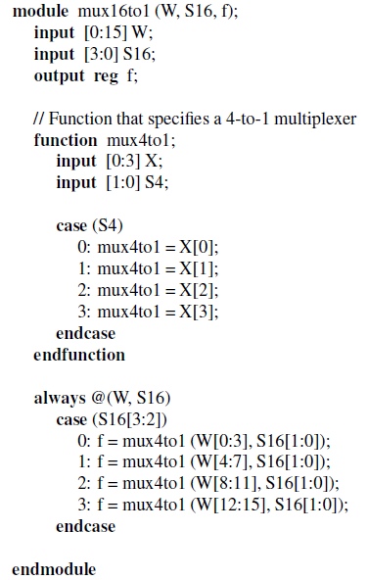
Using Function in Verilog
Function: circuit function for invocation
Return a single value which is placed where the function is invoked.
A function can call other function but cannot call a task.
Input
Return one of the inputs (W₁₂₋₁₅)

