Slide 1
Multiplication and Division basics

Slide 2
Multiplication
More complicated than addition
  accomplished via shifting and addition
More time and more area
Let's look at 3 versions based on gradeschool algorithm
0010 (multiplicand)
__x_1011 (multiplier)
0010
0010
0000
0010
See if the right most bit of the multiplier is 1.
  Shift 1 bit right for the multiplier
  Note the position of placement
    Multiplicand is shifted left.
Negative numbers: convert and multiply
  there are better techniques, we won’t look at them
Partial
product

Slide 3
Multiplication: first version Implementation

Slide 4
Multiplication: first version Implementation

Slide 5
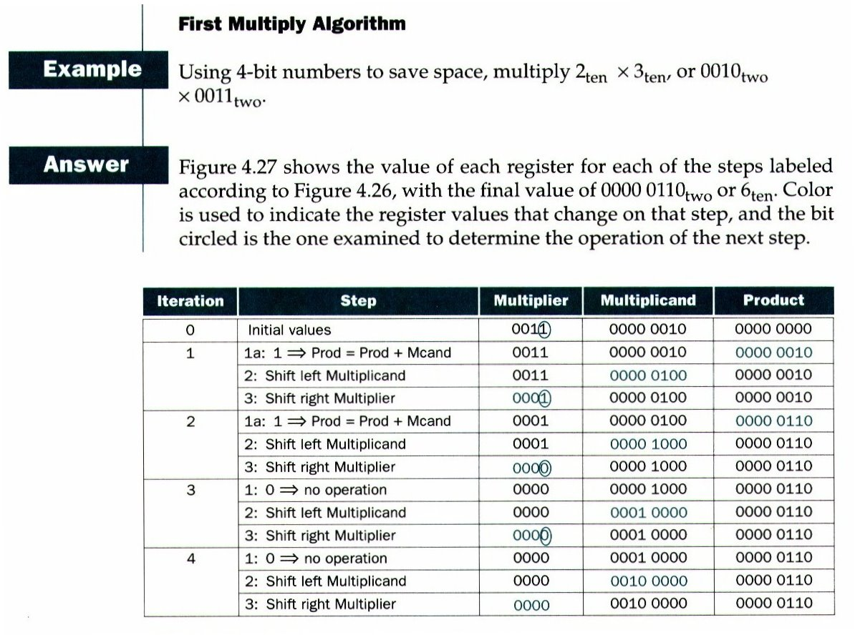

Slide 6
Second Version
Observe the addition
  Only 4 bits are added at a time
  The left most 4 bits are added
  The right most bit of the product is not changed once we got it.

Slide 7
Second Version

Slide 8
Final Version

Slide 9
Final Version

Slide 10
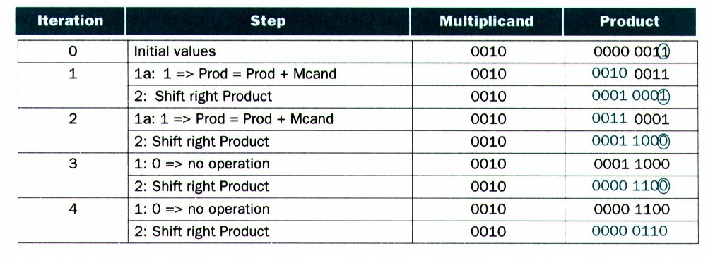
Final version
2 x 3

Slide 11
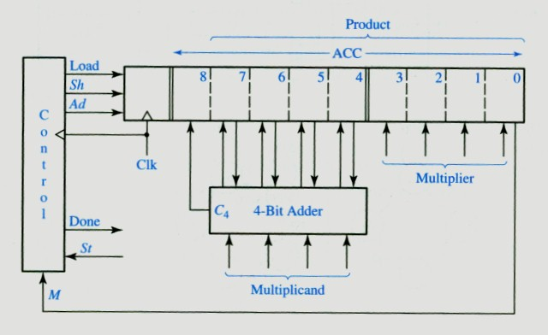
An implementation example
Product register [3:0] = multiplier
Load: ACC = 00000::multiplier
Sh: shift ACC 1 bit right.
St: start signal, start operation.
M bit: M= 1, add + shift. M = 0, shift.

Slide 12
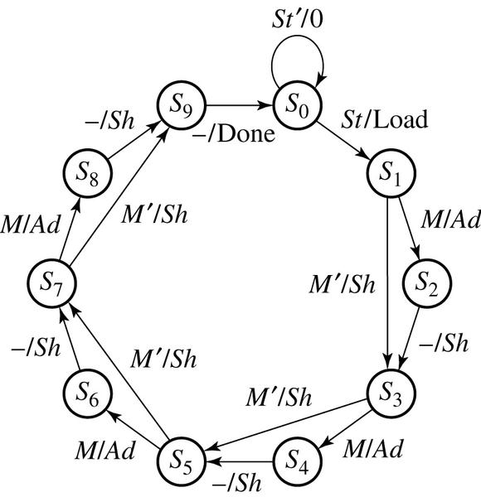
Controller Implementation
M/Ad: If M = 1 then Ad = 1, the rest of outputs is 0.
How many clocks are required for a multiplication?
Reset (waits for start)
One bit

Slide 13
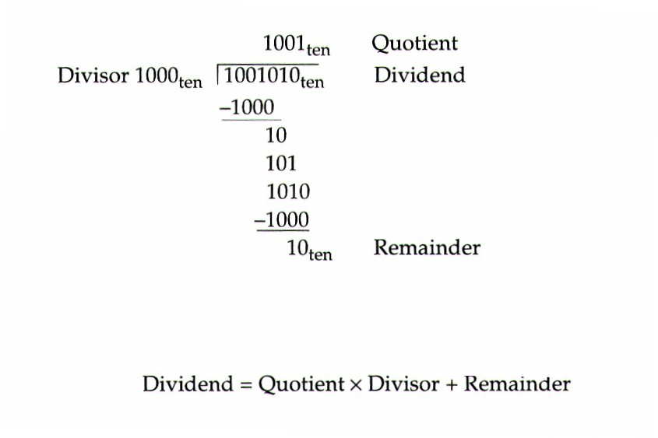
Division
Subtract and shift
Subtract from the left
  Divisor concatenated with 0000

Slide 14
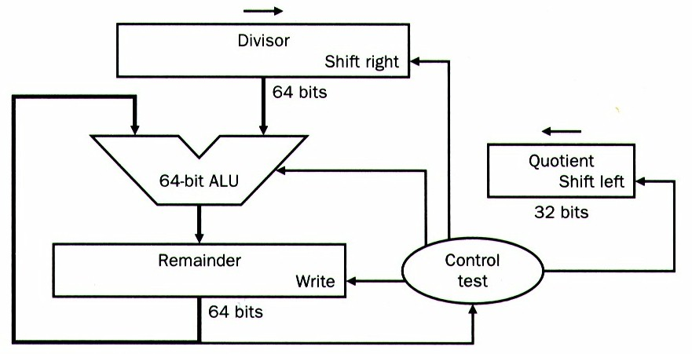
First version
Shift the divisor right

Slide 15
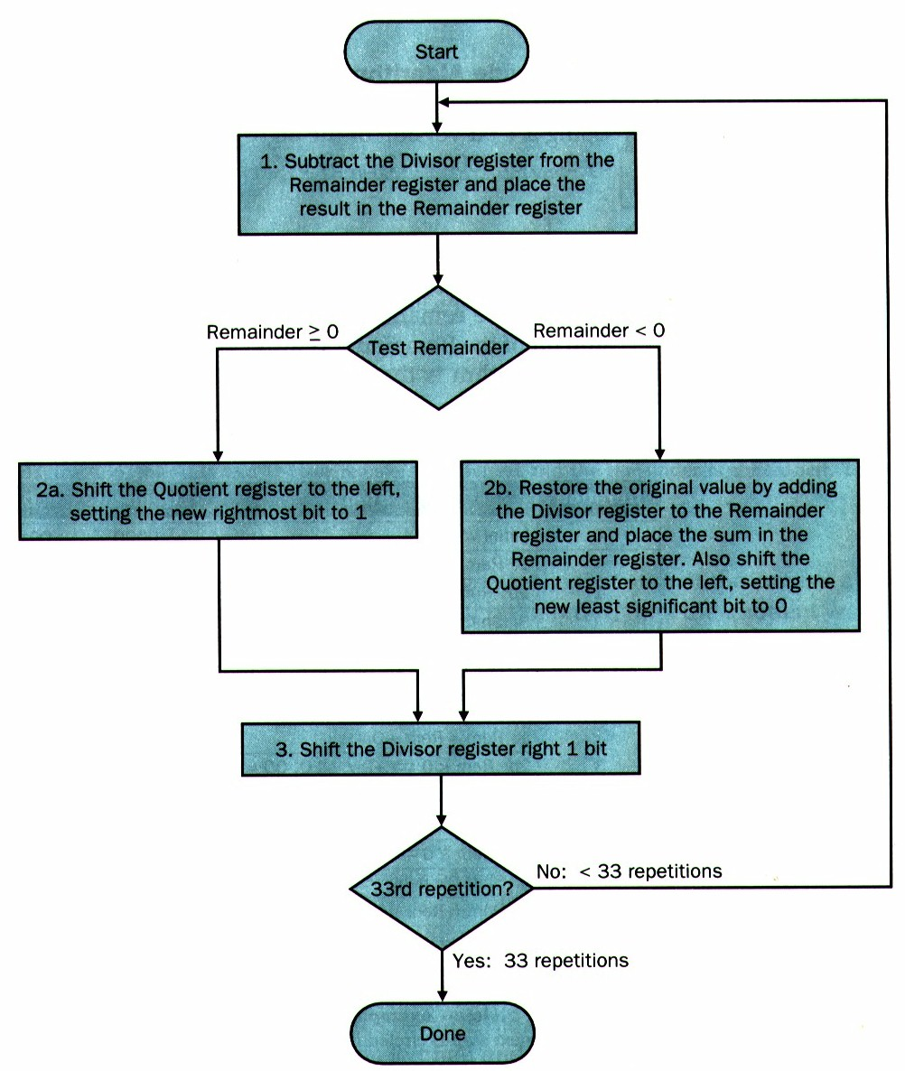
First version

Slide 16
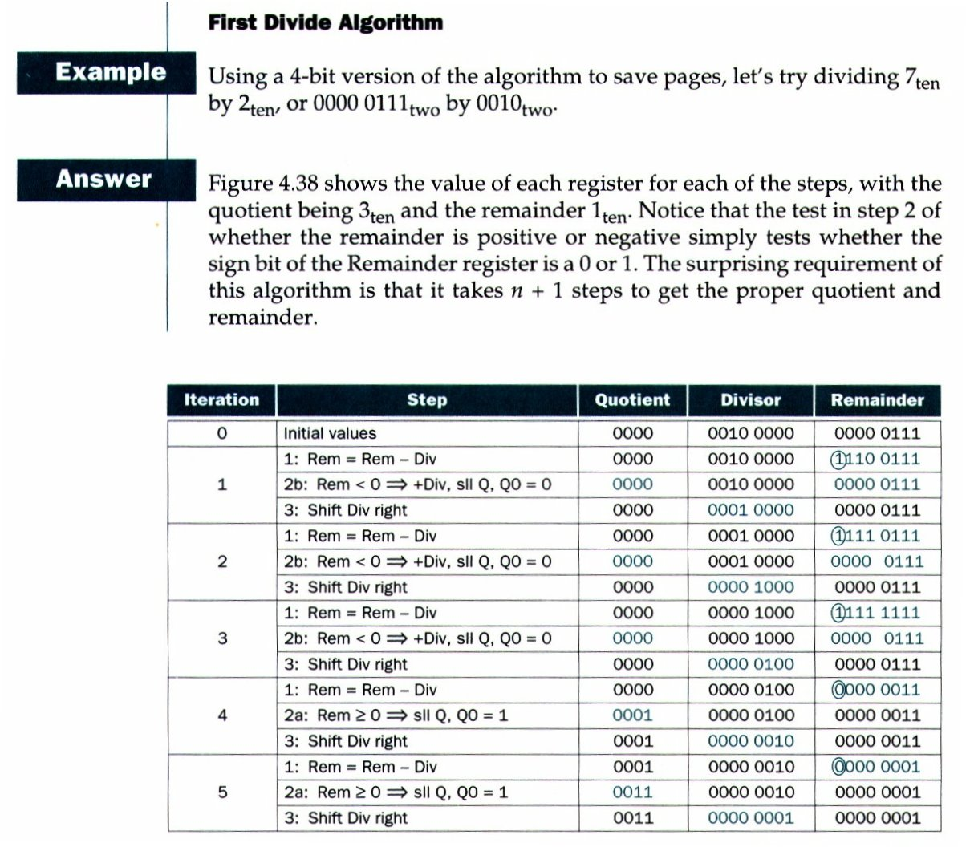
First version example

Slide 17
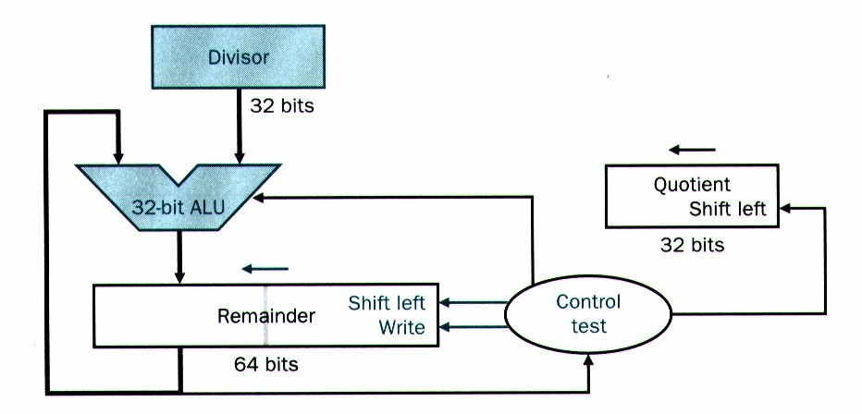
Second version
Reduce hardware cost
  Shift the remainder left
  Keep the divisor where it is
  Only 4 bits are subtracted at a time (4-8 bit case)

Slide 18
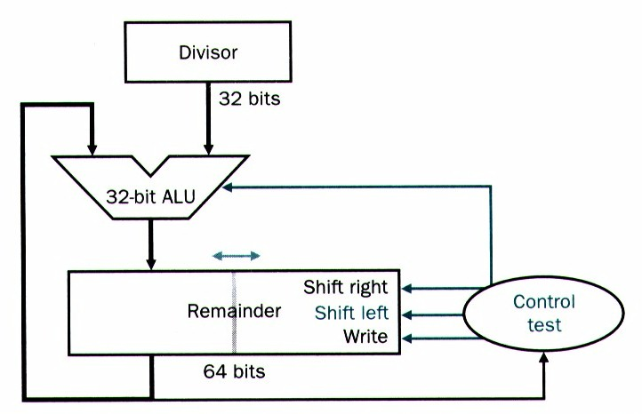
Third version
Reduce hardware cost further
  Quotient value goes to remainder register

Slide 19
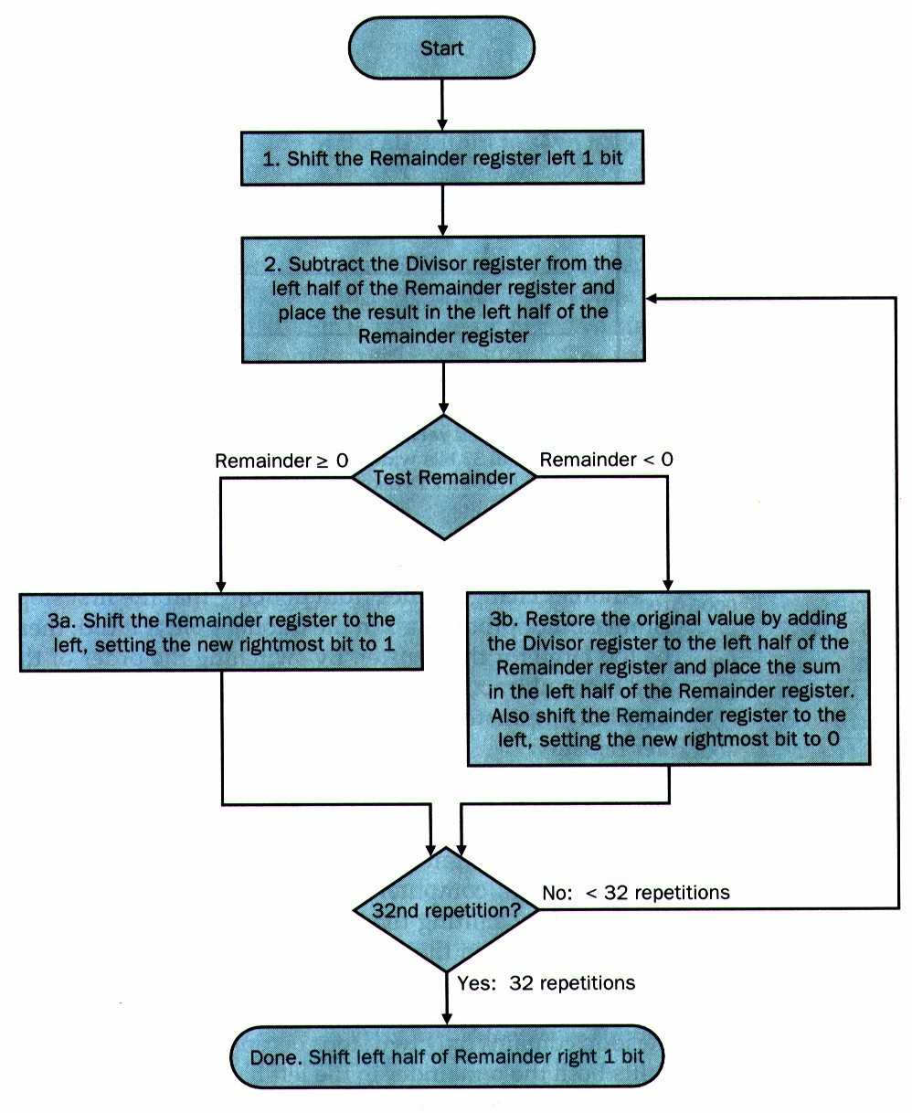
Third version

Slide 20
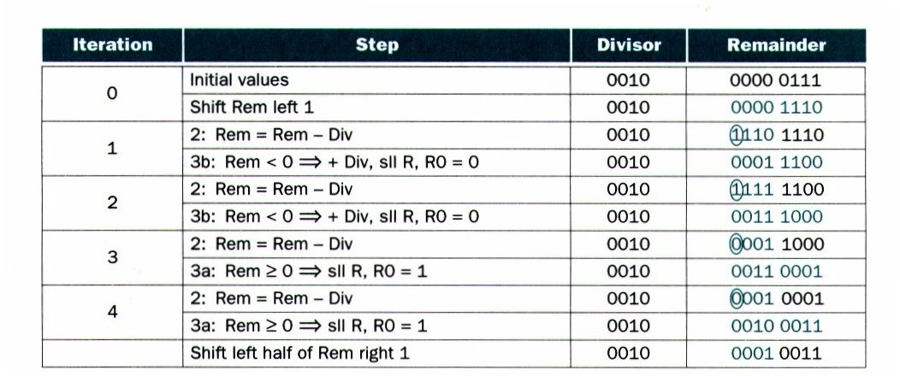
Third version example

Slide 21
Signed division
Dividend = quotient x divisor + remainder
Ignore the sign for computation
Remember the signs of divisor and dividend
  Negate the quotient if the signs are different
  Dividend and remainder must have the same sign
-7 / -2 : Q = +3, remainder = -1
+7 / -2 : Q = -3, remainder = + 1

