Slide 1
Lecture 11-1 FPGA
We have finished combinational circuits, and learned registers. Now are ready to see the inside of an FPGA.

Slide 2
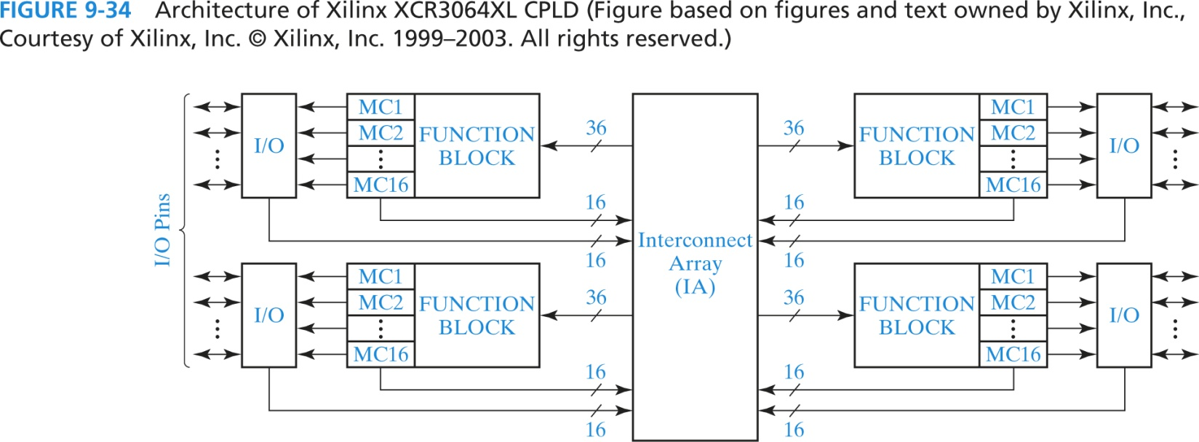
Complex Programming Logic Devices
Xilinx XCR3064XL CPLD
Function block (16 macrocells)= PLA
Macrocell = a flip flop + multiplexers
IA routes signals
Input of function block

Slide 3
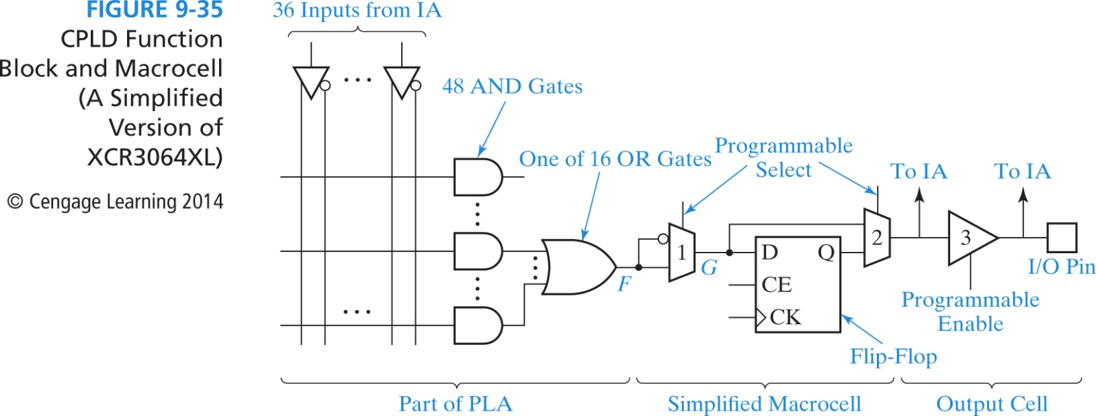
Function Block and MC
Signal from PLA -> marcocell -> I/O pin
Use CAD tool to fit the design into the PLD.

Slide 4
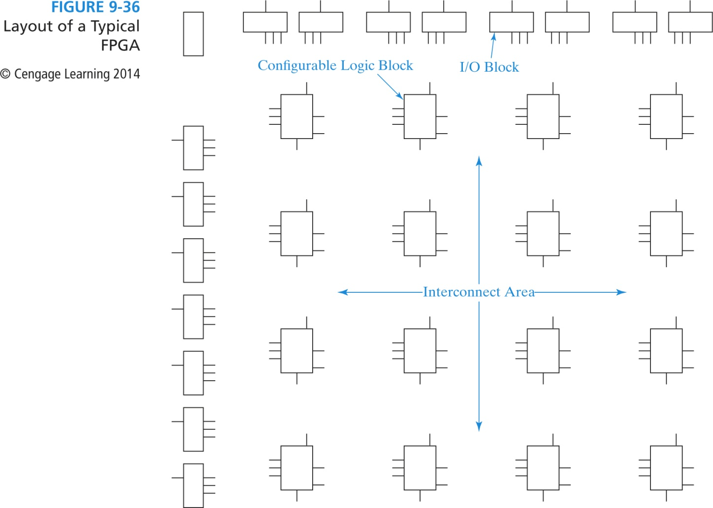
Field Programmable Gate Arrays (FPGA)
Logic cell: configurable logic blocks (CLBs)
Input/Output blocks (I/O blocks)

Slide 5
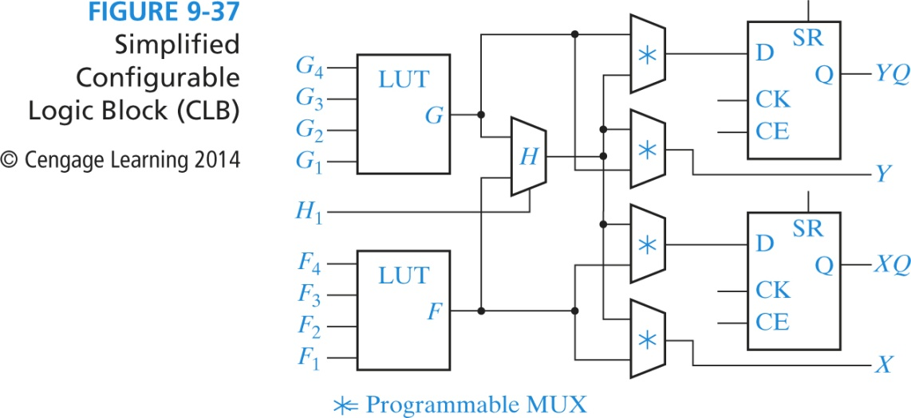
Configurable Logic Block
Inside a CLB: function generators (LUT), FFs, and MUXs
LUT: lookup table (truth table) is a reprogrammable ROM (16 1-bit words)

Slide 6
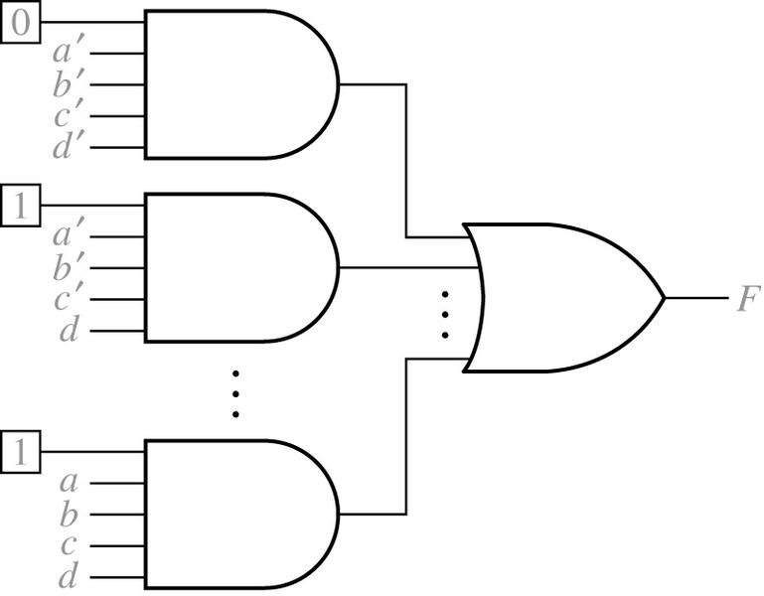
A Lookup Table (LUT)
If we want F = abc (one minterm)
1110 (and F=1) + 1111 (and F=1)
Or if we want F = a’b’c’d’ + a’b’cd’ + …abcd. (15 minterms)
Require a single function generator. Program the LUT table to get what we want.
To be implemented
This is a 4-variable function
generator.
a b c d F
0 0 0 0 0
0 0 0 1 1
0 0 1 0 1
…..
1 1 1 1 1
Bit stored in the LUT.

Slide 7
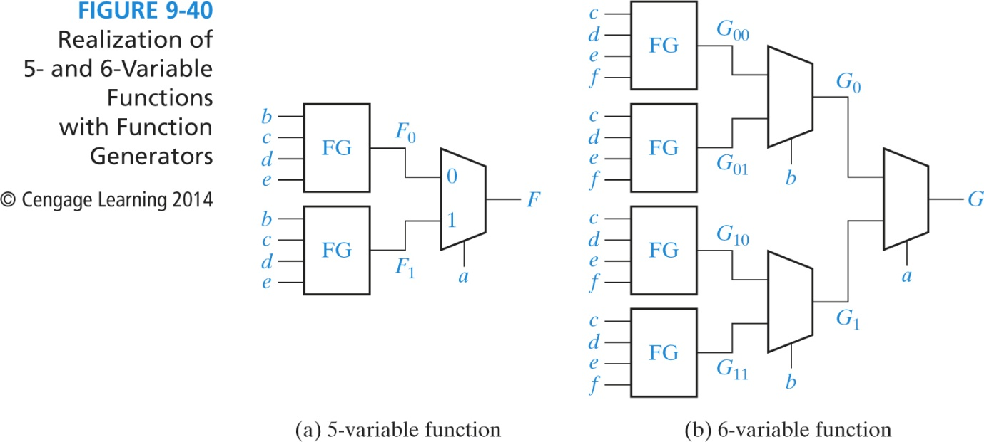
Application of Shannon’s Expansion Theorem
What if # of variables > 4 variables
f (x₁, x₂,… x_{n})
= x_{i}’ f (x₁, x₂,..x_{i-1}, 0, x_{i+1}, … x_{n}) +
x_{i} f (x₁, x₂,..x_{i-1}, 1, x_{i+1}, … x_{n})
= x_{i}’ f₀ + x_{i}f₁
f (a, b, c, d, e) = a’ f(0, b, c, d, e) + a f(1, b, c, d, e)
Let a = 0, what lefts
are terms with b, c, d, e
2-1 MUX F = a’I₁ + a I₂

Slide 8
Shannon’s Expansion Theorem: a majority function
f = x₁x₂ + x₁x₃ + x₂x₃
= ~x₁(x₂x₃) + x₁(x₂+x₃+x₂x₃); //let x₁ = 0 for f, and let x₁= 1 for f
= ~x₁(x₂x₃) + x₁(x₂+x₃)
What is the circuit using a 2-1 MUX for x₁ ?

Slide 9
Shannon’s Expansion Theorem: XOR
Ex: f = x₁⊕ x₂ ⊕ x₃
= ~x₁(0⊕ x₂ ⊕ x₃) + x₁(1⊕ x₂ ⊕ x₃)
= ~x₁(x₂ ⊕ x₃) + x₁~(x₂ ⊕ x₃)
x
1
x
2
f
x
1
x
2
x
3
f
f = x1 ⊕ x2
x
0
0
0
0
2
x
0
0
1
1
1
x
⊕
2
x
3
x
3
0
1
0
1
f
0
1
1
0
1
0
0
1
1
0
1
0
x
⊕
2
x
3
1
1
0
0
1
1
1
1

Slide 10
Shannon’s expansion for more than two variables
f (x₁, x₂,… x_{n})
= x_{i}’ f (x₁, x₂,..x_{i-1}, 0, x_{i+1}, … x_{n}) + x_{i} f (x₁, x₂,..x_{i-1}, 1, x_{i+1}, … x_{n})
= x_{i}’ f₀ + x_{i}f₁
Say for x₁ and x₂;
f (x₁, x₂,… x_{n})
= x₁’ x₂’ f (0, 0, x₃… x_{n}) + x₁’ x₂ f (0, 1, x₃… x_{n}) + x₁ x₂’ f (1, 0, x₃… x_{n}) + x₁ x₂ f (1, 1, x₃… x_{n})
This expansion can be implemented by a 4-to-1 multiplexer where x₁ and x₂ are the selection signals.

