Slide 1
Abstraction and Inter-Discipline in EE
Department of Electrical Engineering
National Cheng-Kung University
Prof. Chung-Ho Chen (陳中和)

Slide 2
Outline
IT technology and EE courses
Abstraction [æb ‘strækʃən]
Discipline [‘dɪsəplɪn]
Inter-discipline

Slide 3
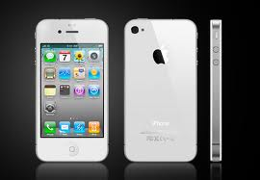
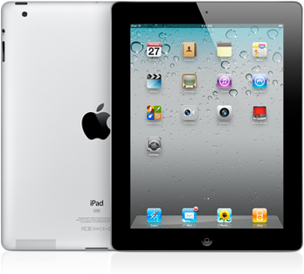
Key Player
Apple

Slide 4
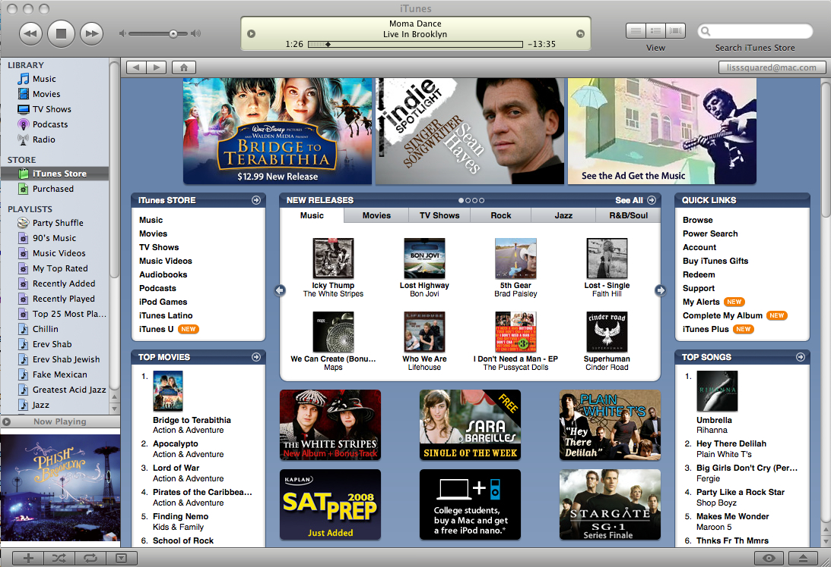
Beyond Physical forms of Products
iTunes
iTunesU
App
Book

Slide 5
Get a course from iTunes U
iTunes U

Slide 6
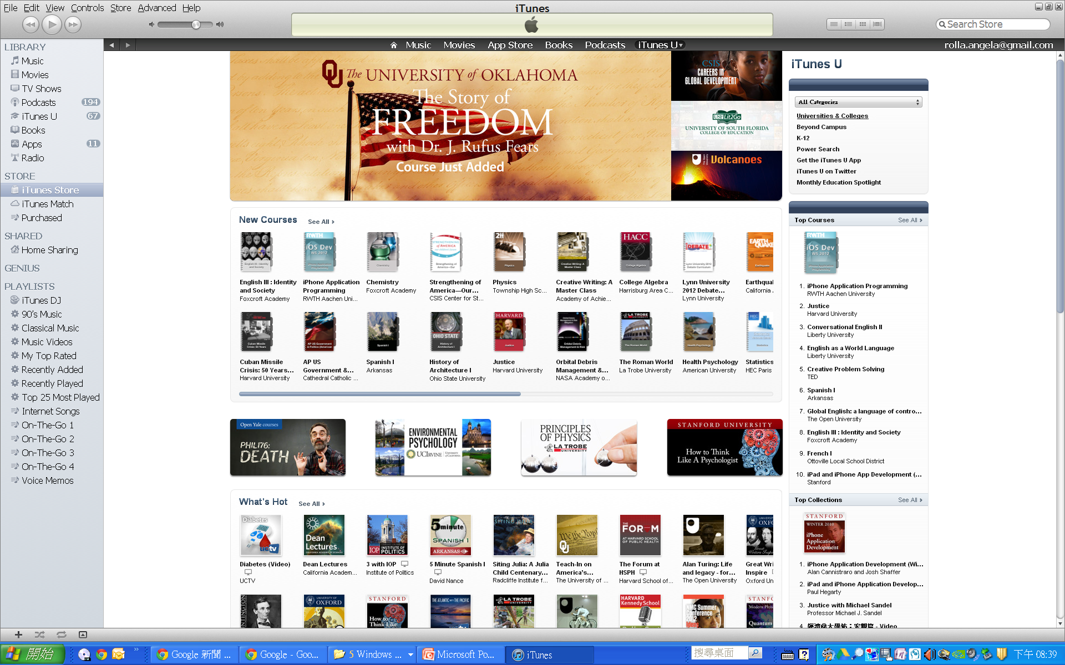
Get a school and select Eng..
University
& colleges

Slide 7
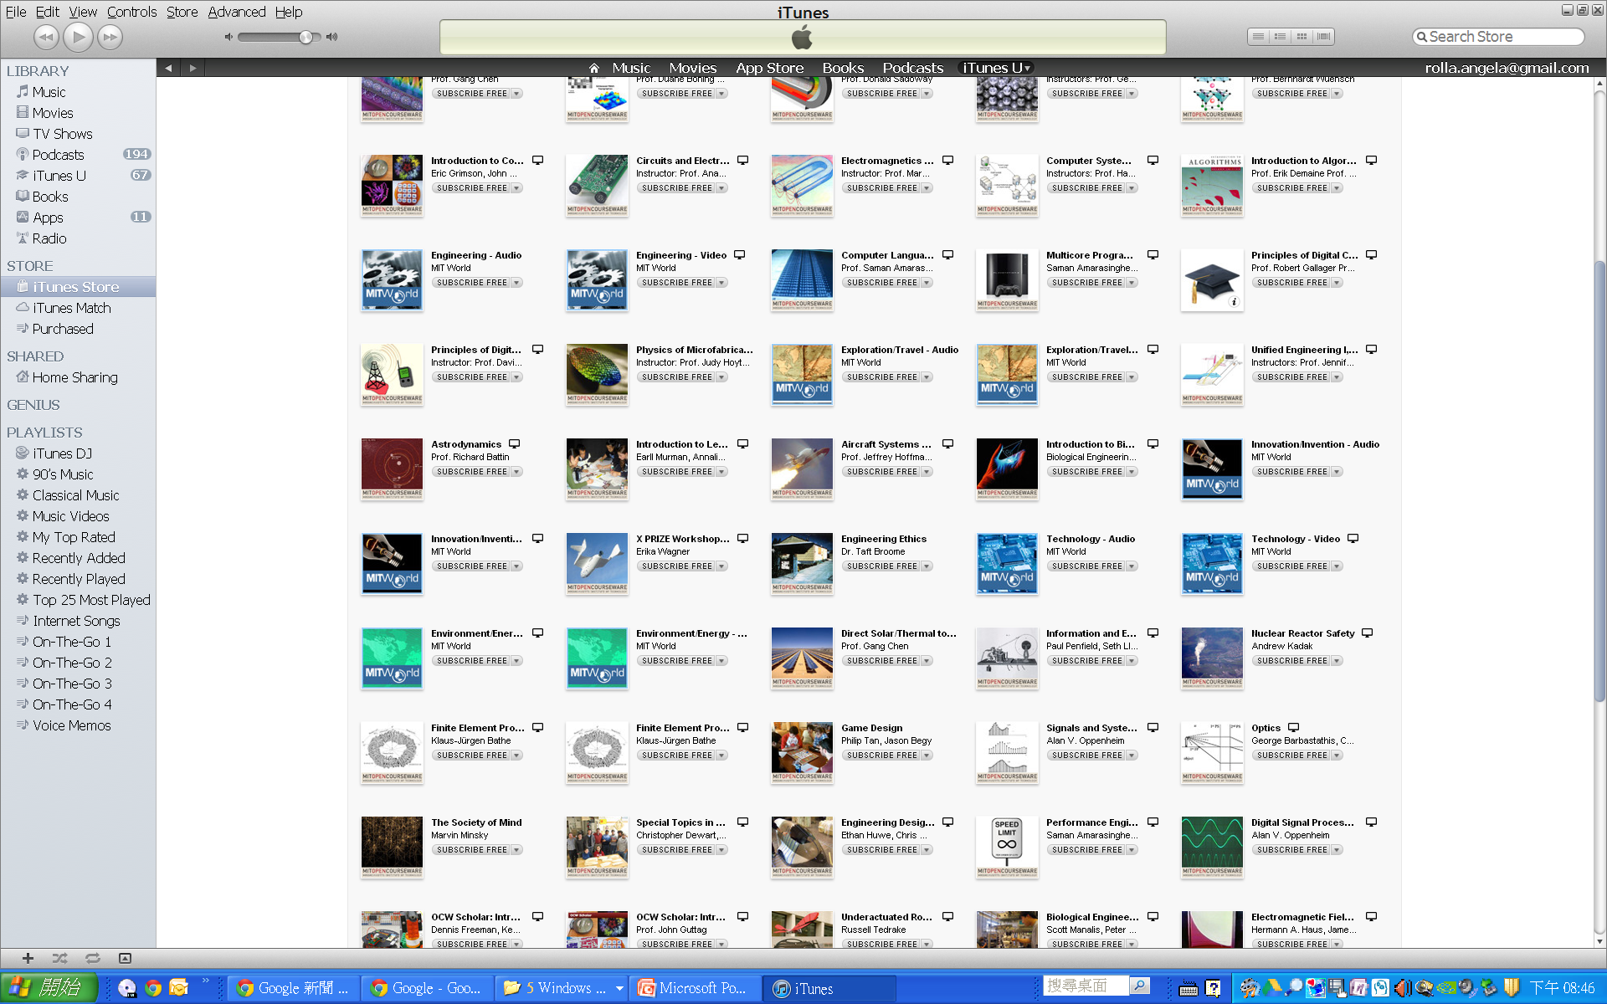
Subscribe a course from MIT

Slide 8
EE course for sophomore
Circuits and Electronics
Instructor: Prof. Anant Agarwal
Introduces the fundamentals of the lumped circuit abstraction. Topics covered include: resistive elements and networks; independent and dependent sources; switches and MOS transistors; digital abstraction; amplifiers etc.
電路學
電子學
邏輯系統(some)

Slide 9
EE course for junior and senior
Digital Signal Processing
Prof. Alan V. Oppenheim (1975)
an introductory course in analog and digital signal processing, including seismic data processing, communications, speech processing, image processing, consumer electronics, and defense electronics.
The discrete-time Fourier transform, Z-transform, digital filters, etc
數位訊號處理

Slide 10
How to use these videos to enhance your stay in NCKU
Self motivation
決心

Slide 11
Possible achievement
English
實力

Slide 12
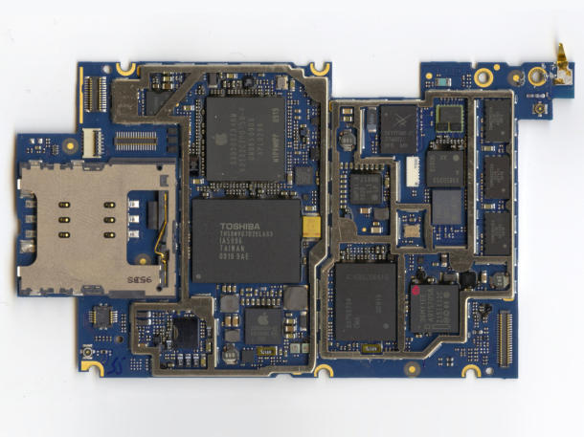
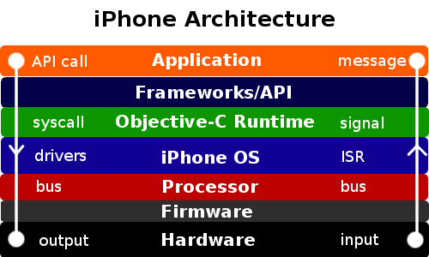
Technology
Services
Application
Software
Hardware
IC

Slide 13
Fundamental EE Courses: Computer Engineering
C/C++/Java/Apps
Data Structure/Algorithms
Compiler
Networks
Operating System
Computer Organization
Logic and System
Microelectronics
Electrical Circuit

Slide 14
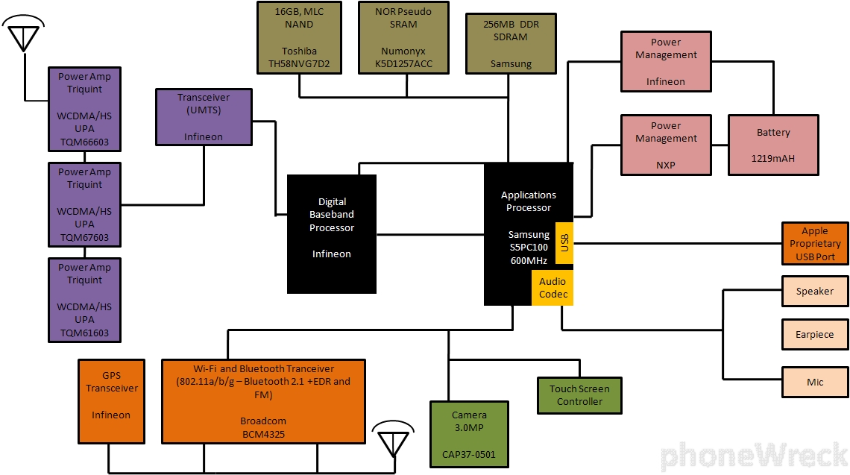
Internals: iPhone 3GS
Microelectronics
materials
VLSI process
VLSI
design
Signal processing
Communication/networks
Electrical circuits

Slide 15
Level of Abstraction in EE/CSE Courses
Abstraction makes thing easy to learn
Measurement
Physic Law
(Maxwell Equation)
Lumped Circuit abstraction (R, C, L)
Volt source
Amplifier
Digital
(Not, AND, OR)
Digital
Combinational
ckt
Digital
Sequential
ckt
Instruction set architecture
Language
C, Java
Software
Sys (Unix, etc)
MP3, Video Games, Apps
$$$

Slide 16
Abstraction
In Chinese: 抽象化
中文表示如何精確化?
Abstraction is the process of taking away or removing characteristics from something in order to reduce it to a set of essential characteristics.

Slide 17
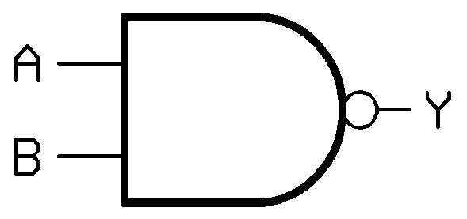
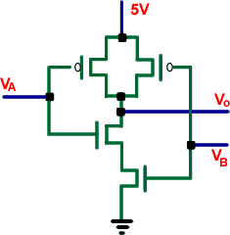
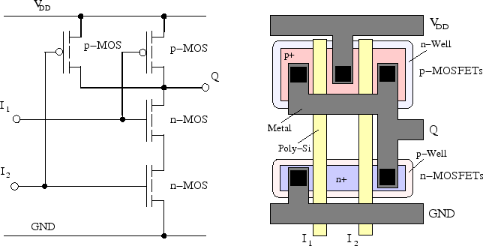
Abstraction: lower level
Abstraction (from the Latin abs, meaning away from and trahere, meaning to draw) is the process of taking away or removing characteristics from something in order to reduce it to a set of essential characteristics.
NAND
CMOS NAND layout
CMOSNAND

Slide 18
Abstraction: somewhere in the middle
Instruction set architecture
software
ADD r2, r3, r4
instruction set
Ripple adder
Carry lookahead adder
Processor of
600MHz,
1GHz,
2GHz, etc
Processor of
Non-pipelined
Pipelined
Superscalar
OOO, etc
hardware

Slide 19
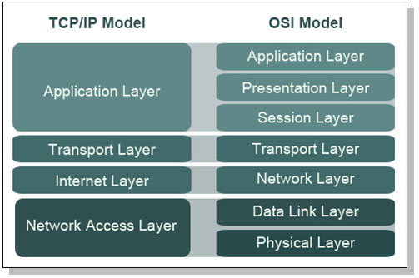
Abstraction: network layers
TCP/IP networks
Sockets
Connections

Slide 20
Abstraction is everywhere
Give an example from C

Slide 21
Abstraction
Makes things easier to learn
Makes things easier to communicate
Makes things easier to design
Makes things easier to integrate

Slide 22
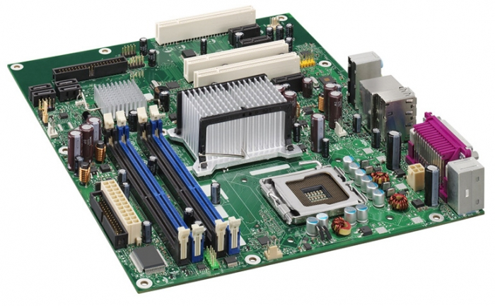
Abstraction in a different perspective
Motherboards / system makers
Take CPU from
Take chipset from
Take components from
Take BIOS from
Take board schematics from
Ecosystem

Slide 23
Become Red Sea Technology
紅海戰略是指在現有的市場空間中競爭，是在價格中或者在推銷中作降價競爭，他們是在爭取效率，然而增加了銷售成本或是減少了利潤

Slide 24
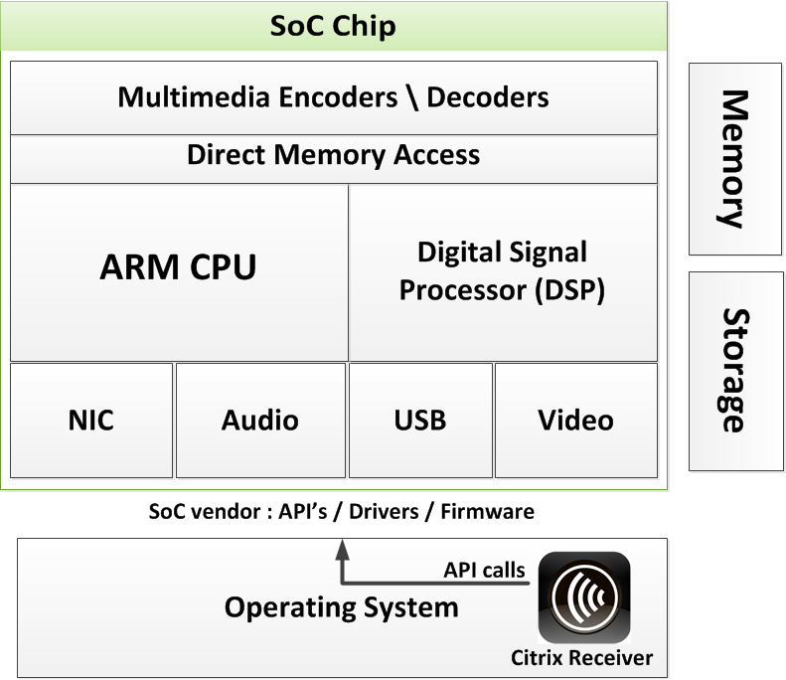
Abstraction in SoC industry
SoC: System on a Chip, platform-based design
get CPU from
get GPU from
get USB from
get DSP from
get SRAM cells from
get drivers from

Slide 25
How much do you know below the abstraction?
Android（讀音：['ændrɔid]，中文俗稱為「安卓」）是一個以Linux為基礎的半開放原始碼作業系統，主要用於行動設備，由Google成立的Open Handset Alliance（OHA，開放手機聯盟）持續領導與開發中
工業設計- 外貌 形狀 感覺
使用標準公版程式碼，少數客製化
使用晶片廠商提供的驅動程式
全部用別人的!?
Smart phone maker
Android/OS
Drivers/Firmware
AP processor/SoC

Slide 26
Having some abstraction layers of your own
如果這是自己的?
SAMSUNG
Smart phone maker
Android/OS
Drivers/Firmware
AP processor/SoC

Slide 27
What if you have all of the layers?
Apple
Design its own AP processor
Design its own OS
Have its own iTunes store services
公益 services
iTunes U
Free APPs, etc

Slide 28
藍海策略
「BLUE OCEAN STRATEGY」，是由知名學者金偉燦（W. Chan Kim）和勒妮·莫博涅（Renée Mauborgne）共同著作的一本經濟學暢銷書。
「藍海策略」旨在脫離血腥競爭的紅色海洋，創造沒有人與其競爭的市場空間，把競爭變成無關緊要。這種策略致力於增加需求，不再汲汲營營於瓜分不斷縮小的現有需求和衡量競爭對手。
創新：
Google scholar
ITunes, ITunes U
IT technology: System-Wide Domain Technology

Slide 29
YOUR BLUE OCEAN STRATEGY
Discipline (wiki)
In its original sense, discipline is systematic instruction given to disciples to train them as students in a craft or trade, or any other activity which they are supposed to perform, or to follow a particular code of conduct or "order".
真理不在於解答，而在於求此答案的過程
Self-discipline can be defined as the ability to motivate oneself in spite of a bad situation. Qualities associated with self-discipline include willpower, hard work, and persistence.
Inter-discipline
跨學科

Slide 30
As a whole
Get to know well on each abstraction
Get into depth of the internal of abstractions
Build up system wide domain knowledge from related courses
Become a system architect
Discipline
Inter-discipline
Abstraction makes inter-disciplinary study easier

Slide 31
Q & A
IT technology and EE courses
Abstraction [æb ‘strækʃən]
Discipline [‘dɪsəplɪn]
Inter-discipline

