Slide 1
人工智慧晶片設計與應用
AI-on-Chip for Machine Learning and Inference
LAB5

Slide 2
Lab 5: OpenCL Exercises on CASLab GPU (GPU)
Objective: Understanding how to write OpenCL program
Tools
  OpenCL
  SystemC
Environments
  Linux container GPU servers
  Ubuntu

Slide 3
Outline
Background Knowledge
    Introduction to OpenCL
    OpenCL Program Structure
    OpenCL Runtime System
Exercises
    Environment SetUp
    OpenCL on CASLab GPU

Slide 4
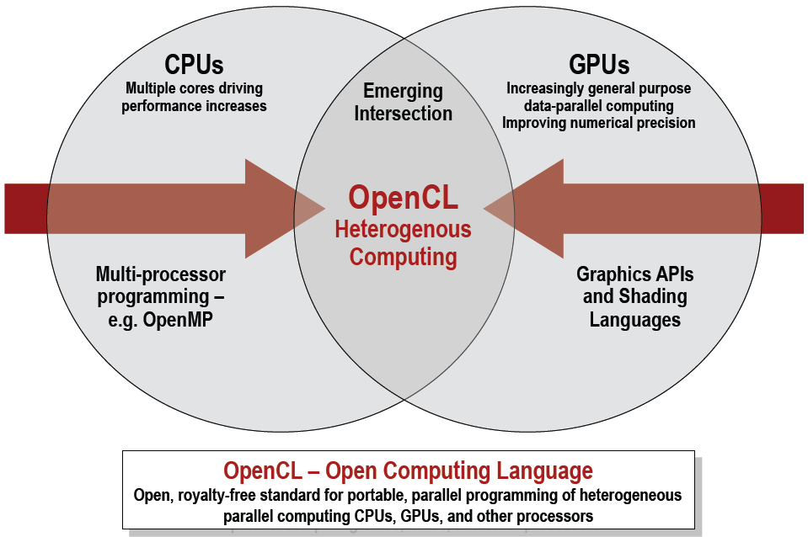
OpenCL : Open Computing Language
Program Portability
  OpenCL is a framework for building parallel applications that are portable across heterogeneous platforms.

Slide 5
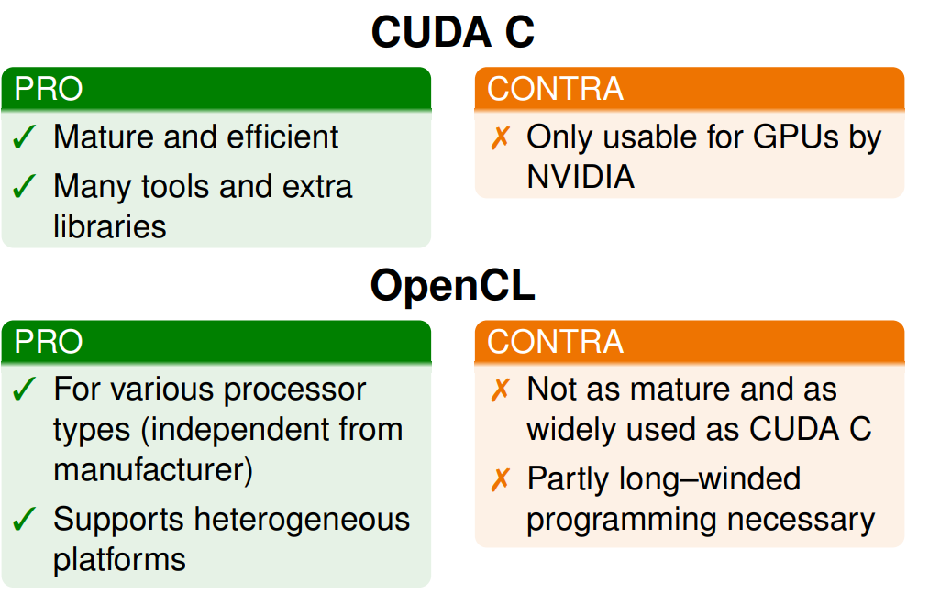
CUDA C vs. OpenCL

Slide 6
Architecture of OpenCL
At the conceptional level
  Platform model
  Execution model
  Memory model
  Programming model
At the programming level
  OpenCL Platform API
  OpenCL Runtime API
  OpenCL C (kernel code, programming language)

Slide 7
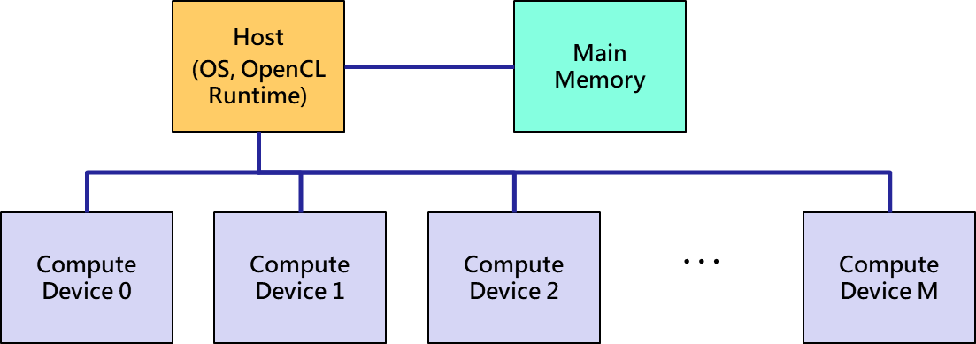
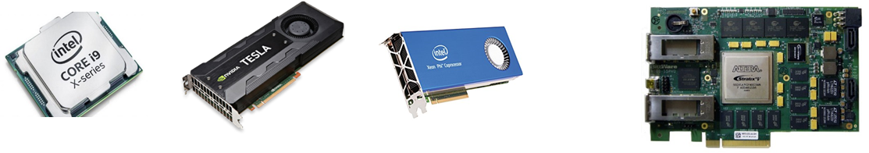
Platform model
Unified Programming Interface
  Abstracted OpenCL platform model
    A host connected to multiple compute devices
  Runtime kernel source compilation

Slide 8
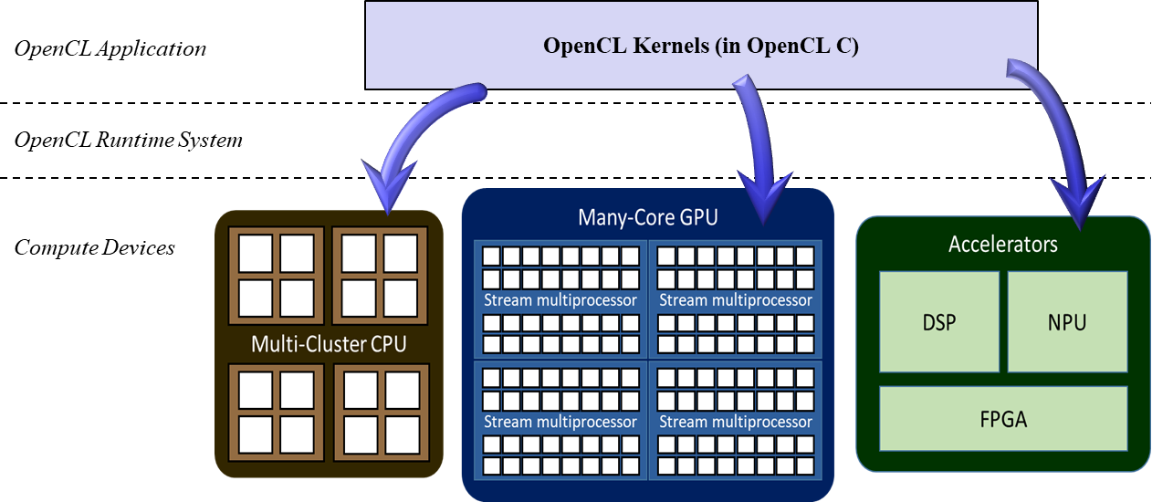
Platform model
Unified Programming Interface
  Abstracted OpenCL platform model
    A host connected to multiple compute devices
  Runtime kernel source compilation

Slide 9
Architecture of OpenCL
At the conceptional level
  Platform model
  Execution model
  Memory model
  Programming model
At the programming level
  OpenCL Platform API
  OpenCL Runtime API
  OpenCL C (kernel code, programming language)

Slide 10
Execution model : Compute Device
Abstracted Hierarchical System
  Both the compute hierarchy and memory hierarchy
Compute Device
Compute Unit 1
Compute Unit N
Processing element, the basic processing unit
Private Memory 1
Private Memory M
Private Memory 1
Private Memory M
…
…
…
PE 1
PE M
PE 1
PE M
Local Memory 1
Local Memory N
Global/Constant Memory Cache
Compute Device Memory
Global Memory
Constant Memory

Slide 11
Execution model : NDRange Index Space
Work-item
  A point of the problem space
Workload Hierarchy
  Global size and local size of work-items
    N-Dimensional index space, N = 1, 2, or 3.
Work-Group ID =
(1, 3, 0)
Global size
(16, 16, 12)
Local Size
(8, 4, 4)
Work-Item,
Local ID (6, 3, 1)
Global ID (14, 15, 1)

Slide 12
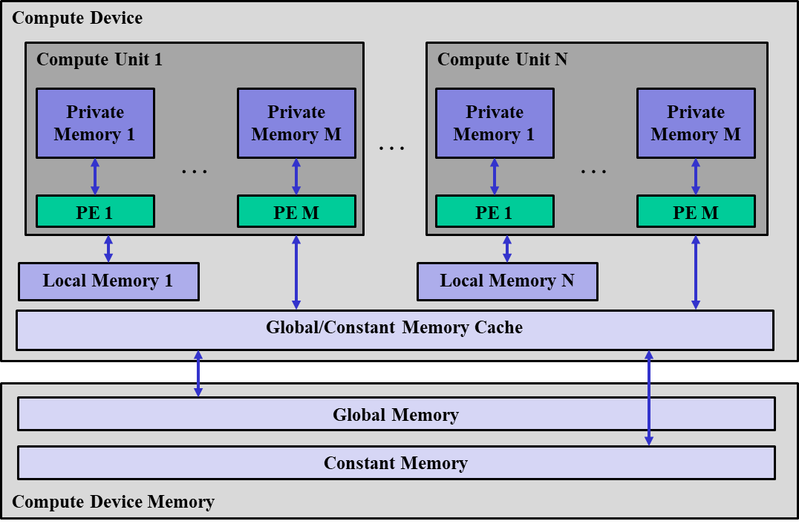
NDRange Workload on Compute Device
NDRange workload to a compute device
A work-group to a compute unit (Synchronization unit)
A work-item to a processing element

Slide 13
Architecture of OpenCL
At the conceptional level
  Platform model
  Execution model
  Memory model
  Programming model
At the programming level
  OpenCL Platform API
  OpenCL Runtime API
  OpenCL C (kernel code, programming language)

Slide 14
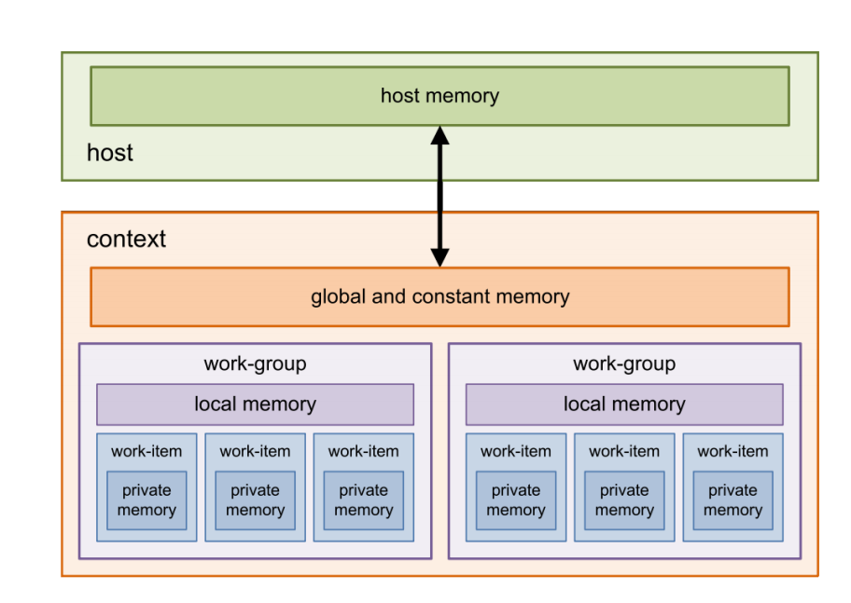
Memory model

Slide 15
Architecture of OpenCL
At the conceptional level
  Platform model
  Execution model
  Memory model
  Programming model
At the programming level
  OpenCL Platform API
  OpenCL Runtime API
  OpenCL C (kernel code, programming language)

Slide 16
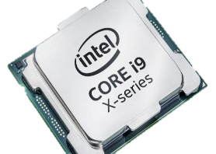
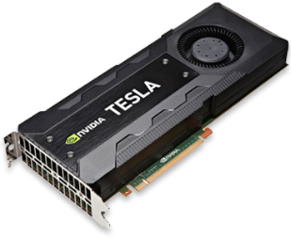
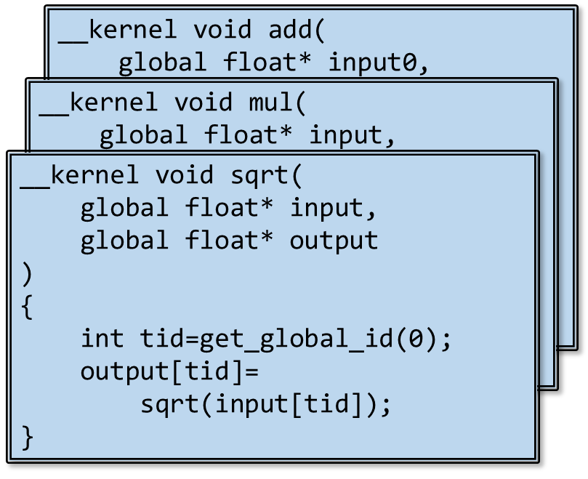
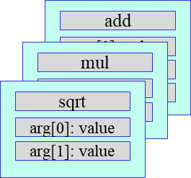
OpenCL Execution Flow
OpenCL Platform
Query information
  Platform and devices
Create context
  Command queue
  Programs and Kernels
  Memory objects
Compile program
Build kernel
  Set kernel arguments
Set data
  copy data to device
Run NDRange workload
Get results
  Read data from device
Context
Programs
Kernels
Memory
Objects
Command
Queues
Buffers
Queue to CPU
Queue to GPU
Iterations!
Compile
Set Arguments
Set Input Data
Send to Execute
Functions for all these steps:
OpenCL Platform and Runtime API
Get Result!

Slide 17
Architecture of OpenCL
At the conceptional level
  Platform model
  Execution model
  Memory model
  Programming model
At the programming level
  OpenCL Platform API
  OpenCL Runtime API
  OpenCL C (kernel code, programming language)

Slide 18
OpenCL API Functions
Event
  Synchronization
Sampler
  Profiling
Querying Functions
  Platforms and devices
Context Management
  Programs and kernels
    Program source and kernel arguments
  Memory objects
    Device memory management
  Command queue
    Commands sending to devices
Enqueued Functions
  Memory requests
    Data copied from/to device memory
  Execution requests
    NDRange workload dispatch

Slide 19
OpenCL Runtime Object Classes
UML diagram
Hardware Objects
Top class of
resource management

Slide 20
Querying Functions
clGetPlatformIDs
  Get the available platform (get object pointer)
clGetPlatformInfo
  Get the platform’s information (get answer)
clGetDeviceIDs
  Get the available device in the particular platform (get object pointer)
clGetDeviceInfo
  Get the device’s information (get answer)

Slide 21
Querying Functions (Cont.)
Two step querying
  First for size
  Next for result
Available queries please referring to OpenCL spec.
  cl_platform_info and cl_device_info
    Stored in Platform and Device classes
Function declaration:
cl_int clGetPlatformIDs(cl_int num_entries,
cl_platform_id* platforms,
cl_uint* num_platforms);
Function declaration:
cl_int clGetPlatformInfo( cl_platform_id platform,
cl_platform_info param_name,
size_t param_value_size,
void *param_value,
size_t *param_value_size_ret)
clGetPlatformIDs(0, NULL, &platform_count);
clGetPlatformInfo(platforms[0],
CL_PLATFORM_VENDOR, 0, NULL, &size);
clGetPlatformIDs(platform_count, platforms, &platform_count);
clGetPlatformInfo(platforms[0],
CL_PLATFORM_VENDOR, size, vendor, &size);

Slide 22
Context
Manage object resources
  Command-queues, memory objects, program objects and kernel objects.
Created via OpenCL API functions
  clCreateContext
    Particular device defined by user
  clCreateContextFromType
    Used device of particular type given by Runtime
      CL_DEVICE_TYPE_DEFAULT, CL_DEVICE_TYPE_CPU, CL_DEVICE_TYPE_GPU
dev_ptr = clCreateContext(prop, 1, &device, NULL, NULL, NULL);
dev_ptr = clCreateContextFromType(prop, CL_DEVICE_TYPE_DEFAULT, NULL, NULL, &size);

Slide 23
Programs and Kernels
Program Object
  program = clCreateProgramWithSource(context, 1, (&src), &len, NULL);
Compilation
  clBuildProgram(program, num_device, device_list, options, pfn_notify, user_data);
Kernel Object
  Kernel_sqrt = clCreateKernel(program, “sqrt(Kernel_Name)”, errcode_ret);
  clSetKernelArg(Kernel_sqrt, 0, sizeof(param), &param)
Programs
Kernels

Slide 24
Memory Object
Buffer and Image
  cl_mem_buf = clCreateBuffer(context, CL_MEM_TYPR, size, host_ptr, errcode_ret);
  CASLAB OpenCL Runtime only supports buffer.
Five types
  CL_MEM_READ_WRITE
  CL_MEM_WRITE_ONLY
  CL_MEM_READ_ONLY
  CL_MEM_USE_HOST_PTR
  CL_MEM_ALLOC_HOST_PTR
Buffer Object
Context
Size
Type (cl_mem_flags)
Host Pointer
Device Pointer
We can leverage these pointers to achieve shared virtual memory for OpenCL 2.0 (or its successor) implementation.

Slide 25
Command Queue
Pass command to a particular device
  queue = clCreateCommandQueue(context, device, properties, errcode_ret);
    In-order queue or out-of-order queue
    CASLAB OpenCL only supports in-order now.
Commands to CPU device
Commands to GPU device

Slide 26
Enqueue Commands
Memory commands
  Data transfers
    host to device:
      clEnqueueWriteBuffer(queue, mem_buf, CL_TRUE, offset, sizeof(host_ptr), host_ptr, num_event, event_list, event);
    device to host:
      clEnqueueReadBuffer(queue, mem_buf, CL_TRUE, offset, sizeof(host_ptr), host_ptr, num_event, event_list, event);
    inside device:
      clEnqueueReadBuffer(queue, src_buf, dst_buf, src_offset, dst_offset, size, num_event, event_list, event);
Kernel execution commands
  NDRange workload
    clEnqueueNDRangeKernel(queue, kernel, dim, offet, &global_size, &local_size, num_event, event_list, event)

Slide 27
Architecture of OpenCL
At the conceptional level
  Platform model
  Execution model
  Memory model
  Programming model
At the programming level
  OpenCL Platform API
  OpenCL Runtime API
  OpenCL C (kernel code, programming language)

Slide 28
OpenCL kernel code
Derived form ISO C99
A few restrictions
  No recursion
  No function pointers,
  No functions from the C99 standard headers
  Preprocessing directives defined by C99 are supported (e.g., #include)
Built-in data types:
  Scalar and vector data types, pointers, images
Mandatory built–in functions
  Work-item function
  math.h
  Synchronization function

Slide 29
Qualifiers and Functions
Function qualifiers
  __kernel qualifier declares a function as a kernel
Address space qualifiers
  __global, __local, __constant, __private
  Pointer kernel argument must be declared with an address space qualifier
Work-item functions
  get_work_dim(), get_global_id(), get_local_id(), get_group_id(), etc.
Synchronization functions
  Barriers — all work-items within a work-group must execute the barrier function before any work-item can continue: barrier(cl_mem_fence_flags flags)

Slide 30
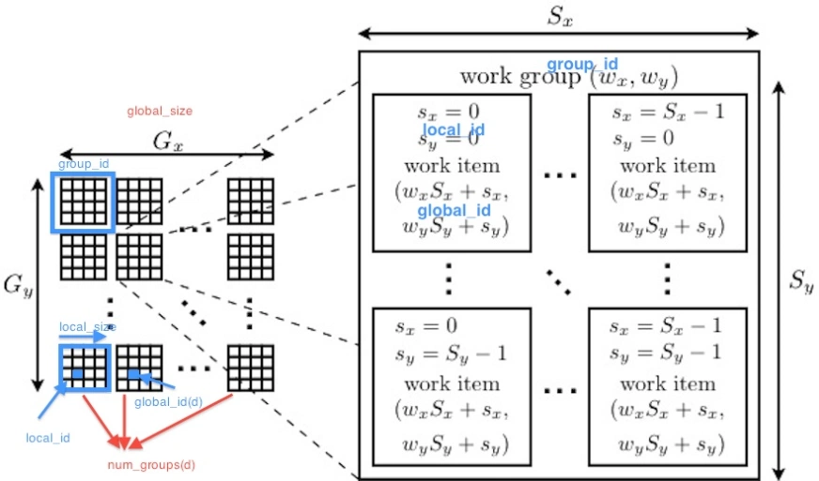
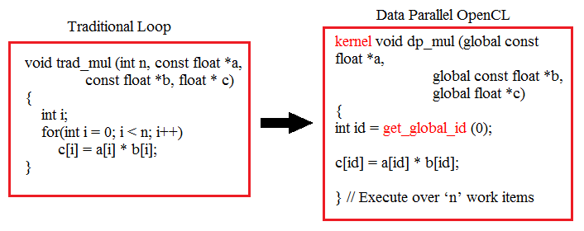
OpenCL kernel code
Example : loop with the OpenCL data paeallel

Slide 31
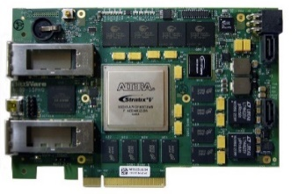
OpenCL Runtime System
Dynamic linking library
  OpenCL API functions
  OpenCL Runtime System
libOpenCL.so

Slide 32

Cross Platform
Environment variable
  LD_LIBRARY_PATH for UNIX-based system
libOpenCL.so (NVIDIA)
Application
OpenCL Runtime System
NVIDIA Driver API
OpenCL API
Host Source
(.cpp)
Kernel Sources
(.cl)
libOpenCL.so (CASLAB)
C/C++ Compiler
OpenCL Runtime System
CASLAB CPU/GPGPU
Driver API
OpenCL API
Executable File
libOpenCL.so (Intel)
OpenCL Runtime System
Pthread-based implementation
OpenCL API

Slide 33
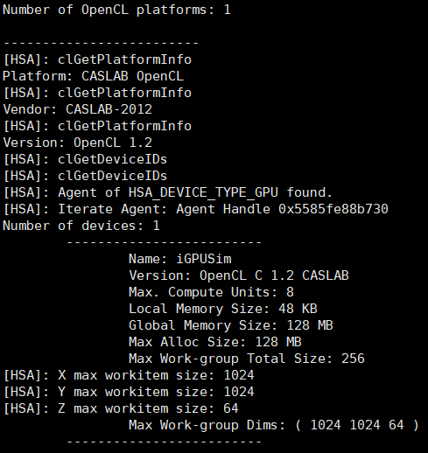
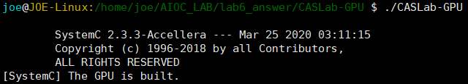
Ex. 1: OpenCL Runtime System and CASLab-GPU
Setup the environment
CASLab-GPU platform
  Hardware simulator
  Get device info

Slide 34
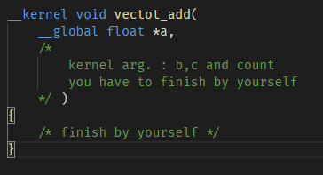
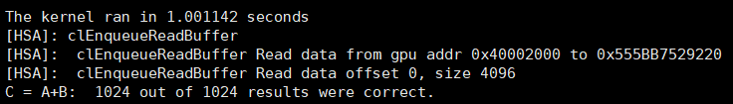
Ex. 2: OpenCL Vector add
Modify kernel code vector_add.cl
Compile the code to run
Result

Slide 35
Ex. 3: OpenCL Vector add_chain
Modify the host code to finish Chaining vector add
  Start with your C program in Ex 2.
  Add additional buffer objects and assign them to vectors defined on the host
  (see the provided vadd programs for examples of how to do this).
  Chain vadds ... e.g. C=A+B; D=C+E; F=D+G.
  Read back the final result and verify that this is correct.
  Compare the complexity of your host code to C.

Slide 36
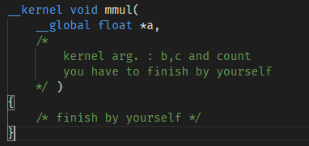
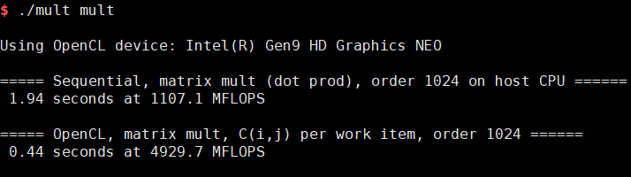
Ex. 4 : OpenCL matrix multiplication
Using the code in Execrise04
Implement the kernel code vector_add.cl
Compile the code to run
Result

Slide 37

Thanks You
Machine Learning
Hello!! R2-D2

