Slide 1
AI on Chip Lab3
Getting started to use Kneron KL520 USB AI dongle
2021/3/17

Slide 2
Outlines
Environment setup
Object detection
Run Yolov3 on CPU
Run Yolov3 with Kneron KL520
Transfer Mode
Dynamic Model Engine (DME)
Kneron Toolchain

Slide 3
TA
黃瀚群 (Han-Qun, Huang)
Email : hanqun0723@gmail.com

Slide 4
Environment Setup

Slide 5
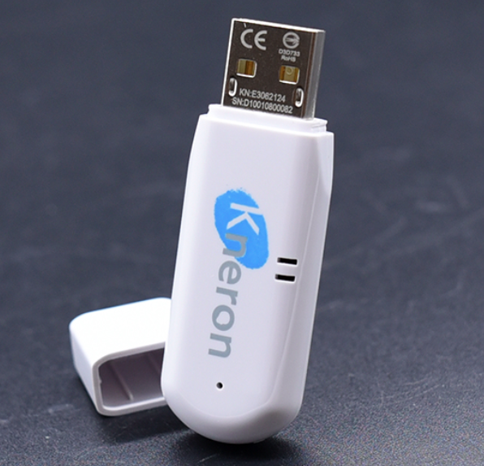
Environment setup
Hardware
Kneron KL520 USB AI dongle
One PC or Laptop
Camera
Operating System
Ubuntu18.04(Recommended) or Windows10

Slide 6
Environment setup
Processor | ARM Cortex - M4@200MHz for system control ARM Cortex-M4@250MHz as AI -processor
NPU | Maximum Frequency@300 MHz Peak throughput of 8-bit mode 345 GOPS, 576MAC/cycle
Flash | 32MB SPI NOR Flash
Memory | 64MB
Peripheral Interface | USB2.0 type A
Supported AI framework | ONNX/Caffe/Keras/Pytorch/TensorFlow
Dimension | 55 x 20.5 x 10 mm
Weight | 18g
Working temperature | 0 °C to 45°C
LED | Status

Slide 7
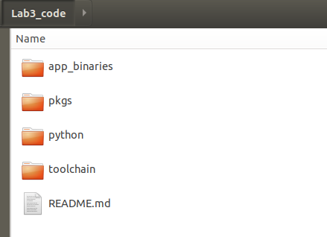
Environment setup
In this section, all steps are done in Ubuntu
Download Lab3 code from CASLAB website
Folder Tree
/home/{username}/Lab3_code

Slide 8
Environment setup
Check your python version is above 3.8.6
$ sudo add-apt-repository ppa:deadsnakes/ppa
$ sudo apt-get update
$ sudo apt-get install python3.8
$ sudo update-alternatives --install /usr/bin/python3 python3 /usr/bin/python3.8 1
$ sudo update-alternatives --install /usr/bin/python3 python3 /usr/bin/python3.6 2
$ sudo update-alternatives --config python3
(select python version 3.8)

Slide 9
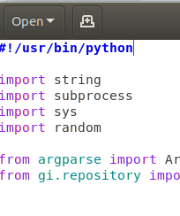
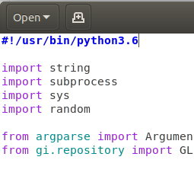
Environment setup
If your terminal cannot open after install python 3.8
$ cd /usr/bin
$ sudo gedit gnome-terminal
change #!/usr/bin/python3
to #!/usr/bin/python3.6

Slide 10
Environment setup
Install pip3 package and related software libraries
$ sudo apt-get install python3-pip
$ pip3 install --upgrade pip
$ pip3 install numpy==1.19.3
$ pip3 install opencv-python
$ sudo apt-get install libusb-1.0-0-dev

Slide 11
Environment setup
Install Kneron Host Side API
$ cd ~/Lab3_code/pkgs/
$ pip3 install kdp_host_api-1.1.2_linux_-py3-none-any.whl
Installation path:
~/.local/lib/python3.8/site-packages/kdp_host_api/*

Slide 12
Object detection – - Run Yolov3 on CPU - Run Yolov3 with Kneron KL520

Slide 13
Run Yolov3 on CPU
Open the terminal and type the following commands:
$ cd ~/Lab3_code/python
$ python3 sw_yolo3.py -h

Slide 14
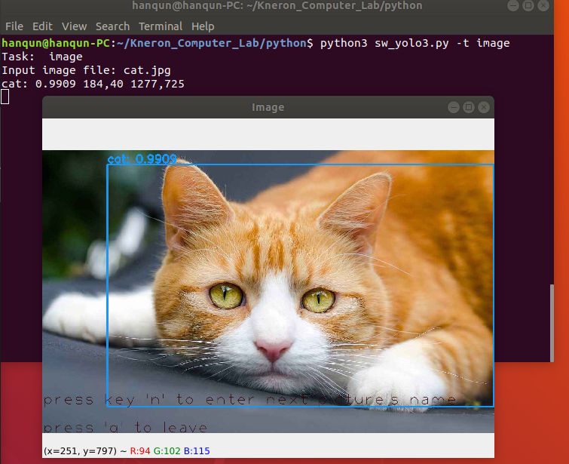
Run Yolov3 on CPU
$ python3 sw_yolo3.py -t image
Input image file : cat.jpg
You can type the following command
and see the results.
$ python3 sw_yolo3.py -t camera

Slide 15
Object detection – - Run Yolov3 on CPU - Run Yolov3 with Kneron KL520

Slide 16
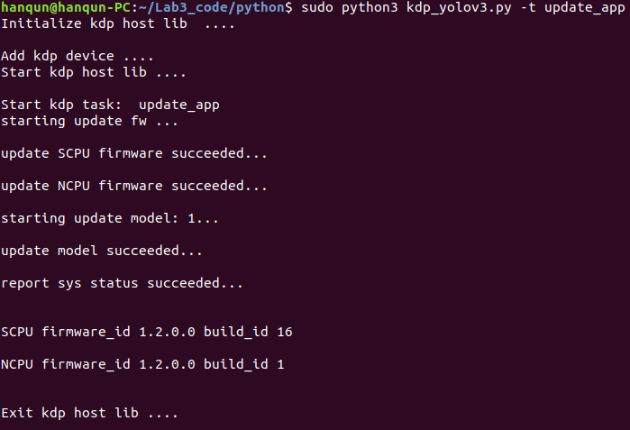
Run Yolov3 with Kneron KL520
Because KL520 can support different neural network models, you need to update the firmware and model first.
$ sudo python3 kdp_yolov3.py -t update_app
Wait a few minutes...

Slide 17
Run Yolov3 with Kneron KL520
$ sudo python3 kdp_yolov3.py -t <option>
See the results!

Slide 18
Run Mode

Slide 19
Run Mode
Kneron NPU supports three transfer mode :
Serial transfer
Pipeline transfer
Parallel transfer
$ python3 kdp_yolov3_mode.py -t <option>
serial
pipeline
parallel

Slide 20
Run Mode – Serial transfer
Kneron NPU supports three different run mode :
Serial transfer
Pipeline transfer
Parallel transfer
Transfer
Image
Inference in NPU
Send Result Back
Transfer
Image
Inference in NPU
Send Result Back
1000 times

Slide 21
Run Mode – Pipeline transfer
Kneron NPU supports three different run mode :
Serial transfer
Pipeline transfer
Parallel transfer
Transfer
Image
Inference in NPU
Send Result Back
Transfer
Image
Inference in NPU
Send Result Back
Transfer
Image
Inference in NPU
Send Result Back
1000 times

Slide 22
Run Mode – Parallel transfer
Kneron NPU supports three different run mode :
Serial transfer
Pipeline transfer
Parallel transfer
Transfer
Image
Inference in NPU
Send Result Back
Transfer
Image
Inference in NPU
Send Result Back
Transfer
Image
Inference in NPU
Send Result Back
1000 times

Slide 23
Dynamic Model Execution (DME)

Slide 24
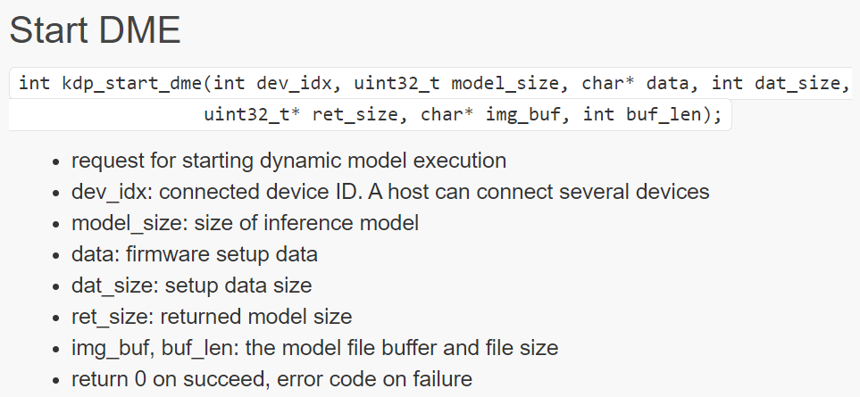
DME mode
The model is loaded to DDR from host through USB during run-time
Compared to models on flash memory (ISI mode)
DME API

Slide 25
DME mode
Host
KL520
Host_com_thread
Firmware setup data (fw_info.bin)
return length of fw_info.bin
model file (all_models.bin)
return length of all_models.bin

Slide 26
DME mode
Host
KL520
Host_com_thread
kdp_start_dme
return 0 on succeed
kdp_dme_configure
return 0 on succeed

Slide 27
DME mode
Host
KL520
Host_com_thread
kdp_start_dme
return 0 on succeed
kdp_dme_configure
return 0 on succeed
how to do? (bypass preprocess/postprocess? ), input/output size/# of channels

Slide 28
DME mode
send input Image
Host
KL520
Host_com_thread
kdp_dme_inference
return 0 on succeed
kdp_dme_get_status(polling)
status == 0 means unfinished

Slide 29
DME mode
Host
KL520
Host_com_thread
kdp_dme_get_status(polling)
status == 1 means finished
kdp_dme_retrieve_res
return 0 on succeed

Slide 30
DME mode
Host
KL520
Host_com_thread
kdp_end_dme
return 0 on succeed

Slide 31
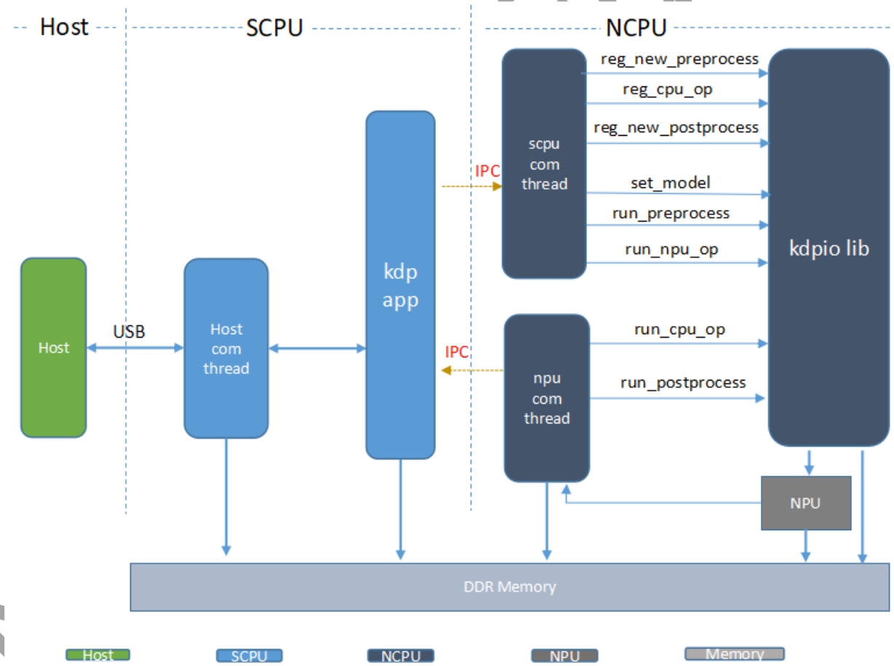
DME mode

Slide 32
DME mode

Slide 33
DME mode
kdp_app_dme

Slide 34
DME mode

Slide 35
DME mode

Slide 36
DME mode

Slide 37
DME mode

Slide 38
Kneron ToolChain

Slide 39
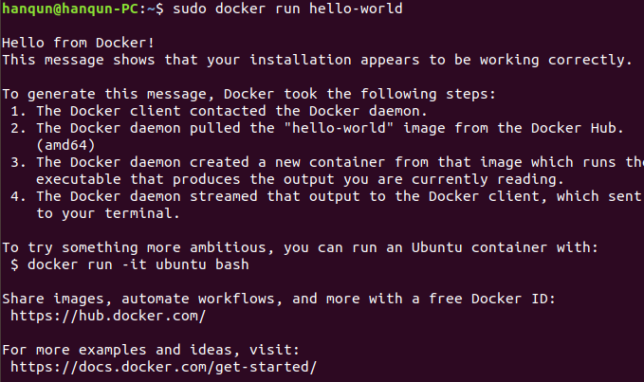
Environment Setup
Docker installation
$ sudo apt-get install docker.io
$ sudo docker run hello-world

Slide 40
Environment Setup
Pull the ToolChain container from Dockerhub
$ sudo docker pull kneron/toolchain:520

Slide 41
Environment Setup
Open the container and set the interactive folder
$ cd ~/Lab3_code/toolchain
$ sudo docker run -it --rm -v $PWD:/data1 kneron/toolchain:520

Slide 42
ToolChain Workflow
AI model (Keras, Caffe, Pytorch, Tensorflow)
converter
AI model(.onnx)
1.input_params.json
2.batch_input_params.json
fpAnalyser & Batch Compiler
all_model.bin
fw_info.bin
fw_info.txt

Slide 43
ToolChain Workflow
First step, prepare your model and convert it to “kneron” onnx formats.
AI model (Keras, Caffe, Pytorch, Tensorflow)
converter
AI model(.onnx)
1.input_params.json
2.batch_input_params.json
fpAnalyser&Batch Compiler
all_model.bin
fw_info.bin
fw_info.txt
Notes:
http://doc.kneron.com/docs/#toolchain/converters/

Slide 44
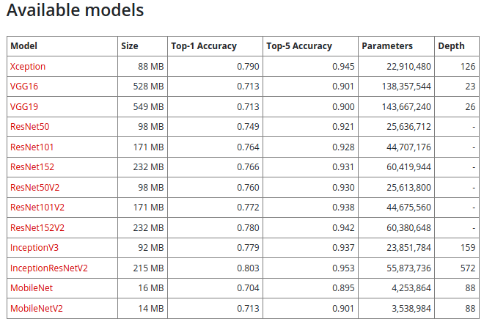
Prepare model
Option1 : Download the open source model from Keras (Tensorflow , Pytorch, ...etc)
(container)$ cd /data1
(container)$ python MobileNetV2.py
~/Lab3_code/toolchain/MobileNetV2.py
https://awesomeopensource.com/projects/keras-models

Slide 45
Prepare model
Option2 : Build the model by yourself
(container)$ cd /data1
(container)$ python mnist.py
~/Lab3_code/toolchain/mnist.py

Slide 46
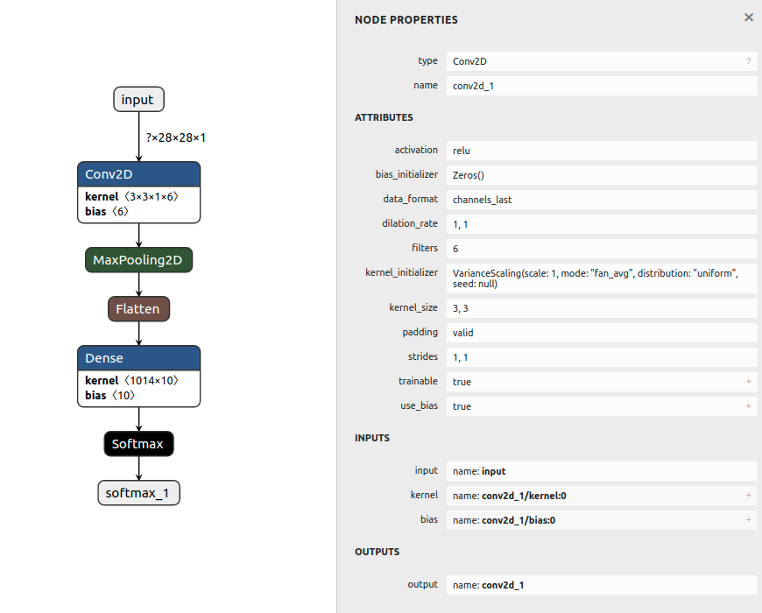
Example : Simple CNN Model
A useful tool: netron
$ sudo snap install netron
$ netron mnist.h5
able to visualize the model file in lots of format

Slide 47
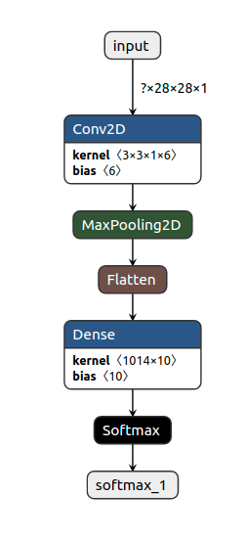
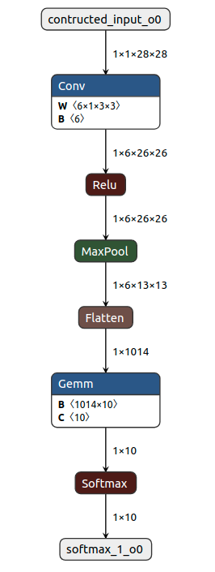
Example : Simple CNN Model
(container) /data1 # python /workspace/libs/ONNX_Convertor/keras-onnx/generate_onnx.py -o mnist.h5.onnx -O --duplicate-shared-weights mnist.h5
Convert
.h5 (keras)
.onnx

Slide 48
Example : Simple CNN Model
KL520 cannot process softmax layer, so we need to move the softmax layer to the post-processing of the network (bypass postprocess)
Optimization ( e.g. Conv+BN layer fusion)
(container) /data1 #python /workspace/libs/ONNX_Convertor/optimizer_scripts/onnx2onnx.py mnist.h5.onnx -o mnist_opt.h5.onnx -t
convert
.onnx
.onnx (kneron)

Slide 49
ToolChain Workflow
Second step, prepare your onnx file and json configuration file to compile the binary
AI model (Keras, Caffe, Pytorch, Tensorflow)
converter
AI model(.onnx)
1.input_params.json
2.batch_input_params.json
fpAnalyser&Batch Compiler
all_model.bin
fw_info.bin
fw_info.txt

Slide 50
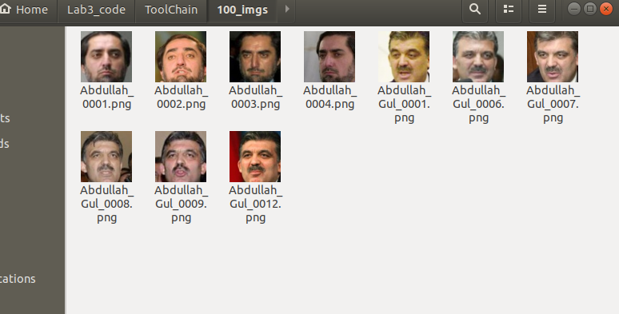
fpAnalyser
fpAnalyser
NPU only supports Int8, so we need to convert weights in floating point to fixed point
If we want to compile the floating point model to fixed-point, we need to prepare some training images (suggest 100 images) to perform fixed-point analysis

Slide 51
Batch Compiler
Batch Compiler
Generate three files
all_model.bin
fw_info.bin
fw_info.txt

Slide 52
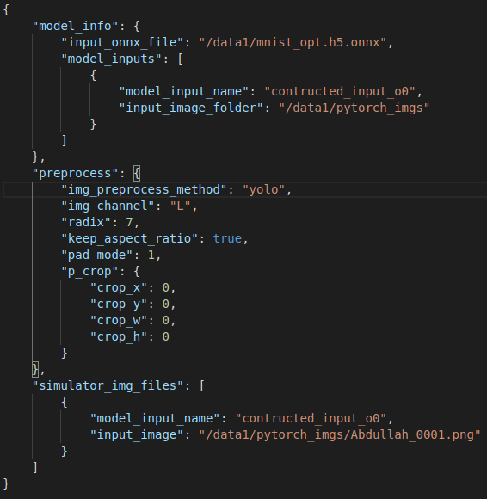
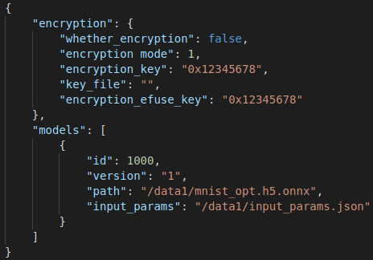
Example : Simple CNN Model
The model compilation process requires two configuration files, input_params.json and batch_input_params.json.
batch_input_params.json
input_params.json

Slide 53
Preprocess Method
img_preprocess_method and radix
How did you preprocess your training data?
What should the range of values of input pixels be?
“kneron”: RGB/256 - 0.5,
“tensorflow”: RGB/127.5 - 1.0,
“yolo”: RGB/255.0
“pytorch”: (RGB/255. -[0.485, 0.456, 0.406]) / [0.229, 0.224, 0.225]
“caffe”(BGR format) BGR - [103.939, 116.779, 123.68]

Slide 54
Fixed point
F
W
001.01

Slide 55
Floating Point to Fixed Point
Assume we only have three bits(Int3), a.k.a (3, F)
(3, 1)
10.0 | -2.0
10.1 | -1.5
11.0 | -1.0
11.1 | -0.5
00.0 | 0
00.1 | 0.5
01.0 | 1
01.1 | 1.5
(3, 2)
1.00 | -1
1.01 | -0.75
1.10 | -0.5
1.11 | -0.25
0.00 | 0
0.01 | 0.25
0.10 | 0.5
0.11 | 0.75
W1 = 0.7
(3, 1): 0.5
(3, 2): 0.75
W2 = 1.87
(3, 1): 1.5
(3, 2): 0.75
Less accurate, larger range
More accurate, smaller range

Slide 56
NPU Input Format
Host
SCPU
NCPU
input image
input image
NPU
Width*height
Any format
Width*height
4 channel
8 bits
fixed point

Slide 57
NPU Input Format
Let’s get back to our example, if we choose “yolo”…
Host
SCPU
NCPU
NPU
input image
input image
28*28
Gray scale: 0~255
28*28
4 channels
0~1

Slide 58
NPU Input Format
Host
SCPU
NCPU
NPU
input image
input image
00001000
28*28
Gray scale: 0~255
28*28
4 channels
0~1
Fixed point representation! Where the decimal point should be at?
Hint: range 0~1

Slide 59
NPU Input Format
 | Max | Min
(8, 8) | .01111111 = 0.49609375 | .10000000 = -0.5
(8, 7) | 0.1111111 = 0.99218750 | 1.0000000 = -1
00001000 = 8
0.00001000 = 8/255
Use fixed point (8, 7) to represent 0.00001000:
0.0000100
compare to the input 00001000
We need to right shift one bit!!

Slide 60
NPU Input Format
However, NPU doesn’t support right shift operation. We have two options then:
Give RGBA and right shifted image directly and bypass NCPU preprocess (preprocess on host)
Do right shift operation on NCPU (need to register a preprocess method)
in this example
Host
SCPU
NCPU
input image
NPU

Slide 61
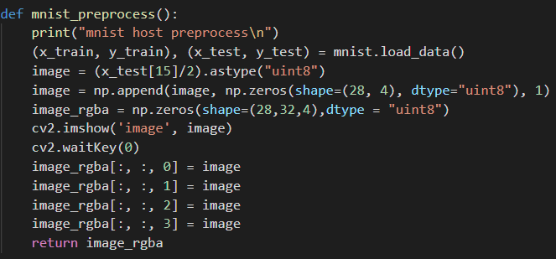
NPU Input Format
Bypass preprocess
dme_mnist.py

Slide 62
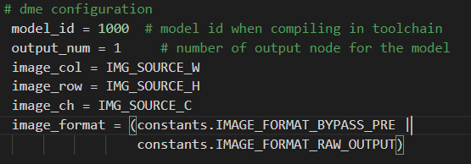
NPU Input Format
dme configuration
kdp_wrapper_mnist.py

Slide 63
NPU Input Format
Host
yolo 0 ~ 1
input image: 0 ~ 255
0 ~ 127
uint8:
00000000 ~ 11111111
right shift
->
00000000 ~ 01111111
NPU
int8 fixed point, radix 7
-1 ~ 0 ~ 1
1.000000 ~ 0.0000000 ~ 0.1111111

Slide 64
NPU Input Format
Host
method2:
input image (0 ~255) - 128
int:
10000000 ~ 01111111
kneron -0.5 ~ 0.5
input image: 0 ~ 255
uint8:
XOR 10000000
00000000 ~ 11111111
10000000 ~ 01111111
NPU
int8 fixed point, radix 8
-0.5 ~ 0.5
.10000000 ~ .01111111
00000000 ~ 11111111
10000000 ~ 01111111

Slide 65
Example : Simple CNN Model
batch_input_params.json

Slide 66
Example : Simple CNN Model
input_params.json

Slide 67
NPU Input Format
The input image width needs to be aligned 16, so we need to extend the input image to 28*32 (height*width) by padding zero
0.2 | 0.1 | 0.3 | 0.4 | 0.9 | 0.8 | 0.7 | 0.5 | 0.2 | 0.0 | 0.7 | 0.9 | 0 | 0 | 0 | 0
…
16
27
31

Slide 68
Example : Simple CNN Model
Container :
/data1 # python /workspace/scripts/fpAnalyserBatchCompile_520.py -t 8(number of threads)
/data1 # cd batch_compile
/batch_compile # cp fw_info.bin all_models.bin ../
Host :
$ cp fw_info.bin all_models.bin ../python/mnist_bin/

Slide 69
Example : Simple CNN Model
Run the dme mode
$ cd ~/Lab3_code/python
$ sudo python3 dme_mnist.py
If dme mode executed successfully, it means we deployed our CNN model on KL520, and did the inference. The result is already sent back to our host PC.

Slide 70
Reference
GitHub - kneron/Kneron_Computer_Lab
https://www.kneron.com/tw/support/developers/
https://www.kneron.com/tw/support/developers/
https://developers.google.com/machine-learning/crash-course/ml-intro
https://developers.google.com/machine-learning/glossary

Slide 71
Contacts
計算機架構與系統實驗室 CASLab
EE 6F room 92617
陳中和教授
Lab3 TAs

Slide 72
Thank You for your listening

